Slide 1
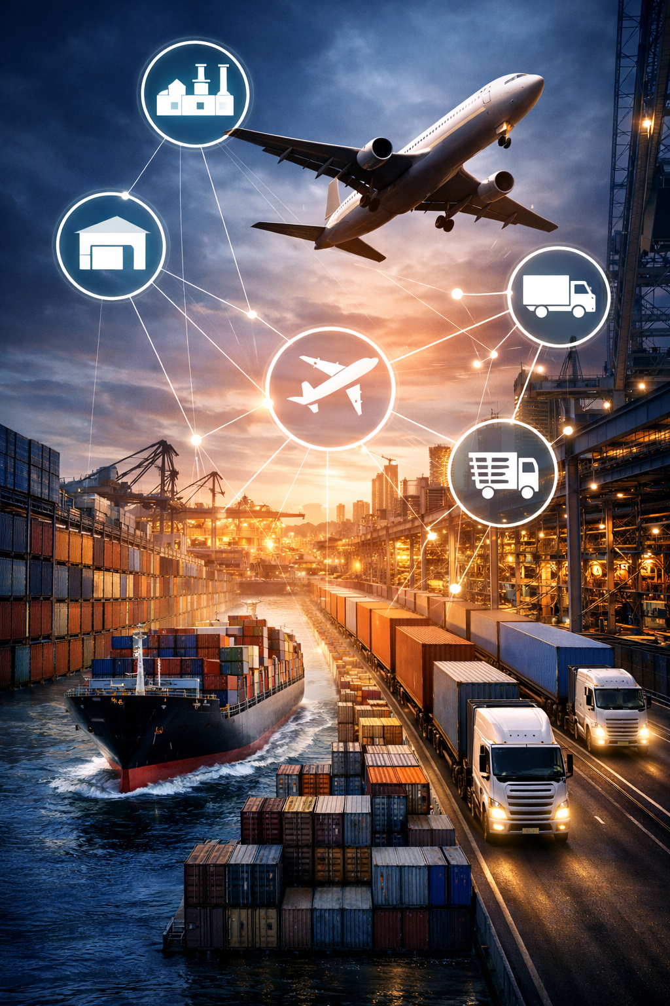

THE SYSTEM IS THE SUPPLY CHAIN
OPTIMISING PROCUREMENT, LOGISTICS, AND SUPPLY CHAINS
IN THE AGE OF INTELLIGENT MACHINES
Anayo Agu
West Africa Industrialisation, Manufacturing & Trade Submit and Exhibition, Landmark Event Center, Victoria Island, Lagos.
March 4, 2026

Slide 2
The System Is the Supply Chain
Optimizing Procurement, Logistics, and Supply Chains
In the Age of Intelligent Machines
Supply chains sit at the heart of industrial performance, trade competitiveness, and economic resilience. Yet procurement, logistics, and supply chain management are still too often treated as operational or technological functions rather than as development infrastructure.
Recent global disruptions from the COVID-19 pandemic to persistent infrastructure fragility and insecurity in many developing regions, have exposed the limits of this view. Despite rapid advances in artificial intelligence, robotics, automation, and digital platforms, supply chain performance across many sectors remains volatile and unreliable.

Slide 3
THE KEYSTONE POINT
The central argument of this presentation is relatively simple but consequential:
“Supply chains fail not because resources, technology or talent is absent, but because systems are weak. Intelligent machines amplify the quality of the systems they inhabit; they do not replace systemic maturity.
In this sense, “the system is the supply chain”.

Slide 4


Why
Supply Chains
Matter
Understanding their roles in development and execution
Development Infrastructure
Supply chains are vital for economic growth and stability.
Critical Components
They are as essential as roads, power, and ports.
Translating Ambition
Supply chains turn strategic goals into actionable outcomes.
Connecting Markets
They facilitate access to resources and consumer bases.

Slide 5



Invisible vs. Visible Supply Chains
Invisible where they work
Painfully visible where they fail
Examples: Delays, volatility, informality
“Supply chains are not neutral technical arrangements.
They are development infrastructure, just as critical to industrialisation as roads, energy, ports, and capital.
They determine whether factories can plan, whether markets can be served, and whether trade promises can be kept.

Slide 6

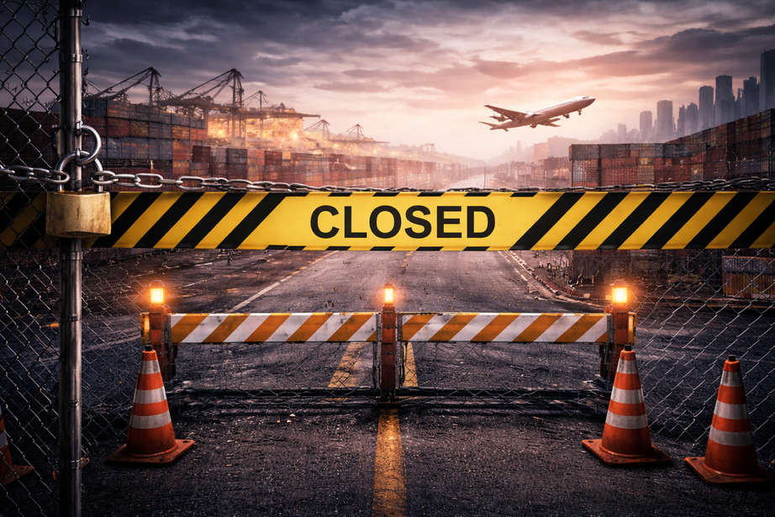



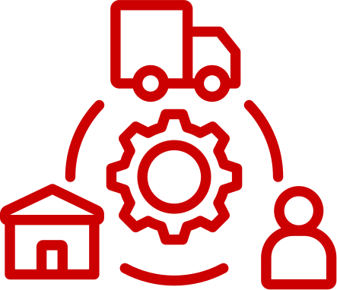
COVID-19
The Global Stress Test
The global shutdowns triggered by COVID-19 did not introduce supply chain fragility; they revealed it.
Entire industries collapsed; not because demands overwhelmed them or disappeared, but because inputs could not arrive and outputs could not circulate.
Borders closed
Factories halted
Ports restricted
Movement stopped

Slide 7
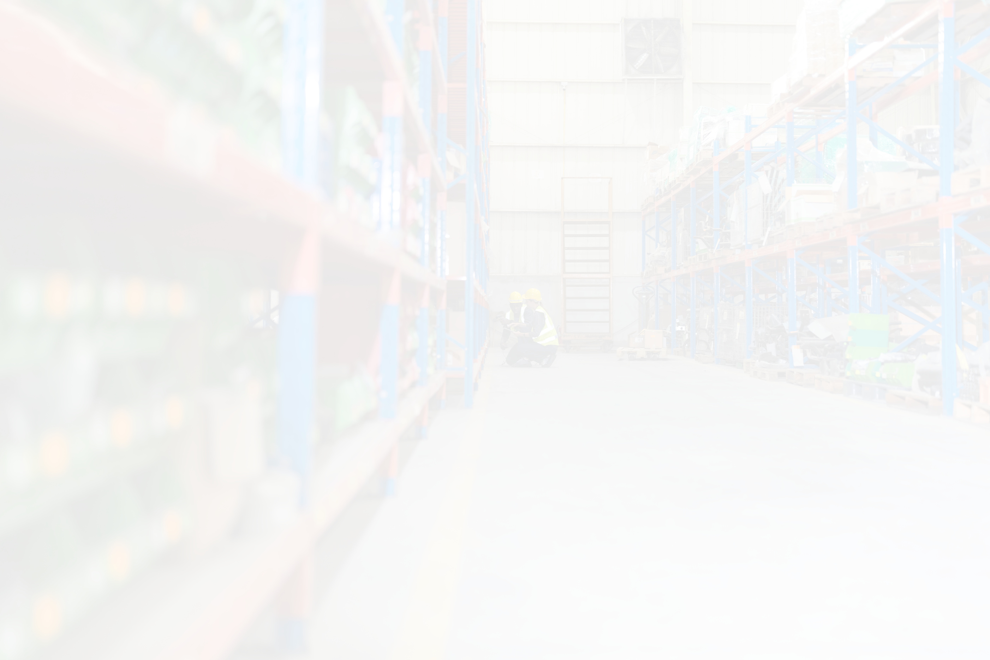

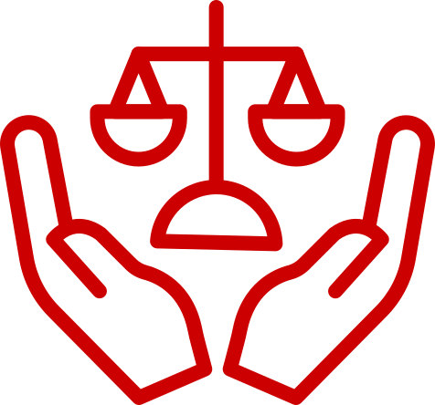

THE LESSON FROM THE PANDEMIC
Efficiency ≠ resilience
The pandemic demonstrated that modern economies depend less on isolated productive capacity than on systemic coordination across time and space. Highly optimized, cost-efficient supply chains proved vulnerable when redundancy and resilience were absent.
Just-in-time collapsed
Systems were fragile

Slide 8

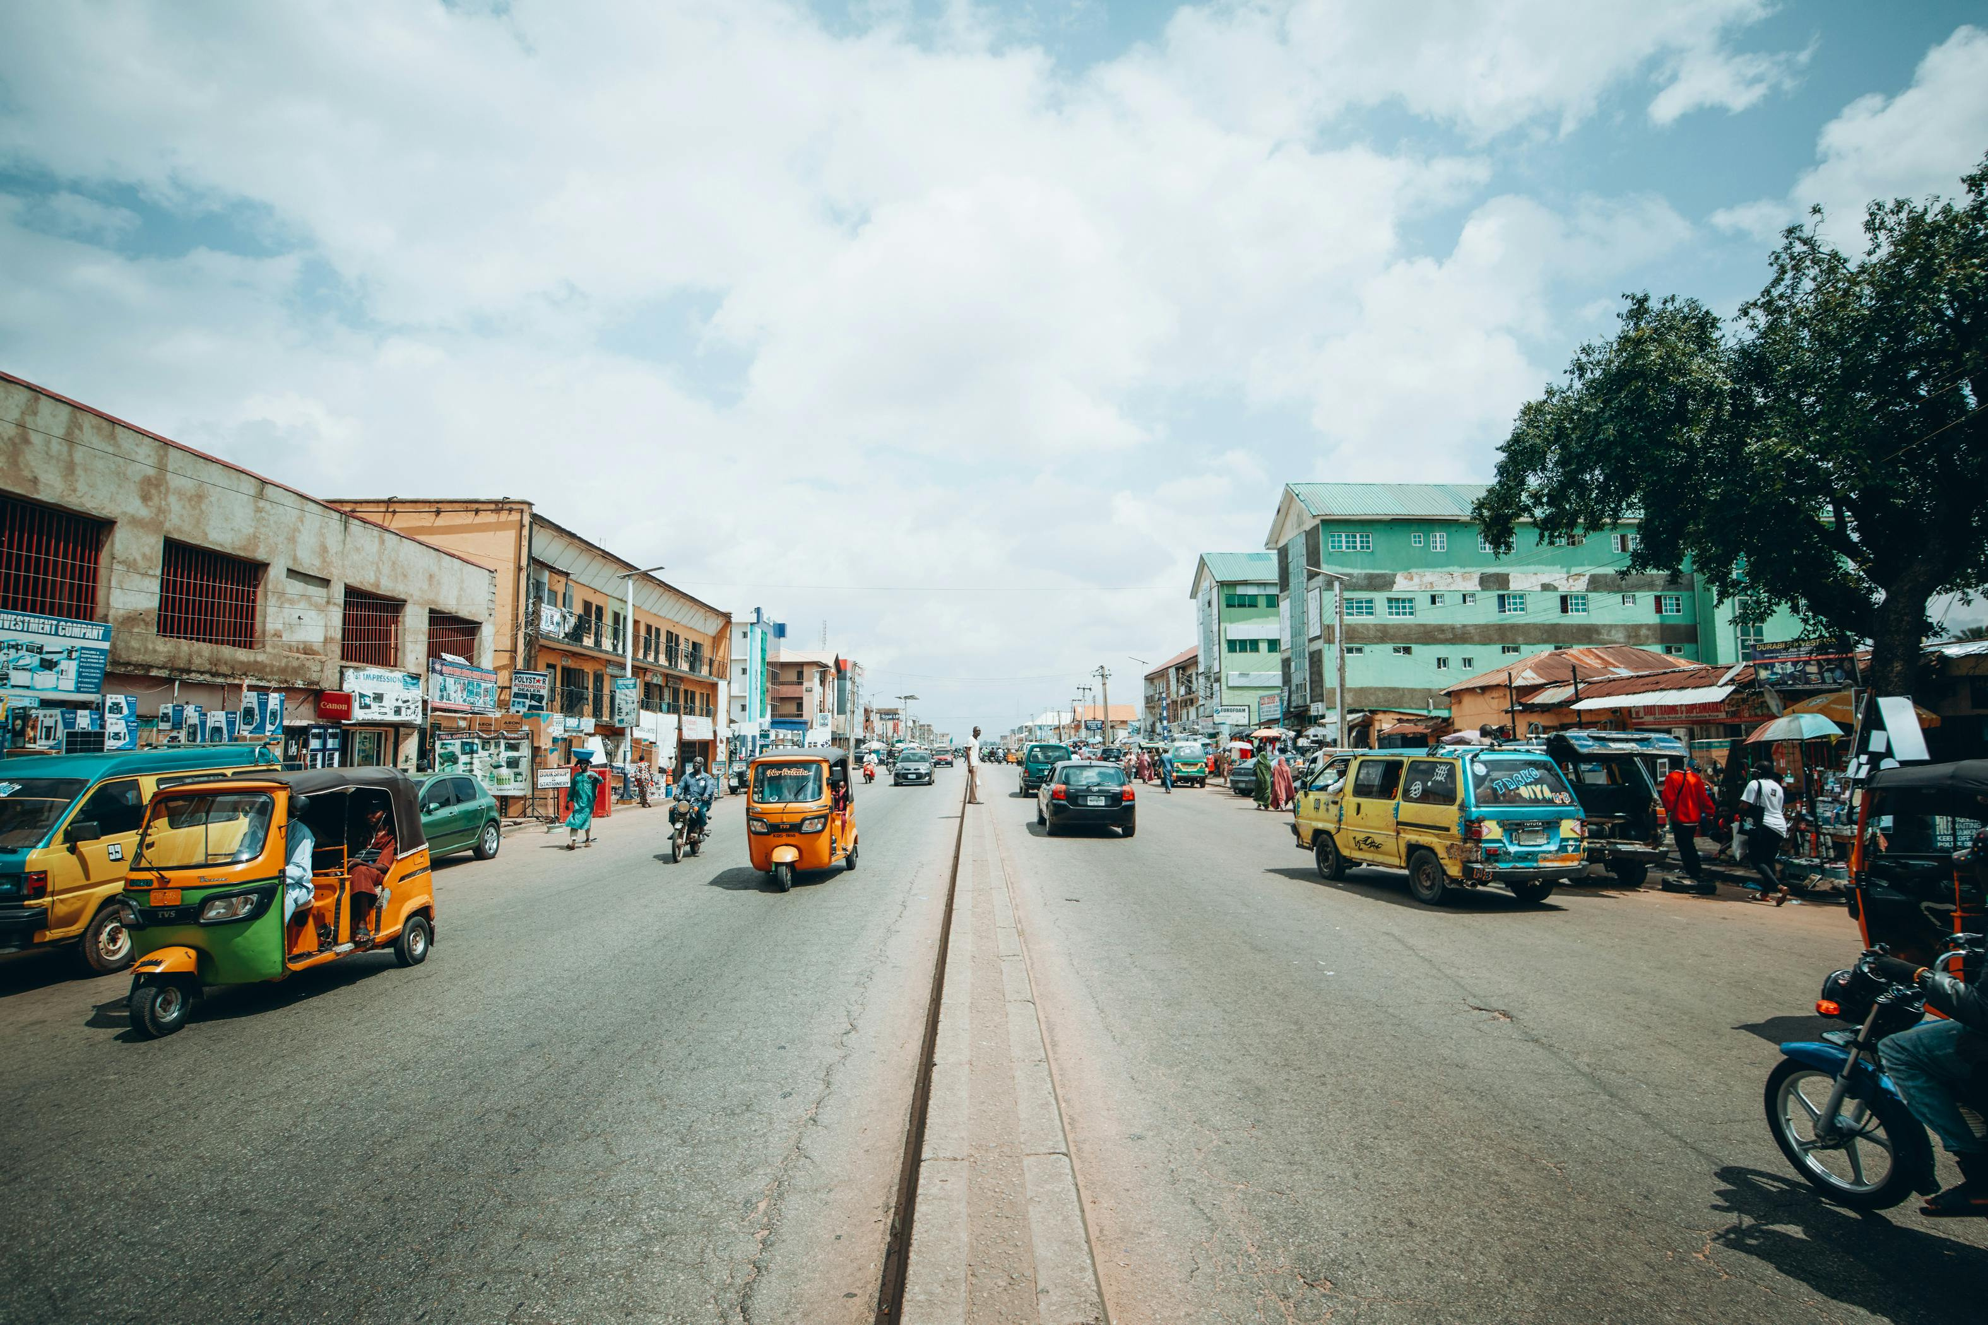
Disruption Is Structural
Infrastructure fragility
Energy instability
Security disruptions
Policy shutdowns
In places like Nigeria, disruption is not exceptional; it is structural.
Road closures, insecurity, telecom shutdowns, and energy failures routinely paralyze procurement, logistics, and supply chains.

Slide 9
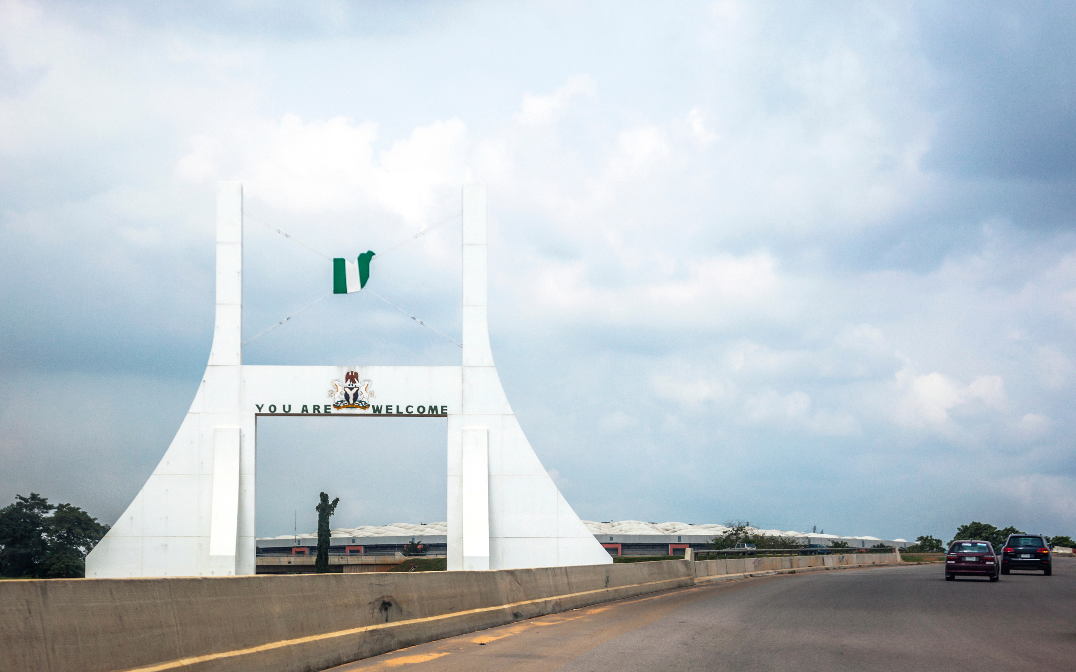


Example;
Northern Nigeria
Cottage industries isolated
Access to markets severed
Production reverts to subsistence
Many cottage industries in Northern Nigeria are not failing because of lack of skill or demand.
They are failing because they are cut off from the infrastructure and security conditions that make logistics and supply chains viable.

Slide 10
WHY DEFINITIONS MATTER
These three terms are often used interchangeably, but they are not the same
Confusing these terms leads to fragmented decision-making.
Clarifying them enables leaders to design and improve systems rather than merely execute tasks, a critical shift for scaling operations, managing complexity, and building enterprises that endure beyond individuals
Procurement ≠ Logistics ≠ SCM
Confusion creates fragmentation
Clarity enables system design and Process improvement

Slide 11


Supply Chain Management (SCM)
End-to-end coordination
Integrates strategy & operations
Governs the whole
Supply chain management answers the question:
1) How do all components of the value-creation process function coherently as an integrated whole?
2) SCM provides the organizing logic governing coordination, alignment, and performance across the entire system

Slide 12
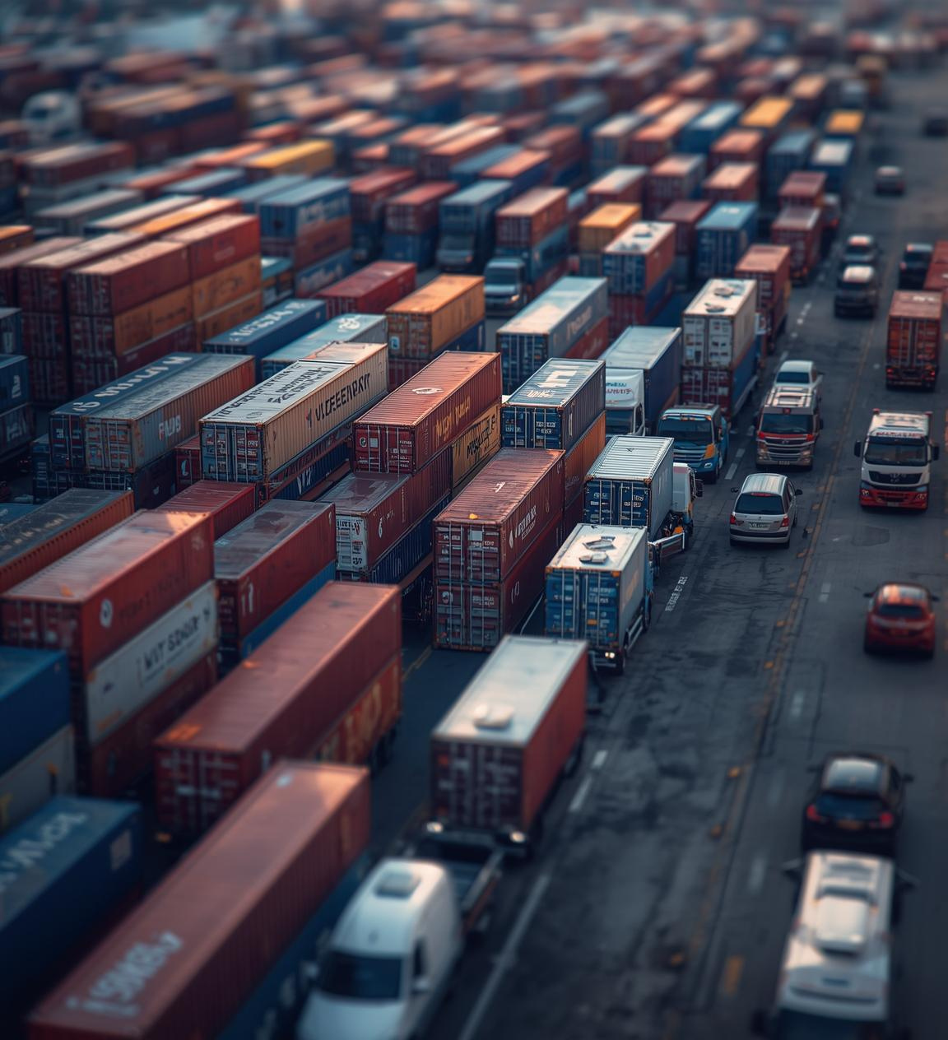
Procurement
Strategic value acquisition
Supplier selection & contracting
Upstream discipline
Procurement answers a different question;
What should we buy, from whom, and on what terms?
It is not just purchasing - it is strategic

Slide 13
Logistics
Physical movement & storage
Right product, place, timelines
Speed, reliability, cost
Logistics answers yet another question:
How do goods move, and where are they positioned to meet demand?

Slide 14



Why the Distinction Matters
Not competitors
Interdependent subsystems
Misalignment creates failure
How They Work Together as a System
Procurement secures the right inputs under the right commercial and relational conditions.
Logistics ensures those inputs and outputs flow smoothly through space and time.
Supply Chain Management aligns procurement, logistics, production, and demand into a coherent operating system that delivers value consistently and at scale.
When one function is optimized in isolation, performance gains are limited. When they are integrated, enterprises achieve resilience, responsiveness, and sustainable advantages including cost effectiveness.
Without systemic alignment, excellence in one function often generates failure or dysfunction in another.”

Slide 15

What Is a System?
Interdependent elements
Purpose-driven
Governed by rules & feedback
In systems theory, a system is a structured configuration of interdependent elements organized to achieve a purpose.
Performance emerges from relationships and interactions - not from parts

Slide 16

The Core Thesis
THE SYSTEM IS THE SUPPLY CHAIN
The central claim of my presentation
Software ≠ supply chain
Trucks & planes ≠ supply chain
Robots ≠ supply chain

Slide 17
Where the System Resides
Decision rights
SOPs
Data integrity
Incentives
Governance
This is the invisible system - sorry, the invisible logic - that determines performance

Slide 18

Inefficiency Is a Development Tax
Working capital strain
Habitual informality
Lost trust
Short investment horizons
Inefficiency compounds. Over time, it reshapes behaviour, institutions, and investment decisions.
Eventually, it fractures or destroys trust.
According to late Stephen Cover;
“Trust is the glue of life. It's the most essential ingredient in effective communication. It's the foundational principle that holds all relationships.”

Slide 19


Intelligent Machines
AI
Robotics
Automation
Drones
These technologies are essential - but they are not substitutes for systems

Slide 20
Technology Presupposes Maturity
AI → clean data
Robotics → stable energy
Automation → standardization
Platforms → governance
Technology magnifies what already exists.
It does not correct incoherence

Slide 21





Three Systemic Requirements
Systems Thinking- Seeing the whole, not the parts.
These are not abstractions.
They are operational fundamentals and necessities
Systems Dependency - Trust the process & work the system
Systems Conscientiousness- Give your upmost for the common good.

Slide 22

Strategic Sequence
Build systems
Stabilize infrastructure
Embed governance
Then deploy technology
Reverse this sequence and you get spectacle - not transformation

Slide 23

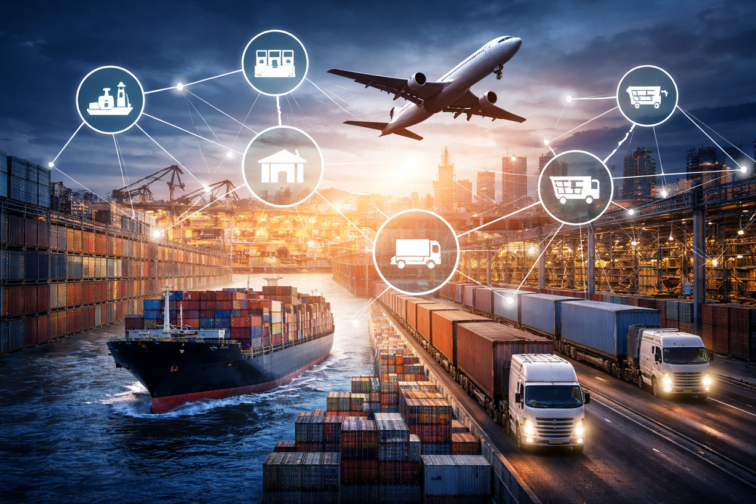


The System Is the Supply Chain
As Nobel Laureate Paul Romer reminds us
“Growth is driven by ideas and recipes - not by working harder alone.”
Supply chains are civilizational capabilities.
No technology can rescue a weak system in the absence of internal readiness.
No economy can sustainably industrialize without reliable supply chain infrastructure

Slide 24

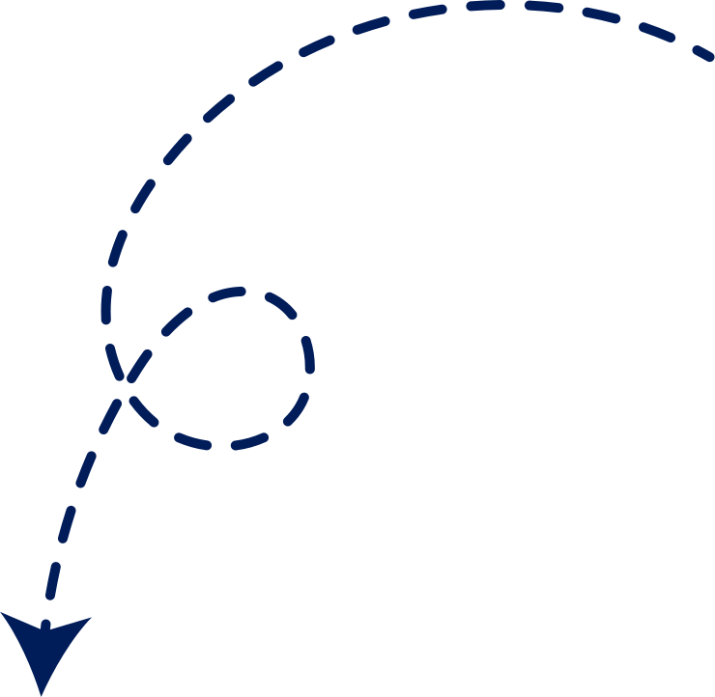

“THE SYSTEM IS THE SUPPLY CHAIN”
THANK YOU!
Anayo Agu is a Business Transformation Adviser at MIGFO Nigeria Ltd and Co-Founder of the Seeds of Greatness Institute (SGI).
He offers pro bono strategy counselling on systems thinking, executive functions, market access, entrepreneurship, and enterprise development via:
anayoagu@seedsofgreatnessinstitute.com.
+234 814 068 8854
Q&A

