Slide 1


Design
for Manufacturability
in Emerging Industrial Economies
Turning Engineering Concepts into Scalable Production
Isaac Ibidapo Bisi

Slide 2


Introduction
03
What is Design for Manufacturing(DFM)
04
Elaboration of the Object of Topic
05
How do we go from emerging industrial economies to Advanced economies?
08
What are the Steps that an Engineer must take OR understand
09
Contents Overview
Phases (1-9)
10
Conclusion & Final Thoughts
21

Slide 3


Page 03
Introduction
Scenario
There have been cases where a product was designed – appears to be a perfect design. However, the product cannot be produced OR would require extreme effort before it can be produced. Why? Because the design appears to be too theoretical. Design for Manufacturability was not considered
Story
My friend John was to produce a corn harvester. He called me to check out his design. He was quite proud of the design. On reviewing the design, it was not manufacturable. I gave him my feedback, reminding him that a lot of “T” s have not been crossed. He explained my observations away.
Story
5 months later, he called me seeking some form of soft loan to complete the prototype. Why? The manufacturing cost had skyrocketed, going extremely out of budget, the quality was looking poor; the machine was not close to deployment and after the patron had injected extra funds into the project, gave up on it. Now, he just wants to complete the job for accomplishment’s sake.

Slide 4



Page 04
What is Design for Manufacturability (DFM)
✔ A systematic approach to design products that are easy and cost-effective to manufacture
✔ Reduces complexity, material waste, production time & costs
✔ Ensures higher quality and smoother transitions from prototype to production
DFM Focuses On
Process capability
Tolerance alignment
Tooling feasibility
Material suitability
Reduction of
Complexity

Slide 5


Page 05
What is an Emerging Industrial Economy
✔ Rapidly transitioning from agriculture- or resource-based economies toward industrial and manufacturing capacities.
✔ Building productive industries that add value to raw materials rather than just exporting them.
✔ Increasing manufacturing’s share of GDP, employment, technological sophistication, and integration into global value chains.
✔ Investing in policy, infrastructure, and investment climates that attract production-oriented capital.
Elaboration on the Topic

Slide 6


Page 06
Why The Topic
Currently, the three biggest emerging industrial economies in West Africa are Ghana, Nigeria, and Senegal.
It must be said that the contributions of the industrial sector to these countries ' GDP—and to West African countries at large - are quite small.
Ghana:
Industrial sector accounted for between 24.5% and 33.2% of the GDP
Nigeria:
As one of the largest economies in Africa, yet the industrial sector accounted for only about 9.62% of the GDP)
Senegal:
Industrial sector accounted for roughly 25.4% of the GDP

Slide 7



Page 07
However, West African nations are increasingly pursuing industrial agendas focused on value addition, manufacturing expansion, and economic diversification
More specifically, President Bola Tinubu’s administration has launched the Nigeria Industrial Policy 2025, signaling a structured national strategy to transform Nigeria’s industrial base. The policy aims to:
Government
Efforts
Transition from exporting raw materials to producing finished goods
Strengthen value chains
Build manufacturing capacity
Integrate small and medium enterprises (MSMEs) into industrial growth
Align infrastructure and energy with industrial ambition

Slide 8

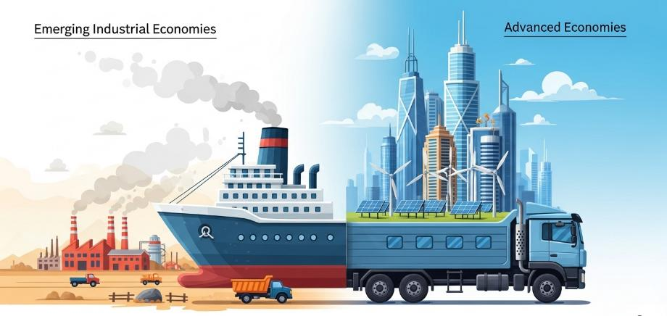
Page 08
How do we go from Emerging Industrial Economies to Advanced Economies
One of the vehicles that will take us there is designing engineering solutions which are – they must be – tailored to current industrial capability. From there, we can develop deeper industrial capabilities.
This is where Engineering Design - Design for manufacturability become very important.

Slide 9

Page 09
Start With a Strategic Position:
DFM Is Not a Tool — It Is a Discipline
Manufacturability is not something we “check” after design. It is something we design into the product from Day 1.
If we treat DFM as an afterthought, we will:
Redesign under pressure
Delay customers – this becomes a threat to the business itself, dissatisfied customers can decide to change their suppliers.
What Are the Steps That an Engineer Must Take or Understand
Bleed margins – gradually, your estimated profit erodes due to errors, defective products, rejects and repetition.
In Nigeria and West Africa, this can have a more devastating effect on the region – because the customers may decide to procure from foreign nations.
Scale
Smoothly
Protect
Margin
Built
Industrial Credibility

Slide 10
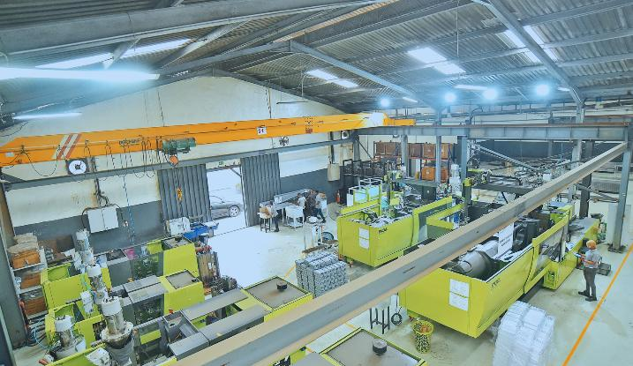
Page 10
Phase 1
BEFORE CAD OPENS, WE MUST ASK:
Map Our Industrial Reality Before We Design
What machines do we actually have?
What is our true tolerance capability?
What materials are consistently available locally OR What materials and components do we have a reliable vendor for?
What processes are stable vs temperamental?

Slide 11
Page 11
Phase 1
Map Our Industrial Reality Before We Design
Continuation
Some processes will always have repetitive outcomes. Like cutting on LaserJet, CNC bend operations. These are stable processes.
While some processes are subjective – heavily dependent on the personnel’s skill, environmental conditions etc. Such processes are termed temperamental.
A designer must know these things beforehand, plan proactively with OR around them to avoid undesirable outcomes.
What supplier lead times are realistic?
Engineers should not just design using theoretical capability OR ideal instances. Rather, actual capability and prevailing conditions – as stated above – must be considered.

Slide 12
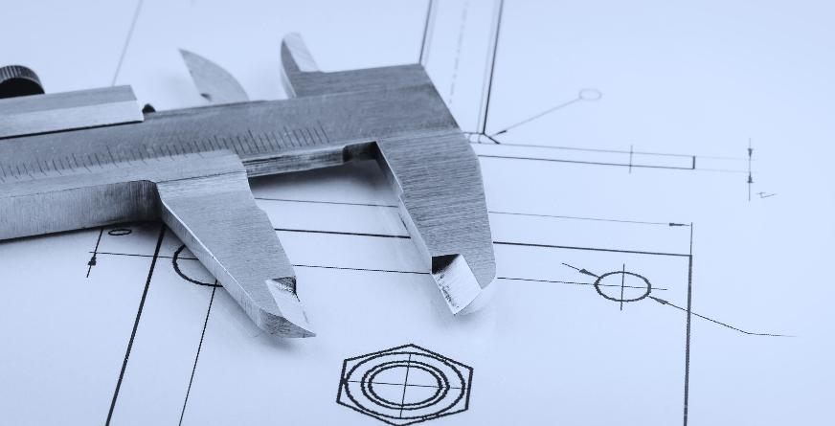
Page 12
Phase 2
Introduce DFM Gates at Concept Stage
EVERY CONCEPT MUST PASS THROUGH 5 DFM QUESTIONS:
Concept Development with Manufacturability Filters
1. Can this geometry be produced repeatedly with our current machines?
2. Are we introducing unnecessary part count?
3. Are we specifying tolerances tighter than required?
4. Are we using non-standard materials?
5. Does this design assume perfect operators?
If the answer to any of these introduces instability, redesign early. This prevents scaling failure later.

Slide 13

Page 13
Phase 3
Design Simplification & Standardization
REDUCE COMPLEXITY AGGRESSIVELY
Elon Musk has emphasized that "if you're not adding back at least 10% of the things you've deleted, you're not deleting enough"
Complexity multiplies cost.
Every new part number increase:
Procurement friction/bottle necks
Inventory carrying cost
Error probability
Supply vulnerability

Slide 14
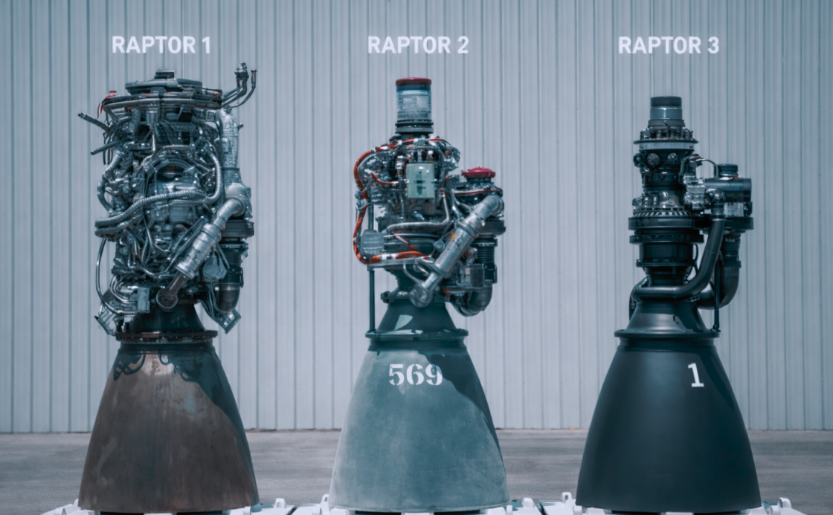
Page 14
Phase 3
Design Simplification Standardization
Continuation
Hence, we must:
Minimize unique parts
Standardize fasteners
Use repeatable hole patterns
Align sheet sizes with local stock
Simplicity is industrial power.

Slide 15

Page 15
Phase 4
ENGINEERING CANNOT DESIGN IN ISOLATION
Early Manufacturing & Supply Chain Involvement
DFM collapses if manufacturing and supply chain are consulted after drawing release.
There must be:
1. Cross-functional design reviews
2. Early supplier involvement
3. Production sign-off before release
4. Prototype build participation by factory floor
Engineers must be heavily involved – literally stand beside operators – during first builds.
That is where true manufacturability is revealed.

Slide 16
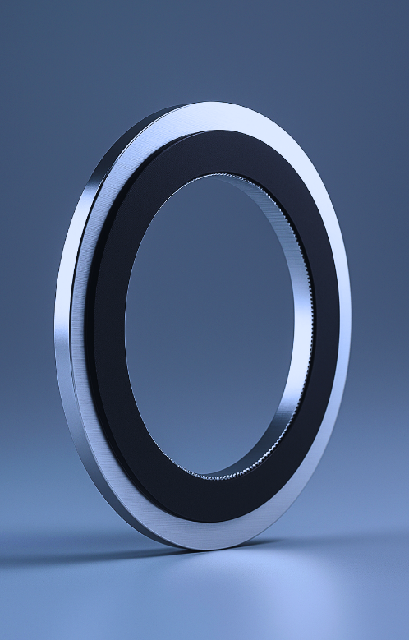
Page 16
Phase 5
BUILD PROTOTYPES THAT REFLECT PRODUCTION REALITY
MVP means Minimum Viable Product – which is the simplest product configuration that delivers core customer value and can realistically transition to repeatable production.
Conduct prototypes as such:
Use intended materials
Use intended processes
Use intended suppliers
Use intended assembly flow
Once the prototype works, it can be reproduced consistently and someone is willing to pay for it, congratulations, you have a proper MVP and a prototype.
If we fabricate parts manually “just to make it work,” we are deceiving ourselves.
Prototype as Industrial MVP — Not Showpiece

Slide 17

Page 17
Phase 6
MATCH DESIGN TOLERANCES TO PROCESS CAPABILITY
Tolerance Process Alignment
Avoid strict tolerances – except its extremely necessary. Over-specification kills manufacturability.
Engineers must understand the process’ tolerance capabilities:
· CNC capability variation
· Welding distortion realities
· Sheet metal spring back behaviour
· Surface finish variability
We must design tolerances that reflect statistical capability — not ideal assumptions.

Slide 18
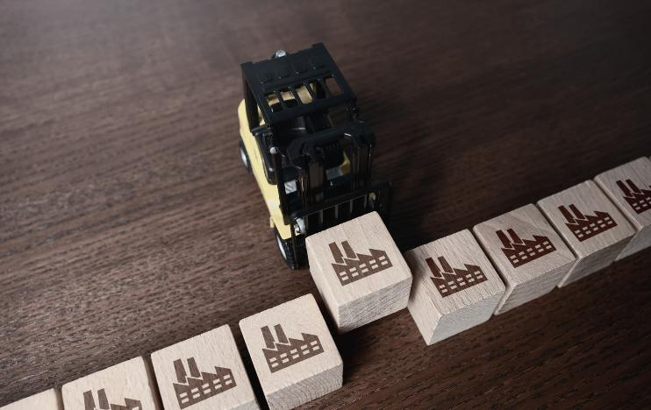
Page 18
Phase 7
Design for Supply Chain Stability (DfSC)
ALIGNING WITH LOCAL AND REGIONAL SUPPLY ECOSYSTEMS
Design for manufacturability in Nigeria or West Africa must consider:
Import volatility
FX exposure
Port delays
Limited specialty component availability
Where possible:
Prefer local standard materials
Design modularity to allow supplier substitution
Avoid single-source components
Design for flexible equivalents
Manufacturability without supply stability is illusion.
DFM + DFSC = Scalable Production

Slide 19
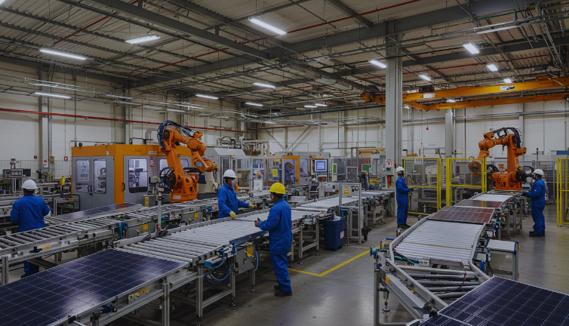
Page 19
Phase 8
Design for Scale, Not Just First Batch
STRESS TEST THE DESIGN AT 10X VOLUME
Ask:
Does cost reduce at volume?
Does assembly time scale linearly?
Does quality hold under repetition?
Does supply capacity hold?
Many products work beautifully at 5 units and collapse at 500.
True DFM anticipates growth before it happens.

Slide 20

Page 20
Phase 9
CREATE A FEEDBACK LOOP FROM PRODUCTION TO ENGINEERING
Engineers must review:
NCR trends
Field failure data
Scrap analysis
Assembly time studies
Customer complaints
Manufacturability is dynamic — not static.
Every production cycle should refine future design rules.
Institutionalize Learning

Slide 21

Page 21
Now that we have discussed what the engineers must know and understand, let us look at what we need to do to enhance that, in a bid to have scalable industrial growth:
Invest in design software (CAD tools like Solid Edge, SolidWorks, Creo, Autodesk Inventor etc.).
They enhance quality design due to the various embedded functions and capabilities.
Some current and future technologies that enhance DFM are
1. Additive manufacturing (3D Printing)
2. IoT-enabled production lines
3. AI-driven design optimization
Fund engineering process audits
Invest in training on DFM principles
Measure manufacturability KPIs
Here are some of the metrics to measure DFM success.
1. manufacturing cost,
2. time to production,
3. first-pass yield,
4. suppliers’ lead times
Align design incentives with production success

Slide 22
Page 22
Final Thoughts...
“THE LONGER AN ARTICLE IS IN THE PROCESS OF MANUFACTURE AND THE MORE IT IS MOVED ABOUT, THE GREATER ITS ULTIMATE COST.”
“An exotic and beautiful design that cannot be manufactured at scale is not a product — it is an elaborate CAD toy, and scale will punish it.”
Isaac Ibidapo Bisi
Henry Ford

Slide 23

Page 23
THANK YOU
?

