Slide 1
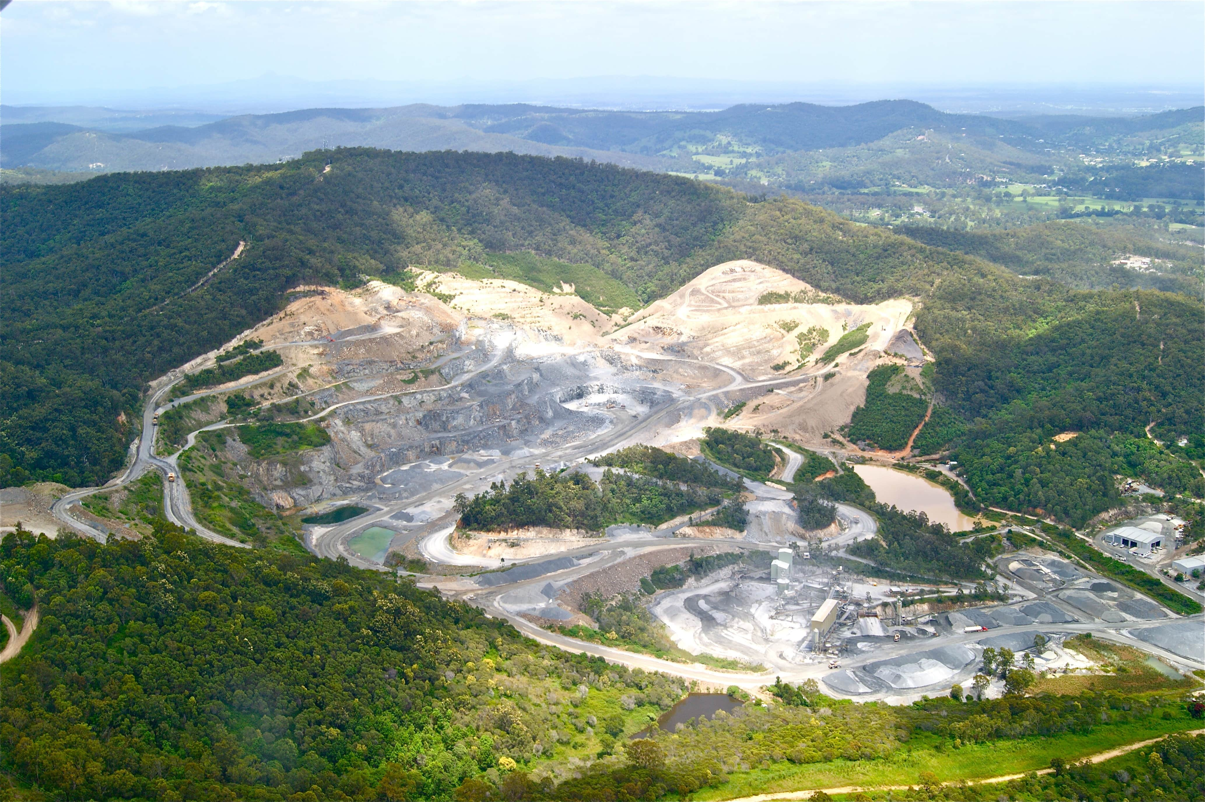





SUSTAINABLE
INDUSTRIA
LIZATION
IN WEST AFRICA:
Pathways for Steel Manufacturing and Solid Minerals
START

Slide 2


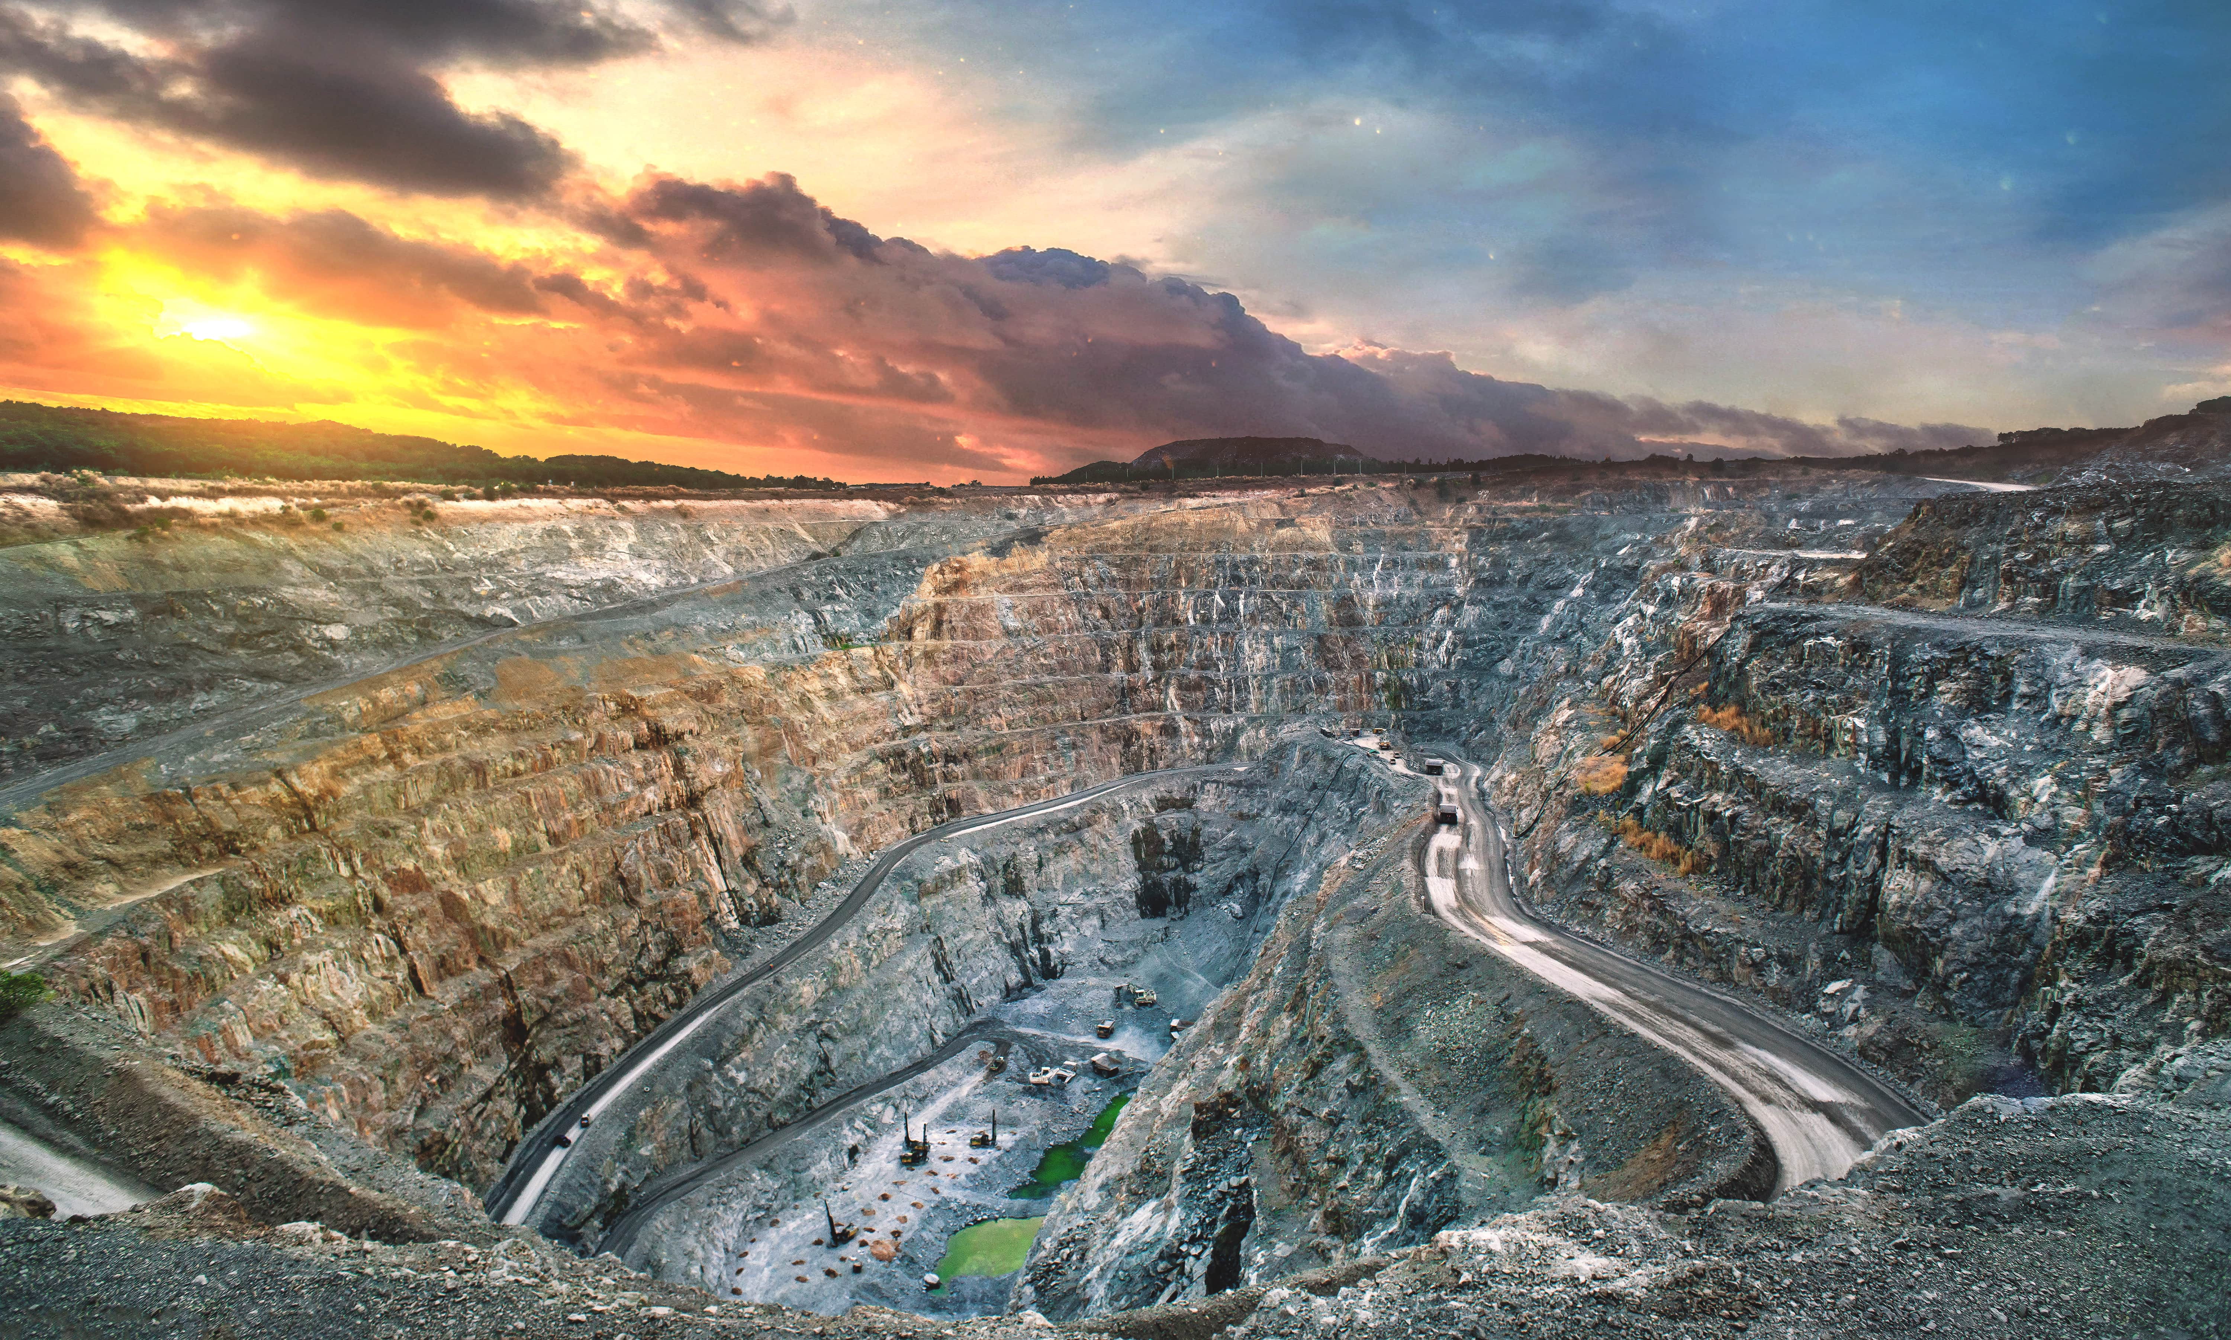
A 15-minute cross-stakeholder strategic overview
The scope:
Integrating responsible extraction (solid minerals) with value-added processing (steel manufacturing).
Objective: Demonstrate how connecting mining to manufacturing via sustainable pathways drives regional resilience and economic growth.

Slide 3
A 15-minute cross-stakeholder strategic overview
The comparative advantage of the region can used with high efficiency to drive sustainable industrialization of the region as against the poor concept of self-reliance
The economy of the region can be globally competitive by adopting synergistic and sustainable economic integration in the supply chains of manufacturing.

Slide 4
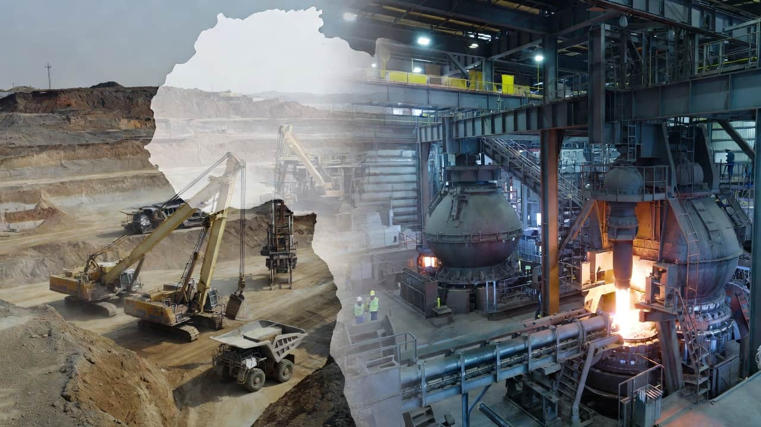

A mine site transitioning into a modern steel plant

Slide 5

Why Now? West Africa Context
West Africa holds vast reserves of iron ore, bauxite, manganese, and limestone—critical inputs for industrialisation.
The total 2025 import bills of aluminum and aluminum related items came to about $2.5bn while $6.6bn value of raw ore was exported.
The total 2025 import bills of steel and steel related items came to about $8.1bn while $2.35bn value of raw ore was exported.
These gaps provide viable opportunities for economic development.
The total estimated land size of active mines is 350,000 hectares. And planting coconut trees on just 30% of these lands will guarantee a gross annual revenue of $1.5bn and reduce environmental footprints.

Slide 6
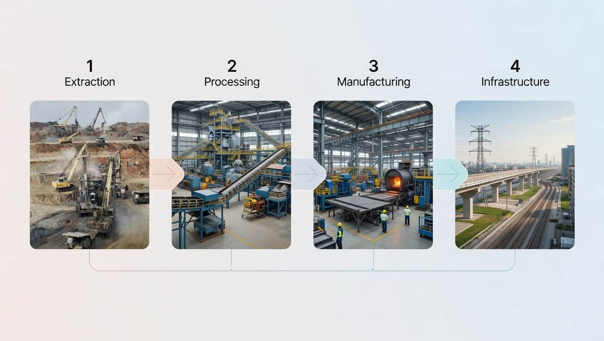
Most minerals are exported raw, while finished steel and industrial goods are imported.

Slide 7
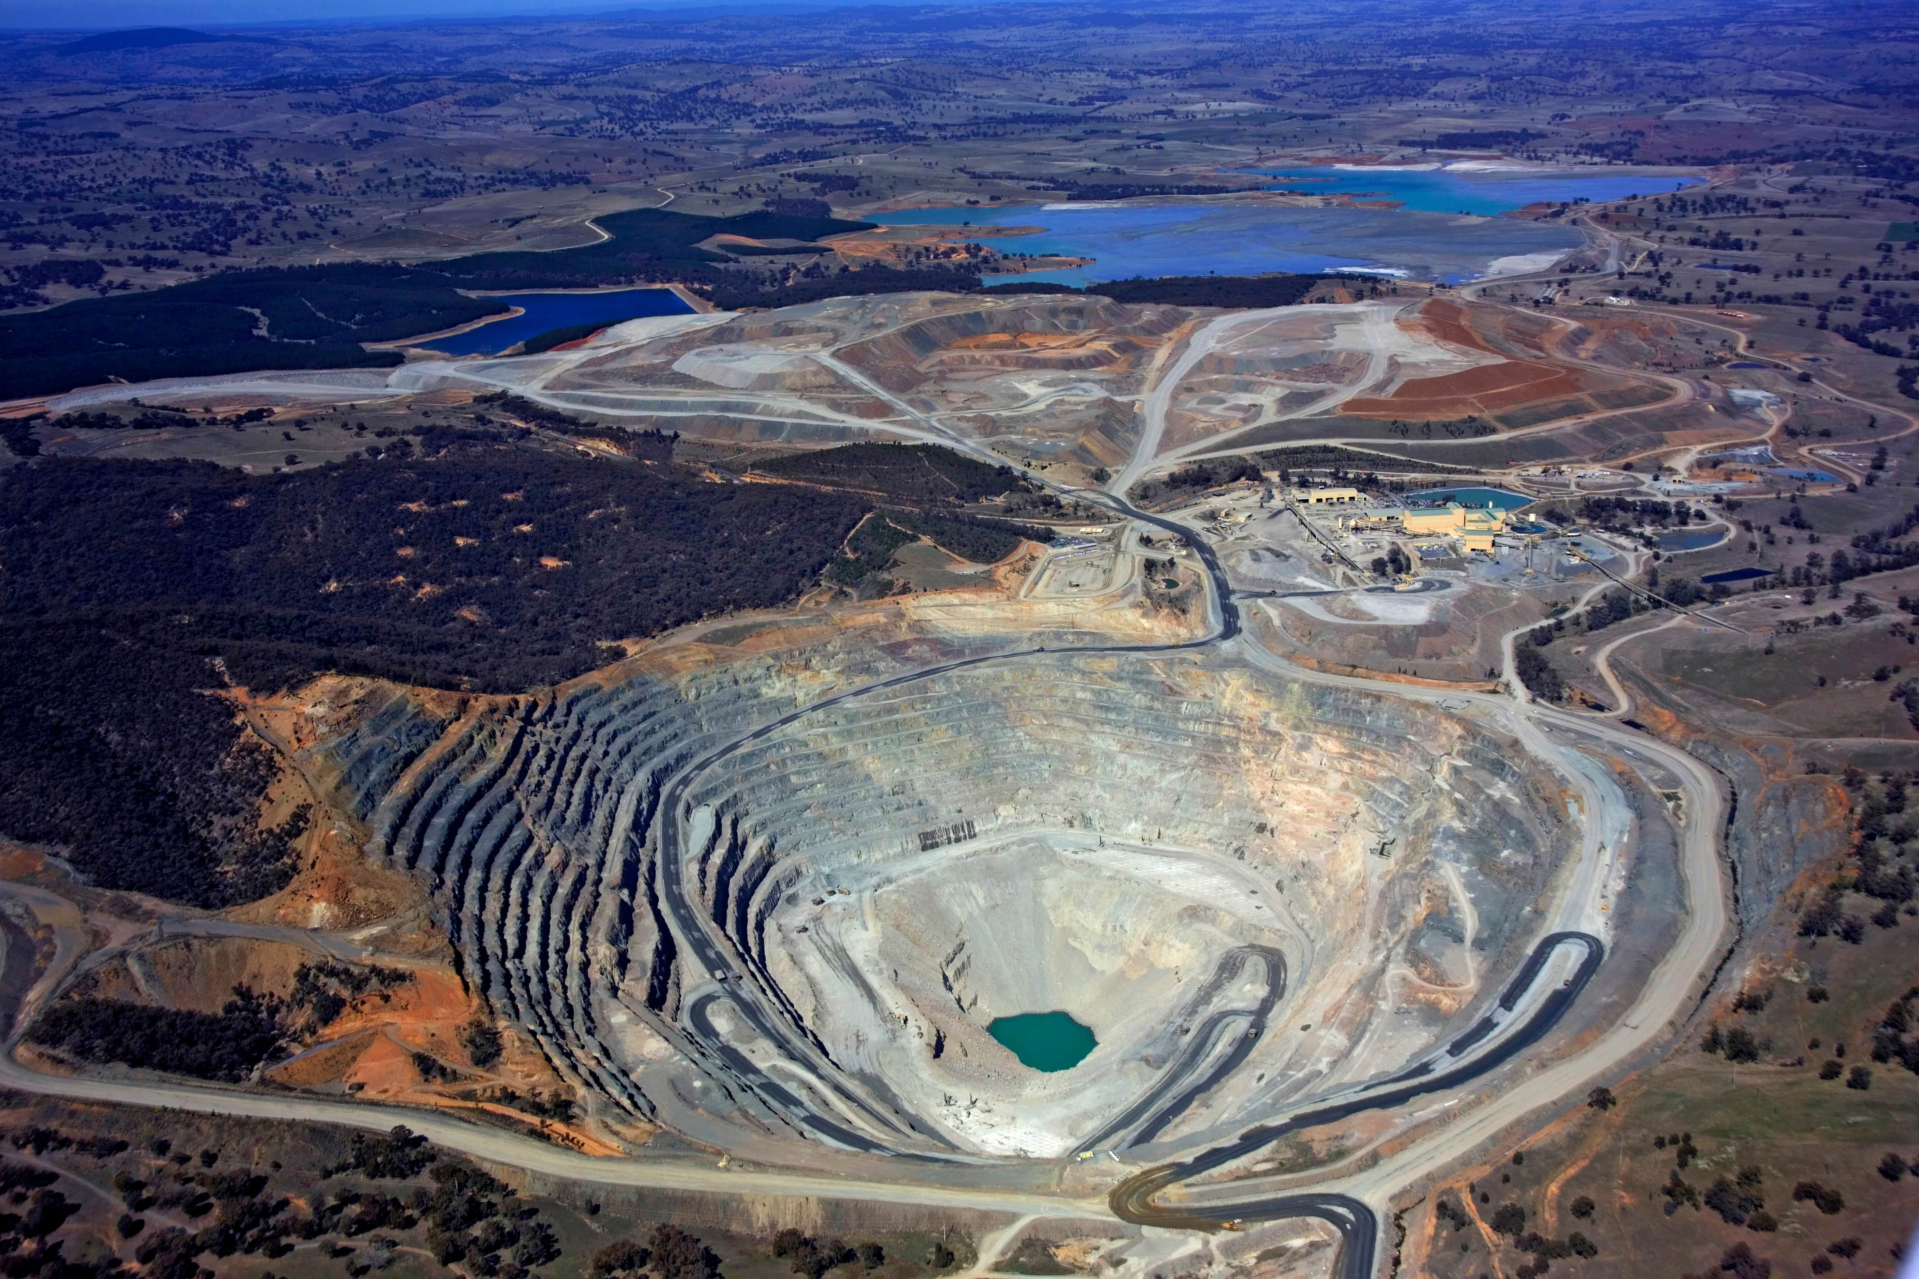

Four Dimensions of Sustainable Industrialisation
Environmental: Rehabilitation of mine sites, water stewardship in processing, and energy-efficient smelting.
Economic: Moving up the value chain (from pit-to-port to pit-to-plant), reducing import bills, and currency stabilization.
Social: Community development agreements (CDAs), artisanal mining formalization, and safety standards.
Governance: Transparency in licensing (EITI standards), preventing illicit financial flows, and regional harmonization.

Slide 8
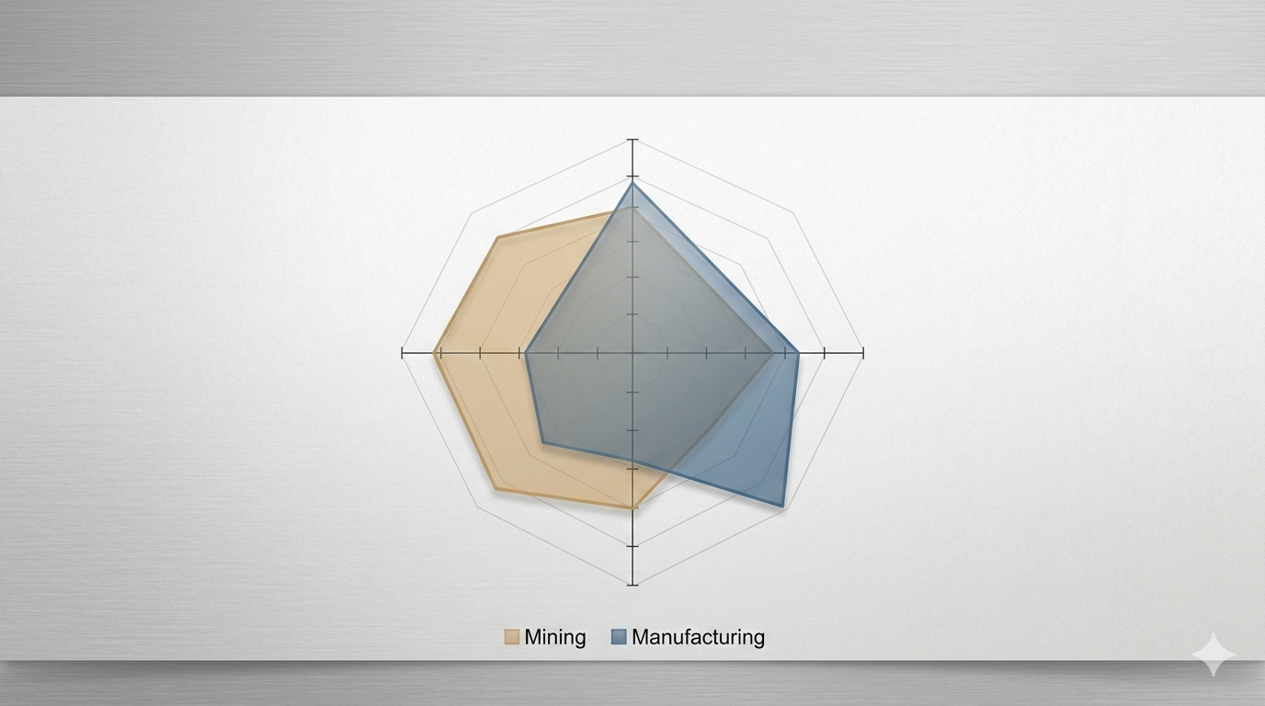

Slide 9
Practical Pathways for Industry (Miners & Manufacturers)
A) Energy Integration: Co-locating renewable energy (solar/hydro) with mines and steel plants to reduce grid reliance and emissions.
B) Resource Efficiency: Using "green" mining techniques (electric fleets) and circular steel production (using scrap + DRI).
C) Value Addition: Investing in downstream processing (e.g., turning iron ore into billets/rebar locally).
D) Technology: Digital geological mapping and automated processing controls.

Slide 10
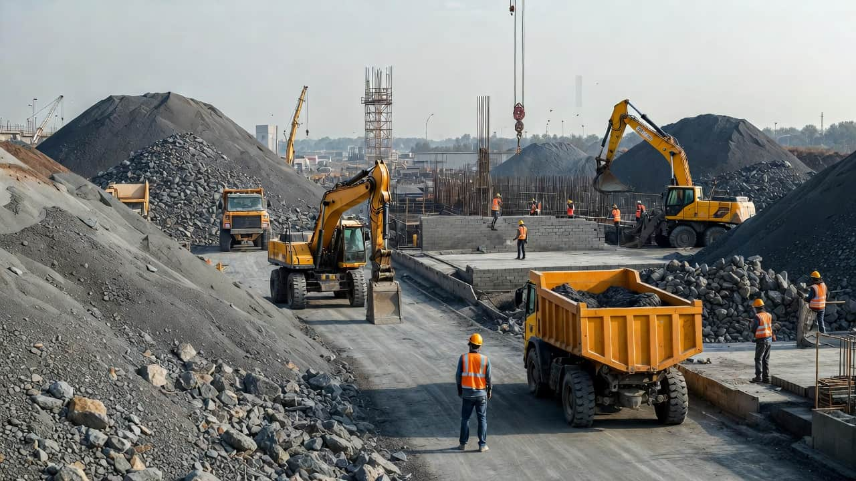
An "Eco-Industrial Park" where mining waste is used for construction materials.

Slide 11

Practical Pathways for Policy Makers
Local Content Laws: Enforcing mandates that infrastructure projects use West African steel and cement.
Infrastructure Corridors: Building rail and power links that connect mineral deposits to industrial zones and ports.
Beneficiation Incentives: Tax breaks for companies that process minerals domestically rather than exporting raw ore.
Regional Alignment: ECOWAS-wide mining codes to prevent a "race to the bottom" on royalties. We may need to consider regional manufacturing hubs (Regional Free Trade Zones) that provide linkages between raw materials and processing/production , cleaner and cost-effective energy.

Slide 12

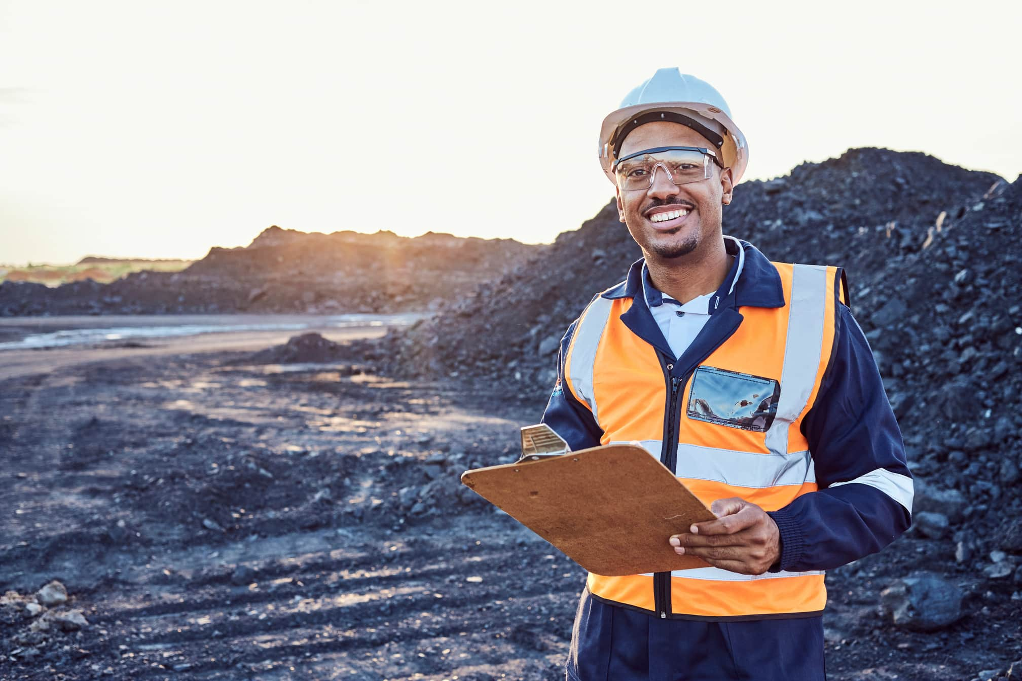

Practical Pathways for Financing Institutions
Sustainable mining requires a multi-faceted approach that includes reducing carbon footprints, fostering community development, ensuring worker safety, and planning for post-mining land use.
Project Finance: Long-term capital for capital-intensive smelters and refineries.
ESG-Linked Loans: Lower interest rates for mines and factories that meet high environmental and social standards.
Risk Mitigation: Blended finance to cover exploration risks and early-stage industrial setu
Trade Finance: Supporting intra-regional trade of steel and mineral products.

Slide 13
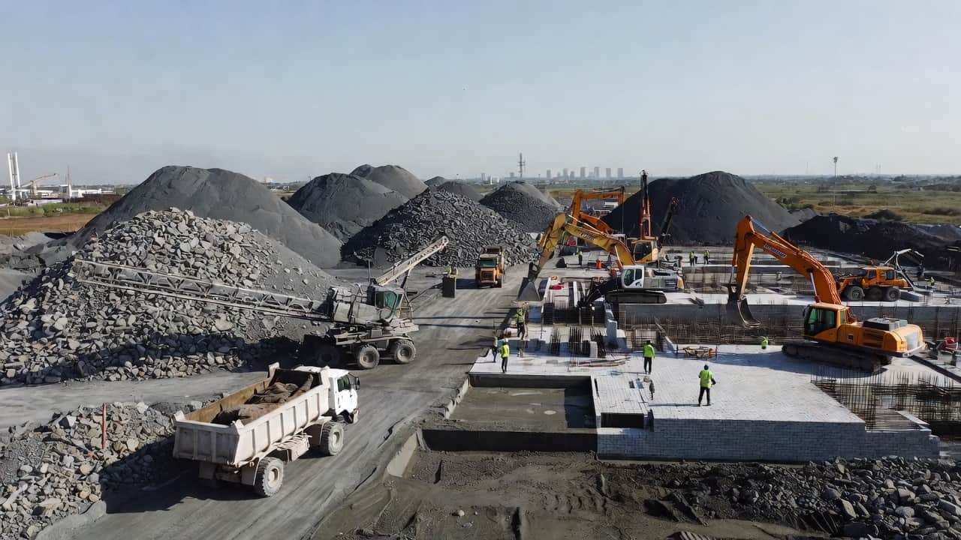
Financing funnel from exploration

Slide 14
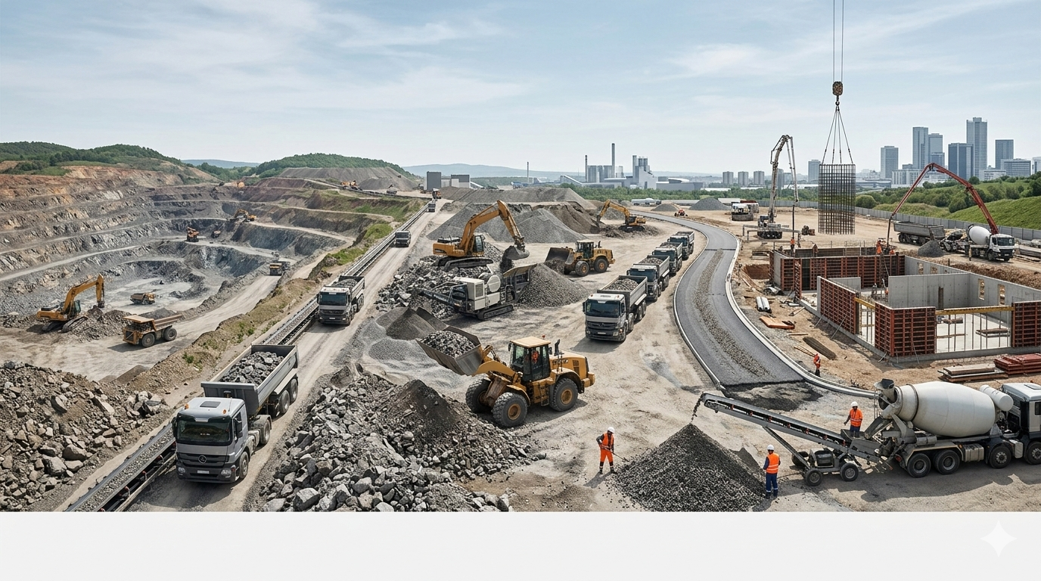

Practical Pathways for Public and Civil Society
Modern technologies are transforming mining into a cleaner and more efficient industry. Innovations such as renewable energy adoption,
Transparency: Monitoring mining revenue usage and environmental impact assessments (EIAs).
Artisanal Inclusion: Advocating for the integration of artisanal miners into the formal industrial supply chain.
Community Rights: Ensuring Free, Prior, and Informed Consent (FPIC) for land use.

Slide 15
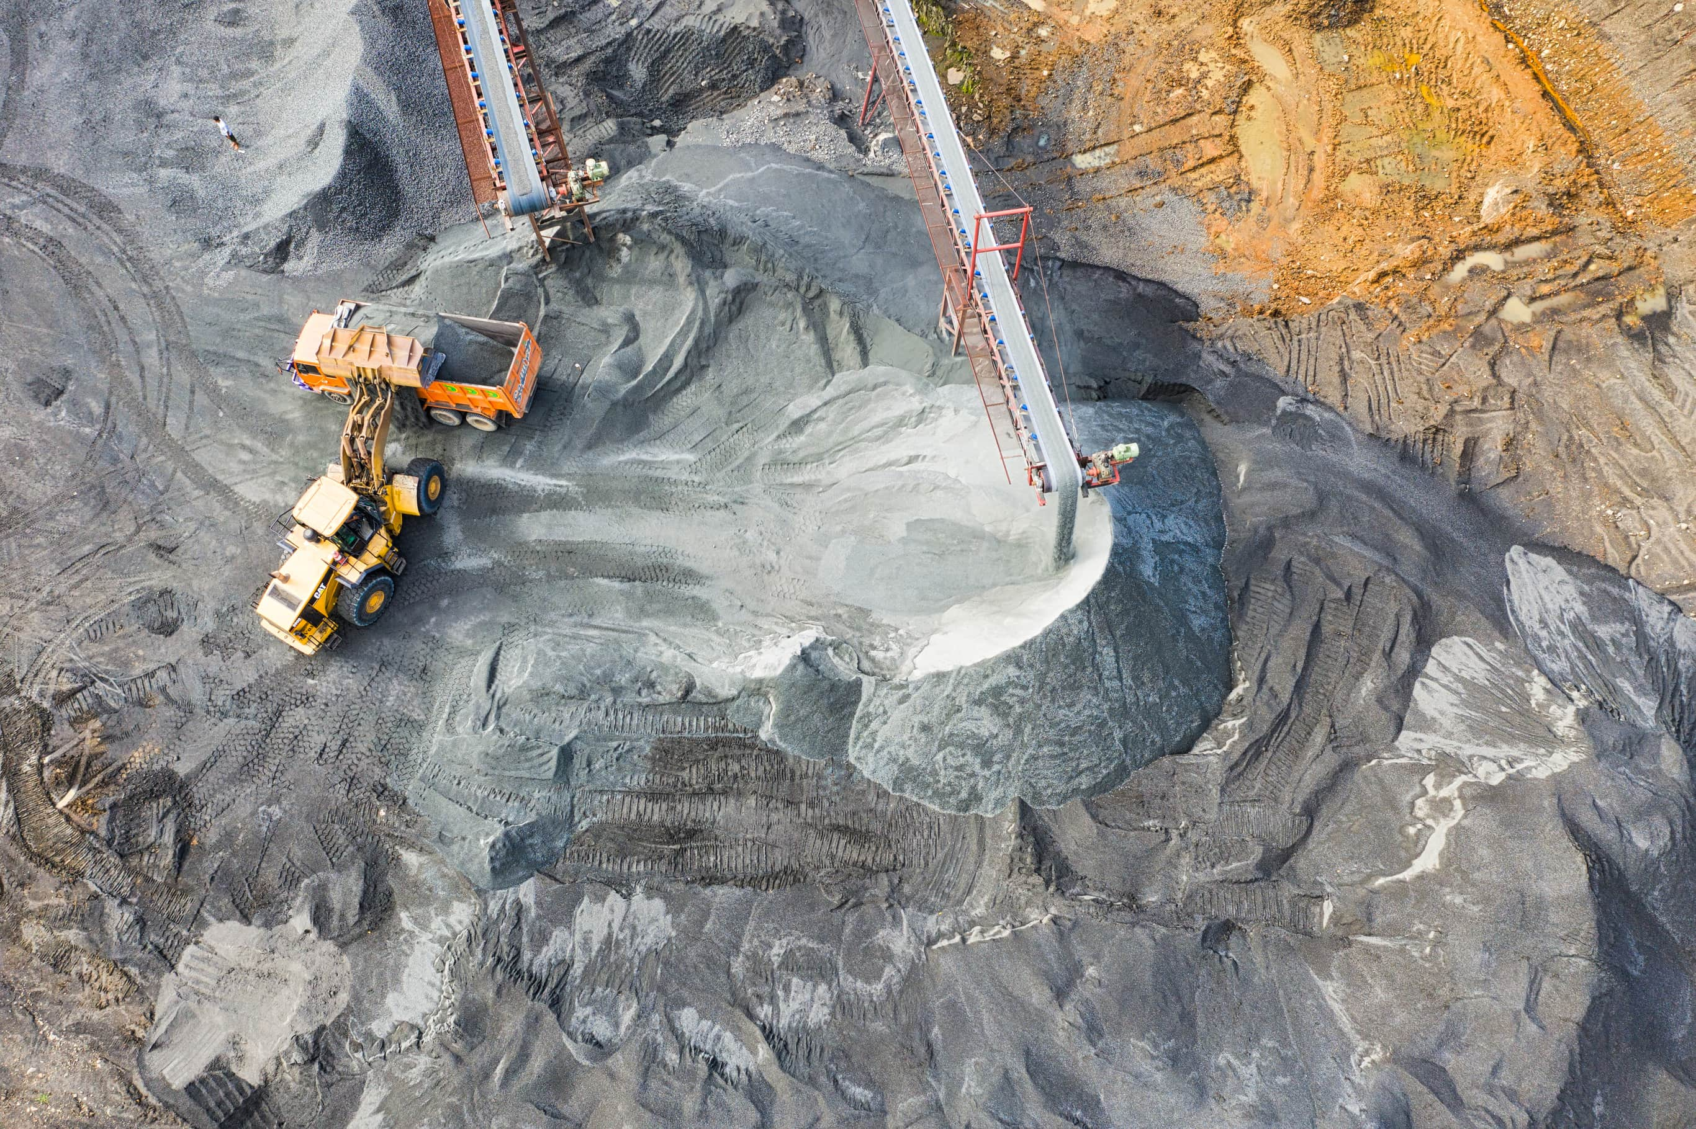


Metrics and Indicators
Economic: Percentage of local procurement; Contribution to GDP beyond royalties.
Production: Tonnage of minerals processed locally vs. exported raw
Environmental: Rehabilitation rate of mined land; Carbon intensity per ton of steel/mineral.
Social: Number of direct vs. indirect jobs; Reduction in mining-related conflicts.

Slide 16
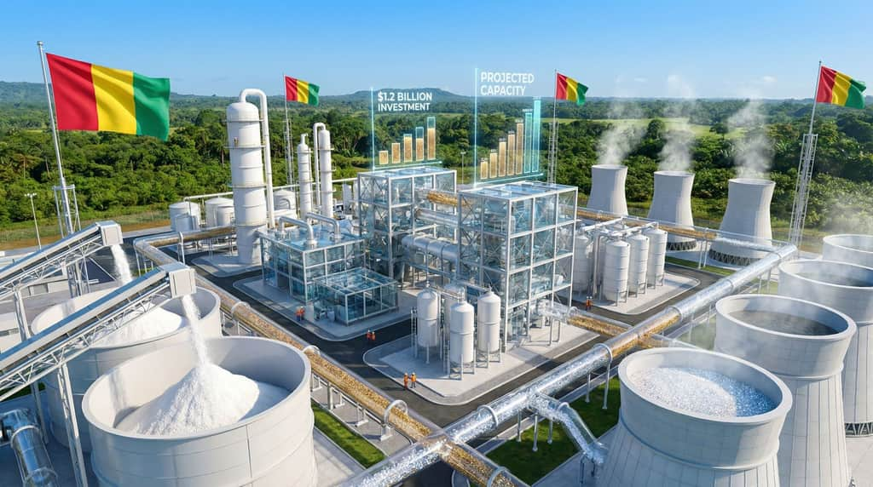
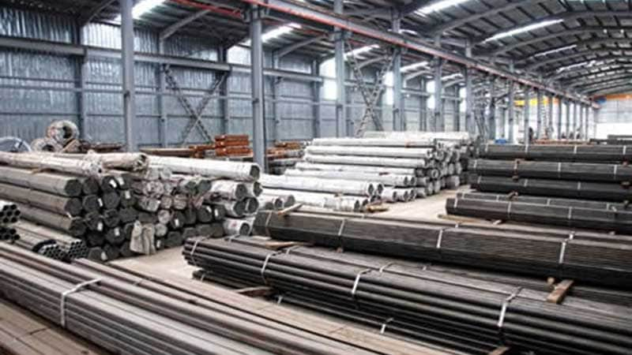

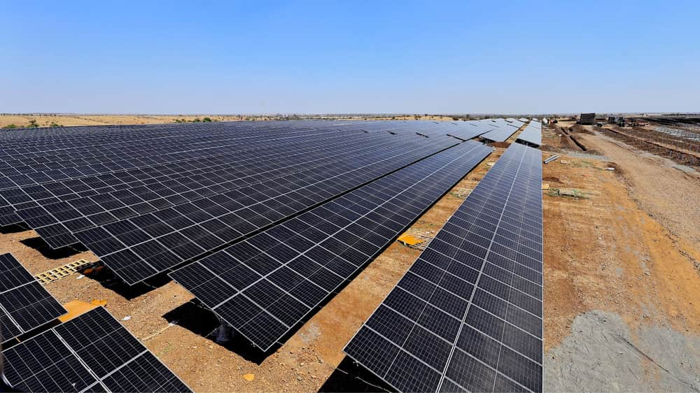
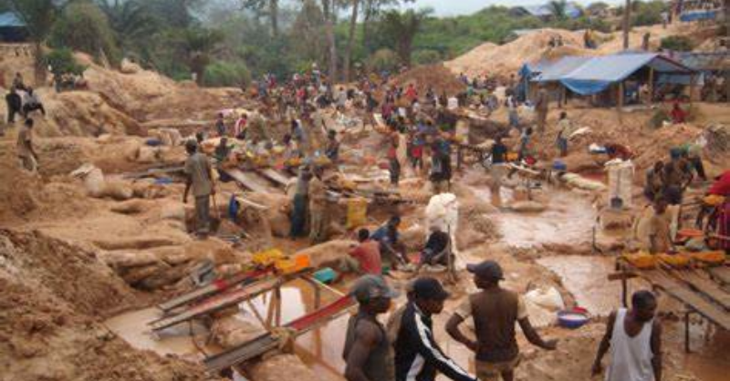
Real-World Illustrations
Example 1: A bauxite mine in Guinea integrating a refinery to produce alumina locally.
Example 2: A Nigerian steel plant utilizing local iron ore and coal/gas resources to replace imports.
Example 3: A gold mine in Ghana powering operations with a dedicated solar farm.
Example 4: Formalization of artisanal miners supplying legitimate aggregators.
Sustainable mining offers substantial benefits, including cost savings, improved community trust

Slide 17



Risks and Mitigation
Environmental Degradation: Mitigation - Strict enforcement of rehabilitation bonds and "zero-discharge" water policies.
Infrastructure Deficit: Mitigation - Public-Private Partnerships (PPPs) for rail and power.
Price Volatility: Mitigation - Long-term offtake agreements and diversifying mineral portfolios.

Slide 18

The future of mining lies in innovation and collaboration. By investing in renewable energy, enhancing transparency, and prioritizing community development, the mining sector can achieve a balance between growth and environmental stewardship.
Call to Action
Industry*: Commit to "Value Addition" targets—process at least X% of output locally by 2030.
Government: Harmonize mining and industrial policies to support domestic manufacturing.
Finance*: Unlock capital for downstream processing, not just extraction.
Civil Society: Hold stakeholders accountable for environmental and social promises.

Slide 19
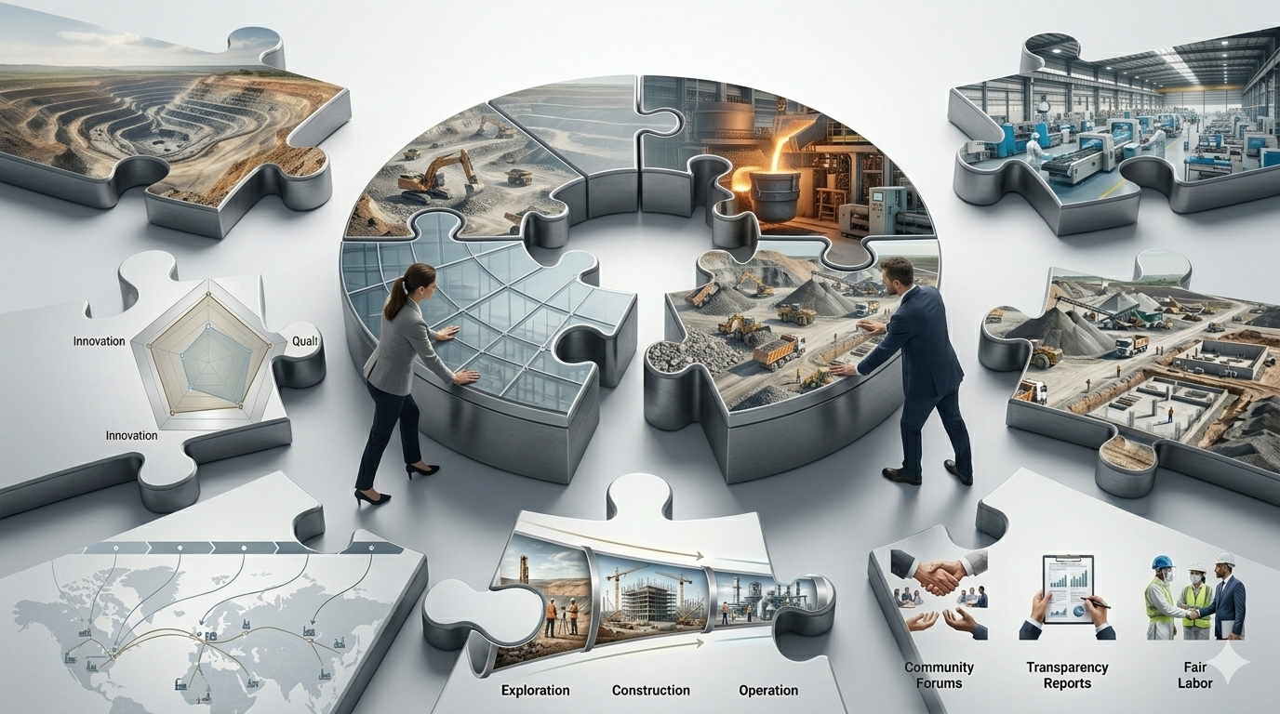
Call to Action

Slide 20



Quick Takeaways
Linkage is Key: Mining and manufacturing must be viewed as one continuous value chain.
Sustainability Pays: Green steel and responsible minerals command premium prices globally.
Regional Strength: West Africa is stronger together—pooling energy and markets creates viability.

Slide 21
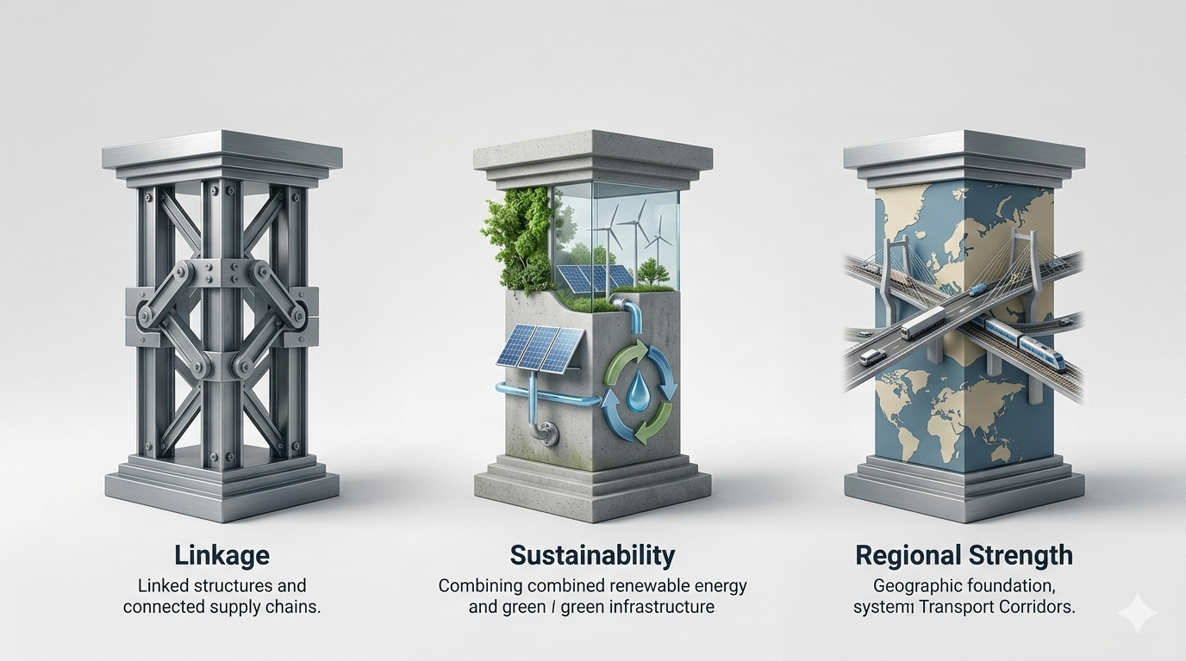

Slide 22



THANK YOU
You are welcome to
partner with us!
Kwale Free trade zone, Delta State, Nigeria
+234 813 800 5304
+27 718 85 7261
www.tyrogroup.org
info@tyrogroup.org

