Slide 1



Green Manufacturing Framework
Lifecycle | Efficiency | Decarbonization | Circularity
Dr. Sanmi Olowosile
MNIQS RQS MGBCN CGEM DGNB Int’l LEED for Cities & Communities Pro

Slide 2

CONTENT
01
02
Green Manufacturing Definition
Core Pillars
03
04
Operational scope
What it is not
05
Strategic Value Proposition

Slide 3


Green Manufacturing Definition
Green Manufacturing is a strategic production paradigm that integrates environmental stewardship, resource efficiency, and lifecycle carbon management into core industrial operations while maintaining commercial viability and product performance.
Technical Definition
Green manufacturing refers to the design and operation of manufacturing systems that minimize environmental impact across the product lifecycle, including:
• Reduced greenhouse gas emissions
• Optimized energy consumption
• Lower material intensity
• Minimal toxic substance use
• Waste prevention and circularity integration
• Responsible water stewardship

Slide 4
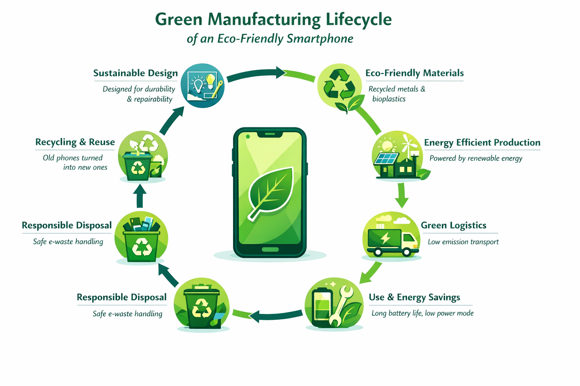

Slide 5
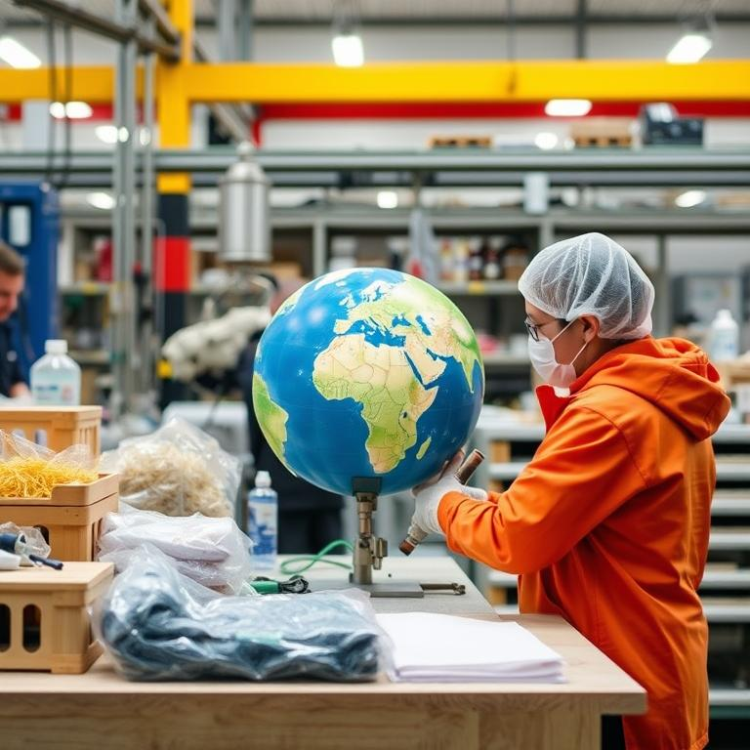
Systemic lifecycle redesign
01
Systemic goods redesign
Redesigns engineering, sourcing, manufacturing, distribution, use, and recovery across the lifecycle.
02
Lifecycle impact minimization
Minimizes emissions, energy, materials, toxics, waste, circularity, and water impacts.
03
Lifecycle management alignment
Anchored in lifecycle thinking, aligned with ISO 14001 and ISO 14067 methodologies.

Slide 6
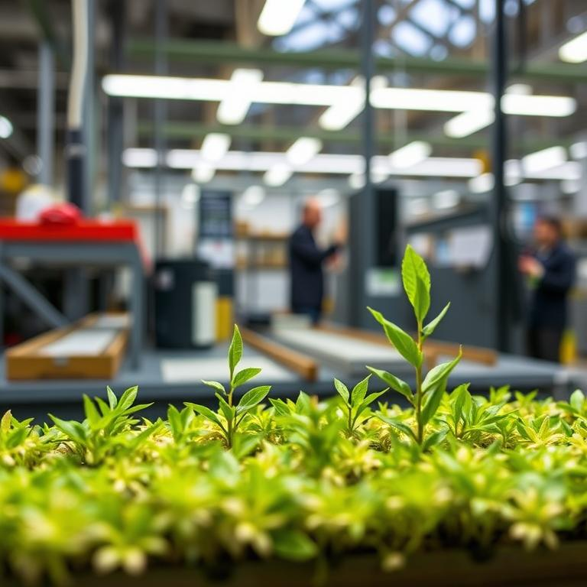
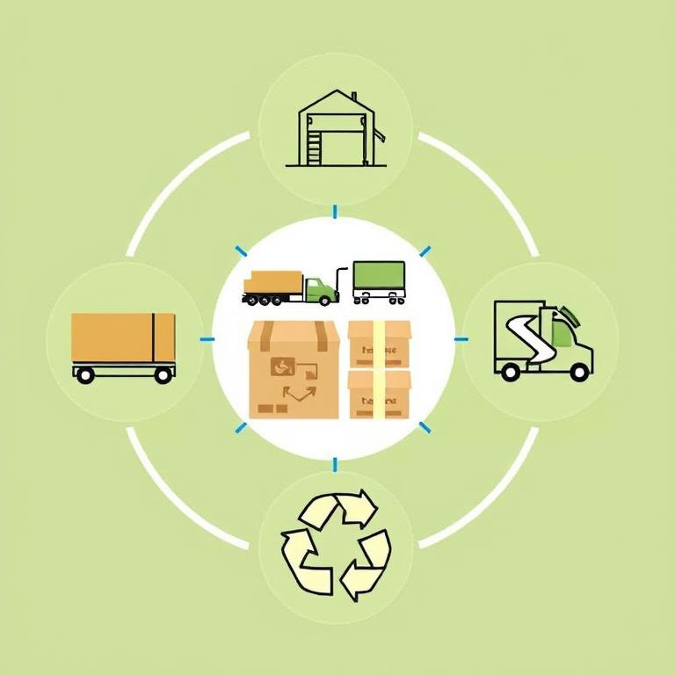

Lifecycle thinking framework
Anchored in lifecycle thinking
Applied across lifecycle stages
Uses lifecycle assessment tools
Green manufacturing minimizes environmental impact across the product lifecycle, anchored in lifecycle thinking.
It covers design, sourcing, production, packaging, distribution logistics, and end-of-life recovery.
It often incorporates Life Cycle Assessment, carbon accounting, and 14001 environmental management systems, ISO 14067 product carbon footprint methodologies.

Slide 7

02
Green Manufacturing Core Pillars

Slide 8



Resource efficiency focus
Output per unit input
1
Optimized energy consumption
2
Digital traceability monitoring
3
Systems maximize output per unit of material, water, and energy input.
Green manufacturing includes optimized energy consumption to minimize environmental impact.
Real-time monitoring tracks energy, emissions, and material flows to improve measurable performance.

Slide 9
Scope emissions decarbonization
01
Scope 1–3 reduction
03
Electrification and renewables
Decarbonization targets Scope 1, Scope 2, and relevant Scope 3 emissions.
Emissions reduction is pursued via electrification and renewable energy integration.
02
Process redesign
Decarbonization includes process redesign as a systematic emissions-reduction approach.

Slide 10


Cleaner production substitution
Hazardous substance substitution
Source pollution reduction
Replaces hazardous substances with safer alternatives to support cleaner production.
Reduces pollutants at the source rather than relying on post-treatment.

Slide 11
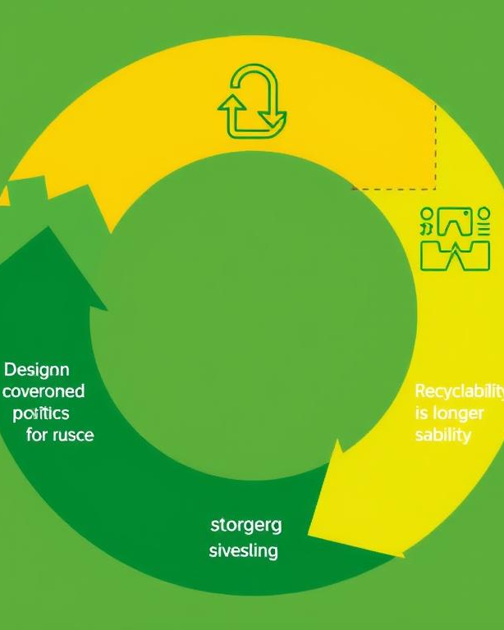

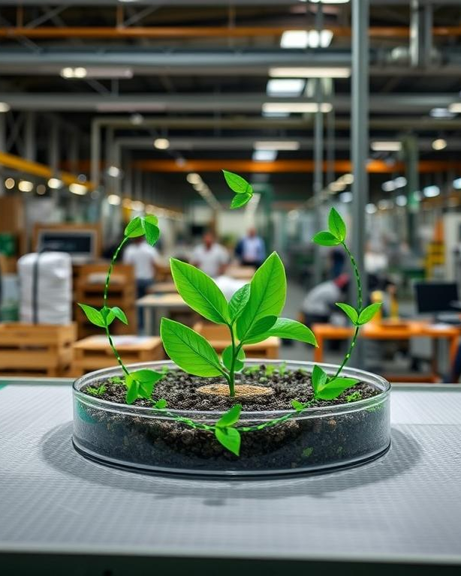

Circularity by design
Design for reuse
Circularity includes designing products for reuse, remanufacturing, recyclability, and longer lifespan.
Circularity integration
Green manufacturing includes waste prevention and circularity integration to minimize lifecycle environmental impact.

Slide 12
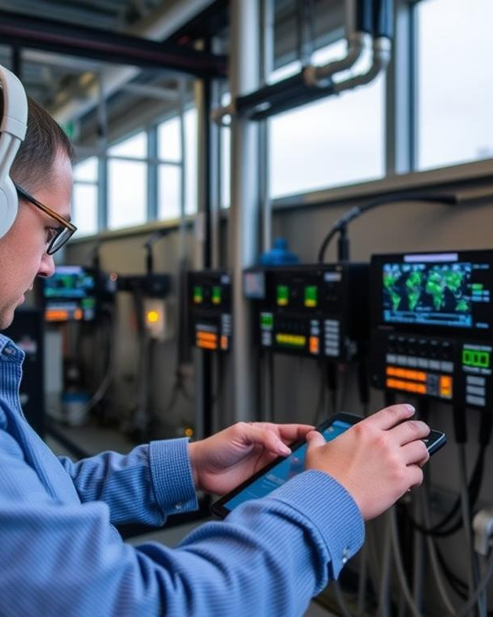
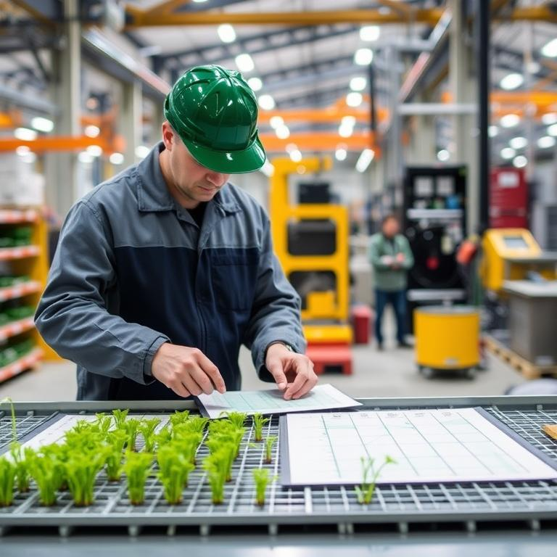
Digital traceability systems
Real-time monitoring deployment
Deploys real-time monitoring systems to track energy, emissions, and material flows.
Measurable performance improvement
Uses tracked data for measurable performance improvement in green manufacturing operations.

Slide 13
03
Operational Scope

Slide 14
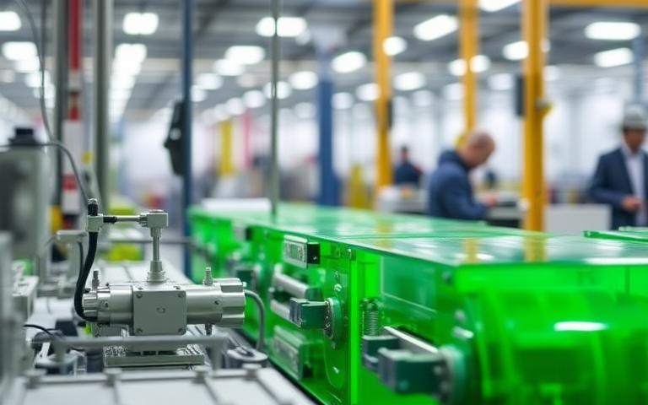
Product design phase
Product Design Application
Green manufacturing applies across the product design phase within its overall operational scope.

Slide 15
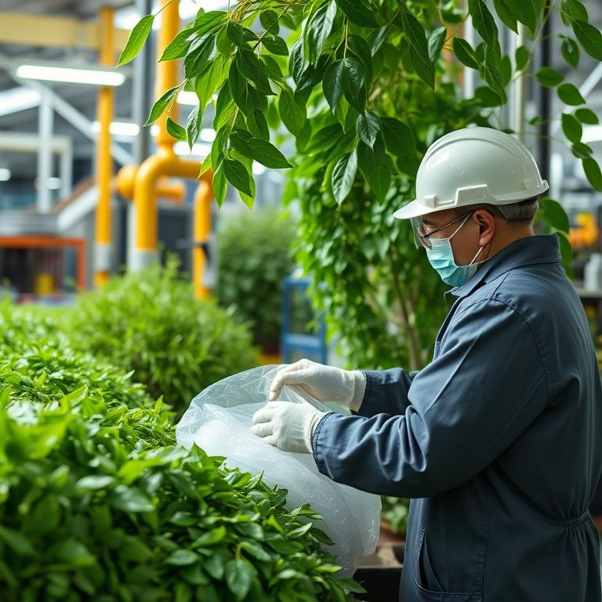
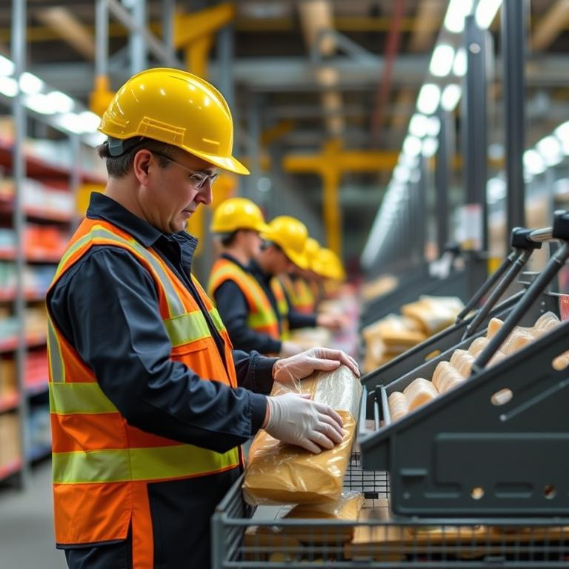
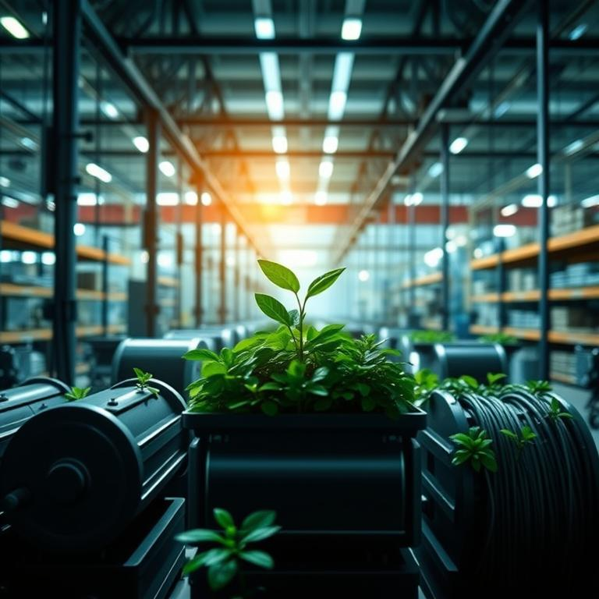
Raw material sourcing
Sourcing in scope
Systemic sourcing redesign
Structural supply governance
Green manufacturing applies across raw material sourcing within its operational scope.
It redesigns how goods are sourced as part of end-to-end manufacturing changes.
True green manufacturing requires structural change in supply chain governance and investment priorities.

Slide 16





Production processes control
Green manufacturing applies to production processes as part of its operational scope.
Production process coverage
Decarbonization includes process redesign to reduce Scope 1, 2, and relevant Scope 3 emissions.
Process redesign decarbonization
True green manufacturing requires structural change in process engineering, not compliance minimums.
Structural process engineering change

Slide 17
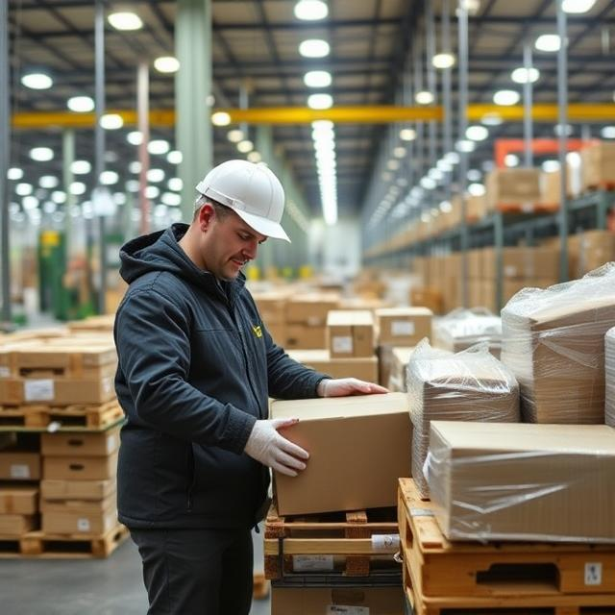
Packaging and distribution
Operational Scope
Applies across packaging and distribution logistics within green manufacturing operational scope.

Slide 18
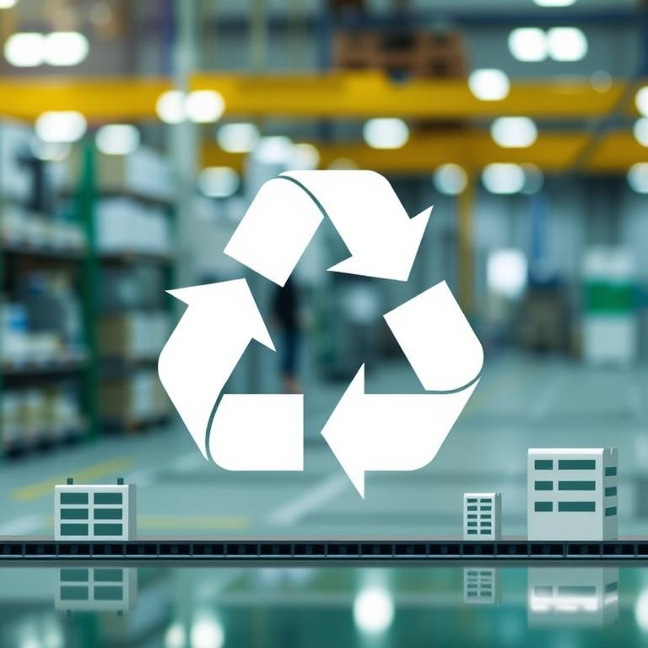


End of life recovery
01
Applied Operational Scope
Green manufacturing applies to end-of-life recovery within its operational scope.
02
Lifecycle and End-of-Life
It includes end-of-life of manufacturing systems to minimize environmental impact across lifecycle.
03
Circularity Integration
It integrates waste prevention and circularity, including design for reuse, remanufacturing, recyclability.

Slide 19
04
What it is not

Slide 20

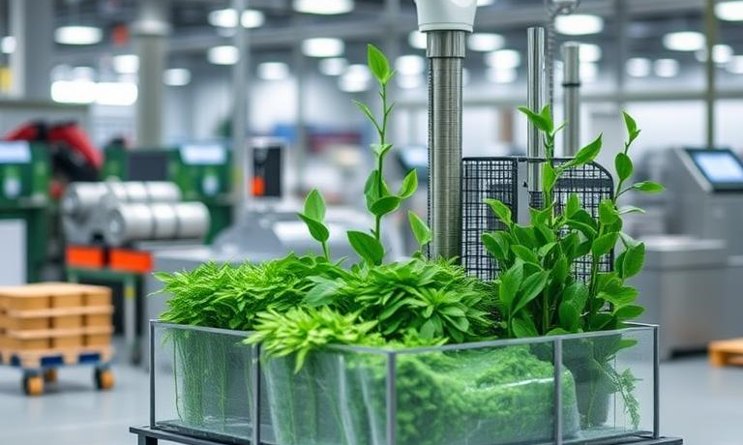
Not recycling alone
1
Beyond Recycling Programs
Green manufacturing is not limited to recycling programs alone; it requires broader systemic redesign.
2
More Than Renewable Procurement
It is not solely renewable energy procurement; true implementation demands structural operational change.
3
Not Marketing or Compliance
It excludes marketing-driven claims and compliance minimums, emphasizing process, supply chain, and investment shifts.

Slide 21

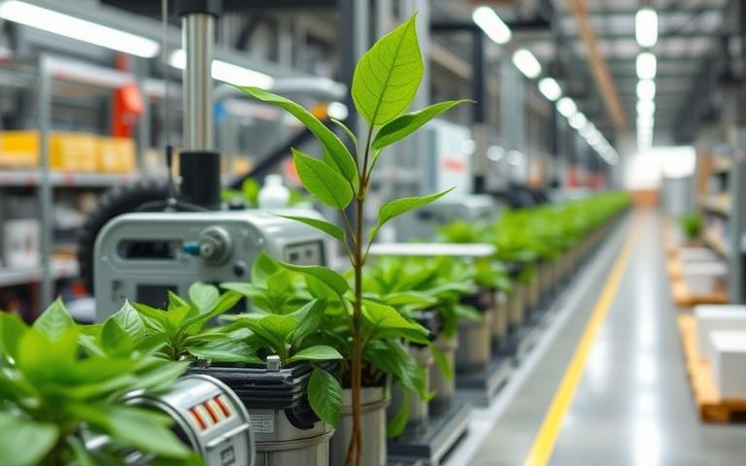
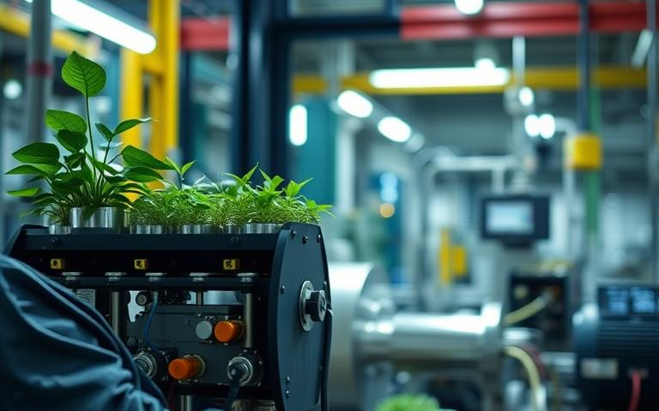

Requires structural change
Not a peripheral initiative
Process engineering change
Governance and investment shifts
Green manufacturing is a systemic redesign, not a standalone sustainability program.
True green manufacturing requires structural change in process engineering.
It requires changes in supply chain governance and capital investment priorities.

Slide 22
05
Strategic Value Proposition

Slide 23
Lower long term costs
01
02
03
Efficiency-driven operating costs
Resource efficiency pillar
Digital traceability monitoring
Green manufacturing lowers long-term operating costs through efficiency improvements.
It maximizes output per unit of material, water, and energy input.
Real-time monitoring tracks energy, emissions, and material flows for measurable performance improvement.

Slide 24

Reduced regulatory exposure
Reduced regulatory exposure
The text lists “Reduced regulatory exposure” as a corporate benefit of green manufacturing.

Slide 25
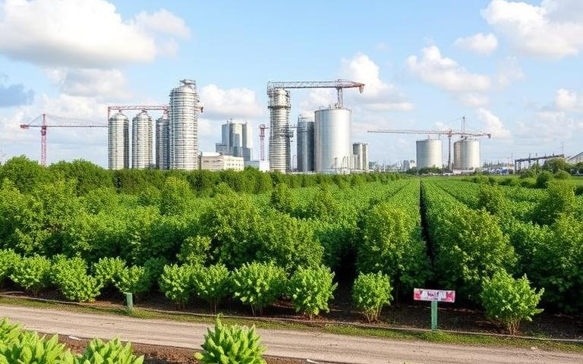
Access to ESG capital
Access to ESG capital
Green manufacturing provides access to ESG-driven capital from a corporate standpoint.

Slide 26
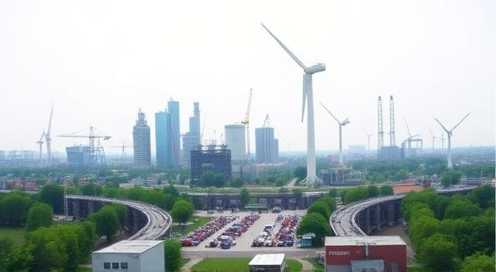
Carbon regulated export readiness
Export readiness benefits
Green manufacturing provides export readiness for carbon-regulated markets from a corporate standpoint.

Slide 27

Enhanced brand credibility
Enhanced brand credibility
Green manufacturing is not marketing-driven environmental claims, but requires structural operational change.

Slide 28
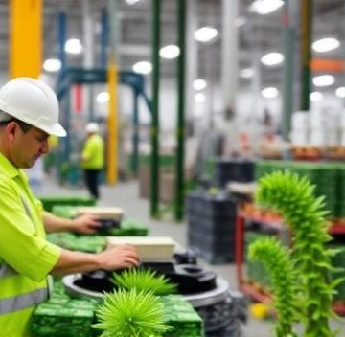
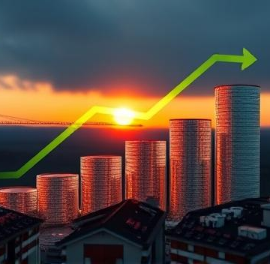
Reduced carbon tax costs
Efficiency lowers operating costs
Green manufacturing reduces long-term operating costs through improved efficiency.
Saves carbon tax costs
The strategic value proposition includes saving cost on carbon tax.

Slide 29
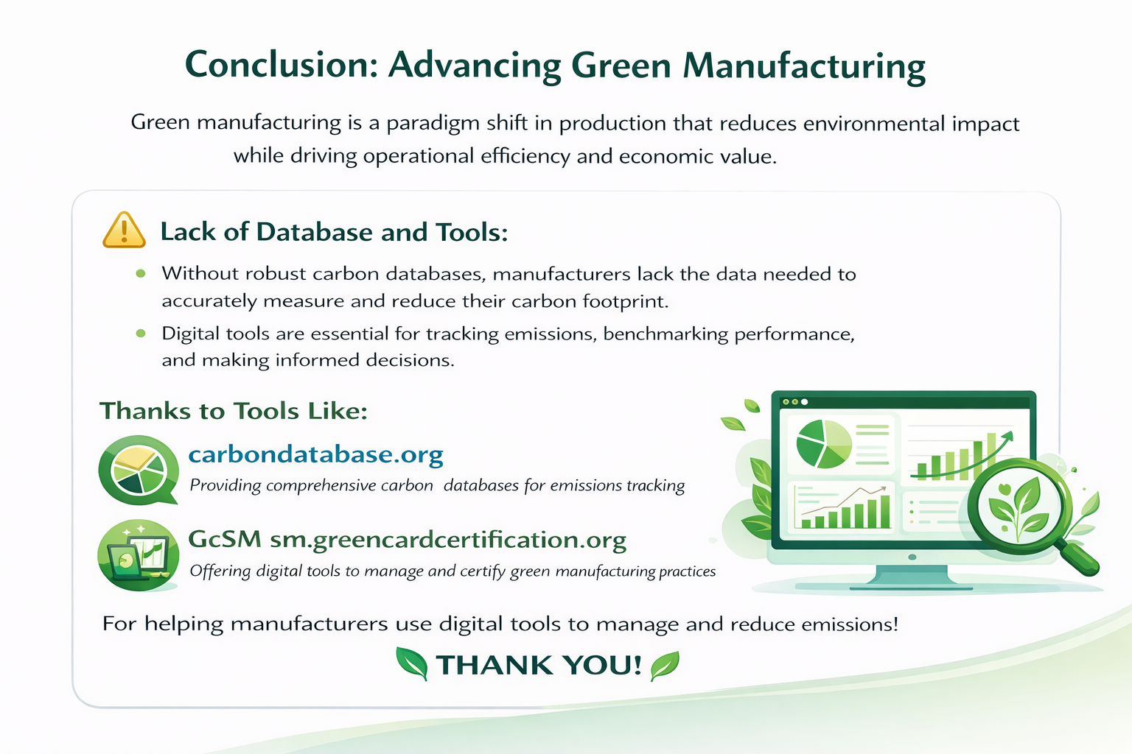

Slide 30
Thank you
Connect at: sanmi@constructgreenconsult.com

