Slide 1

Innovation & Future Technology in Manufacturing
Bridging Global Innovation with African Industrial Growth
PRESENTED BY
OYEDEPO SHAKIRAT
ALL MANUFACTURING SOLUTION AFRICA LIMITED
AND
TECHPLUS SOLUTIONS LIMITED

Slide 2

Setting the Vision
Innovation is no longer optional in manufacturing
The future is already here – the question is readiness
Africa’s manufacturing growth depends on smart technology adoption

Slide 3


– Who We Are
Local technical and commercial partner to global OEMs
Focus sectors: Food, Pharmaceutical & Non-Food, CEMENT, STEEL AND CHEMICAL manufacturing INDUSTRIES
Beyond equipment: integration, training, after-sales & lifecycle support
Bridging global innovation with local realities
All Manufacturing Solution Africa Limited (AMS Africa)
TechPlus Solutions Limited
Customers: Nestle | Cadbury | Perfetti | Twinings | Sumal | Sweetco | Unilever | Dangote Group | BUA | Mangal |Saint Gobain
Email: sales@amsafrica.com.ng; sales@techplussolutions.ng
WEBSITE: WWW.AMSA.COM.NG WWW.TECHPLUSSOLUTIONS.NG
Local Rep: Syntegon | Hansella| Boatopack | Statec Binder | Rommelag | Masystech | Qlar | Beumer Group
Plot 4, Oyetubo Street, Ikeja,
Lagos, Nigeria.
Zipcode: 100282
Phone number: +2347026366346

Slide 4
The Manufacturing Reality Today
Rising production and energy costs
Quality and regulatory pressure
Skills gaps and operational inefficiencies
Demand for flexibility, speed, and sustainability

Slide 5
What Innovation Really Means Today
Smart automation, not just faster machines
Digitalization and Industry 4.0
Modular and scalable systems
Sustainability-driven engineering

Slide 6
FOOD MANUFACTURING – Feeding the Future
Safety, consistency, and efficiency are critical First
Shift from volume-driven to intelligence-driven production
Demand for flexible packaging and fast changeovers

Slide 7
Food Technology Solutions
Smart weighing and packaging systems Predictive maintenance and reduced downtime
Waste reduction and energy-efficient designs
Partners: Syntegon, Hansella, Statec Binder, Boatopack

Slide 8
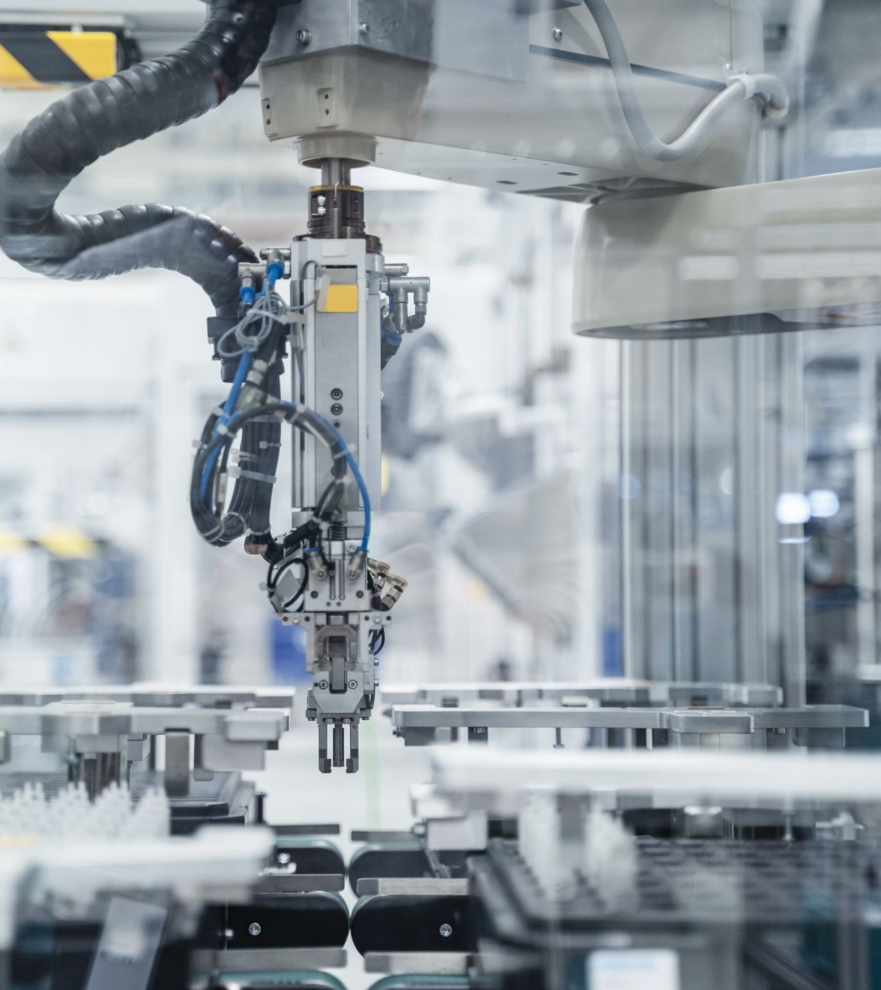
Vision for FooD
Manufacturing
Digitally connected production lines
Sustainable packaging solutions
Improve Product Handling
Reduced product loss and improved shelf life
Food factories built for growth and resilience

Slide 9
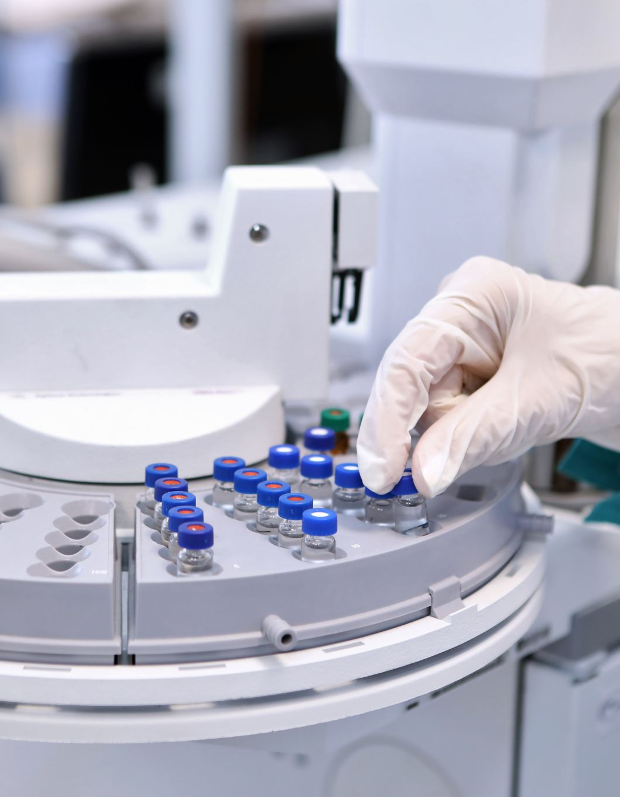
PHARMACEUTICAL MANUFACTURING – Zero Compromise
Human lives depend on manufacturing precision
Quality must be built into the process, Inline quality Check or Control
Compliance and traceability are non-negotiable

Slide 10
Pharma Technology Solutions
High-precision filling and packaging systems
Digital batch records and serialization
AI-supported inspection and monitoring
Partners: Syntegon, Hansella, Rommelag

Slide 11
Vision for Pharmaceutical Manufacturing
Fully traceable and data-driven operations
Reduced human error through automation
Faster regulatory compliance and audits
Trust built through technology

Slide 12

NON-FOOD MANUFACTURING – Smart Industrial Systems
Automation for efficiency and safety
Intelligent material handling and logistics
Energy-efficient and scalable plants

Slide 13
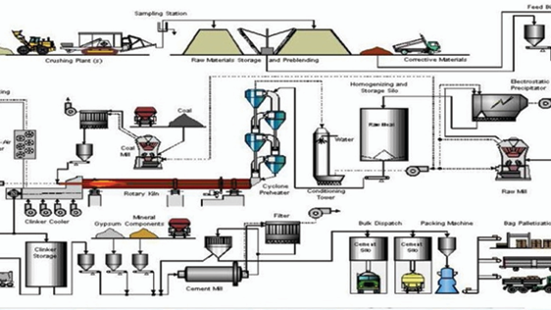
Non-Food Technology Solutions
Intelligent conveying and bulk handling systems
Condition monitoring and predictive analytics
Modular plant design for future expansion
Partners: Beumer Group, Masystech, Qlar

Slide 14
Vision for Non-Food Manufacturing
Data-driven decision making
Lower lifecycle cost and higher uptime
Safer working environments
Competitive, future-ready factories

Slide 15

Why Local Representation Matters
Technology must fit local operating conditions
Faster response and after-sales support
Skills development and knowledge transfer
Long-term partnership, not one-off supply

Slide 16
The African Manufacturing Opportunity
Africa is a growth market, with opportunities for technology advancement
Innovation must be adapted, not copied
Smart investments today define tomorrow’s leaders

Slide 17
Call to Action
Invest in smart, scalable technologies
Partner with experienced local integrators/ OEM Representatives
Build resilient and sustainable factories

Slide 18

Closing
The future of manufacturing is intelligent
Africa can compete globally with the right technology
AMS Africa and Techplus Solutions: delivering innovation that works
Thank You !!!

