Slide 1



Net Zero Industrial Park Solutions
CQSamas@gmail.com
JUN WANG，General Manager of SAMAS China
CQSamas@gmail.com

Slide 2
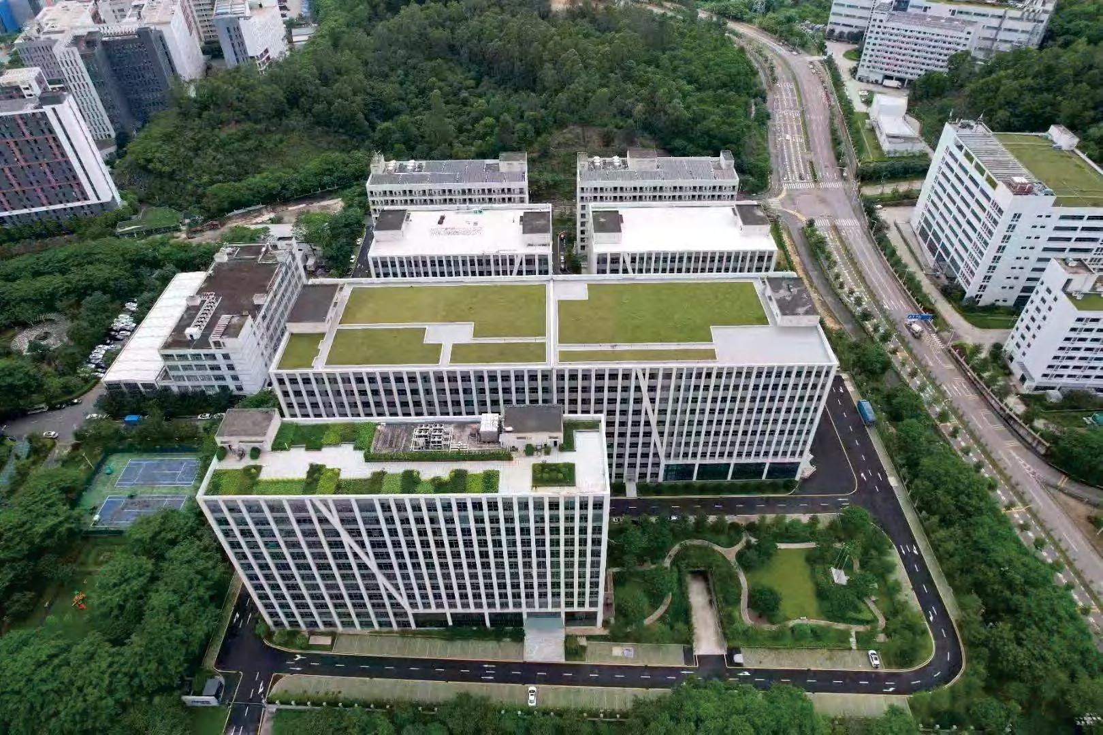
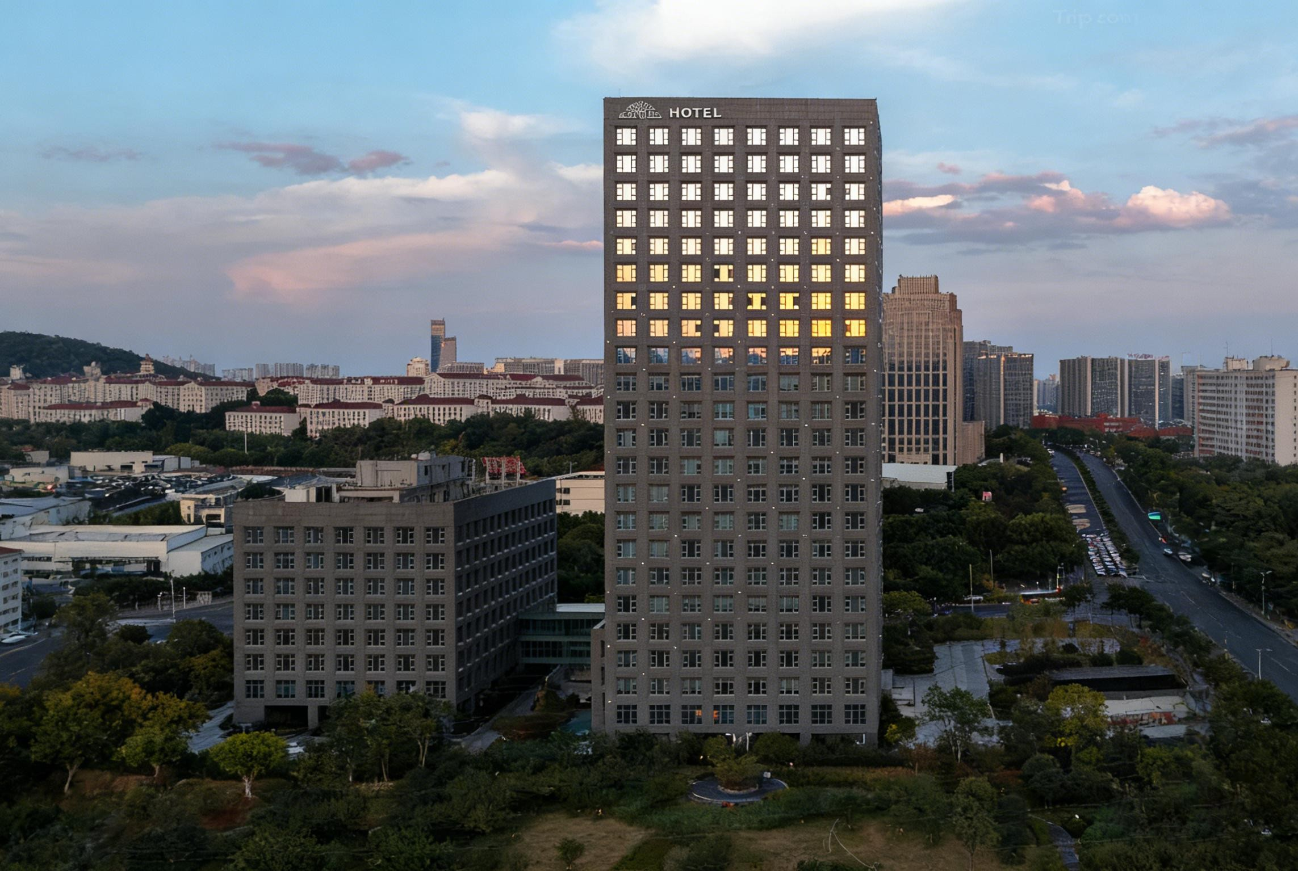
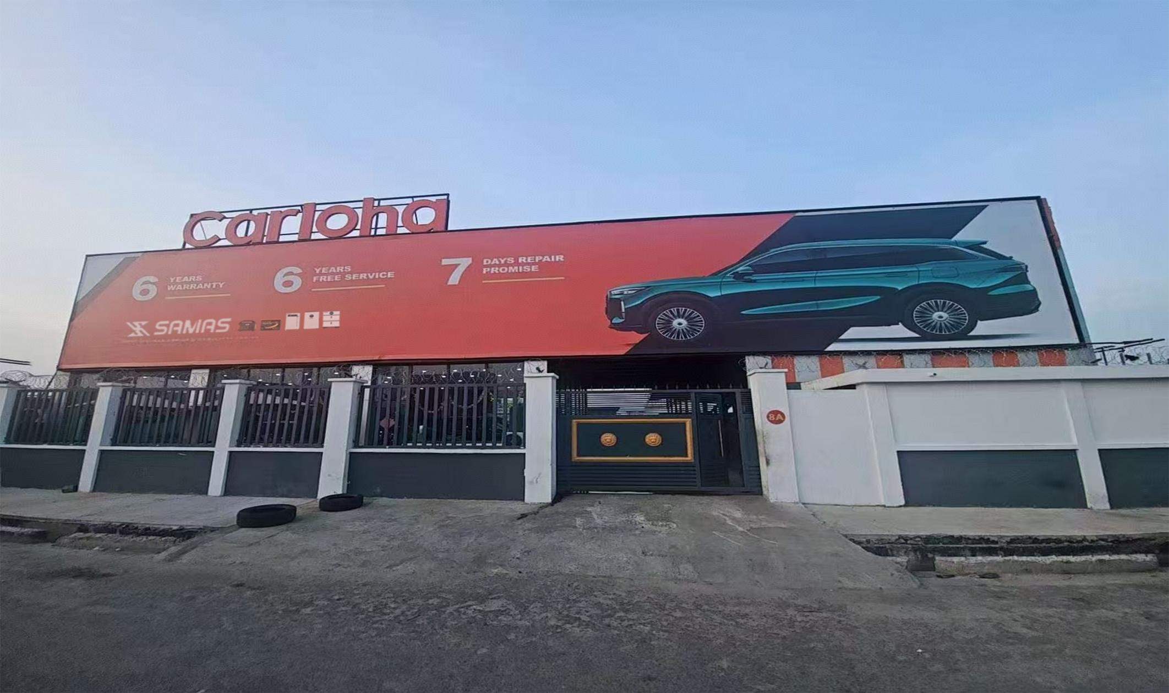
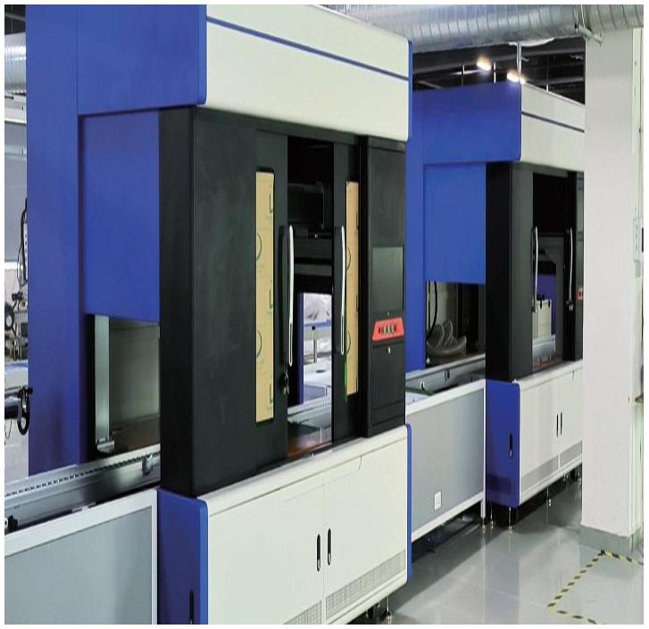
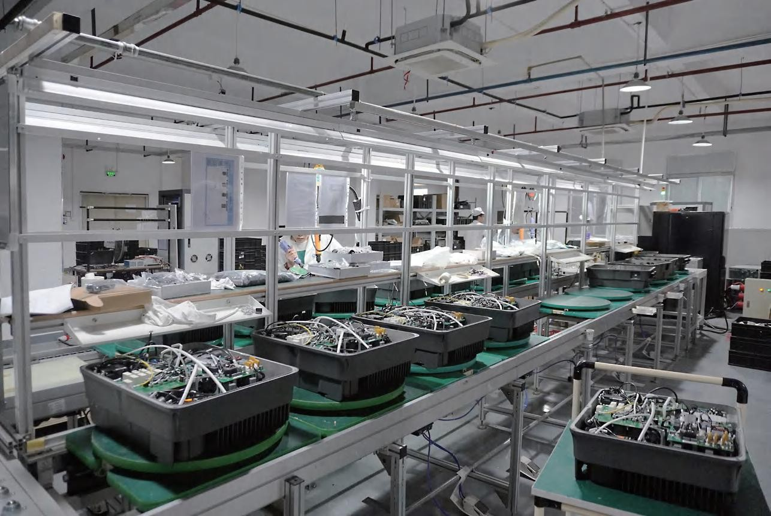
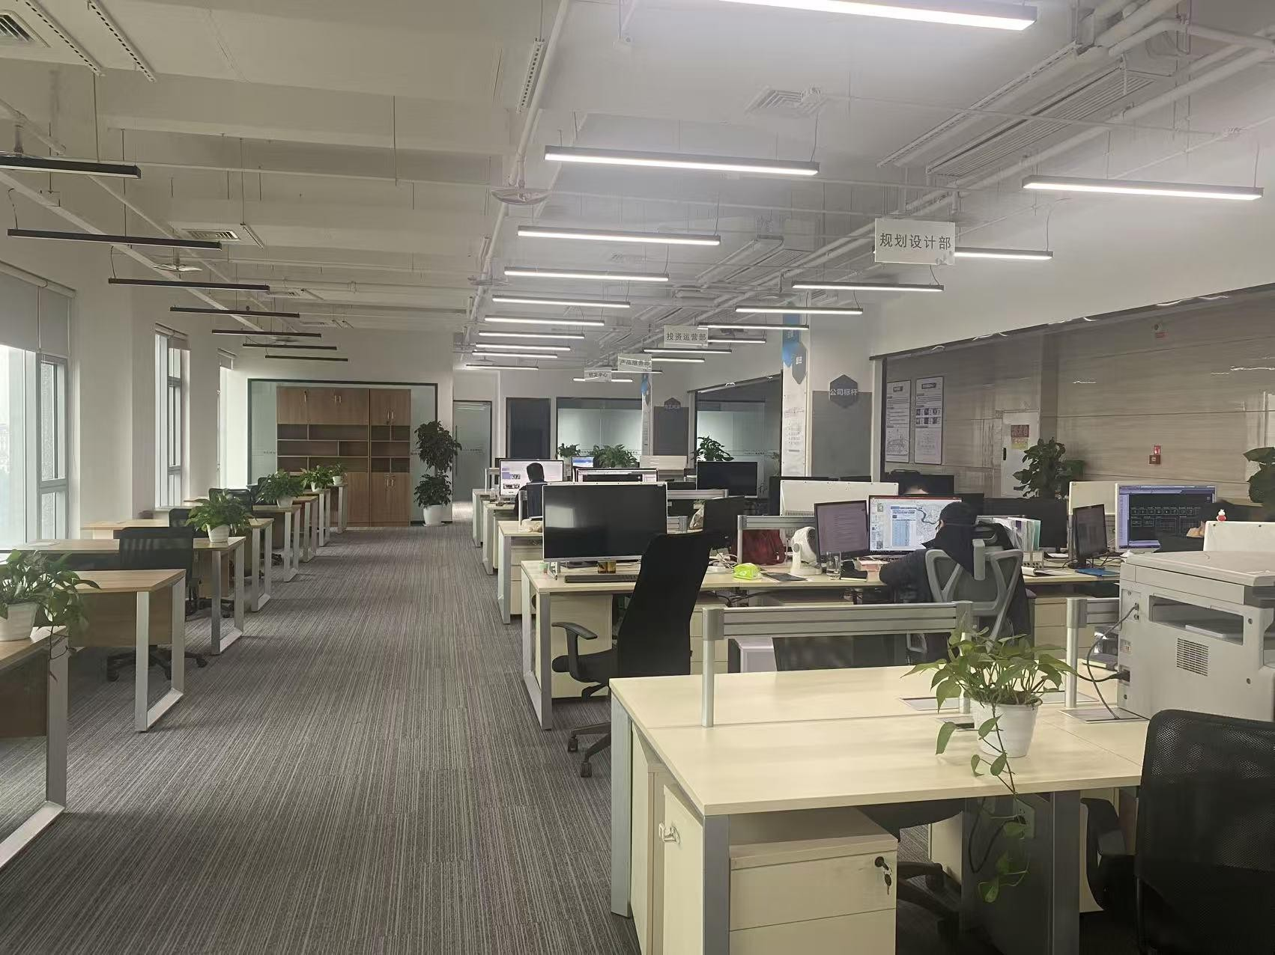
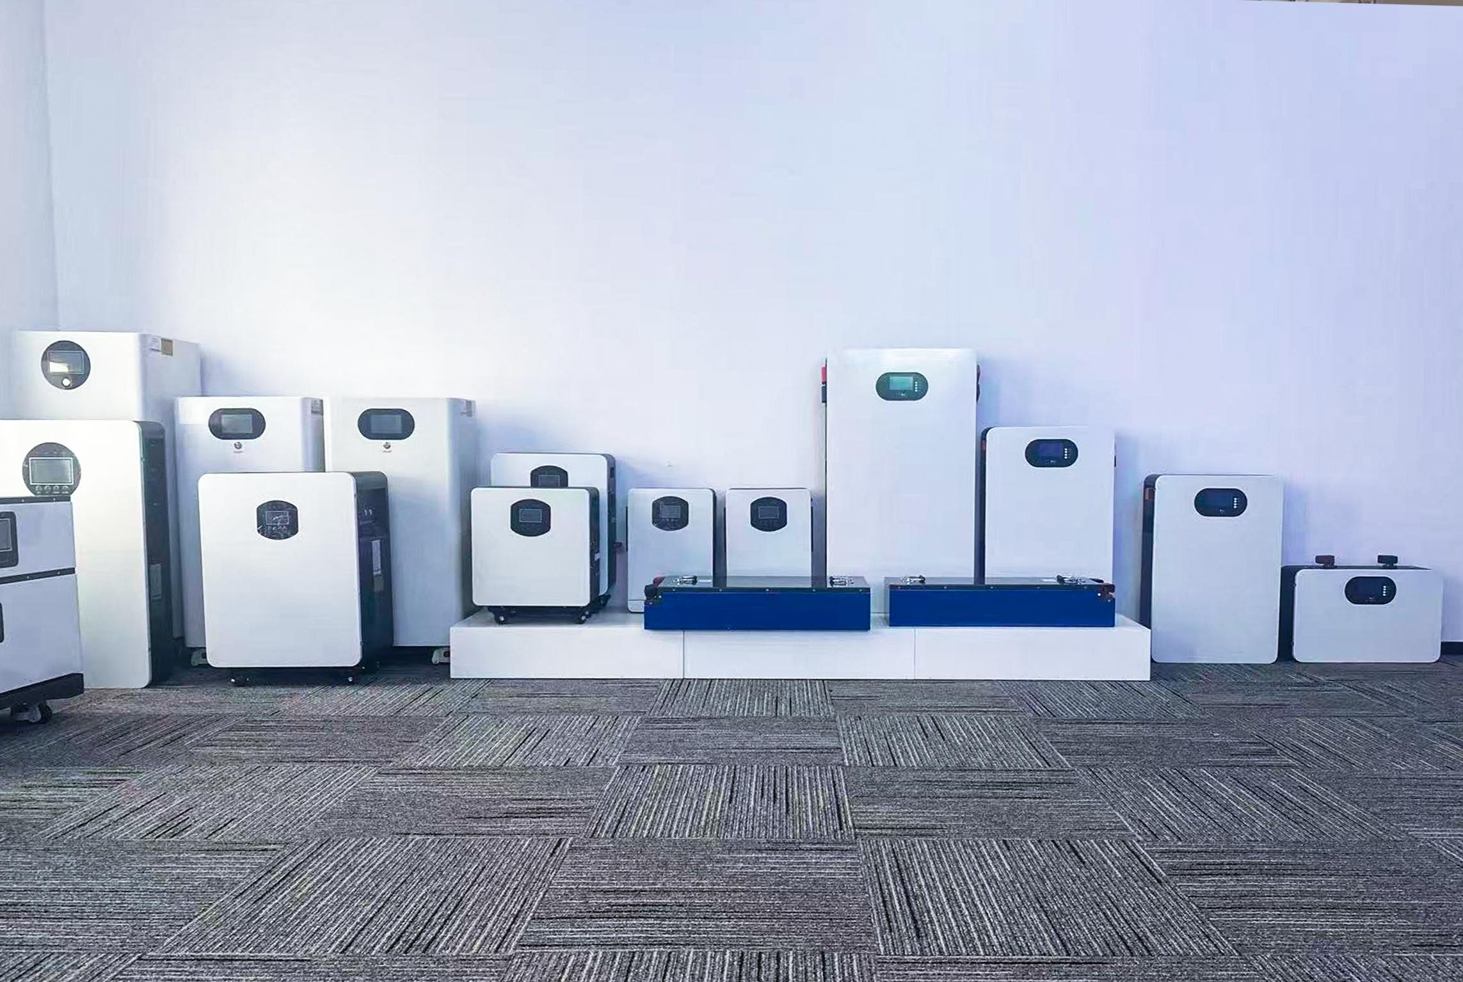
ABOUT SAMAS
CQSamas@gmail.com
SAMAS Technology is a high-tech enterprise specializing in innovative energy storage systems and Net Zero solutions. Our portfolio includes mobile, residential, commercial, and industrial storage applications. We provide integrated carbon management and renewable energy design services. Visit us to explore reliable, sustainable power solutions tailored for the Nigerian market.
Let's work together to build a greener, Net Zero future.
Shenzhen Factory
Chongqing company
Nigeria Service Center
Production Floor
Manufacturing
R&D Office
Sample Display

Slide 3












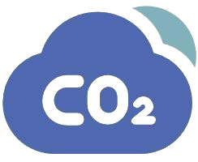
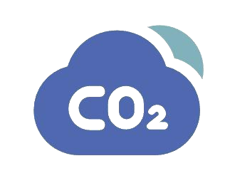








Business
CQSamas@gmail.com
portable Power Station
Renewable Energy Design
Home Energy Storage
Energy Storage Systems
Net Zero Solution
Net Zero Design
C&I Energy Storage
Carbon Management
Vehicle Power Batteries

Slide 4
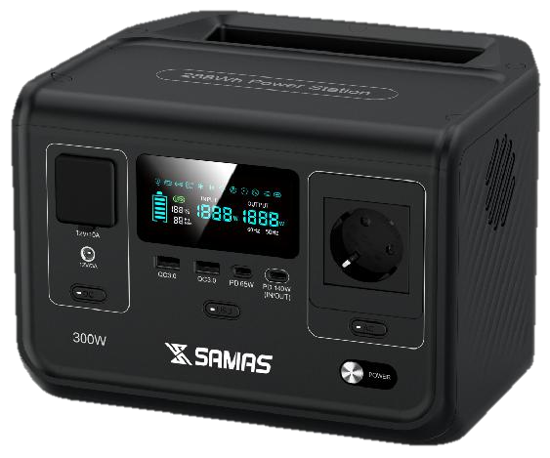



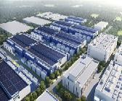









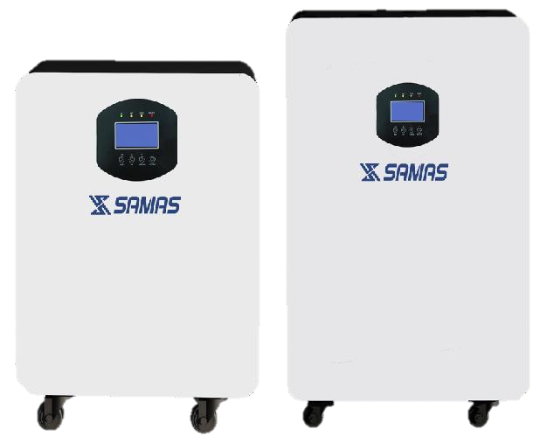

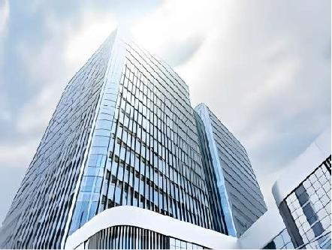





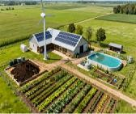






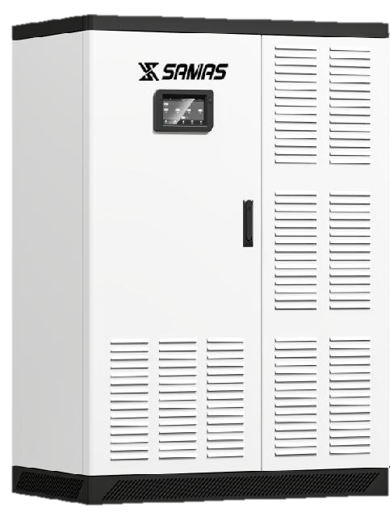
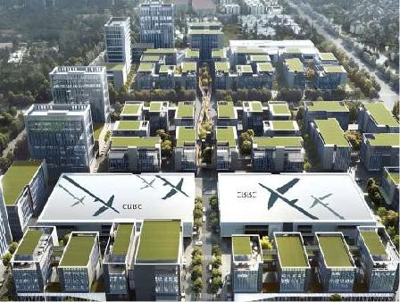
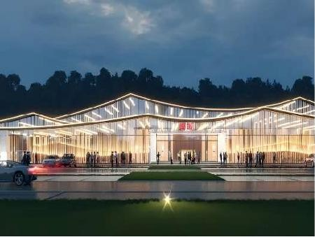
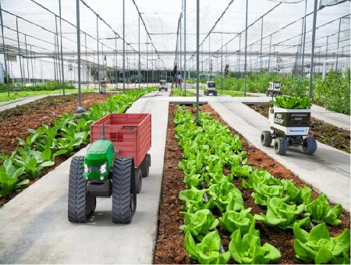
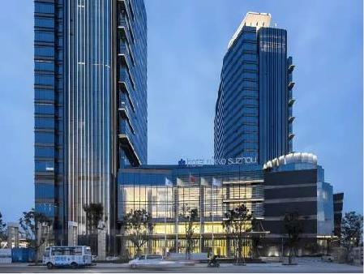














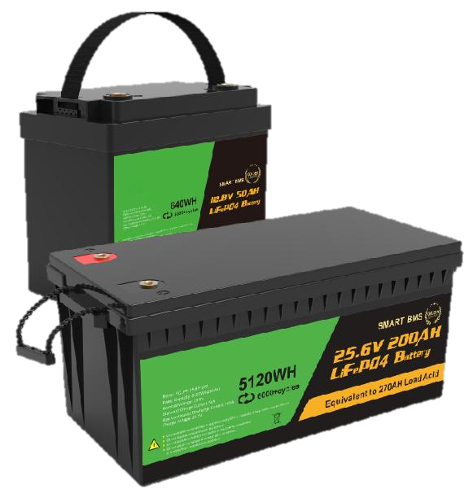
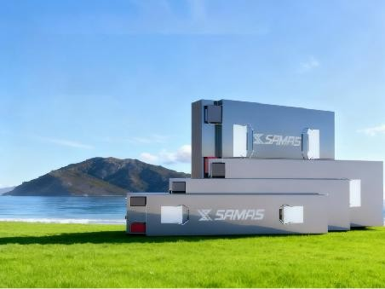
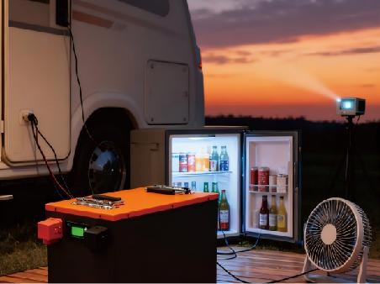
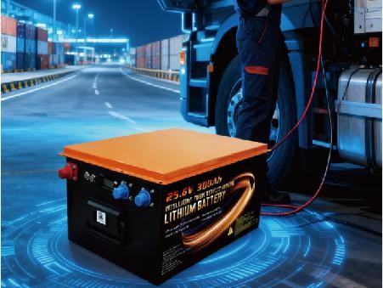













Product
CQSamas@gmail.com
Mobile Energy Storage
Renewable energy design
Outdoor Camping
Outdoor live streaming
Outdoor Construction
Solar Design
Wind power design
Energy Storage System Design
Fast chargings 1.5 hours
Multiple Poks
Pure sine wave
Emergency lights
Multiple protections
Solar panel charging
Integrated Solutions
Investment Return Calculation
Power Generation Efficiency Simulation
Home Energy Storage
Drawing Optimization Design
Energy Transition
Green Technology Innovation
Rooftop photovoltaic
Net-zero design
Family users
Enterprise unit users
Shop users
Hotel users
Up to 6000+ cycles
Indoor and outdoor installation options
Extend the battery service life
Modular structure
Equipped with advanced BMS
Intelligent battery management system
Commercial & Industrial Energy Storage
Net Zero Industrial Park
Net Zero Factory
Net Zero Farm
Energy Transition,
Value Chain Decarbonization
Energy Transition, Corporate Decarbonization
Carbon Emission Accounting, Emission Reduction Planning
Drawing Optimization Design
Precision Carbon Management, Revenue Estimation
Emission Reduction Activities, Revenue Estimation
Industrial park
Expressway service area
Farm use
Commercial comprehensive
Net Zero Farm
Safe and reliable
Suitable for all scenarios
Carbon management
Core components independently developed
Efficient integration
Commercial & Industrial Energy Storage
Carbon accounting
Decarbonisation scheme
Carbon management software
Product Carbon Footprint
Corporate Carbon Footprint
Personalized Decarbonization Pathways
Blade battery
RV parking lithium battery
Truck integrated lithium battery
Lithium battery for low-power two-
wheel and three-wheel vehicles
AI-Generated Sustainability Reports
Multiple protections
Equipped with advanced BMS
Long battery life
Visualization Screen
Customized SaaS Platform
Easy to install
High level of integration and high conversion rate
Meet the high power
Enterprise Carbon Accounting

Slide 5
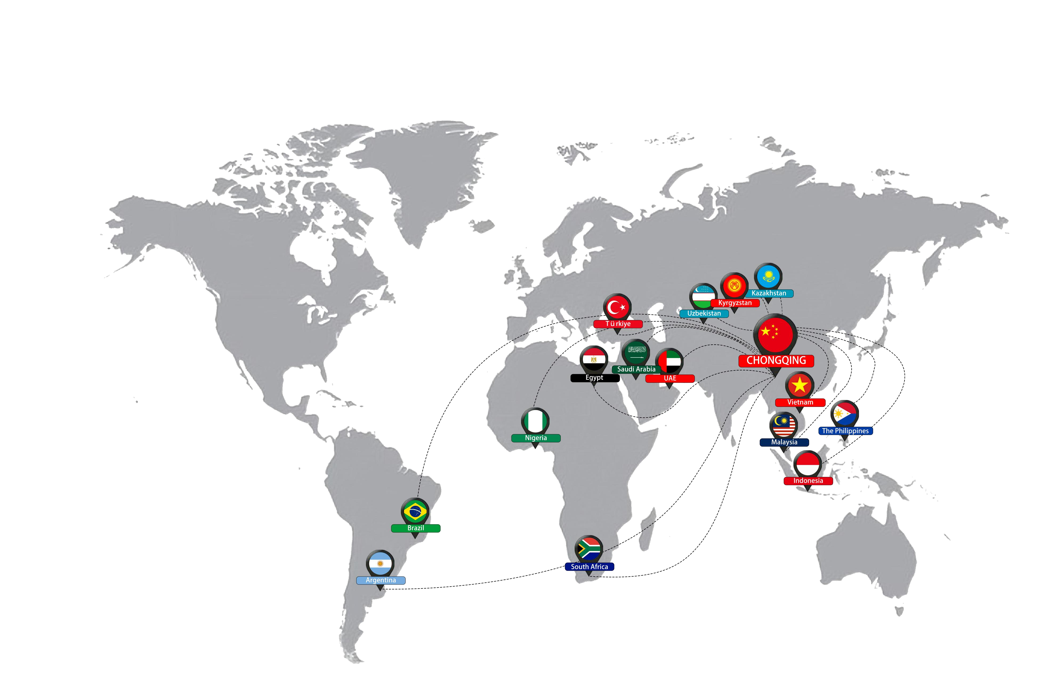
Service Center
CQSamas@gmail.com
Nigeria
Nigeria Service Center: Carloha Nigeria oriental showroom.
China Company
Building A, Tuobang Tower, Liangjiang New District, Chongqing
China Factory
No. 7 Huanping Road, Longgang District, Shenzhen
United Arab Emirates
925 Sultan Bin Zayed The First Street (Al Muroor Road), Al Nahyan, Abu Dhabi
Saudi Arabia
2857-2827 Abi Ad Duha, Badr, Riyadh 14727, Saudi Arabia.
Kazakhstan
Zhetysu-3 shagin audani, 050063Almaty, The Republic of Kazakhstan
Kyrgyzstan
6А, 720073 Yakov Logvinenko St, Bishkek, Kyrgyzstan.
Malaysia
W.P. Kuala LumpurKH Tower, No. 8, Lorong P. Ramlee, Federal Territory of Kuala Lumpur, Malaysia
Brazil
R. Gen. Pantaleão Teles, 38 - Parque Jabaquara São Paulo - SP, 04626-911, Brazil
Argentina
Almte. F.J. Seguj 2485, C1416 Cdad. Autónoma de Buenos Aires, Argentina.
Egypt
Qetaa an Nahdah, Amreya 1, Alexandria Governorate 5258742, Egypt.
South Africa
13 Jellicoe Ave, Epping, Cape Town, 7475, South Africa.
Türkiye
Merkez mah, Nihan Sk., 34413 Kağıthane/İstanbul, Türkiye.
Uzbekistan
Sayram St, 100170, Tashkent, Uzbekistan.
Indonesia
TamansariJl. Kesederhanaan No.38B, RT.9/RW.3, Keagungan,
Kec. Taman Sari, Kota Jakarta Barat, Daerah Khusus Ibukota Jakarta 11180.
Vietnam
Huynh Tan Phat, Quarter 5, Nha Be District, Ho Chi Minh City 73202, Vietnam.
The Philippines
1101 new Antipolo St, Tondo, Manila, Metro Manila, The Philippines.
5

Slide 6
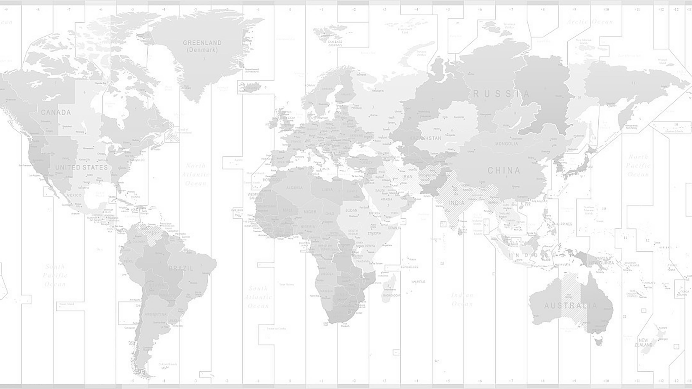
Policy & Background
Challenges & Opportunities
Strategies & Paths
Green Finances
Net Zero Service
CQSamas@gmail.com
CONTENTS
01 Policy & Background
02 Challenges & Opportunities 03 Strategies & Paths
04 Green Finances 05 Net Zero Service

Slide 7
Policy & Background
Challenges & Opportunities
Strategies & Paths
Green Finances
Net Zero Service
CQSamas@gmail.com
01
Policy & Background

Slide 8
Why is "Green" So Urgent ?
CQSamas@gmail.com
EU Green Barriers are Reshaping Global Trade Rules: CBAM, CSRD, and CSDDD collectively forge a "Price-Disclosure-Governance" trinity within the green trade framework.
EU Carbon Border Adjustment Mechanism
（CBAM）
To address "carbon leakage" and ensure that imported products bear a carbon cost equivalent to that of EU products
Published in May 2023, CBAM is the world's first trade policy instrument centered around carbon pricing (often referred to as a "carbon tariff"). It is set for full enforcement starting January 1, 2026. Upon implementation, EU importers will be legally obligated to purchase and surrender CBAM certificates to account for the carbon emissions embedded in specific imported goods.
Transitional Phase (2023–2025): Importers are required to submit quarterly reports detailing the direct emissions and specific indirect emissions of imported products, with no financial obligation to purchase certificates. The initial scope focuses on six sectors at high risk of carbon leakage: iron and steel, cement, aluminum, fertilizers, electricity, and hydrogen.
Definitive Implementation Phase (2026–2027): Importers must purchase CBAM certificates at prices pegged to the average weekly EU ETS (Emissions Trading System) auction prices to cover the embedded carbon emissions of their products. By 2030, the scope will gradually expand to include other sectors regulated by the EU ETS, such as chemicals, plastics, and textiles.
Deepening & Adjustment Phase (2035–2040): As free allocations are entirely phased out, CBAM certificates will become the sole mechanism for carbon cost adjustment, with certificate prices fluctuating in real-time alignment with EU ETS carbon prices. Downstream products (e.g., fabricated metal and chemical products) will be integrated into the regulatory framework. Furthermore, suppliers will be required to provide certification for recycled material content, driving the adoption of low-carbon technologies across global supply chains.
Corporate Sustainability Reporting Directive
（CSRD）
To address "Information Disclosure" by providing comprehensive, reliable, and comparable sustainability information
Entered into force in January 2023 , the CSRD mandates that both EU companies and non-EU entities meeting specific revenue thresholds must disclose information regarding their Environment, Social, and Governance (ESG) performance, as well as their entire value chain. Reporting must align with the ESRS (European Sustainability Reporting Standards) and follow a phased implementation approach, covering strategic alignment, progress toward targets, and risks and opportunities (R&O).
Mandatory Assurance: By requiring independent third-party assurance, the CSRD ensures data quality and enhances the credibility of reports, setting a definitive new global benchmark for ESG disclosure.
Corporate Sustainability Due Diligence Directive
（CSDDD）
To address "Process Governance" by requiring enterprises to identify, prevent, and mitigate human rights and environmental risks across their global value chains.
Formally entered into force in July 2024, the CSDDD mandates large-scale enterprises to establish a robust risk management system for human rights and environmental protection across their entire value chains. This framework requires companies to identify and assess risks, formulate preventive measures, implement climate transition plans, establish grievance mechanisms , and publish regular progress reports.
Climate Due Diligence: Developing and executing mitigation transition plans that are strictly aligned with the 1.5°C target of the Paris Agreement.

Slide 9
Why is "Green" So Urgent ?
CQSamas@gmail.com
CCA 与 FPFA (U.S. Legislative Proposals), UK CBAM (United Kingdom Carbon Border Adjustment Mechanism)
CCA
（U.S. Legislative Proposals）
The most influential U.S. proposal for a Carbon Border Adjustment Mechanism (CBAM), aiming to foster a level playing f ield for domestic and international enterprises through a "Carbon Intensity Fee."
The Clean Competition Act ( CCA) was formally introduced in June 2022, and the Foreign Pollution Fee Act (FPFA) underwent significant revision in April 2025. Using the average carbon emissions of comparable U.S. products as a benchmark, these acts propose a carbon tax on both imported goods and high- carbon domestic products. Both currently remain in the proposal stage and have yet to be formally enacted into law.
UK CBAM
As the world's second carbon tariff regime to be implemented, the UK CBAM is designed to prevent "carbon leakage"—a scenario where businesses relocate production to j u r i s d i c t i o n s w i t h l e s s s t r i n g e n t environmental standards to evade carbon costs. It ensures that imported high-carbon products bear a carbon price equivalent to that of domestic UK products, thereby fostering a level playing field for home- grown manufacturing while driving progress toward the UK’s legally binding 2050 Net Zero target
Set for implementation on January 1, 2027, the UK CBAM targets five primary sectors: iron and steel, aluminum, cement, fertilizers , and hydrogen (currently excluding electricity). Compared to the EU CBAM, the UK version places a stronger emphasis on its independent tax attribute, covers a broader range of indirect emissions, and will be enforced directly without a transitional phase.
Tax Exemption Threshold: Businesses with a total value of imported CBAM goods below £50,000 over a 1 2 - m o n t h p e r i o d a r e e x e m p t f r o m reporting and payment obligations. The tax is administered and collected by HM Revenue & Customs (HMRC).
Carbon Intensity Accounting: The calculation scope is highly comprehensive, encompassing Scope 1 (direct emissions), Scope 2 (indirect emissions from electricity, heat, steam, and cooling), and Scope 3 (upstream supply chain emissions)
" Relative Carbon Content" Mechanism : By leveraging a "relative carbon content" approach, these bills effectively bypass the absence of a federal carbon market in the U.S., constructing a U.S.-centric green trade barrier.
Dual Focus on Penalization and Protection: The framework prioritizes penalizing high-carbon producers while safeguarding domestic industries. The proposed scope is extensive, covering steel, aluminum, cement, glass, fertilizers, hydrogen, solar products, and battery components
Full- Spectrum Carbon Accounting: Carbon i n t e n s i t y c a l c u l a t i o n s a r e r i g o r o u s a n d comprehensive, encompassing Scope 1 (direct emissions), Scope 2 (indirect electricity emissions), and Scope 3 (upstream supply chain emissions).
FPFA
（U.S. Legislative Proposals）
A manifestation of U.S. trade protectionism and industrial strategy, designed to reduce reliance on overseas supply chains.

Slide 10
Policy & Background
Challenges & Opportunities
Strategies & Paths
Green Finances
Net Zero Service
CQSamas@gmail.com
02
Challenges & Opportunities

Slide 11






The Strategic Significance of Net Zero Industrial Parks
CQSamas@gmail.com
The Net Zero Industrial Park goes far beyond mere clean energy substitution; it represents a fundamental paradigm shift—a comprehensive restructuring and systematic upgrading of industrial, ecological, and institutional frameworks, all anchored by ambitious low-carbon imperatives.
Expediting the transition to carbon- free energy systems
Accelerating Energy Transition: We aim to alleviate the bottlenecks of energy transmission corridors and increase the share of renewable energy consumption, thereby accelerating a green and low- carbon energy transition.
Economic Growth
Steering industries toward deep-seated carbon abatement
Driving Industrial Transformation: We guide traditional industries to pioneer deep decarbonization pathways while empowering emerging sectors to reduce their carbon footprints and sharpen their global competitiveness.
Socio- Ecological
economic Benefits
Sustaina bility
Fostering high-value and sustainable growth
Pioneering Park Transformation: Net Zero Industrial Parks are of paramount significance in driving the low-carbon and carbon-neutral transformation of various industrial zones, fostering a new era of high- quality green development.
Social Progress
Social Environme nt
Environm ental Protection
Promoting integrated and balanced regional expansion
Leveraging Resource Advantages: This strategy consolidates the international competitive advantages of key industries and leverages abundant wind and solar resources to strategically accommodate industrial transfers.
Navigating and adapting to global green trade frameworks
Securing Global Market Leadership: These parks enable enterprises to effectively navigate international green trade rules, further amplifying their low-carbon advantages and securing a first-mover position in the global competition for green and low-carbon products.

Slide 12
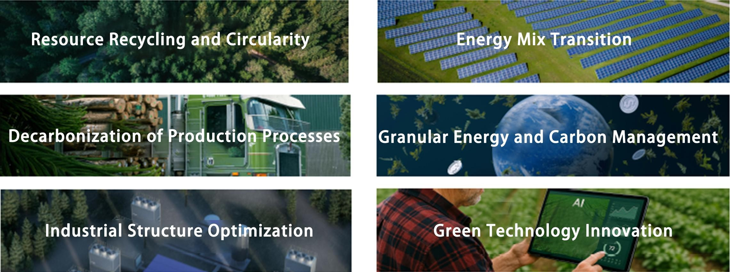
Core Elements of Net Zero Industrial Park Construction
CQSamas@gmail.com
The Six Core Elements: Energy Synergy as the Foundation, Industrial Upgrading as the Pathway, and Innovation as the Enduring Momentum.

Slide 13



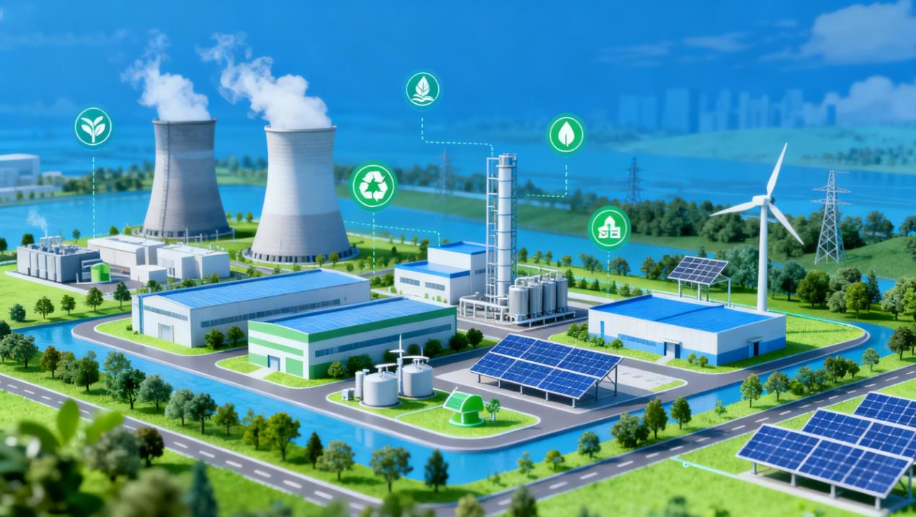
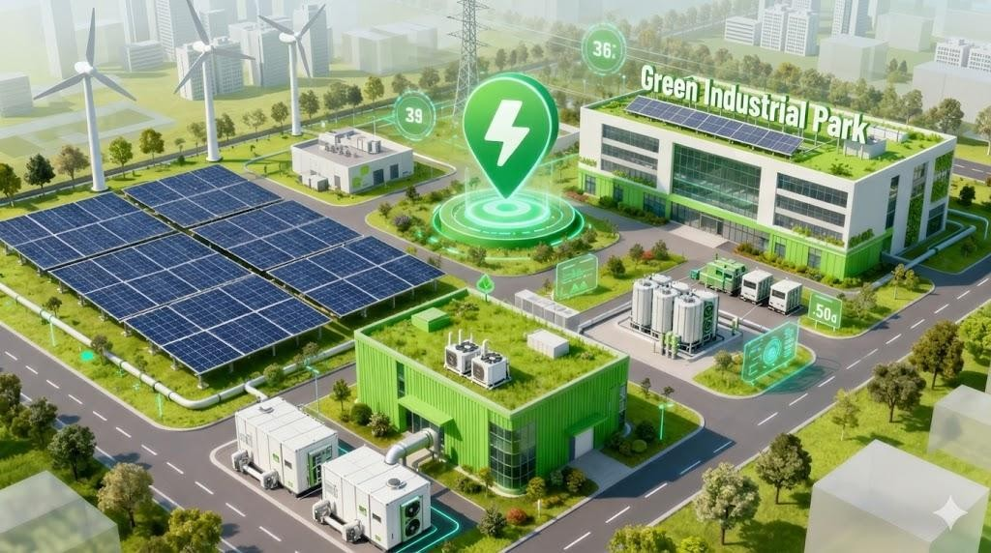
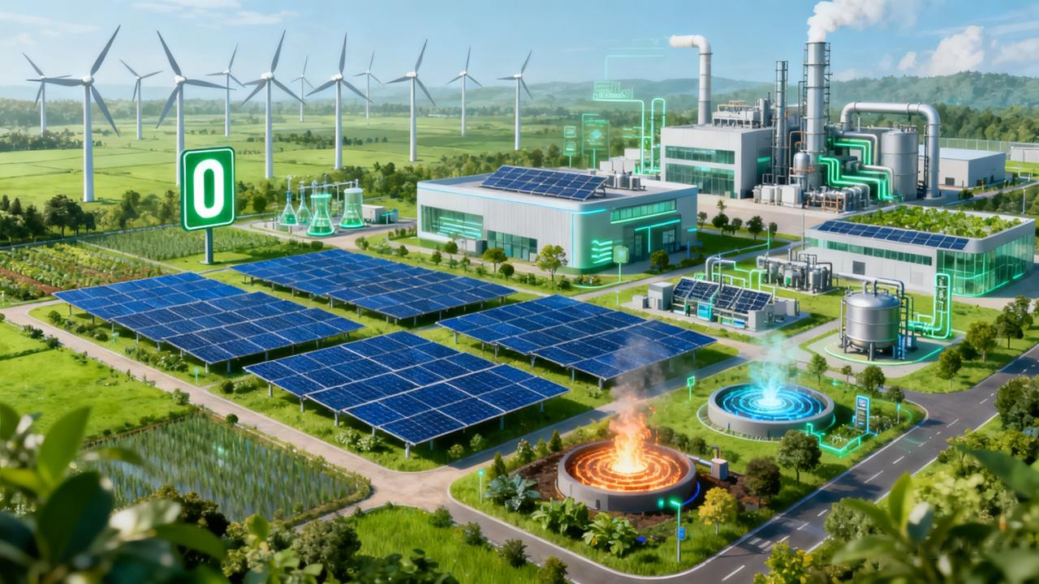
Development Pathway for Net Zero Industrial Parks
CQSamas@gmail.com
The "Triple Jump" from Low-Carbon to Net-Zero: Building a Net Zero Industrial Park is an evolutionary process of progressive deepening that necessitates unified strategic planning and phased implementation.
Low-carbon Industrial Park
Green Industrial Park
Net Zero Industrial Park
Adhering to the principles of low energy consumption, low pollution, and low emissions, the approach emphasizes relative decoupling, high- efficiency utilization of energy and resources, and the enhancement of carbon productivity, while ensuring compliance with national phased carbon reduction requirements.
Building upon the foundation of low-carbon parks, this transitional stage aims to approach a Net Zero emission threshold. It is characterized by the systemic integration of technologies—such as renewable energy substitution and carbon capture—and management innovations, which further drive down both the total volume and the intensity of carbon emissions.
The objective is to achieve a dynamic equilibrium between carbon emissions and carbon sinks. In this model, economic growth is propelled by emerging low- carbon industries, while energy consumption is sustained by Net Zero carbon sources, effectively accumulating operational experience for the ultimate realization of a Net Zero Industrial Park.
Achieving " Net Zero Emissions" by maintaining a dynamic equilibrium between carbon emissions and carbon offsets.
Core Indicator: Carbon Intensity per Unit of Energy Efficiency$
≤0.2$ t/tce (for parks with an annual comprehensive energy consumption of 0.2 to 1 million tce)
≤ 0.3$ t/tce (for parks with an annual comprehensive energy consumption ≥1$ million tce)
Direct and indirect carbon emissions (Scope 1 and 2) within the park are to be reduced to "Net Zero" levels, underpinned by the capability to reach " Net Zero Emissions" through robust carbon offsetting mechanisms
The low-carbon indicator system typically evaluates r e g i o n a l l o w - c a r b o n d e v e l o p m e n t p r o g r e s s b y calculating the ratios of total carbon emissions to local GDP, population, or land area. These metrics represent a distinctly relative concept, focusing on intensity rather than absolute volume.

Slide 14
Core Challenges in Net Zero Industrial Park Construction
CQSamas@gmail.com
Insufficient Capital Supply: High Initial CAPEX and Extended Payback Periods
The transition from planning to implementation requires massive infrastructure investment, including PV power stations, energy storage systems (BESS), and low-carbon thermal networks. A single park often demands multi-billion RMB investments, placing immense pressure on the developer’s financial capacity. Most projects rely on long-term energy savings and carbon asset appreciation, with payback periods typically exceeding 5 years, leading to a significant short-term liquidity mismatch.。
Insufficient Capital Supply and Financing Gaps
Restricted Technology Deployment: Compatibility Gaps and Conflicting Demands
There is an inherent friction between legacy infrastructure and emerging low-carbon technologies. Users face a complex trade- off between efficiency enhancement, cost reduction, and green transition. Current park planning often fails to bridge these multi-dimensional requirements, leading to fragmented technical implementations and poor system integration.
Restricted Deployment and Scalability of Low-carbon Technologies
Inefficient Institutional Frameworks and Governance Mechanisms
Practical Challenges and Bottlenecks
Inefficient Mechanisms: Fragmented Responsibilities and Low Coordinatio
Net Zero Industrial Parks involve diverse stakeholders, including governments, operators, tenants, and residents. Overlapping yet fragmented responsibilities, coupled with a lack of unified coordination, often lead to administrative deadlocks. Furthermore, data silos and inconsistent standards prevent accurate carbon footprint accounting and real-time dispatching, resulting in delayed management decisions.
Flaws in Commercial Models: Subsidy Dependence and Scalability Obstacles
While innovation should drive the sector, current growth relies heavily on government subsidies and policy-backed loans. The core value of low-carbon industries lacks mature monetization channels, making it difficult to attract private equity or social capital. Without a self-sustaining business model, large-scale replication remains a significant challenge.
Deficiencies in Commercial Viability and Business Models
Shortcomings in Digital and Intelligent Management Infrastructure
Shortcomings in Intelligent Management: Weak Dispatching and Incompatibility
Achieving net-zero requires the unified management and optimization of "Source-Grid-Load-Storage" (SGLS) systems. However, current digital infrastructure lacks the robust intelligent dispatching capabilities and cross-platform compatibility needed to support such large-scale, complex energy orchestration.

Slide 15
Policy & Background
Challenges & Opportunities
Strategies & Paths
Green Finances
Net Zero Service
CQSamas@gmail.com
03
Strategies & Paths
15

Slide 16

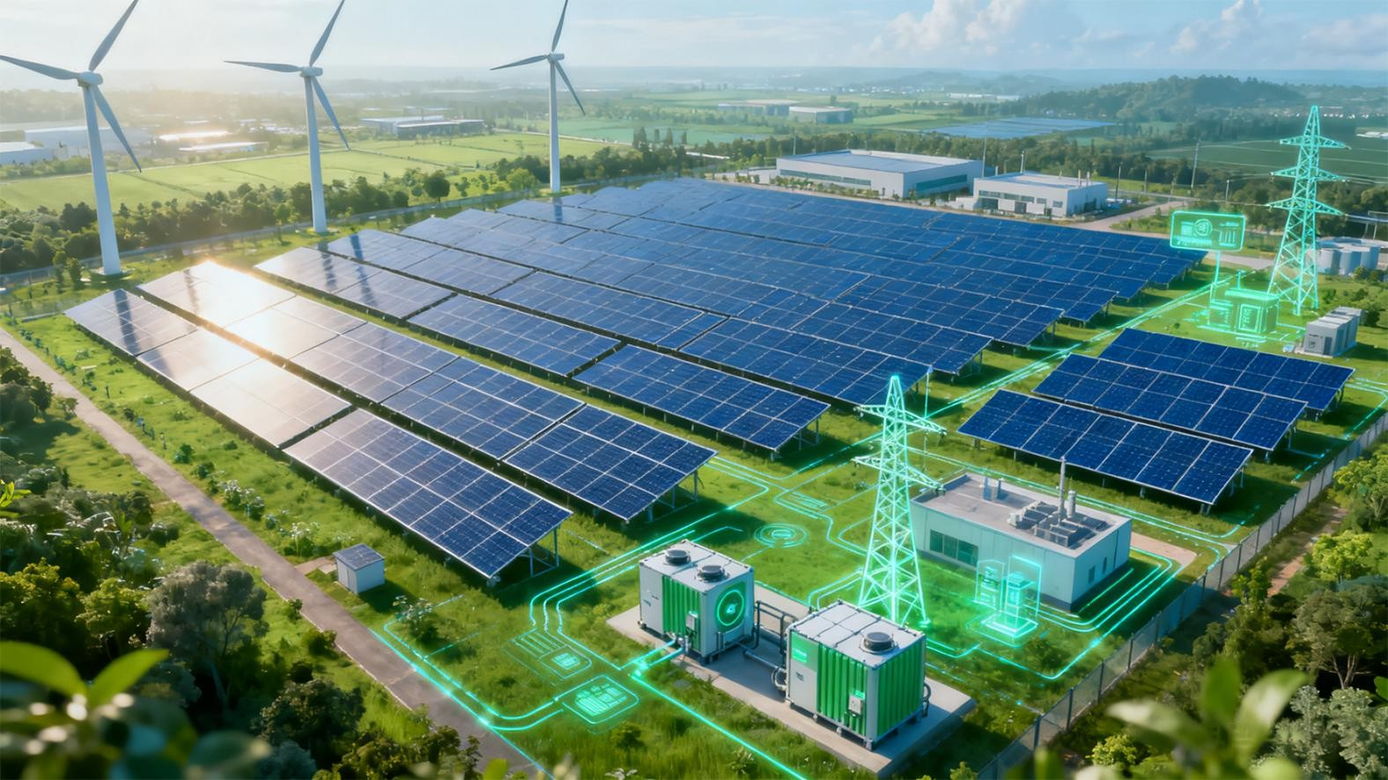
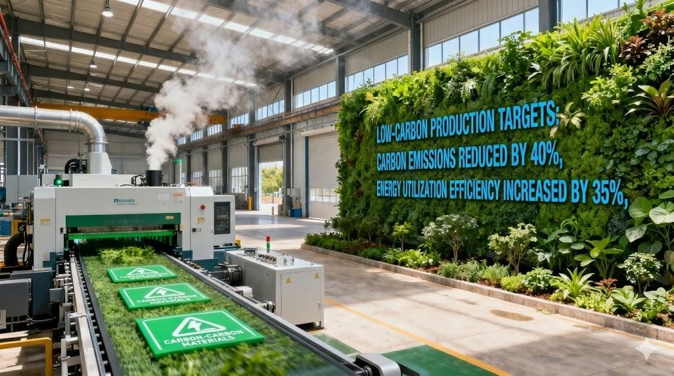
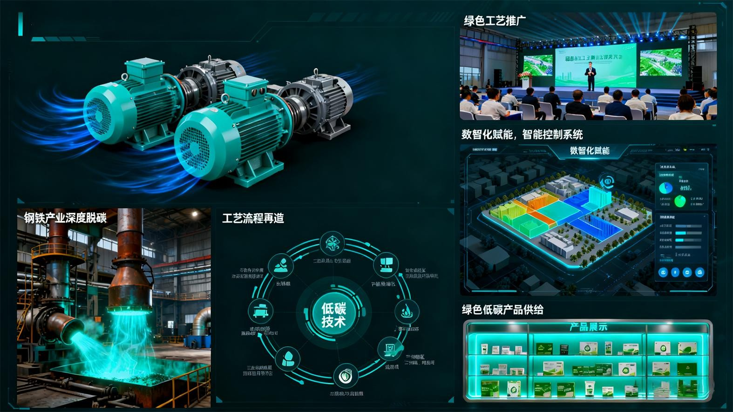
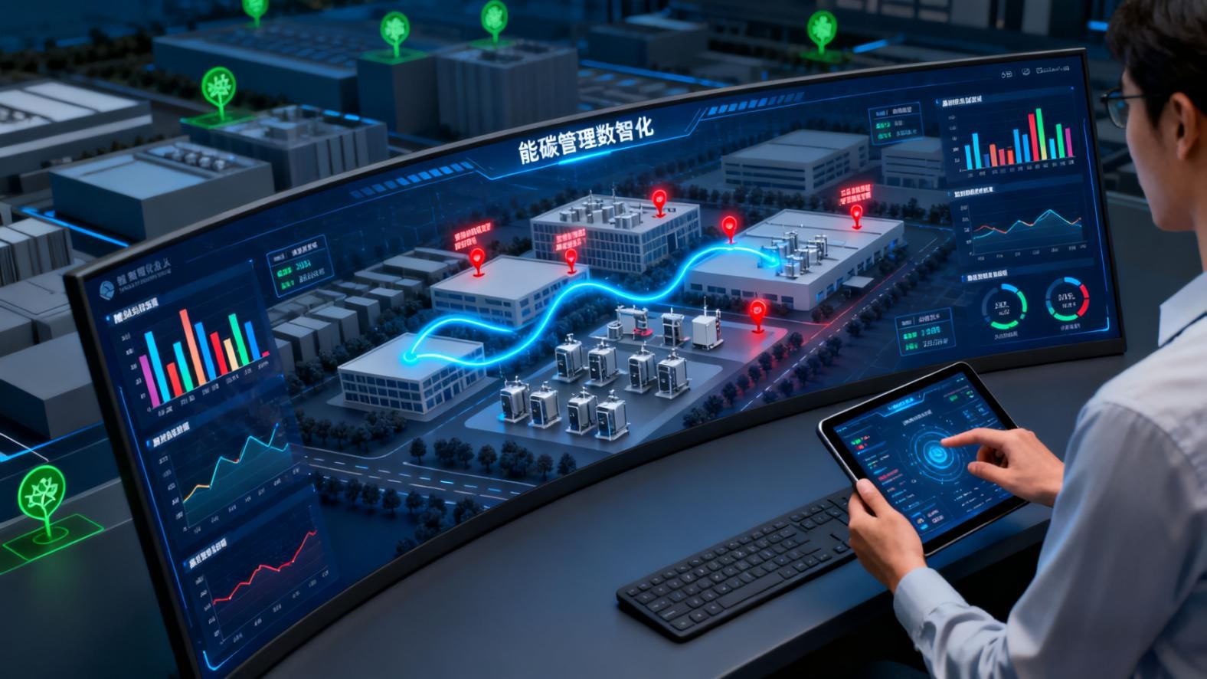
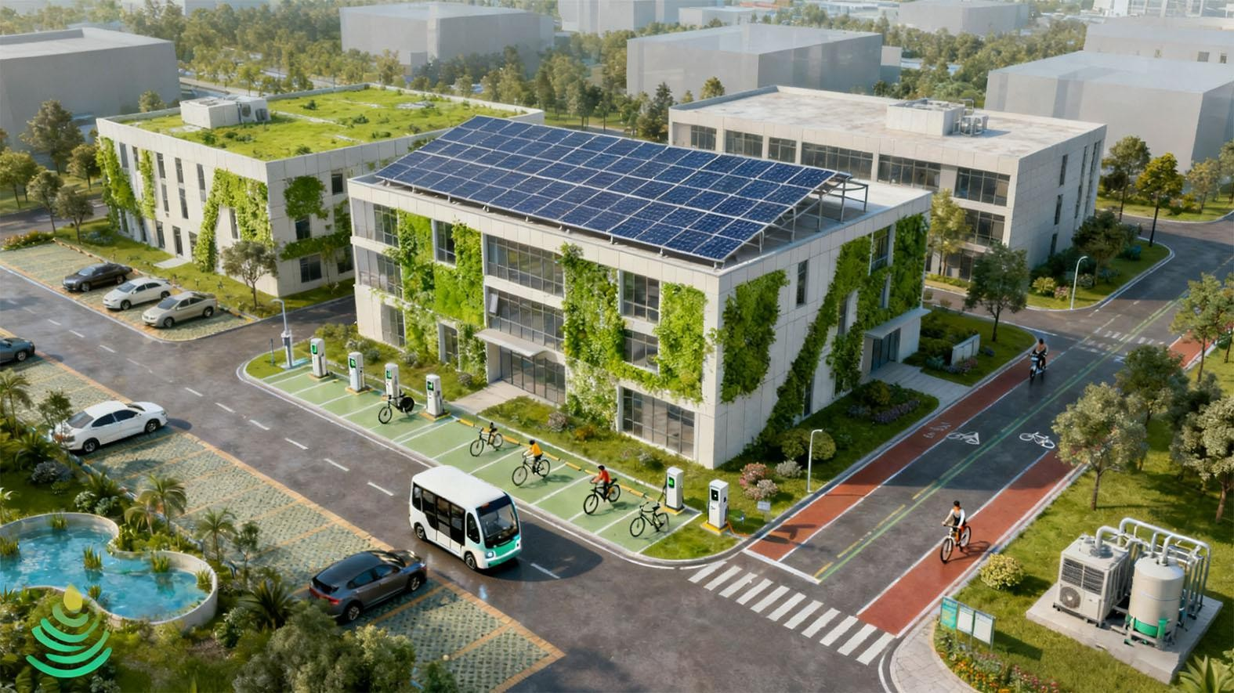
Full Life-cycle Construction Strategy:
Developing the "Playbook" for Net Zero Industrial Parks
CQSamas@gmail.com
Strategic Planning & Preparation
Master Planning & Design
Investment & Construction
Operations & Iteration
Setting the Strategic Compass, Goal Anchoring and Target Setting
Blueprinting the Future, Site Selection and Spatial Optimization
Building the Low-carbon Framework, Green Supply Chain Management (GSCM)
Refining Operational Excellence, Intelligent Operation & Maintenance (O&M)
Energy synergy serves as the foundational pillar, industrial upgrading constitutes the core strategic pathway, and innovation-led development provides the sustained impetus for long-term growth
Greening of the Energy Consumption Mix
Low-Carbon Transformation of Industrial Clusters
Demonstration-led Application Scenarios
Digital & Intelligent Energy and Carbon Management
Greening of Infrastructure and Facilities

Slide 17
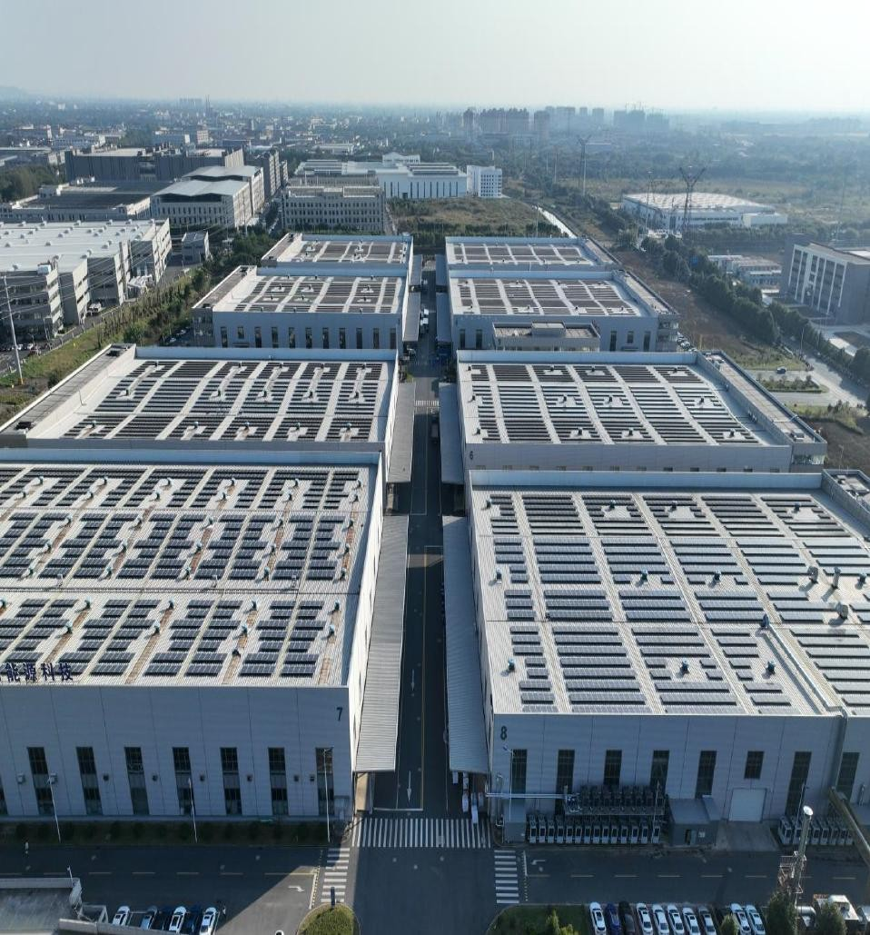
Greening of the Energy Consumption Mix
CQSamas@gmail.com
Increase the share of renewable energy
Optimize the configuration of Energy Storage Systems (ESS)
Direct green power connection and multi- energy synergy
17

Slide 18
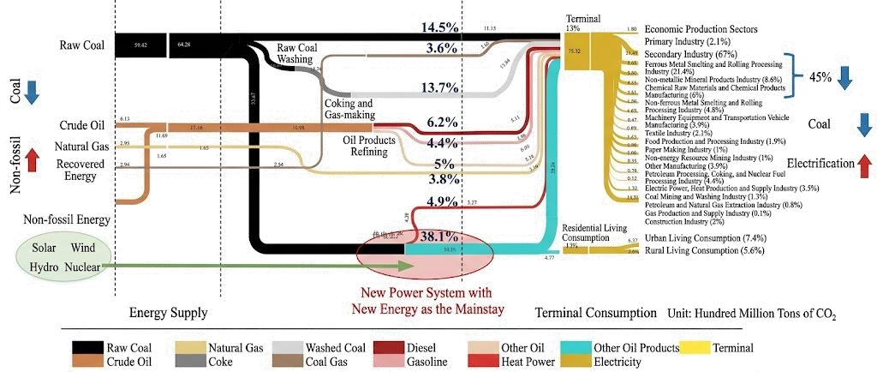





Greening of the Energy Consumption Mix
CQSamas@gmail.com
Increase the share of renewable energy
Most electricity for production and daily life in traditional parks comes from fossil fuels. It acts as a key intermediate and the primary carrier of carbon emissions.
To build a Net Zero Industrial Park, it is necessary to restructure the energy system toward low carbonization, develop a new-type power system, and fully replace carbon-containing energy with clean sources such as solar, wind, hydro and nuclear power.
Utilization of renewable energy in the park

Slide 19











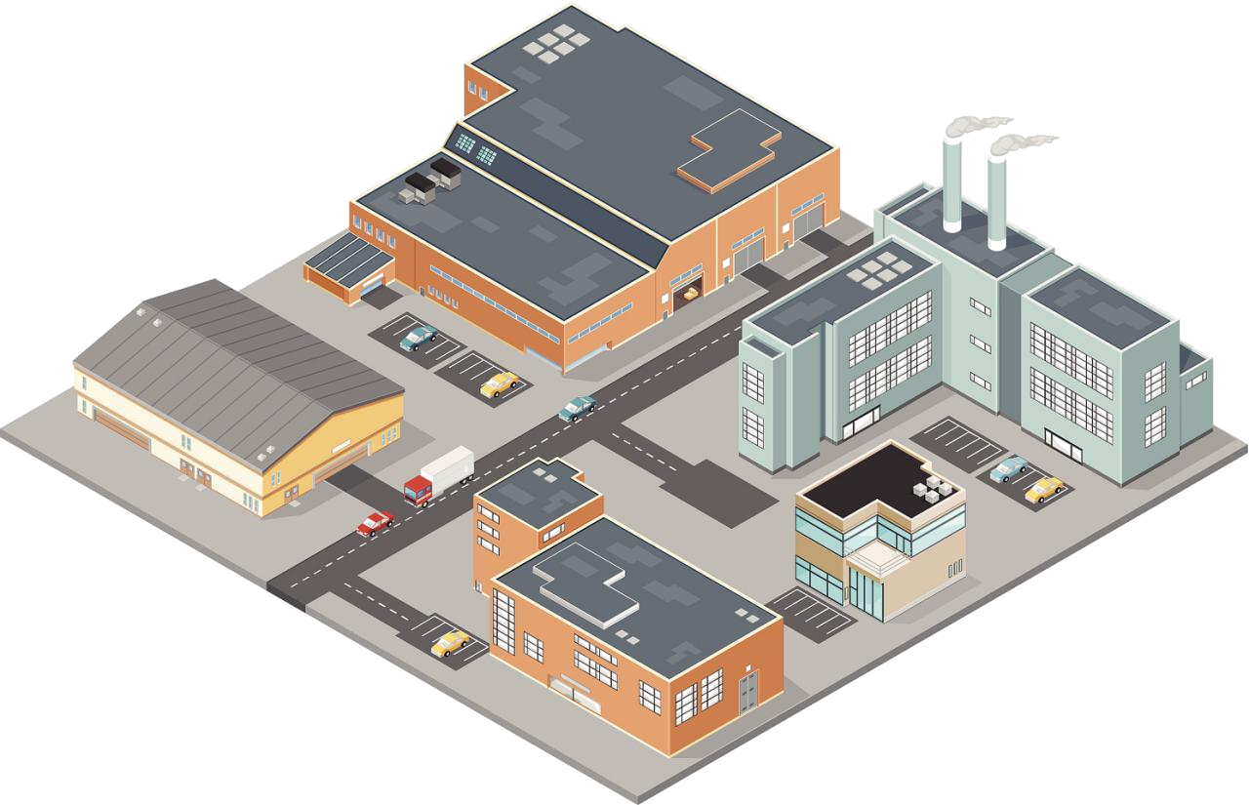


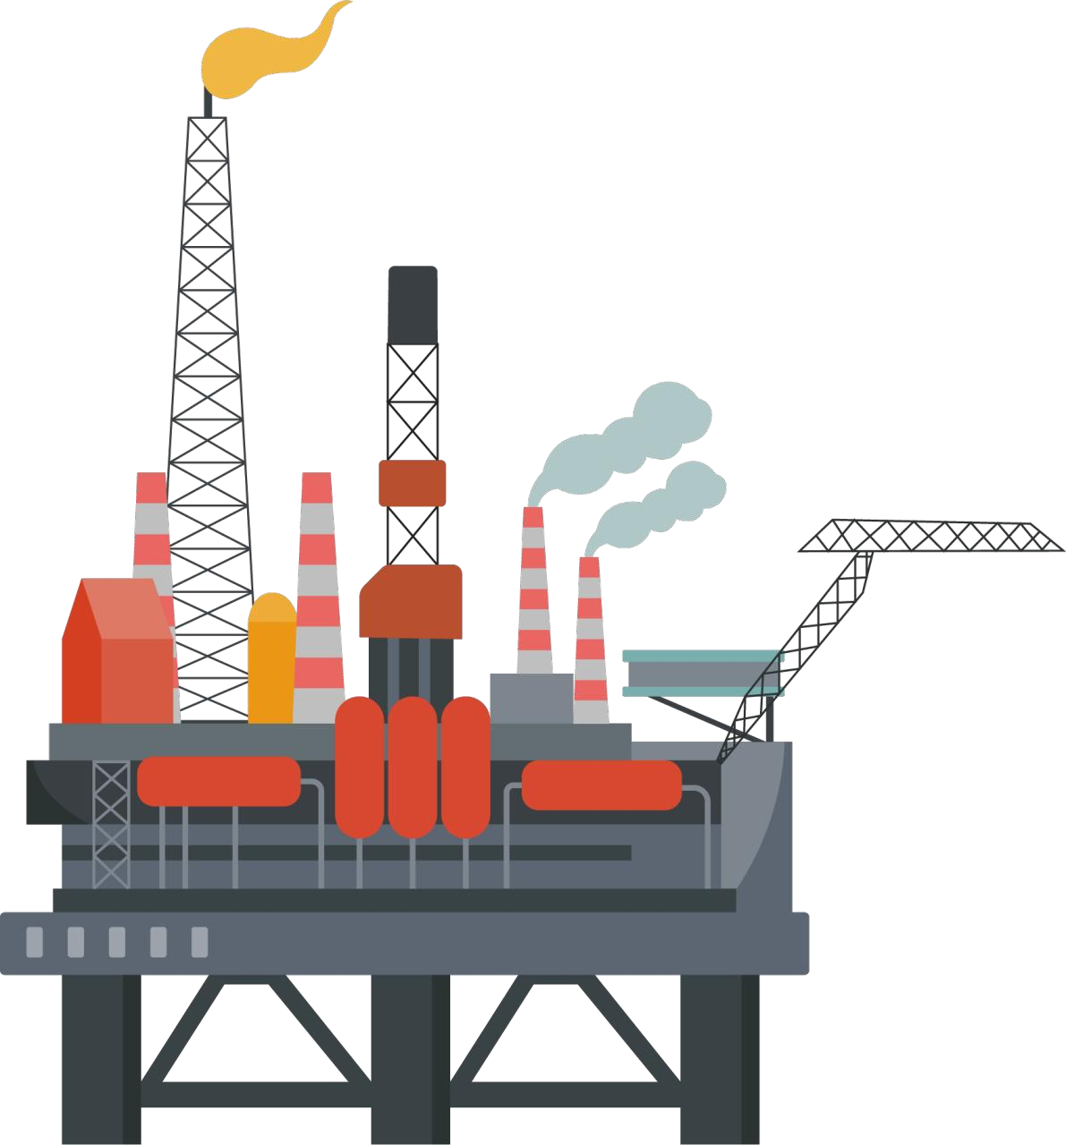
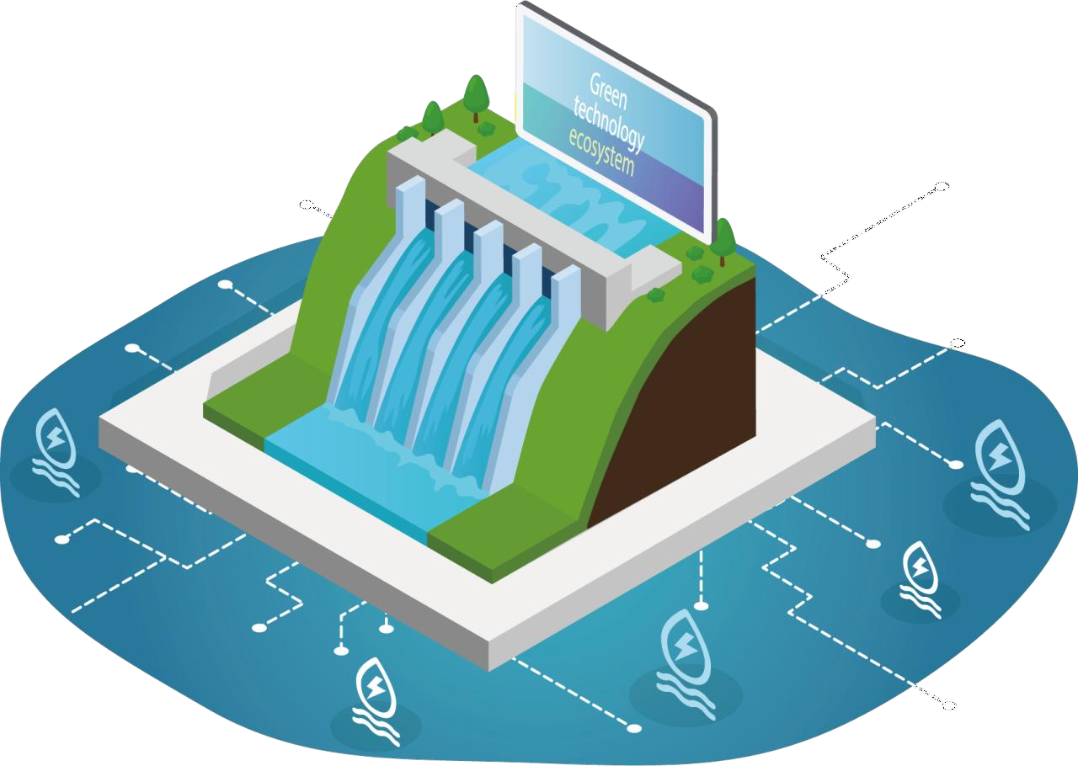
Greening of the Energy Consumption Mix
CQSamas@gmail.com
Optimize the configuration of Energy Storage Systems (ESS)
Adding energy storage is a fundamental element of the new-type power system.
Energy storage matched with new energy can effectively balance grid instability, improve the accommodation rate of renewable energy, and reduce wind and solar curtailment.
Energy storage systems operate in coordination with distributed PV, wind power and other renewable energy sources, improving the park’s green power self- sufficiency rate, reducing reliance on traditional fossil fuels, and advancing the park toward its Net Zero goal.
Traditional power system
New-type power system
coal
Photovoltaic
Energy Storage System
wind power
natual gas
nuclear energy
generator
Transmission and Distribution
factory
booster
Smart Transmission and Distribution
factory
crude oil
hydropower
Unidirectional output / energy flow
Bidirectional output / energy flow

Slide 20
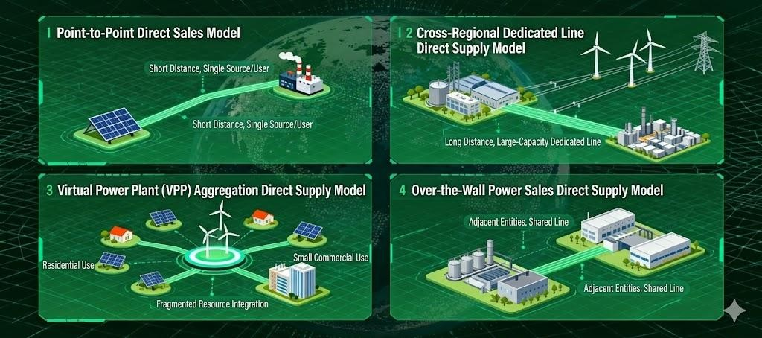
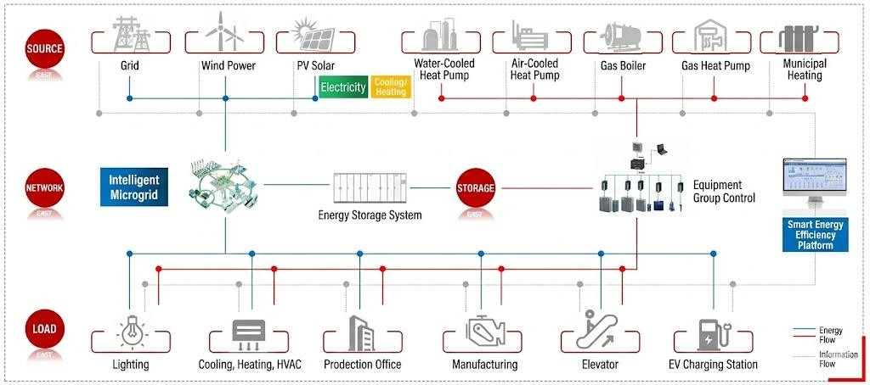
Greening of the Energy Consumption Mix
CQSamas@gmail.com
Direct green power connection and multi-energy synergy
Point-to-point direct connection mode in the park: micro-circulation of "on-site production and on-site consumption".
Cross-wall power sales direct connection mode: convenient sharing between "adjacent entities".
Cross-regional dedicated line direct connection mode: Point-to-point transmission with "long distance and large capacity".
Virtual Power Plant (VPP) Aggregation and Direct Supply Mode: Intensively dispatch "fragmented resources" to directly supply green power to users.
Multi-energy Complementarity + Integrated Source-Grid-Load-Storage:
Develop smart energy services in the park, implement systematic digital planning and integrated energy management. Through energy storage and optimal dispatch by the smart energy efficiency platform, integrate electricity, gas, cooling, heating and renewable energy systems to maximize safety performance and energy-saving potential.

Slide 21
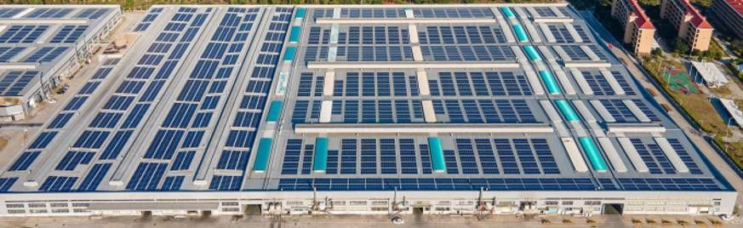
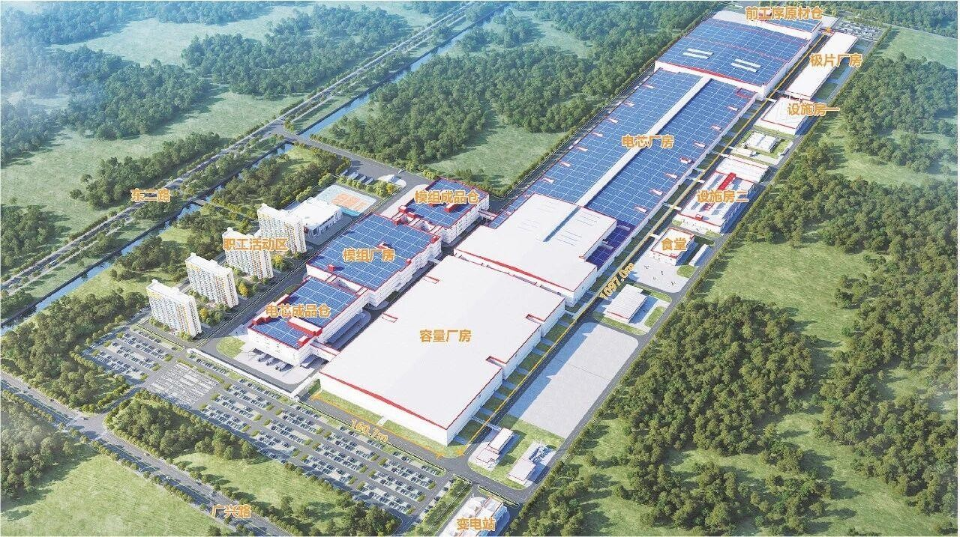
Greening of the Energy Consumption Mix
CQSamas@gmail.com
Case Study: The "Source-Grid-Load-Storage" Integrated Project in Jiangjin Baisha Industrial Park, China
Green Energy Development of the Park
Type | Construction Metrics
Source | 12.3 MW PV power system
Grid | PV system: low voltage 0.4 kV; energy storage system: 6 kV
Load | Plant electricity load
Storage | 0.6 MW/1.2 MWh lithium iron phosphate battery
Project Operation Effect Analysis
Through the precise regulation technology of "Source- Grid-Load-Storage", we will coordinate and control adjustable load resources such as HVAC, lighting and production lines.It will achieve 50% clean energy substitution for the park’s electricity consumption, reduce carbon emissions by 8,940.69 tons per year, and provide up to 20% capacity of load demand response.
Case Study: Direct Green Power Connection and Multi-energy Complementarity Project in CATL Dongying Net Zero Industrial Park, China
Power generation: Wind-solar hybrid and intelligent grid-forming with energy storage, smoothing intermittent wind and PV power to meet over 8,000 hours of annual power demand for park enterprises.
Grid: Independent dedicated lines for point-to-point direct power supply, connecting generation and load directly.
Load side: Green intelligent lithium battery manufacturing attracts upstream and downstream enterprises, forming a 100- billion-level green lithium industrial cluster.
Economic benefits: The annual output value of the industrial park reaches 26 billion yuan, tax revenue 120 million yuan, creating 2,400 jobs.
Environmental benefits: Annual green power consumption exceeds 5 billion kWh, replacing 1.5 million tons of standard coal and reducing CO₂ emissions by 3.8 million tons. Green power utilization rate reaches nearly 100%, cutting enterprise electricity costs by 15%–20%.

Slide 22
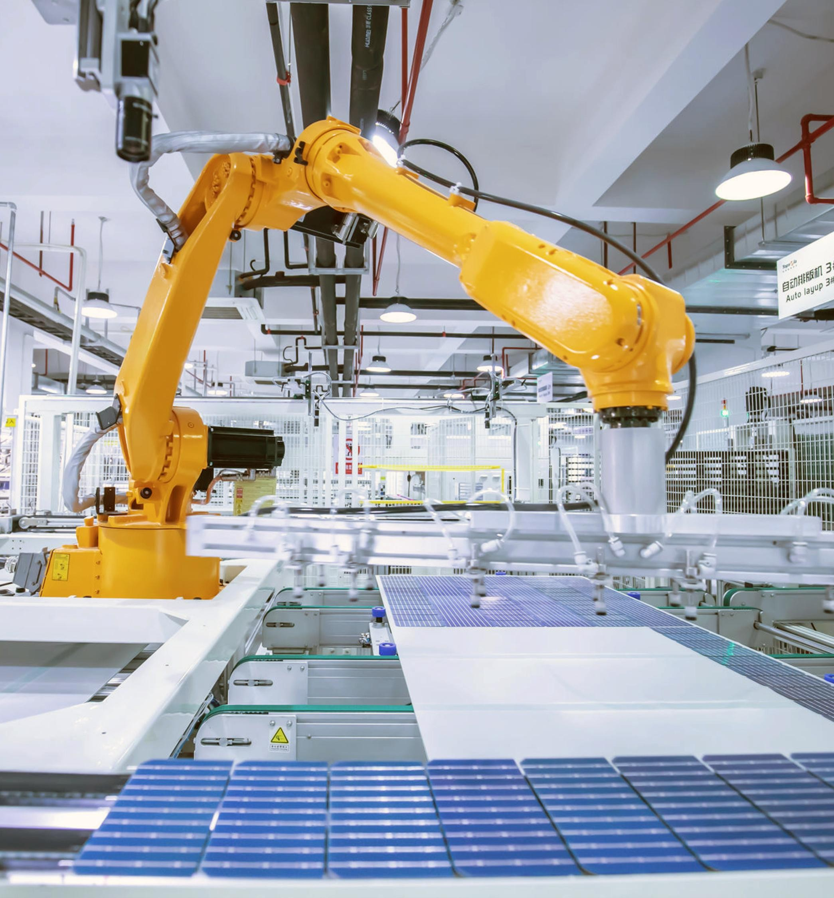
Low-Carbon Transformation of Industrial Clusters
CQSamas@gmail.com
Nurture emerging industries and establish a green, low-carbon industrial framework
Advance the circular economy and promote the synergistic utilization of waste resources
Drive green industrial agglomeration and synergy to forge a sustainable, closed-loop value chain
22

Slide 23
Low-Carbon Transformation of Industrial Clusters
CQSamas@gmail.com
Nurture emerging industries and establish a green, low-carbon industrial framework
Focus on strategic emerging industries including new energy, new materials, biomedicine, and high-end equipment manufacturing, and gradually transform high- energy-consumption, high-pollution industries toward green development.
Meanwhile, cultivate future frontier sectors such as hydrogen energy, advanced energy storage, biomanufacturing, and generative AI.
For example, Dongqiao Development Zone in Ningde, China, has built a new energy industrial cluster led by CATL, promoting power batteries, smart energy and other emerging fields.Huzhou, China, is piloting the hydrogen energy industry chain and developing demonstration projects for green hydrogen production and application.
Focus on eight strategic emerging industries.
Upgrade energy-intensive and high- pollution industries to green.
Cultivate nine future industries.
Industrial Fields | Sub-sectors
New Generation Information Technology | 5G (5th generation mobile communication technology), electronic information manufacturing, software industry, emerging digital sectors, etc.
New Energy | New energy power generation, new energy grid connection, key new energy equipment, etc.
Advanced Materials | Advanced petrochemical and chemical materials, advanced iron and steel materials, advanced non-ferrous metals and rare earth materials, advanced inorganic non-metallic materials, etc.
High-end Equipment | Industrial robots, high-end CNC machine tools, agricultural machinery, construction machinery, medical equipment, etc.
New Energy Vehicles | New energy vehicle complete vehicles, key component systems, core components, intelligent connected technology, etc.
Green and Environmental Protection | Carbon peaking and carbon neutrality, green manufacturing, industrial energy conservation, industrial water conservation, industrial environmental protection, etc.
Civil Aviation | Aircraft, aero-engines, airborne systems, etc.
Ship and Marine Engineering Equipment | High-tech ships, marine engineering equipment, etc.
Industrial Fields | Sub-sectors
Iron and Steel | Restrict new production capacity, focus on phasing out outdated capacity, and promote electric furnace short-process steelmaking.
Chemical Industry | Strictly prohibit the addition of new coking and coal chemical production capacity, and promote the clean transformation of existing projects.Focus on renovating highly polluting sectors such as oil refining, synthetic ammonia, and electrolytic aluminum.
Building Materials | Cement: Restrict new cement clinker production capacity and eliminate outdated cement production lines; Glass: Promote ultra-low emission transformation in the flat glass industry and strictly control new capacity; Ceramics: Prohibit the use of outdated kilns such as coal-fired open-flame tunnel kilns and sagger-loaded sanitary ceramic tunnel kilns.
Non-ferrous Metals | Limit the expansion of energy-intensive smelting capacity such as electrolytic aluminum and alumina, shut down enclosed blast furnaces and electric furnace copper smelting, and advance flash smelting and other advanced technologies.
Thermal Power | Strictly control new coal-fired power projects, phase out conventional coal-fired units of 300,000 kW and below, promote the transformation of in-service units into peaking power sources, and develop integrated coal- power joint ventures.
Industrial Fields | Sub-sectors
Metaverse | Industrial Metaverse, Urban Metaverse, Commercial and Entertainment Metaverse, etc.
Brain- Computer Interface | Input/output interfaces such as brain information reading and writing, as well as brain information encoding and decoding algorithms.
Quantum Information | Quantum Computing, Quantum Communication, Quantum Measurement.
Humanoid Robot | Special structural components, driving components, electromechanical system components for humanoid robots, etc.
Generative AI | Application platforms, data access, service quality, application trustworthiness, etc.
Biomanufacturi ng | Biomanufacturing of food, pharmaceuticals, fine chemicals, etc.
Future Display | Quantum Dot Display, Holographic Display, Retinal Display, Micro- LED Display, etc.
Future Network | Deterministic Network, Digital Twin Network, Computing-Network Convergence / Computing Power Network, etc.
New Energy Storage | Lithium-ion batteries, sodium-ion batteries, hydrogen energy storage/hydrogen fuel cells, solid-state batteries, etc.

Slide 24
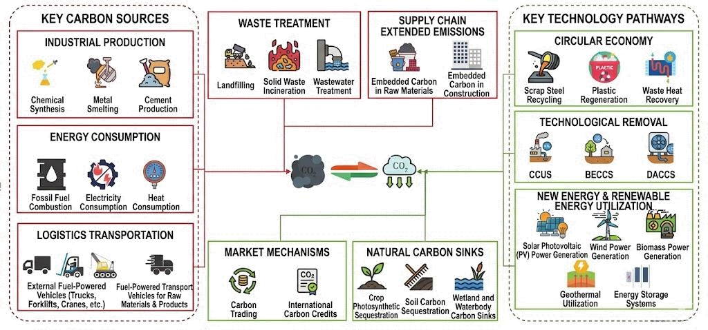
Low-Carbon Transformation of Industrial Clusters
CQSamas@gmail.com
Advance the circular economy and promote the synergistic utilization of waste resources
We will build a circular chain of "waste–renewable resources" and shift industrial development from a resource‑ consuming model to an ecological‑ regenerative model, which is mainly reflected in green energy and energy storage, circular economy and resource regeneration, industrial coordination, and other fields.For example, Jinchuan Group in Gansu Province, China, has adopted a "resource collection & storage–processing–reuse" model to convert smelting waste residue into building materials, achieving a closed‑ loop resource system.
Typical Layout of Circular Economy Industries
Industry Category | Synergy Utilization Objects | Output Products | Keywords
Green Energy and Energy Storage | Photovoltaic: "power generation on panels, desert control under panels, planting between panels"; echelon utilization of energy storage batteries; by- product utilization from green hydrogen production. | Green Power, Ecological Restoration and Resource Recycling. | Construct a closed loop of "green power production – energy storage manufacturing – new energy applications – recycling".
Circular Economy and Resource Regenerati on | Waste electrical and electronic equipment, scrapped new energy vehicles, waste power batteries, etc. | Recycled raw materials, building materials. | Build a "urban mineral" system.
Industrial Synergy | Comprehensive utilization of industrial waste heat and energy, wastewater, and industrial solid waste. | Shared Energy, Reclaimed Water. | Inter-enterprise circular economy.
Schematic Diagram of Development Model for Manufacturing-Oriented Net Zero Industrial Park
24

Slide 25
Low-Carbon Transformation of Industrial Clusters
CQSamas@gmail.com
Drive green industrial agglomeration and synergy to forge a sustainable, closed-loop value chain
Promoting the agglomeration and coordination of green industries, and the sharing of green energy and technologies among upstream and downstream enterprises, is the core path for net zero industrial park to build a closed-loop green industrial chain.
Essentially, it achieves industrial ecological coupling through spatial agglomeration, reduces full-chain carbon reduction costs via sharing mechanisms, and ultimately transforms the industrial chain from "linear consumption" to "circular symbiosis", providing sustainable industrial support for net zero industrial park goals.
Typical Categories of Green Industrial Chain Clusters
Industrial Category | Chain-leading enterprise | Collaboration Points | Typical Cases
Photovoltaic and New- type Energy Storage Industry Cluster | Leaders in Silicon Material – Cell – Module – Inverter | Share idle rooftops and open spaces to revitalize resources, and uniformly develop distributed photovoltaic + energy storage systems. Share park-level microgrids to achieve on-site consumption of green power and grid connection of surplus electricity. Share testing, certification, and carbon footprint platforms to quickly obtain export certification for "Net Zero modules". | In the Ordos Net Zero Industrial Park in China, LONGi, Envision, Huajing and other enterprises have formed a full industrial chain.
Power Battery and New Energy Vehicle Industry Cluster | Battery Manufacturers + Automakers + Recycling Companies | Jointly build a "green power dedicated line" to ensure 100% green power for the four key links: cathode materials, cells, Pack, and vehicles. Jointly establish a battery full-lifecycle carbon footprint database to meet the requirements of the EU Battery Regulation. Jointly develop a second-use + recycled materials factory, with nickel, cobalt, and lithium recovery rates >90%. | Yibin Power Battery Town in China gathers CATL, BYD and other enterprises certified for carbon footprint by German authorities.
Green Chemical and New Materials Industry Cluster | Green Hydrogen Suppliers + Synthetic Ammonia/Methanol + Downstream Fine Chemicals | Share the park's green hydrogen pipeline to replace hydrogen produced from natural gas, reducing carbon emissions by over 90%. Share the CO₂ capture pipeline network, using thermal power plant flue gas to produce green methanol and polycarbonate materials. Share reclaimed water reuse and steam waste heat systems to achieve a three-cycle system of "raw materials + energy + water". | Taking Donghua Energy's comprehensive alkane utilization as the core, Maoming Net Zero Industrial Park in China has introduced projects such as acrylic acid, carbon fiber, and special coatings to form an industrial closed loop.
Hydrogen Industry Full- Chain Cluster | Electrolyzer Manufacturers + Hydrogen Suppliers + Fuel Cells + Steel/Glass/Logistics End Users | Share the park's water electrolysis hydrogen production station to uniformly supply ≥99.999% high-purity green hydrogen. Share various storage and transportation facilities including high-pressure hydrogen, liquid hydrogen and pipelines, reducing the comprehensive cost of hydrogen by 20%. Share testing, certification and carbon trading platforms to quickly obtain green hydrogen certificates and carbon emission reduction benefits. | The Mengsu Economic Development Zone in Inner Mongolia, China has built China's first "green hydrogen – green steel" production line, which reversely supplies hydrogen to fuel cell heavy-duty trucks in the park, forming a closed loop.

Slide 26
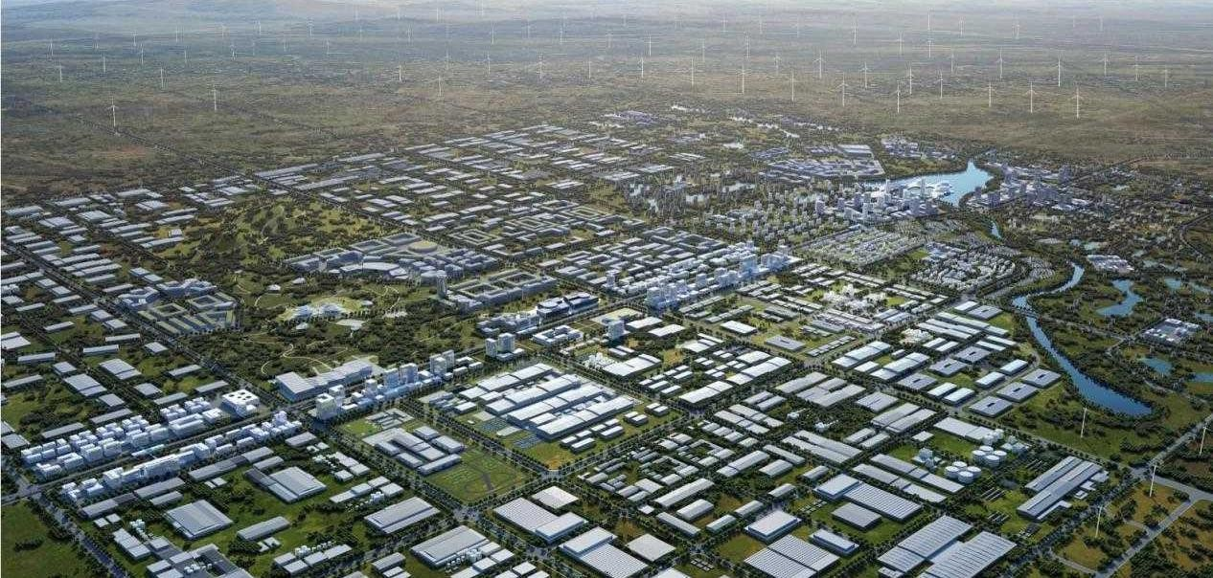
Low-Carbon Transformation of Industrial Clusters
CQSamas@gmail.com
Case Study: Envision Ordos Net Zero Industrial Park, China
The Envision Ordos Net Zero Industrial Park is the world’s first net-zero industrial park, jointly developed by Envision Group and the Ordos Mengsu Economic Development Zone. Located in Ejin Horo Banner, Ordos, Inner Mongolia, the park covers a total planned area of approximately 73 square kilometers with a total investment exceeding 100 billion RMB. Positioned as a 'Chinese Paradigm and Global Benchmark,' the park is architecting a new decarbonized industrial ecosystem that integrates the entire 'Wind-Solar-Hydrogen-Storage-EV' value chain.
Background of the Project
As a traditional coal-resource-based city, Ordos is in urgent need of transformation. Its abundant wind and solar energy resources provide natural conditions for net zero development.
Construction Process
2021.3 Officially Launched
2022.3
Approved for construction
2023.4
Standard Formulation and Large-Scale Development
2024.7
Launch the "Net Zero Industrial Park 2.0" Upgrade Plan
2025 to Date
Stage of International Standard Output and Global Expansion

Slide 27
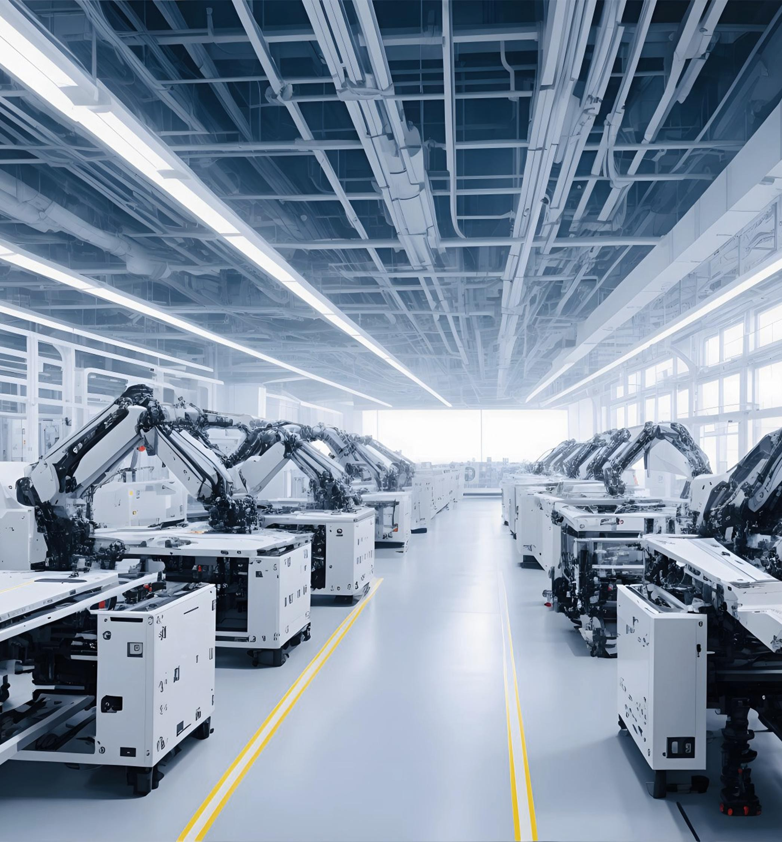
Demonstration-led Application Scenarios
CQSamas@gmail.com
Energy-saving retrofitting, Process re-engineering and Deployment of green manufacturing technologies
Empowering Full-Process Precision Management through Digital Intelligence
Green Office and Lifestyle

Slide 28
Demonstration-led Application Scenarios
CQSamas@gmail.com
Energy-saving retrofitting, Process re-engineering and Deployment of green manufacturing technologies
We follow a full-chain energy-saving strategy: source reduction, process control, and end-of-pipe recovery, focusing on high-energy, high-pollution industries for maximum carbon reduction.
Industrial process reengineering is key to cutting emissions at the source. Disruptive technologies such as total oxygen combustion and hydrogen-based shaft furnaces reduce CO₂ intensity by 30%–50%, lowering costs for subsequent CCUS.
Industrial sector | Energy-saving technological transformation path | Process Reengineering and Green Technology Promotion
Steel | Short route electric arc furnace,Hydrogen metallurgy,Dry quenching technology,Waste heat power generation. | Hydrogen-based Direct Reduced Iron (DRI) replacing blast furnace ironmaking. Technical Path: Use green hydrogen (produced from water electrolysis via renewable energy) as a reducing agent instead of coal. Directly reduce iron ore concentrate in a shaft furnace to produce Net Zero Direct Reduced Iron (DRI), which is then melted and refined in an electric arc furnace for steelmaking.
Chemical industry | Petrochemical & Chemical Industry: Energy-saving technologies for ethylene cracking furnaces, innovation in wet-process phosphoric acid technology. | After purification, converter gas (rich in CO and H₂ ) from steel plants is used as chemical feedstock, while captured CO₂ is reinjected into the steel production system, forming a closed loop: "steel offgas → chemical feedstock → CO₂ reuse in steelmaking". CO₂ hydrogenation to methanol: hydrogen produced by water electrolysis using renewable electricity reacts with captured CO₂ under catalysts to synthesize methanol, which can be used as fuel or chemical feedstock.
Building materials | Cement: Low-clinker formula, kiln efficiency improvement, waste heat power generation. Glass: Oxygen-enriched combustion technology, electric-assisted heating technology. | Cement industry: biomass fuel substitution and total oxygen combustion; replace part of coal with agricultural and forestry residues to reduce fossil energy consumption; use pure oxygen instead of air for combustion to improve thermal efficiency and reduce NOₓ emissions. Glass industry: synergy between electric-assisted heating and oxygen-enriched combustion; apply electrode heating in part of the float glass furnace to enhance homogenization of molten glass, while using oxygen- enriched air for combustion to boost thermal efficiency.
Non-ferrous metals | Aluminum electrolysis: fully graphitized cathode technology, dynamic optimization via artificial intelligence. | Aluminum electrolysis industry: Innovation of low-voltage intelligent electrolysis cells. Fully graphitized cathode materials and AI dynamic control systems are adopted to optimize the electrolyte molecular ratio (the ratio of sodium fluoride to aluminum fluoride in the electrolyte), thereby reducing cell voltage and power consumption.

Slide 29
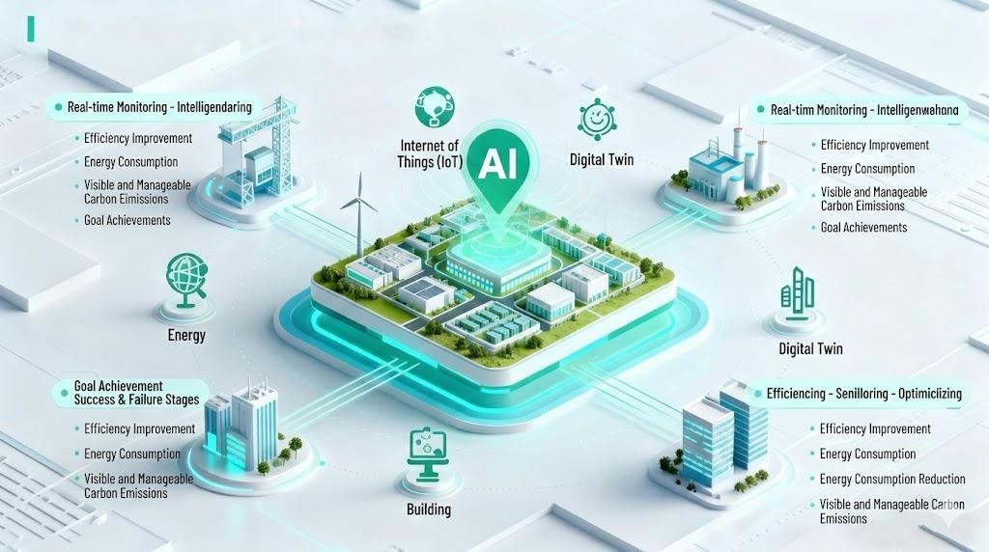
Demonstration-led Application Scenarios
CQSamas@gmail.com
Empowering Full-Process Precision Management through Digital Intelligence
Through IoT, AI, big data, digital twin and other technologies, the whole chain of energy, production, logistics and buildings is connected to build a closed-loop system of "real-time monitoring – intelligent dispatch – optimized decision-making", so as to improve efficiency, reduce energy consumption and realize visible and manageable carbon emissions.
Digital Intelligence Empowerment in Typical Industries
Industrial sector | Carbon Reduction Approaches Enabled by Digital Intelligence | Typical Cases / Technologies
Data center | AI scheduling of server load, dynamic cooling, direct supply of green electricity, PUE reduced to below 1.2 | Net Zero Industrial Park in Shandong and Inner Mongolia, China have introduced "green power + AI energy-saving" data centers
High-end manufacturing | Digital twin factory + AI quality inspection + energy and carbon management platform, reducing energy consumption per device by 10%–30%. | China Shanghai Lingang "Net Zero Bay" Builds a Five-Energy-Integrated Smart Platform
Park microgrid | AI-based prediction of power generation/load, real-time scheduling of energy storage, charging piles and distributed energy resources, raising the consumption rate of green power to over 90%. | China Jiangsu Yining Low-Carbon Smart Energy Park Integrated Digital Platform
Green supply chain | Blockchain + AI route optimization, real-time calculation of transportation carbon emissions and carbon footprint tracking. | Lenovo Group Limited Green Supply Chain System
Green building | BIM + AI for intelligent control of air conditioning, lighting, photovoltaic and energy storage systems, realizing photovoltaic-storage-DC-flexible buildings with an energy saving rate of over 60%. | Shandong Park, China promotes "photovoltaic-storage-DC-flexible" buildings

Slide 30
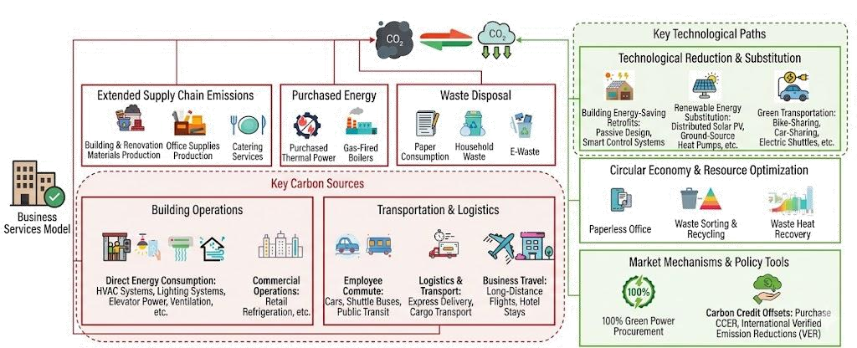
Demonstration-led Application Scenarios
CQSamas@gmail.com
Green Office and Lifestyle
Build green office and living scenarios, extending "green and low-carbon" practices from the production process to daily office work and employees’ lives. Empower office efficiency, energy conservation and consumption reduction through smart technologies, and foster a green and low-carbon living atmosphere with people- oriented care, ultimately achieving the dual goals of environmental friendliness and employee well-being.
Core Points of Green Office and Living Scenarios
Scenario Dimension | Core Objectives | Specific Content and Practices
Green Office | Energy saving and efficiency improvement, paperless and intelligent. | Smart Energy Saving: Adopt intelligent lighting systems; install smart sockets to monitor standby power consumption.
 |  | Paperless Office: Promote digital processes and cloud collaboration platforms; use electronic materials for meetings.
 |  | Space Optimization: Adopt an open layout to facilitate natural lighting and ventilation.
Green Living | Low-carbon and convenient, healthy and circular. | Low-carbon Transportation: Develop a complete slow-traffic system; provide sufficient electric vehicle charging piles and shared smart bicycle stations.
 |  | Water Conservation: Fully adopt water-saving appliances; collect rainwater and air conditioning condensate water for greening irrigation and road washing.
 |  | Waste Sorting and Recycling: Set up clear and convenient waste sorting and collection points; ensure that all types of waste are utilized as resources.
Foundation of Energy and Resources | Renewable Energy, Intelligent Management and Control | Distributed Energy: Install photovoltaic power generation systems on rooftops, carports and idle open spaces; where conditions permit, explore breeze wind power, ground-source heat pumps and other forms of energy.
 |  | Smart Energy Management: Deploy IoT sensors and an energy management platform to monitor electricity, water, cooling and heating energy consumption in various areas in real time.
30

Slide 31
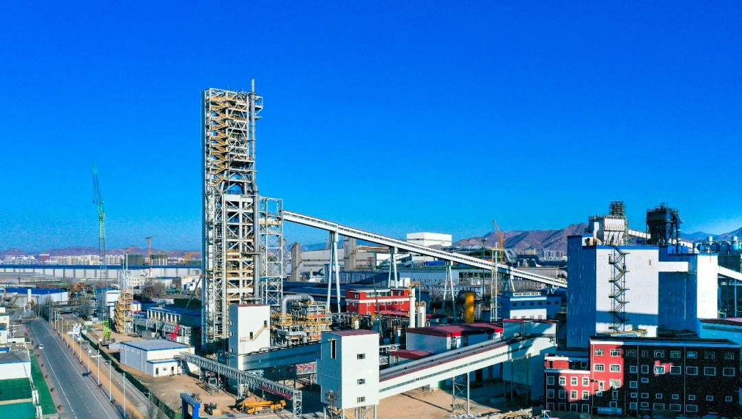

Demonstration-led Application Scenarios
CQSamas@gmail.com
Case Study: HBIS Zhangxuan Technology’s World-First “Hydrogen-Rich Zero-Reforming” DRI Project , China
Overview：The world’s first hydrogen metallurgy project in the steel industry centered on “hydrogen-rich zero-reforming” technology. It achieved stable production in May 2023, with an annual capacity of 1.2 million tons. The metallization rate of the produced Direct Reduced Iron (DRI) exceeds 94%, and all indicators meet international Class I standards.
Core Innovations：Efficient utilization of hydrogen-rich reducing gas; reserved function for switching to green hydrogen; integration of the full process: “hydrogen-rich gas purification – hydrogen-based shaft furnace reduction – carbon capture and reuse – EAF clean steelmaking”. It has formed a brand-new technological route of “CO₂ capture + refining”, realizing the coordinated development of Net Zero hydrogen production and the hydrogen energy industry.
Carbon Reduction and Environmental Benefits：Compared with the traditional “blast furnace + converter” long process, the project achieves a carbon emission reduction rate of over 70%, reducing annual CO₂ emissions by 800,000 tons. Emissions of sulfur dioxide, nitrogen oxides and smoke/dust are reduced by more than 30%, 70% and 80% respectively, solving carbon emissions and pollution problems in steelmaking at the source.
Case Study : The 3-Million-Tonne-Per-Year CCUS Flagship Project in Ningxia, China
Overview: China’s largest full-industry-chain demonstration project for carbon capture, utilization and storage (CCUS). Jointly developed by China Ningxia Coal Industry Co., Ltd. and PetroChina Company Limited, it is located in the Ningdong Energy and Chemical Industry Base with a total investment of approximately 10.2 billion yuan.
Core Innovations: Adopts the combined technology of "supercritical CO₂ flooding + permanent geological sequestration", solving three major industrial challenges: high cost of high-concentration CO₂ capture, low efficiency of long-distance pipeline transportation, and poor adaptability of CO₂ flooding in oil and gas fields.
Carbon Reduction and Environmental Benefits: Annual CO₂ emission reduction of 3 million tons; reduction of SO₂ and NOₓ emissions by approximately 12,000 tons. The annual output value of Phase I is about 500 million yuan, and after the completion of Phase II, the annual output value will reach 1.5 billion yuan.

Slide 32

Digital & Intelligent Energy and Carbon Management
CQSamas@gmail.com
Digital and Intelligent Energy Management
Digital and Intelligent Energy-Saving Management Carbon Emission Quantification and Management Carbon Asset Development and Trading
32

Slide 33


Digital & Intelligent Energy and Carbon Management
CQSamas@gmail.com
As the "Intelligent Core" of a net zero facility, the Digital-Intelligent Energy and Carbon Monitoring Platform leverages a convergence of IoT, Big Data, Cloud Computing, AI, and Digital Twin. It provides end-to-end, multi-dimensional sensing and precision control of energy systems. This architecture facilitates continuous energy efficiency gains and ensures that carbon management is fully digitalized, visualized, and lean-oriented.
Digital and Intelligent Energy Management：
Through data collection and system integration, the integration of energy flow and information flow is realized. Its core lies in the coordinated dispatch and precise control of electricity, gas, cooling, heating, renewable energy and other energy sources by means of real-time monitoring, intelligent analysis and optimal control. It aims to improve energy efficiency, reduce costs and ensure energy supply security, ultimately promoting green, low-carbon and high- quality development of factories.
Digital and Intelligent Energy-Saving Management：
Through big data analysis, abnormal energy consumption and potential energy-saving points are identified. An intelligent sensor network is deployed to monitor indoor and outdoor temperature, humidity and occupancy density in real time. AI algorithms are adopted to realize automatic optimal control of energy systems, achieving "supply on demand" and ensuring that energy-saving effects are measurable and traceable.

Slide 34


Digital & Intelligent Energy and Carbon Management
CQSamas@gmail.com
Carbon Emission Quantification and Management：
Carbon emission quantification determines the total factory emissions through direct and indirect calculations. Combined with the factory’s current situation, it conducts cost analysis and carbon reduction pathway simulation for various emission reduction measures, sets science-based carbon targets, and generates compliant reports with one click.
Carbon footprint management integrates quantitative data based on the LCA methodology. Its core lies in managing the full life-cycle carbon emissions of main products from raw materials to end-of-life recycling, ensuring accountability traceability and continuous improvement.
Carbon Asset Development and Trading：
Carbon Asset Development Service: Helps enterprises develop carbon credits generated by emission reduction or carbon sink projects into credible, tradable carbon assets in accordance with standardized processes and methodologies (CCER, CQCER, GS, VCS, I-REC).
Carbon Asset Trading Service: Assists enterprises in carbon asset trading, effectively manages market and compliance risks, and ultimately achieves low-cost compliance or asset appreciation.

Slide 35

Digital & Intelligent Energy and Carbon Management
CQSamas@gmail.com
Case Study: CATL Liyang Production Base Net Zero Digital & Intelligent Construction Project，China
Net Zero Management Digital & Intelligent Framework：
The project integrates IoT, big data, AI and digital twin. Its digital and intelligent architecture can be summarized into three layers:
Sensing and Data Collection
Deploy a carbon inventory system to realize millisecond-level sensing and collection of energy and resource flows such as electricity, water, gas, heat and carbon.
Analysis and Optimization
Application of AI energy-saving optimization algorithms achieves an energy consumption reduction of more than 15% while ensuring product quality.
The virtual digital model of the digital twin platform maps real-time data of equipment, energy consumption and carbon emissions into the digital space.
The central intelligent energy management system integrates all decentralized systems into one platform, realizing global and coordinated energy dispatch to achieve "supply on demand".
Carbon Asset Management
Record and trace carbon footprint data, providing strong support for ESG reporting and international certification.

Slide 36

Greening of Infrastructure and Facilities
CQSamas@gmail.com
Scaling up Ultra-Low Energy and Net Zero Energy Buildings
Enhancing Green Mobility Infrastructure within the Industrial Park
Green Retrofitting of Municipal Infrastructure

Slide 37





Greening of Infrastructure and Facilities
CQSamas@gmail.com
Scaling up Ultra-Low Energy and Net Zero Energy Buildings
In response to the local climate and site conditions, passive architectural design is adopted to minimize the demand for building heating, air conditioning and lighting. Renewable energy is fully utilized to provide a comfortable indoor environment with minimal energy consumption. The building energy consumption shall be reduced by more than 60% compared with the relevant Chinese national standards.
Core Dimensions | Main Objectives | Specific Measures and Cases
Energy Consumption and Indoor Environmental Standards | Significantly reduce energy consumption and improve comfort. | Set clear energy consumption indicators and indoor environmental parameters.
Passive-first design strategy | Reduce energy demand from the source. | Through high-performance building envelopes, excellent air tightness, thermal-bridge-free design, and the use of natural lighting and ventilation to reduce heating, cooling and lighting loads.
Actively optimized energy system | Efficiently meet energy demand. | Adopt high-efficiency heating, ventilation and air-conditioning systems, energy-saving lighting and electrical appliances, and give priority to the use of renewable energy.
Full-process quality control | Ensure design implementation and continuous optimization. | Cover strict construction management, professional operation and maintenance, as well as continuous energy consumption monitoring and optimization.

Slide 38

Greening of Infrastructure and Facilities
CQSamas@gmail.com
Enhancing Green Mobility Infrastructure within the Industrial Park
Improve the green transportation infrastructure of the park; build a full-chain green transportation system covering energy supply, transportation tools, intelligent management and supporting policies. In addition, hydrogen energy is one of the key directions for the future development of green transportation infrastructure in scenarios that are difficult to cover by electrification, such as heavy-duty freight and long-distance transportation.
Core Direction | Main Measures | Specific Measures and Cases
Improve the energy supply network | Construct charging and hydrogen refueling facilities. | Construct charging and battery-swapping stations: Deploy charging piles in parks and factory areas, and introduce high-power charging piles and battery-swapping stations. Supporting hydrogen refueling stations: Refuel hydrogen fuel cell vehicles and other vehicles.
Promote the replacement of transportation tools. | Upgrade vehicles and machinery by scenario. | New energy adoption for freight vehicles: Guide the use of electric and hydrogen- fueled heavy-duty trucks for bulk cargo transportation, and phase out diesel trucks. Clean replacement of on-site operating vehicles/machinery: Upgrade on-site transport vehicles, forklifts, loading and unloading equipment to pure electric or clean energy equipment. Promotion of new energy official and commuter vehicles: Increase the proportion of new energy official vehicles, and expand the application of new energy shuttles and commuter buses.
Apply intelligent management and dispatching systems. | Digitalization improves transportation efficiency. | Build an intelligent platform: Optimize vehicle routing and parking scheduling through AI algorithms and 5G technology to improve vehicle turnover efficiency. Promote intelligent transportation technologies: Apply technologies such as "green wave bands" to reduce waiting time by adjusting traffic lights in real time.

Slide 39

Greening of Infrastructure and Facilities
CQSamas@gmail.com
Green Retrofitting of Municipal Infrastructure
In the green renovation of infrastructure, promoting the upgrading of facilities such as street lamps and sewage pipelines, and building an efficient resource recycling system are important measures to achieve sustainable development. The core is to realize energy conservation and consumption reduction, improve treatment efficiency and promote resource regeneration through technological upgrading, intelligent management and system optimization.
Renovation Direction | Core Objectives | Specific Measures and Cases
Green Smart Lighting | Energy conservation and consumption reduction, lighting on demand. | Light Source Replacement: Replace traditional light sources such as high-pressure sodium lamps with high-efficiency LED lamps. Intelligent Management and Control: Establish a smart street lamp management platform to realize remote switching and dimming as needed.
Sewage System Upgrade | Improve quality and efficiency, and promote resource reuse. | Process Upgrade: Upgrade to more efficient and stable processes, or adopt combined processes to improve effluent quality. Pipeline Network Renovation: Renovate old pipe networks, build reclaimed water reuse pipelines, and transport treated water to industrial parks for miscellaneous use.
Solid Waste System Optimization | Waste reduction, recycling and intelligent supervision. | Waste Sorting and Resource Utilization: Establish professional treatment centers. Adopt smart approaches such as AI cameras and "cloud station bins" to improve sorting efficiency. Waste Construction Material Recycling: Build construction waste resource utilization facilities to convert waste into recycled building materials, with a resource utilization rate of over 95%.
Resource Recycling | Turn waste into resources, reduce carbon and improve efficiency. | Wastewater to Resources: Reclaimed water that meets discharge standards is used for industrial cooling, greening irrigation, etc., replacing tap water. Straw Energy Utilization: Establish a complete straw collection, storage and transportation system, and rely on local enterprises to use straw as the main fuel for biomass power generation and heating.

Slide 40


Greening of Infrastructure and Facilities
CQSamas@gmail.com
Case Study: State Grid’s Energy Internet Industrial Innovation Center in Xiong An New Area, China
Basic Information: As China’s first Net Zero park certified in accordance with national standards, the China Xiong’an Innovation Center has a total construction area of approximately 198,000 square meters. It serves as a benchmark project for the “green and smart” transformation of the Xiong’an New Area.
Highlights of Infrastructure Upgrade：
Clean heating and cooling system: Adopting ground-source heat pump technology to provide constant-temperature air conditioning water for the park, significantly reducing HVAC energy consumption.
Smart Energy Management: Build an integrated intelligent operation platform for the park to support multi-dimensional data.
Renewable Energy Integration: A distributed photovoltaic system will be built to realize "self-consumption of on-site power generation, with surplus electricity connected to the grid", reducing reliance on the traditional power grid.
Ultra-low Energy Consumption Building Application: Adopting technologies such as high-performance building envelopes, thermal- bridge-free design, and high-efficiency cooling and heating systems to meet ultra-low energy consumption standards.
Case Study: Decarbonizing Port Logistics — The "Hydrogen-Electric Dual-Drive" Transport Synergy at Jiaxing Yemaodun Park，China
Basic Information: Located in Zhapu Port Area, Jiaxing, Zhejiang Province, covering 14 hectares, it is one of China’s four Net Zero logistics park pilots. It has established a Net Zero transportation system and achieved 100% clean energy for in-park vehicles.
Core Innovation: Through the combination of "hydrogen energy heavy trucks + electric forklifts", zero carbon emissions in the entire "port-park" freight process are achieved.
Hydrogen Station with Photovoltaic Canopy: The canopy of the hydrogen station is covered with photovoltaic panels, which convert solar energy into electricity for station operation, achieving energy self-sufficiency.
Charging and Battery Swapping Stations: Equipped with charging piles for electric forklifts and short-distance shuttle vehicles, as well as battery swapping stations to provide fast energy replenishment for hydrogen-powered heavy trucks.

Slide 41
Policy & Background
Challenges & Opportunities
Strategies & Paths
Green Finances
Net Zero Service
CQSamas@gmail.com
04
Green Finances
41

Slide 42



Green Finances
CQSamas@gmail.com
Green Credit and Bonds
Net Zero Industrial Park follow the general rules of traditional industrial parks while possessing unique green attributes, and boast a large number of green assets that can be identified and valued by financial institutions. Therefore, they are shifting from a "bonus item" to a "priority item" in the financing market.
Parks may apply for bank loans based on green and energy-saving planning and design.
Apply for green operating property loans with stable income from rent and energy service fees as the source of repayment.
Special loans for energy conservation, emission reduction, clean energy and green buildings.
Path 1
In the early stage of project launch, market-oriented front-end financing tools are adopted. The owner establishes a special fund or trust plan jointly with financial institutions.
During fundraising, the owner presents future environmental rights income from carbon trading, green certificate trading, etc., as potential value-added benefits to attract financing and share later project returns.
Path 2
EPC+F Construction Period Financing: Large energy state-owned enterprises or professional green technology engineering companies provide "funded contracting" solutions. When the owner needs to delay project payment, the general contractor can introduce a third-party financial institution to transfer the owner’s "accounts receivable" to obtain cash flow in advance.
Path 3

Slide 43
Green Finances
CQSamas@gmail.com
Green Funds and Insurance
In the construction of Net Zero Industrial Park, green funds provide financial support by concentrating capital to invest in key low-carbon technologies and projects in the parks, attracting social capital to participate in the green transformation of the parks. Green insurance can provide protection for high-investment low-carbon projects in the parks through risk diversification, enhancing investment confidence.
Government-guided and social capital-participated equity investment in green low-carbon projects and green tech enterprises in the park, with no debt repayment pressure on enterprises.
Operation Model
Implementation Path
Local governments jointly launch Net Zero industrial investment funds with banks, insurance companies and other institutions to support construction projects in the park.
Insurance Types
Carbon Asset Loss Insurance + Climate Risk Insurance + Low-Carbon Technology Application Insurance.
Implementation Cases
A science park in Shenzhen, China introduced green insurance to cover risks in low-carbon technology application, which enhanced investor confidence and promoted smooth project implementation.

Slide 44
Policy & Background
Challenges & Opportunities
Strategies & Paths
Green Finances
Net Zero Service
CQSamas@gmail.com
05
Net Zero Service
44

Slide 45

Our Business
CQSamas@gmail.com
Four Core Business Areas
Carbon Neutrality Strategy Formulation
Net Zero Industrial Park Planning and Construction
Net Zero Service
Energy-Carbon Management System
Carbon Footprint Accounting

Slide 46



Our Business
CQSamas@gmail.com
Carbon Neutrality Strategy Formulation (SBTi Science-Based Target Planning)
Set science-based emission reduction targets
Set achievable emission reduction targets
Set base year and target year goals
Simulate and set emission reduction target costs
Simulate diverse emission reduction pathways
Customize tailored reduction pathways
Evaluate gaps between measures and targets
Emission Reduction Direction Analysis
Set absolute or intensity target scope
Define clear emission reduction scope & direction
Adopt Science-Based Targets initiative (SBTi)
Set absolute emission reduction targets, intensity reduction targets, or mixed targets.
Continuously track project progress, monitor emissions, and verify target achievement.
Emission Reduction Target Setting
Emission Reduction Direction Setting
Emission Reduction Pathway Implementation
46

Slide 47













Our Business
CQSamas@gmail.com
Net Zero Industrial Park Planning and Construction
Build Net Zero Industrial Park: We provide the park with refined energy consumption management, formulate scientific carbon emission reduction plans, help the park achieve zero emissions at an early date, and build its brand effect.
Energy Consumption Monitoring
Carbon Emission Monitoring
Corporate Carbon Inventory
Photovoltaic Power Generation Construction and Operation
Charging Infrastructure Construction and Operation
Smart Park Management
Energy Structure Optimization
Industrial Transformation and Upgrading
Smart Energy and Carbon Management
CCER Asset Development
Carbon Allowance Management
Carbon Trading Support
Continuously track and dynamically adjust goals and implementation efforts in response to various changes.
Multi-energy Integration and Control
Multi-dimensional energy conservation and emission reduction
Carbon asset management, development and trading
Continuously track project implementation progress and consistently uphold the low-carbon development philosophy.
Identify greenhouse gas emission sources
Quantify and diagnose greenhouse gas emissions
Carbon Quantification
Carbon Management
Carbon emission reduction
Carbon trading
Carbon Net Zero
Integrated Solutions for Net Zero Industrial Park

Slide 48








Our Business
CQSamas@gmail.com
Energy and Carbon Management System (Carbon Footprint Accounting)
Carbon Generalized System of Preferences
Support multiple carbon reduction scenarios
Points System, Ranking List
Accounting Report
Data Inventory
Data Analysis
Quantitati ve Carbon Instrume nts
Carbon Elf
Carbon Net Zero
Value Chain Decarbon ization
Scope 3 Carbon Data
One-stop platform
Value- added Services
ESG
Reporting
48

Slide 49



CQSamas@gmail.com
49
Facebook：CQSamas@gmail.com

