Slide 1
Empowering Africa’s Industrialization Drivers Through Partnerships, Technology & Supply Chain Finance
©Vendorcredit.ng. All rights reserved. Proprietary and confidential. For internal use only.

Slide 2
A short story…
│PAGE 02

Slide 3

Meet, Ms. O, of
Elise Charles
CEO of a small business in Nigeria
A Business woman
A Mother
│PAGE 03

Slide 4

2017
She founded her business
2018
She got her first major contract
│PAGE 04

Slide 5

Ms. O turned to self-funding, family support & financial institutions
but soon realizedthat this couldnot sustainher growth.
70% of MSMEs leverage informal (friends & family) credit access 41% of MSMEs are self funded
│PAGE 05

Slide 6

Within six months, she scaled to processing transactions in the hundreds of mi lions of naira, expanded her capacity to fulfil larger orders, and improved both speed and efficiency in delivery.
However, within a short period, her business transformed, and she
now operates at 5x the capacity she did in 2017.
She now confidently fulfils orders across Africa: Nigeria, Kenya, Senegal, Ivory Coast, Uganda, etc.
│PAGE 06

Slide 7
What changed?
│PAGE 07

Slide 8
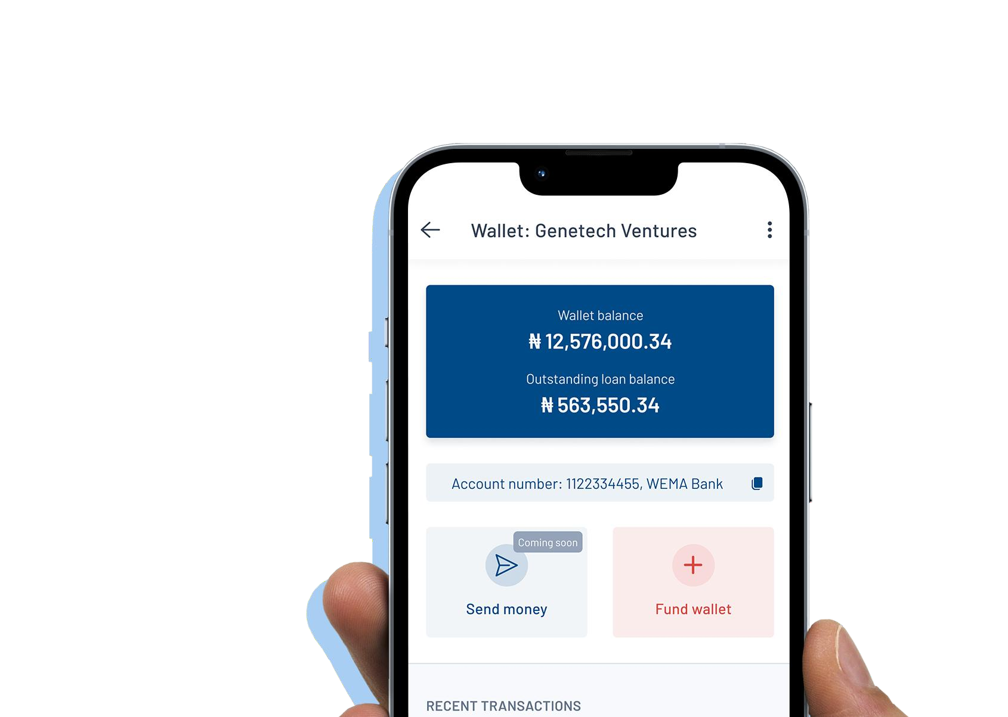












Vendorcredit: Solving the Supply Chain Finance problem
Vendorcredit is a Supply Chain Finance platform that bridges the trade finance gap between MSMEs (Suppliers/ Vendors) with their Buyers (Corporates).
Vendorcredit is a digital financial intermediation platform that streamlines credit from onboarding to co lections, giving MSMEs and large enterprises sustainable access to growth capital.
│PAGE 08
©Vendorcredit.ng. All rights reserved. Proprietary and confidential. Forinternal use only.

Slide 9
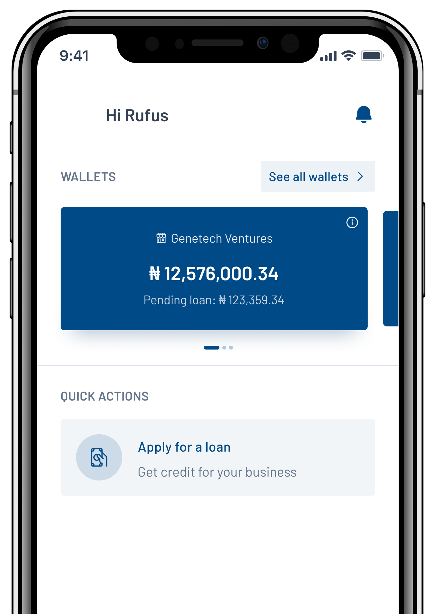

We do this by offering:
A fast, four-step process: finding credit,
reviewing and scoring it, matching it with the right lenders, and completing the payment.
Our smart algorithm checks each transaction,
finds the best financing options, and ensures payments are settled—all within 48 hours.
For our Embedded Finance solution, this takes a few minutes.
By the end of 2030, we target a 5% share of Africa’s SME market, positioning us to serve milions of supply chain businesses at scale and drive sustainable economic growth continent-wide.
│PAGE 09
©Vendorcredit.ng. All rights reserved. Proprietary and confidential. Fo
r internaluse only.

Slide 10
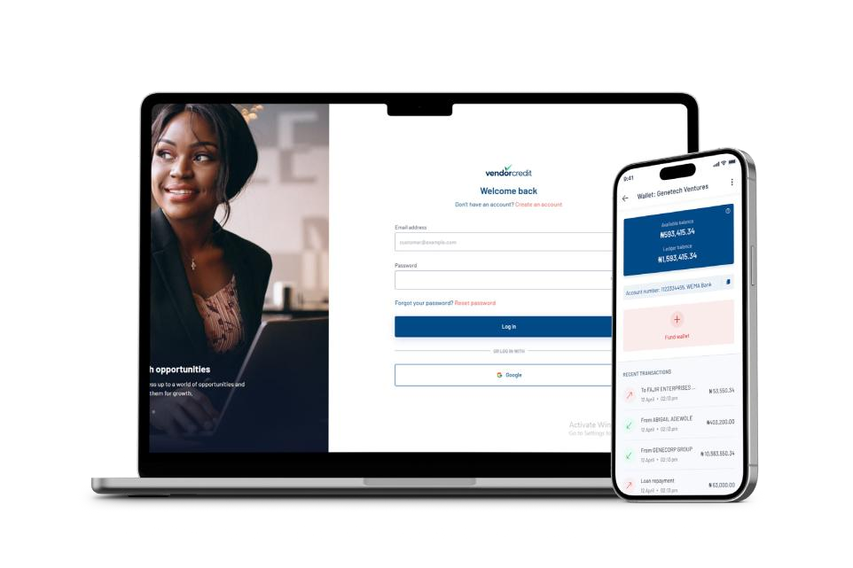
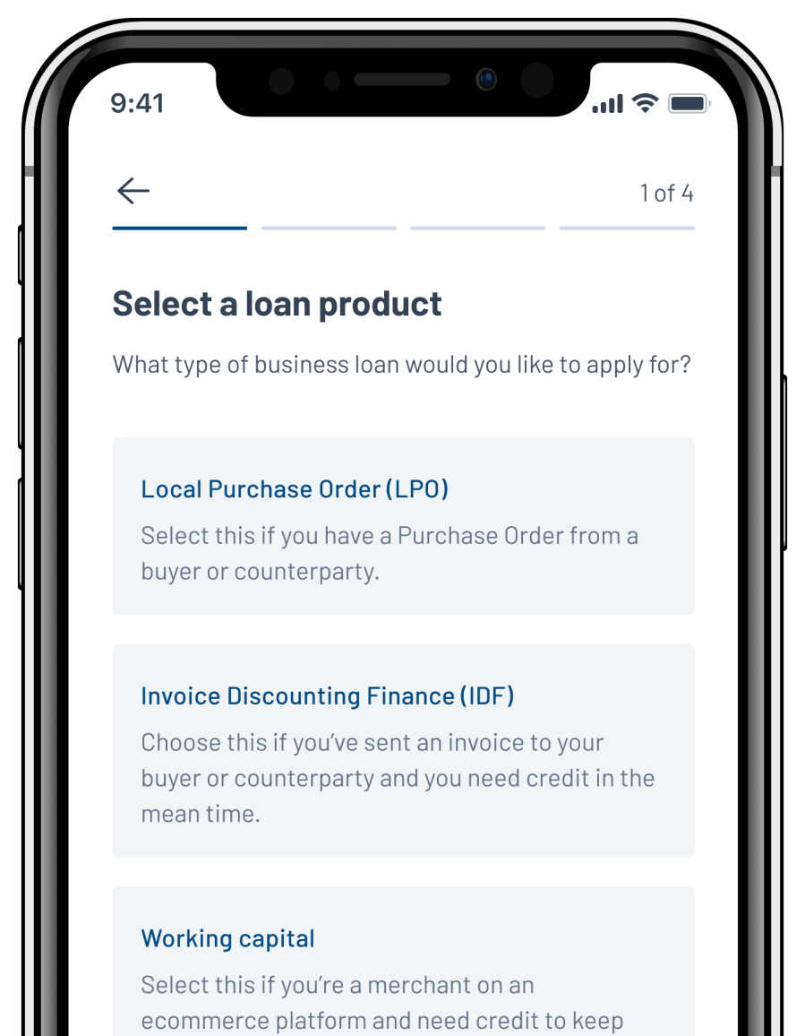
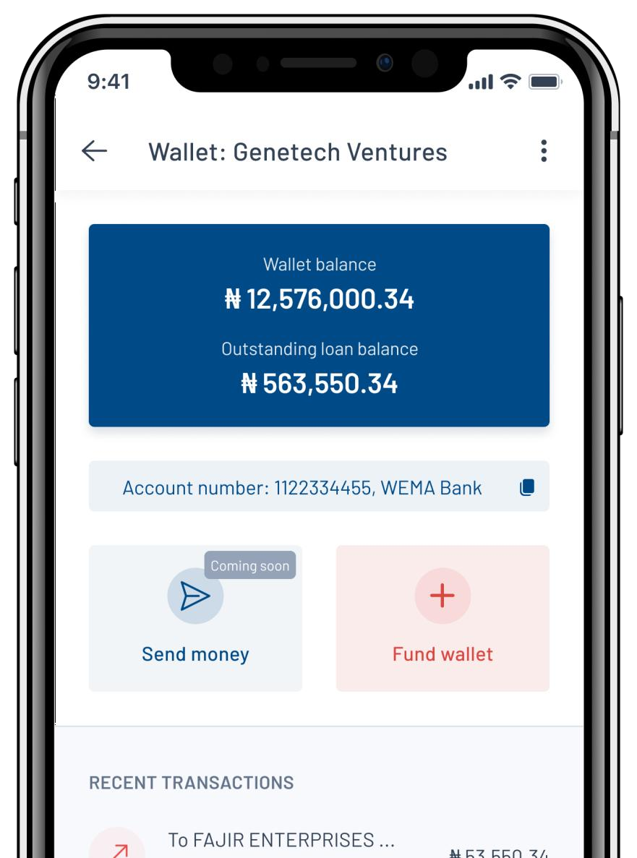






How It Works – 3 simple steps
1 Step One:
Register on our app.
2 Step Two:
Request a loan by uploading the necessary documents.
3 Step Three:
Receive disbursement directly into your account.
Scan to download here!

Slide 11




The Solutions We Offer
We provide tailored access to finance:
For Corporates: Supplier Advance Programs, Asset Financing, Instant Payment Programs, etc.
For Vendors: Purchase Order Financing, Invoice Discounting, and Working Capital Finance, etc.

Slide 12

Why This Matters?
Ms. O’s success is proof of what happens when businesses gain access to the right financing tools.
At Vendorcredit, she is one of over 9,000 vendors we have empowered, with 100s of millions of dollars disbursed across sectors.
Businesses like Ms. O’s are the drivers of industrialization in Africa.

Slide 13
With Vendorcredit, Industrialization Drivers like Elise Charles's don’t just get financial support, they get a strategic growth partner for life.

Slide 14








Impact on Corporates
Our approach is to consider risk from three perspectives
Faster Project Timelines
Transactions to be financed
BUYER/ CORP
SUPPLIER/ SME
99% Project Completion Rate
Industrialization Drivers
Access credit without leveraging balance sheet
Stronger Vendor Loyalty

Slide 15























We have Success Stories across
… and many others
│PAGE 15
©Vendorcredit.ng. All rights reserved. Proprietary and confidential. For internal use only.

Slide 16
Why Us?
200+
Transacted corporate clients
<5%
Default Rate
700+
Active Vendors
27,000+
Jobs Created
N150B+
Transactions processed
40%
Supported green, women & Youth Led Businesses
48hr
turn-around
timeon aver-age
9,000+
Onboarded Vendors
25,000+
Garnered Vendors
22,000+
Processed Requests
100,000
Merchant access to Embedded Finance

Slide 17
Smart Corporates and Reliable Vendors work with Vendorcredit.
Partner with us today. Let’s facilitate drivers of Africa’s supply chain, together.

Slide 18






Growth@Vendorcredit.ng 07038950792 | 08059140306
www.vendorcredit.com
@vendorcredit

