Slide 1
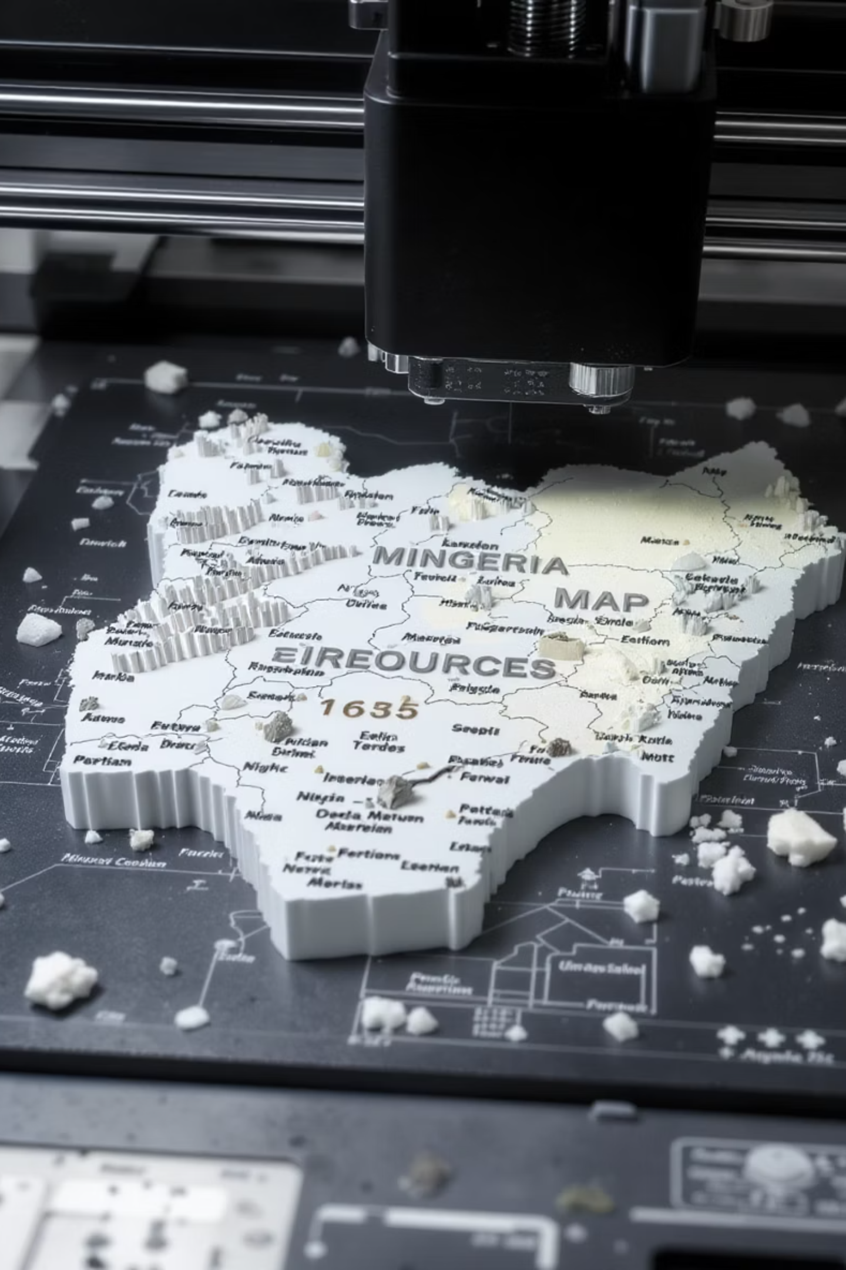

Leveraging West Africa Minerals for Additive Manufacturing – The Nigeria Case Study
Presented by
Dr. Olusanmi A. Adeniran, Ph.D., PMP, CQA
President | Abacoll Solutions LLC, Dallas, Texas, USA
March 3, 2026
West Africa Industrialization, Manufacturing and Trade Summit & Exhibition 2026

Slide 2









About Abacoll
Dr. Olu Adeniran
Ph.D., PMP, CQA
President
Engineering and management consulting company
Located in Dallas, TX
Established in 2018
Our Business
Advanced Materials & Manufacturing Solutions
Alternate Materials & Manufacturing Development
Product Lifecycle Management
Material Quality Advisory
Sustainable Energy
Renewables
Clean Energie
Energetic Minerals
Asset Integrity Solutions
Advanced NDT Inspection
Mechanical Integrity Inspection
Advanced solutions for pipeline assessment
General Consulting, Engineering, and Analysis
Engineering, Procurement, & Construction (EPC)
Materials Performance & Protection
Training & Technical Development
Dr. Zhiru Shi
Ph.D., PMP, PSM1
Director, Engineering
Dr. Davidson Akwada
Ph.D., PMP, CSSBB
Director, QEHS
2
Notes:
Introduction - Definition of Additive Manufacturing (AM), Importance in Aerospace
Current Global Trends - Adoption Rates in Aerospace, Technological Advancements, Key Players, and Regions
Applications in Aerospace - Prototyping, Tooling, End-Use Parts, Quality Assurance
Benefits of Additive Manufacturing - Cost Reduction, Weight Savings, Design Flexibility,
Challenges and Limitations - Material Constraints, Regulatory Hurdles
Future Opportunities - Innovations in Materials, Integration with Other Technologies, Expansion into New Markets
Case Studies - Successful Implementations, - Lessons Learned
Conclusion - Summary of Key Points, Future Outlook
Q&A Session

Slide 3
Agenda
Manufacturing
Additive Manufacturing
The AM Opportunities
The West Africa Minerals Challenges
The AM Road Map for West Africa
Conclusion
3
Notes:
Introduction - Definition of Additive Manufacturing (AM), Importance in Aerospace
Current Global Trends - Adoption Rates in Aerospace, Technological Advancements, Key Players, and Regions
Applications in Aerospace - Prototyping, Tooling, End-Use Parts, Quality Assurance
Benefits of Additive Manufacturing - Cost Reduction, Weight Savings, Design Flexibility,
Challenges and Limitations - Material Constraints, Regulatory Hurdles
Future Opportunities - Innovations in Materials, Integration with Other Technologies, Expansion into New Markets
Case Studies - Successful Implementations, - Lessons Learned
Conclusion - Summary of Key Points, Future Outlook
Q&A Session

Slide 4




Manufacturing
Process of transforming raw materials, components, or parts into finished goods
Traditional
Machining
- Milling, drilling, etc.
Forming
- Sheet metal stamping
Casting
– Investment
casting, sand casting
Forging
Advanced
Additive Manufacturing
- Selective Laser Melting
Joining Technologies
- Specialized welding
- Adhesive bonding
- Mechanical fasteners
Composite fabrication
Autoclave curing
Resin Transfer Molding (RTF)
Heavy Industry
Automotive, mining, cement
Material removal processes
Tooling costs for new designs
Design constraints
Established supply chains
Lower per-unit costs at scale
Material addition processes
No tooling required
Design freedom
Developing supply chains
Higher material utilization
Light Manufacturing
Textiles, electronics
Agro-Processing
Food, beverages, packaging
Pharmaceuticals
Medicinal manufacturing
4

Slide 5
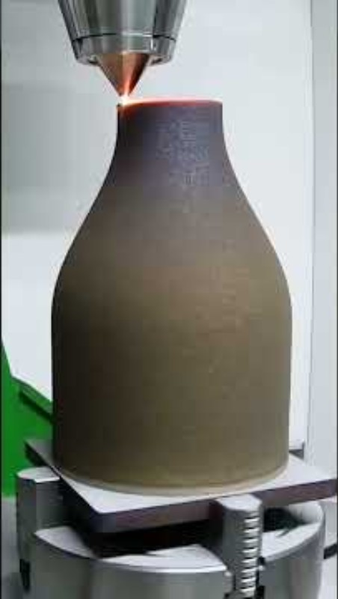
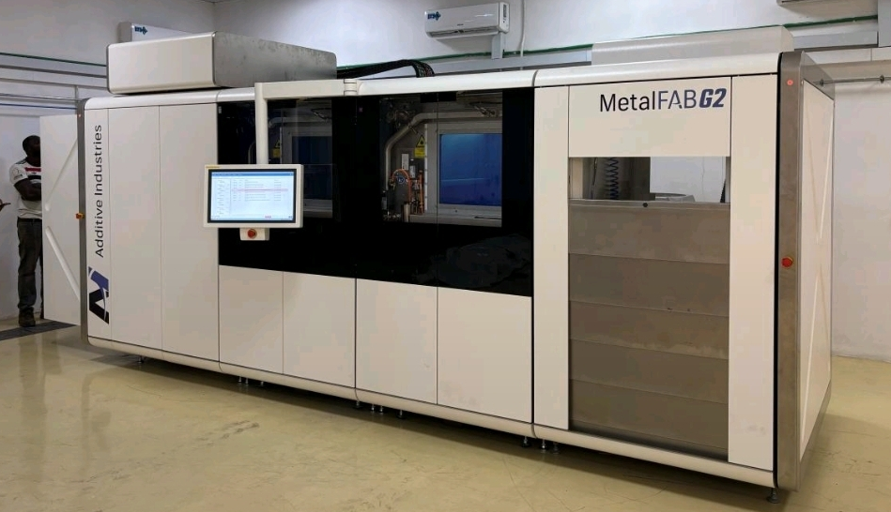
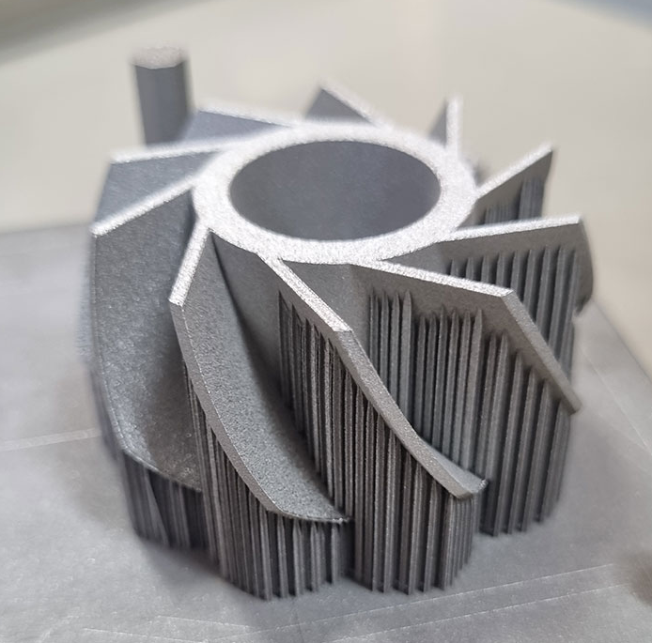
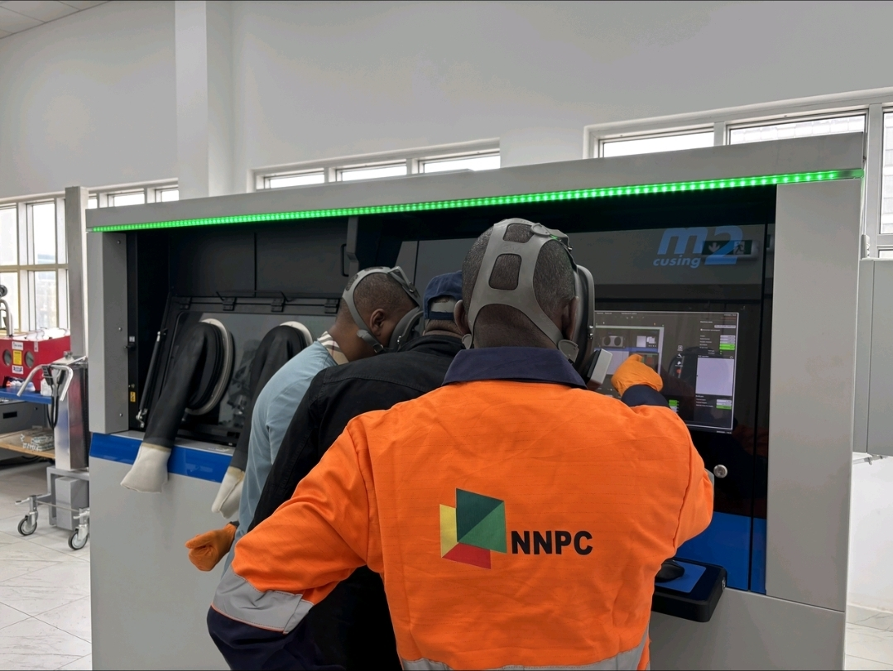
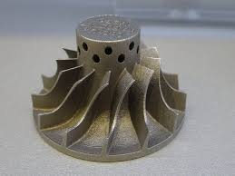
AM at Work
[1] Nigeria Foundries implemented 2025 [Source: LinkedIn]
[3] Stainless steel impeller
https://metalworkingnews.info/mintek-adds-a-laser-powder
-bed-fusion-3d-printer-to-array-of-cutting-edge-technology/
Layer-by-Layer Construction
Digital Design Focus
Complex Geometries
Mass Customization
Supply chain resilience
.
[2] NNPC commissioned 2025 [Source: LinkedIn]
5
Notes:
Introduction - Definition of Additive Manufacturing (AM), Importance in Aerospace
Current Global Trends - Adoption Rates in Aerospace, Technological Advancements, Key Players, and Regions
Applications in Aerospace - Prototyping, Tooling, End-Use Parts, Quality Assurance
Benefits of Additive Manufacturing - Cost Reduction, Weight Savings, Design Flexibility,
Challenges and Limitations - Material Constraints, Regulatory Hurdles
Future Opportunities - Innovations in Materials, Integration with Other Technologies, Expansion into New Markets
Case Studies - Successful Implementations, - Lessons Learned
Conclusion - Summary of Key Points, Future Outlook
Q&A Session

Slide 6
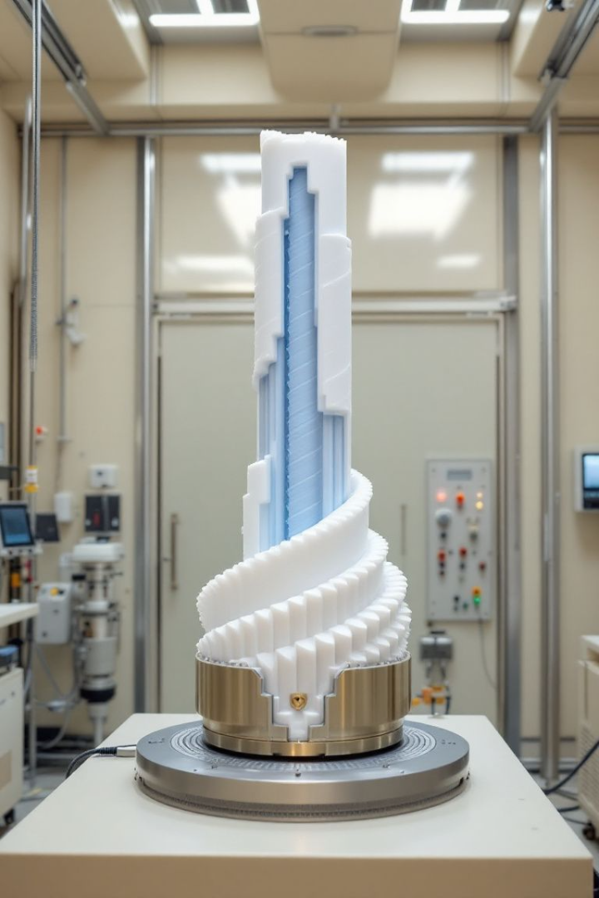




Oil & Gas Opportunities
Drilling Components
Customized drill bits with integrated sensors. Operational life extension beyond 35% in harsh environments.
Valves & Control Systems
Complex internal geometries for improved flow dynamics. Pressure drop reduction beyond 22%.
Pipeline Solutions
On-site printing of repair components. Downtime reduction from weeks to days.
Subsea Equipment
Corrosion-resistant complex components. Performance improvement while reducing costs.
6

Slide 7

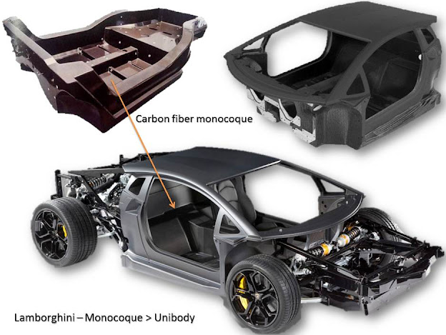
Automotive Opportunities
Steel (50-70%) Plastics and Composites (10-20%) Aluminum (5-15%) Other Materials (5-10%)
Abundant iron ore (for 316L stainless steel), tin (for bronze alloys), and columbite-tantalite (for Nb, Ta alloys) can be explored for industrial revolution in West Africa
7
Notes:
Introduction - Definition of Additive Manufacturing (AM), Importance in Aerospace
Current Global Trends - Adoption Rates in Aerospace, Technological Advancements, Key Players, and Regions
Applications in Aerospace - Prototyping, Tooling, End-Use Parts, Quality Assurance
Benefits of Additive Manufacturing - Cost Reduction, Weight Savings, Design Flexibility,
Challenges and Limitations - Material Constraints, Regulatory Hurdles
Future Opportunities - Innovations in Materials, Integration with Other Technologies, Expansion into New Markets
Case Studies - Successful Implementations, - Lessons Learned
Conclusion - Summary of Key Points, Future Outlook
Q&A Session

Slide 8

Automotive Application
Shelby Cobra 3D Printed at the Oak Ridge, Tennessee, USA National Laboratory
8
Notes:
Introduction - Definition of Additive Manufacturing (AM), Importance in Aerospace
Current Global Trends - Adoption Rates in Aerospace, Technological Advancements, Key Players, and Regions
Applications in Aerospace - Prototyping, Tooling, End-Use Parts, Quality Assurance
Benefits of Additive Manufacturing - Cost Reduction, Weight Savings, Design Flexibility,
Challenges and Limitations - Material Constraints, Regulatory Hurdles
Future Opportunities - Innovations in Materials, Integration with Other Technologies, Expansion into New Markets
Case Studies - Successful Implementations, - Lessons Learned
Conclusion - Summary of Key Points, Future Outlook
Q&A Session

Slide 9
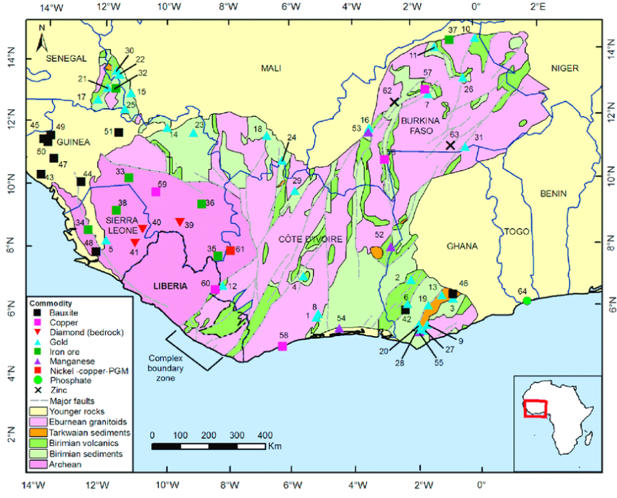
The West African Opportunity
Metals & Alloys
Nickel Based Superalloys
Stainless Steels
Steel Alloys
Aluminum (Bauxite)
Aluminum Alloys
Titanium Alloys
Copper
Special Alloys
Rare Earth Metals
Polymers and Polymer Composites
Global AM market, valued at $18.3 billion in 2023
Projected to reach $50.49 billion by 2029
Location of selected major metallic mineral deposits in West Africa. Gunn, A.G. & Dorbor, J.K. & Mankelow, J.M. & Lusty, Paul & Deady, E.A. & Shaw, Richard & Goodenough, Kathryn. (2018). A Review of the Mineral Potential of Liberia. Ore Geology Reviews. 101. 10.1016/j.oregeorev.2018.07.021.
9

Slide 10
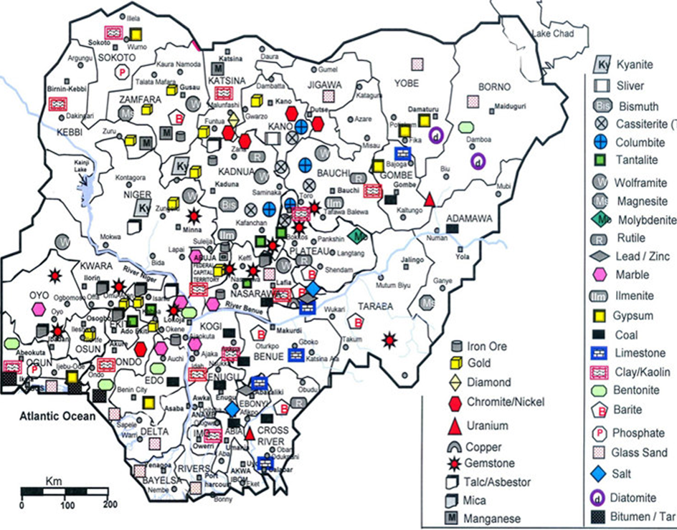
The Nigerian Opportunity
Possesses at least 44 commercially viable mineral types:
Lithium, titanium, iron ore, columbite-tantalite, and rare earth elements.
Extensive mineral resources spanning 923,768 km²
Unprecedented opportunities to establish indigenous additive manufacturing (AM) capabilities in sub-Saharan Africa.
Growing at a 21.2% CAGR. For Nigeria, Africa's largest economy with
Strategic exploitation can establish a robust foundation for the domestic 3D printing industry
By addressing value chain gaps via strategic partnerships, Nigeria can position itself as a regional advanced manufacturing hub, driving industrial diversification and reducing import dependency.
Mineral map of Nigeria [Vision 2020 National Technical Group on minerals and metals development (Agency, 2020, 2022)]
10

Slide 11

Mining Sector's Current Underperformance
0.6%
7.3%
4.8%
25%
GDP Contribution
South Africa
Ghana
Botswana
Nigeria's mining sector contributes only 0.6% to GDP despite hosting 44+ commercially viable minerals
GDP contribution from mining sector
GDP contribution with gold dominance
GDP contribution from diamonds
Systemic constraints including policy fragmentation with minimal or overlapping mandates between federal/state authorities
Informal dominance with 85% of mineral extraction occurring illegally or through artisanal mining
Infrastructure deficit where only 12% of mining sites have grid power
11

Slide 12

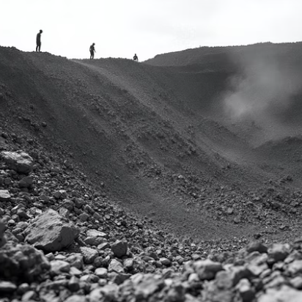
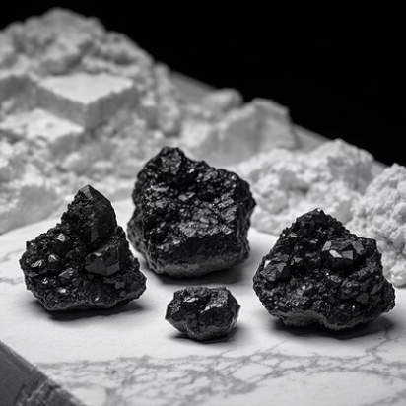

Nigeria's Mineral Endowments
Nigeria's geological framework encompasses diverse mineral occurrences essential for AM feedstock production.
The Nigerian Ministry of Solid Minerals Development catalogues extensive deposits of iron ore (3.0 billion tons), tin (10,000 tons annually), and columbite-tantalite.
The resources align closely with AM feedstock requirements, particularly for aerospace, automotive, and defense applications.
There are also significant occurrences of rare earth elements, positioning it uniquely in the global supply chain for advanced manufacturing materials.
12

Slide 13




Mineral-to-Feedstock Alignment
Iron Ore Deposits
Tin Resources
The Itakpe, Agbaja, and Lokoja deposits contain high-grade magnetite and hematite suitable for producing 316L stainless steel powders, representing 78% of current global AM steel consumption.
Jos Plateau tin deposits, with 99.5% purity levels, provide excellent feedstock for bronze and tin-based alloy powders used in specialized AM applications.
Columbite-Tantalite
Nigeria's dominance in columbite-tantalite production positions the nation uniquely for producing niobium and tantalum powders essential for high-temperature aerospace applications.
Additional resources include titanium in Cross River and Nasarawa (for Ti-6Al-4V powders used in
Biomedical And aerospace applications) and rare earth elements in Bauchi and Oyo (for magnetic
powders used in electronics and motors). See Appendix A for Top 20 Mineral Ores and their importance
13

Slide 14






Geographic Distribution Analysis
Northern Crystalline Complex
Iron ore and rare earth concentrations
Middle Belt Corridor
Encompasses tin, columbite, and tantalite deposits
Southwestern Basement Complex
Diverse metallic mineral occurrences
Strategic clustering in three primary zones across Nigeria.
The geographic distribution creates natural hubs for developing specialized processing facilities tailored to specific mineral types.
The strategic location of the mineral clusters provide opportunities for creating integrated mining and processing centers that can efficiently convert raw materials into AM feedstock with minimal transportation costs.
14

Slide 15






AM Feedstock Requirements
Specialized Applications
Aerospace, automotive, defense
Material Properties
Chemical composition, morphology
Particle Characteristics
Spherical particles, 15-45 micrometers
Contemporary AM technologies for metallic components primarily utilize powder metallurgy principles.
The processes require specific particle size distributions, chemical compositions, and morphological characteristics for optimal print quality
Titanium alloys, aluminum alloys, stainless steels, and nickel-based superalloys dominate industrial applications.
The powder specifications typically demand spherical particles ranging from 15-45 micrometers, which Nigeria's mineral resources can be processed to meet.
15

Slide 16
Strategic Advantages
Resource Security
Cost Competitiveness
Domestic mineral control eliminates supply chain vulnerabilities inherent in imported feedstock materials, providing strategic autonomy for critical manufacturing capabilities.
Direct access to raw materials significantly reduces feedstock costs, traditionally representing 25-40% of AM production expenses according to Wohlers Associates (2023).
Value-Addition Opportunities
Integrated mineral processing and powder production facilities can capture entire value chains, maximizing economic returns from natural resource exploitation.
16

Slide 17



Implementation Framework
Infrastructure Development
Establishing powder production facilities proximate to mineral extraction sites
Processing plants near mining operations
Transportation networks for efficient distribution
Quality Assurance Systems
Implementing international standards for AM feedstock certification compliant with ASTM F3049-14 and ISO/ASTM 52900
Testing laboratories for powder validation
Certification processes aligned with global standards
Technology Transfer
Partnering with established AM equipment manufacturers for knowledge acquisition
Joint ventures with international partners
Training programs for local workforce
17

Slide 18
Implementation Roadmap and Conclusion
Foundation (Years 1-3)
1
Verify solid minerals available to support local industrialization.
Establish pilot processing and testing labs to validate mineral-to-powder conversion processes and quality standards.
2
Expansion (Years 3-5)
Build powder production lines and quality control units to scale up operations and meet international certification requirements.
Integration (Years 5-7)
3
Link extraction, atomization, and AM printing value chains to create a complete ecosystem from mine to finished product.
4
Innovation (Years 8-10)
Develop proprietary AM materials tailored to West Africa ores, creating unique value propositions in global markets.
West Africa's vast, underutilized mineral wealth aligns strongly with the global demand for AM feedstock materials.
With strategic investments in beneficiation infrastructure, powder production, quality certification, and international partnerships, Nigeria and other West Africa nations can lead sub-Saharan Africa into a new era of industrial competitiveness.
18

Slide 19

Questions
19
14

Slide 20
Contact
Dr. Olusanmi Adeniran, Ph.D., PMP, CQA
President, Abacoll Solutions LLC
Dallas, TX, United States
olu@abacoll.com | www.Abacoll.com
+1(682)561-4015
20
15

