Slide 1






INNOVATION & FUTURE TECH.
TRADE | TECH | DEVELOPMENT
WWW. THEINNOVATIONCENTRE. ORG

Slide 2
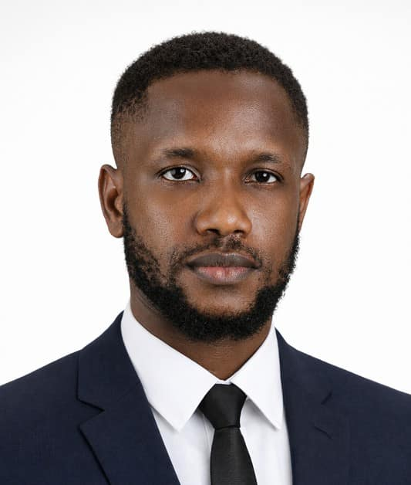




ABOUT US
We work at the intersection between Policy, and Private Sector driving Trade Technology and Development
The Innovation Centre for Inclusive Growth is an organization committed to advancing equitable economic development through Trade, Technology and Development. We work at the intersection of policy,
innovation, and capacity building to ensure that economic growth is broad-based, sustainable, and inclusive.
Jude M. Oseh Founder & ED

Slide 3





INNOVATION
TAKES COURAGE

Slide 4









RESISTANTS
INNOVATORS
RIM OPERATING SYSTEM
SEASHELLS FOR INTERIOR DECO - ENERGY
COSMETICS &
PLASTICS - ELECTRONICS
SOFTWARE AND HARDWARE COMPANY
TELCO - FINTECH & TECH INFRASTRUCTURE
MOBILE PHONES - NETWOKING, TELCO & AI INFRASTRUCTURE
MOVIE RENTALS IN TRADITIONAL
FORMAT (DVD + CDS)
GAMES GPU - GLOBAL AI INFRASTRUCTURE, AUTONOMOUS SYSTEMS & SUPER COMPUTING
PAYMENT GATEWAY - FULL STACK PAYMENT INFRASTRUCTURE
THE COMPANIES THAT DARED TO REINVENT THEMSELVES SURVIVES AND WIN
THOSE THAT RESISTED CHANGE EITHER BECAME IRRELEVANT OR DISAPPEARED.

Slide 5



INNOVATION IS NOT COMFORT.
INNOVATION IS RISKY.
METAVERSE $89 BILLION INVESTMENT LOSS
ONLY THE COURAGEOUS
DEPLOYS RIGHT & ONTIME, WINS

Slide 6












INNOVATION FRAMEWORK
STEP 1
STEP 2
STEP 3
STEP 4
STEP 5
STEP 6
Exermine Frictions
Identify structural bottlenecks, inefficiencies, and pain points within the ecosystem, whether operational, regulatory, financial, or behavioral.
Identify Opportunities
Convert each friction into a solvable opportunity with measurable impact.
Focus on solutions that create systemic value, not isolated fixes.
Research and Develop
Design structured solutions backed by data, stakeholder insight, and feasibility analysis.
Develop prototypes, frameworks, or models that are technically sound and economically viable.
Test and Iterate
Pilot the solution in controlled environments to validate assumptions and performance.
Collect real-world feedback from users, partners, and regulators.
Deploy and Adjust
Roll out the validated solution with proper governance, systems, and accountability. Monitor implementation risks and adapt quickly to operational realities. Execution is where innovation earns credibility.
Analyse & Optimise
Measure impact against defined KPIs and scale what’s working. Because Sustainable innovation is built on continuous optimisation.

Slide 7
OUR SUCCESS

Slide 8




PRESIDENT
40 - 35
Amended the 1999 Constitution to reduce the age qualification for elective offices in 2018.
HOUSE OF REPS
30 - 25
HOUSE OF ASSEMBLY
30 - 25

Slide 9

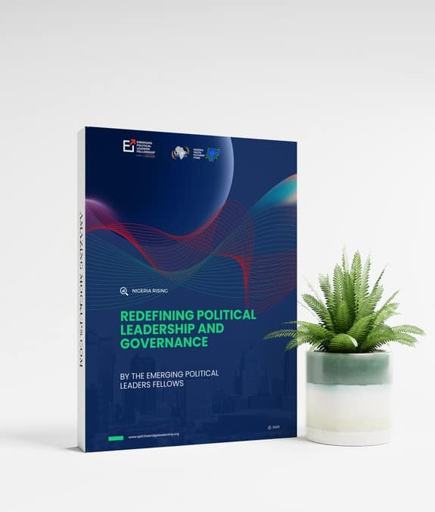

Development Finance: Exploring Alternative Revenue Stream
SOUTHERN TRUST
Policy Brief
Author: Jude McKelvin Oseh, The Innovation Centre
We presented a policy brief that was subsequently published in the EPLF
Compendium for Nigerian Legislators. The brief examined the strategic use of a Sovereign Wealth Fund as an alternative revenue-generation mechanism, proposing it as a sustainable tool for reducing
Nigeria’s debt strengthening stability.
burden long-term
and fiscal
Funded by:

Slide 10








The future of citizens participation in governance.
CivicTech
TM
www.cappnaija.org
As part of our Tech advocacy, we co-created a CivicTech tool that serves as a two-way communication channel
Politeracy
Engagement
between the government and its citizens,
facilitating a more informed, engaged, and accountable democratic process, as CAPP aspires to build a community of active citizens.
100%
70%
Patriotism
Accessable
G E T S T A R T E D
WWW. THEINNOVATIONCENTRE. ORG
CAPP TM
NOW, YOU CAN

Slide 11
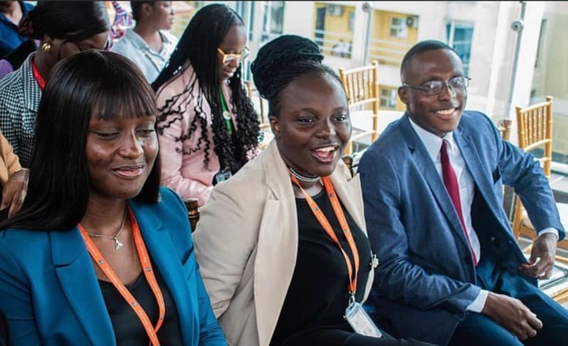

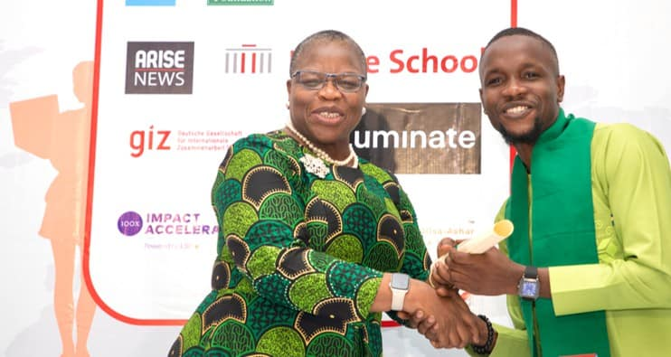



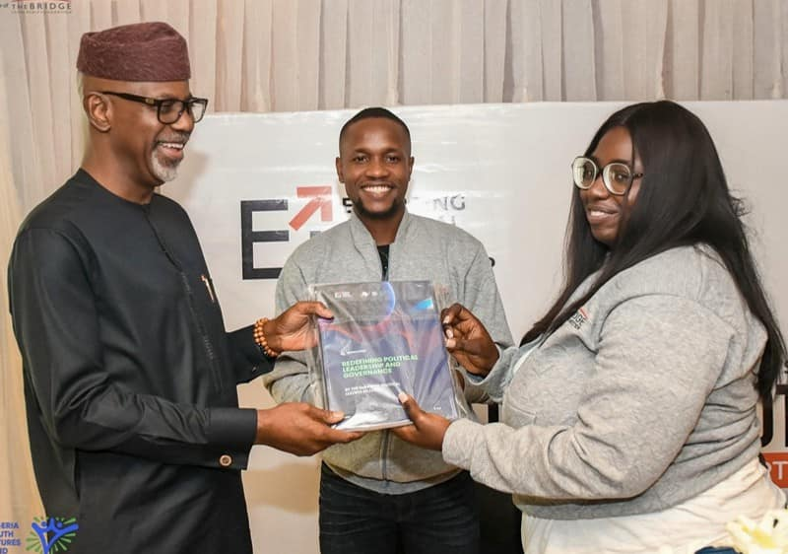
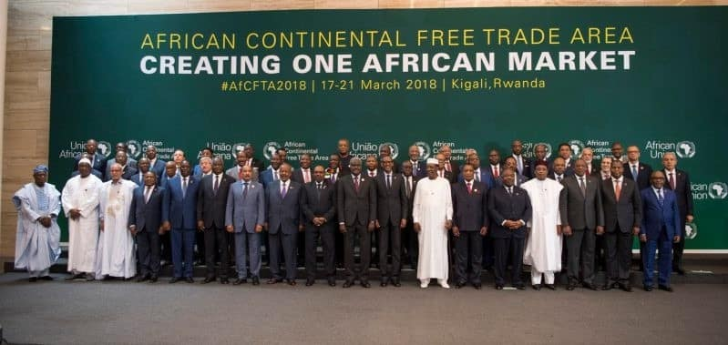
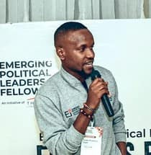
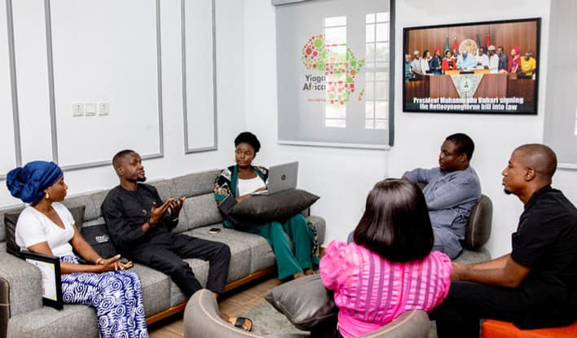
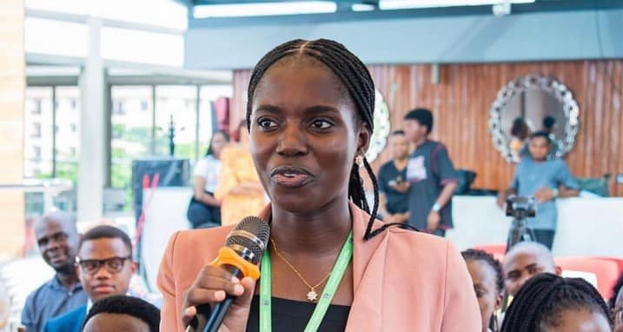
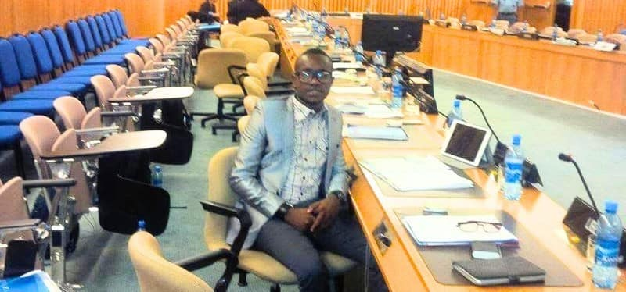
AFRICAN UNION AGENDA
2063

Slide 12
RE-IMAGINING EVERYTHING

Slide 13

TRADE HUB
A Manufacturing Cluster

Slide 14

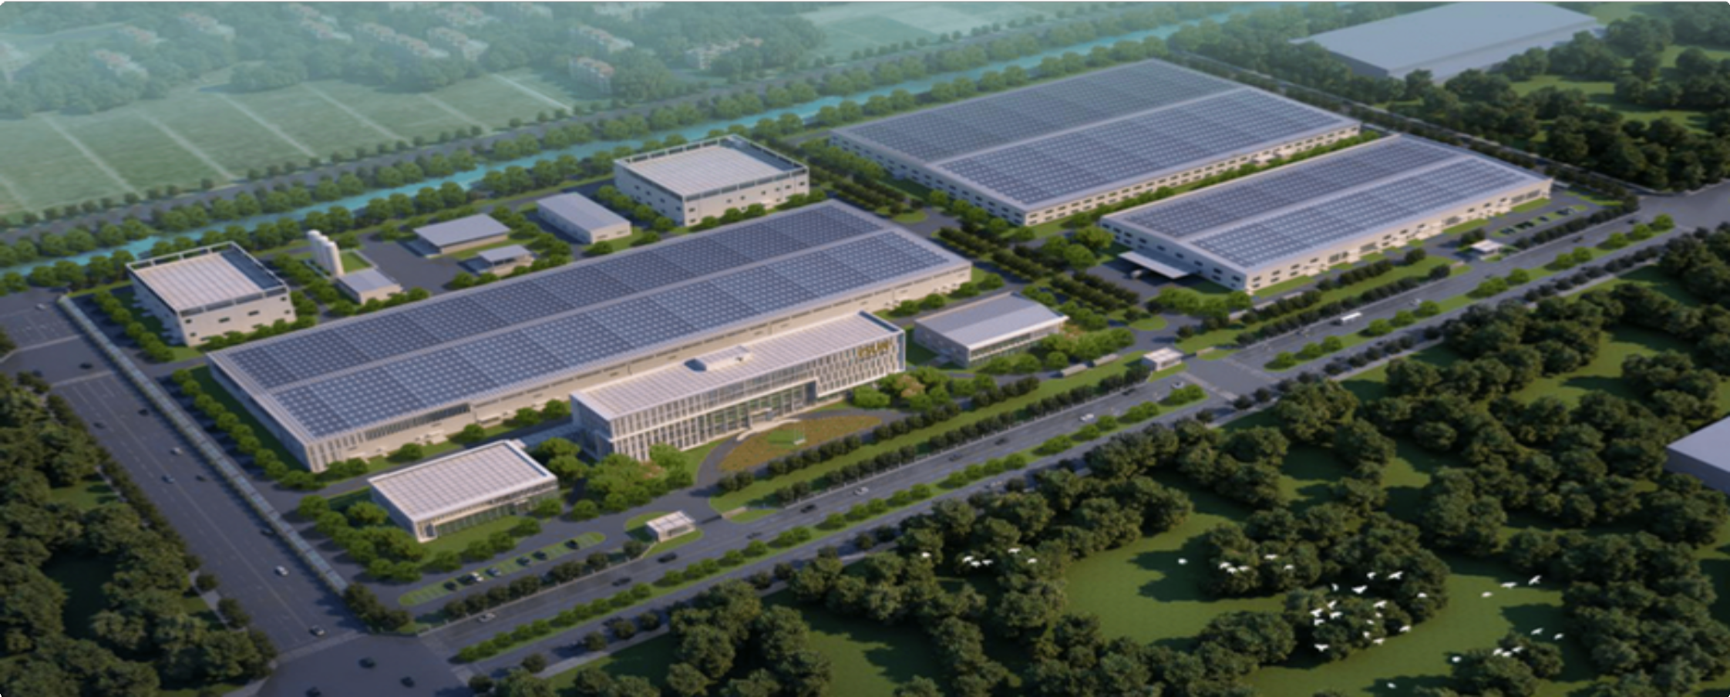



TRADE HUB
A Manufacturing Cluster
A strategically located trade and manufacturing hub designed to drive local production prioritized under the Guided Trade Initiative (GTI) and regional exports under the AfCFTA framework. The park enables efficient manufacturing, seamless cross-border trade, and accelerated access to Africa’s integrated markets.
INDUSTRIES
Food Processing Recycling
Real Estate Packaging Automotive
Home Care Essentials Beverages
Fashion: Clothing, Bags, Shoes
REGIONAL MARKETS
NIGERIA: Manufacturing Park base in Nigeria serving West Africa Region RWANDA: Manufacturing Park base Rwanda serving East Africa Region and SOUTH AFRICA: Serving the Southern African Region

Slide 15




TRADE HUB
A Manufacturing Cluster
Finance & Investment Cluster
Production & Innovation Cluster
Compliance & Standards Cluster
Trade & Market Access Cluster
Ecosystem & Institutional Support Cluster

Slide 16




THE ALL IN ONE PLATFORM FOR INTRA-AFRICA-TRADE PLATORM ENABLLING END-TO-END TRADE ACROSS AFRICA
FROM SOURCING TO SETTLEMENT
SOURCE
Find verified buyers, suppliers, and raw materials across Africa in one trusted network
VERIFY
Trade with confidence — backed by KYB partner verification and automated compliance checks
PAYMENT
Secured seamlessly payments access across 42 African countries
MONITOR
Monitor every deal from payment to delivery, with realtime status updates
INVOICE FINANCING
Upfront invoice financing access to stimulate turnover

Slide 17






FUTURE TECH
LOCALIZING
PERONAL AI
Exploring the Power of Intelligent Machines

Slide 18







What is Artificial Intelligence?
Artificial Intelligence (AI) is the simulation of human intelligence in machines programmed to think and learn like humans. AI systems are capable of performing tasks such as recognizing patterns, understanding language, and solving complex problems. It is transforming industries and driving innovation across the globe.
Pattern Recognition Machine Learning Problem-Solving

Slide 19





Emerging Technologies
Artificial Intelligence
Biotechnology
Robotics
Quantum Computing

Slide 20








Transforming Industries with AI
Healthcare
Diagnostics, drug discovery, and personalized medical solutions.
Finance & Businesses Co-pilots for Fraud detection, Consulting, and assistants.
Security & Defence
Supersonic missels, drones, laser weapons and interceptors are now built with 100% precision and accuracy.
Retail
Chatbots, tailored shopping, and supply chain efficiency.

Slide 21



Ai Infrastructure
Built in Nigeria, by Nigerians for
Africa

Slide 22

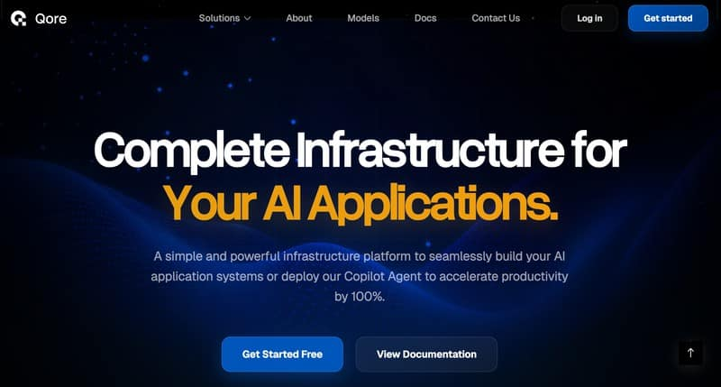

Slide 23
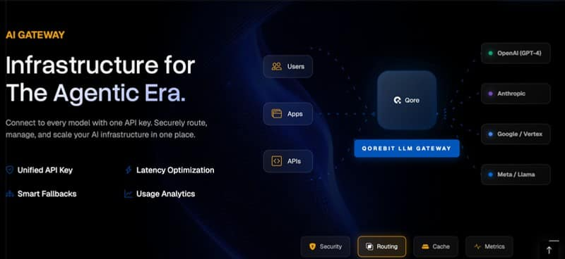

Integrated Ai Models

Slide 24
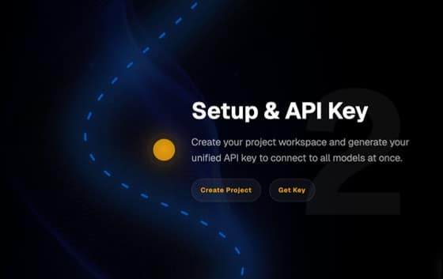

Slide 25


Technology
Adoption in Business
We belive that adopting Ai Technology Systems can potentially accelerate business outcomes in transforming West Africa and across the continent.

Slide 26
The Future is Technologically Driven
ARE YOU REALDY?

Slide 27

Q&A Session
ANY?

Slide 28

Thank You for Your Attention
www.theinnovationcentre.org
@theicafrica

