Slide 1
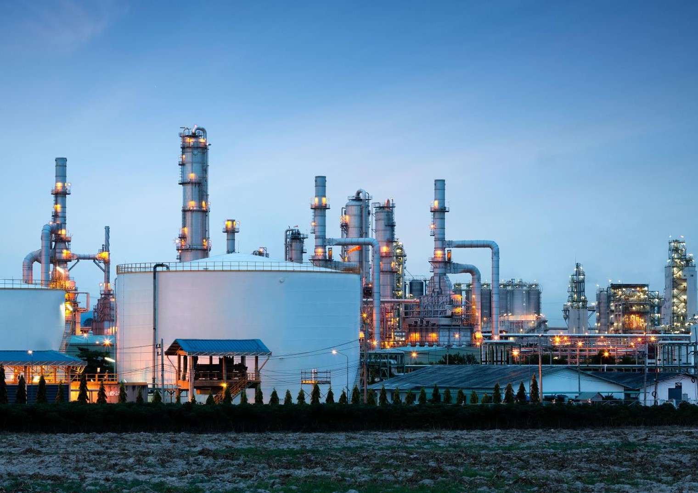








Procurement, Logistics & Supply Chain in Industrial Engineering
4th March, 2026
The West Africa Industrialization Manufacturing
& Trade Summit & Exhibition

Slide 2
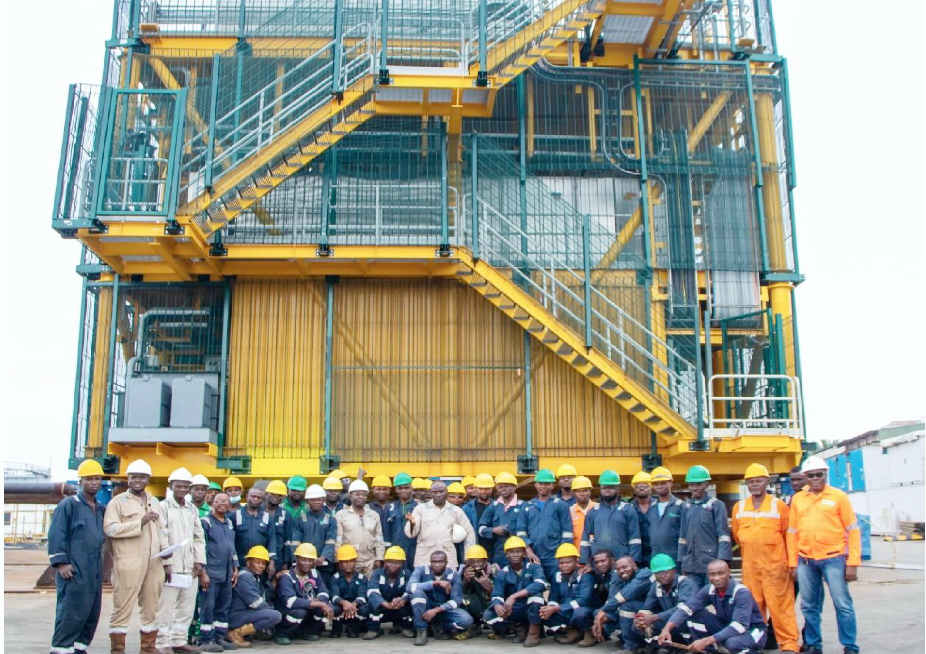
01
Table of Contents
About Us
02
Business Scope
03
Introduction
04
Strategic Procurement in Engineering
06
Logistics for Heavy Equipment
07
Local Content Optimization
07
Future Outlook

Slide 3
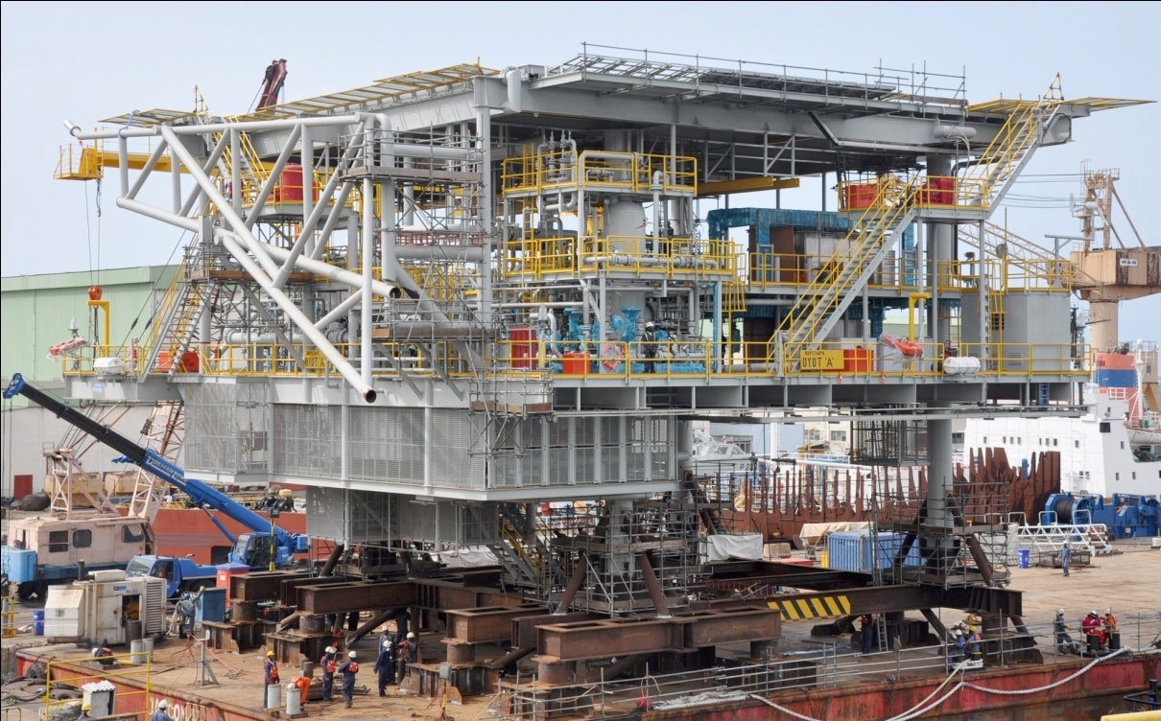
About Us
01

Slide 4
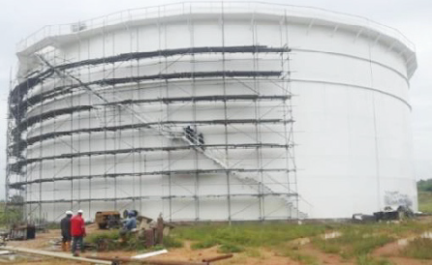
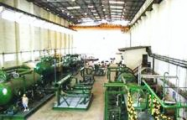
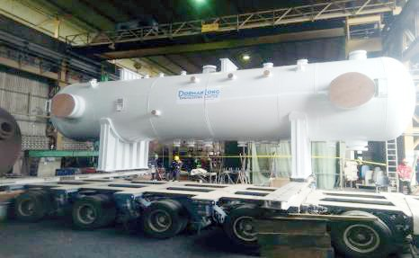
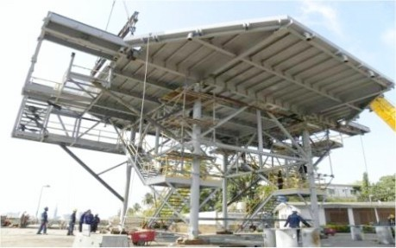
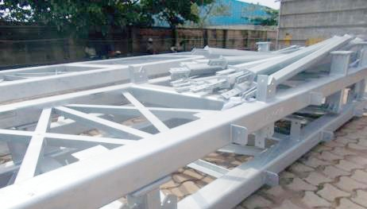
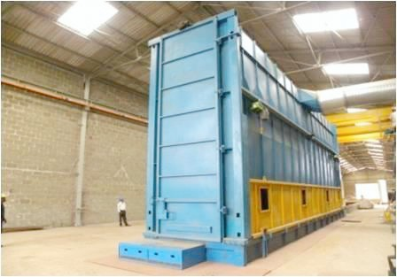
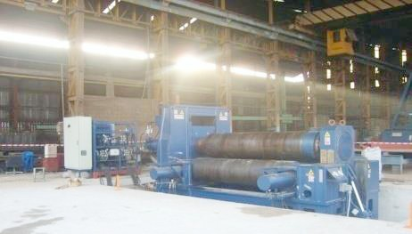
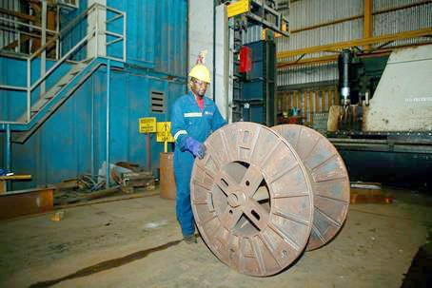
Overview
Dorman Long Engineering Limited (DLE) is an infrastructure and supply chain services company providing top-end services to the oil and gas, power, telecommunications and manufacturing industries.
Operating in Nigeria for over 75 years.
Possesses state-of-the-art facilities with internationally recognized quality and product certifications
Have enviable track record in executing a range of contracts for almost all the Oil and Gas majors and energy services companies operating in Nigeria

Slide 5
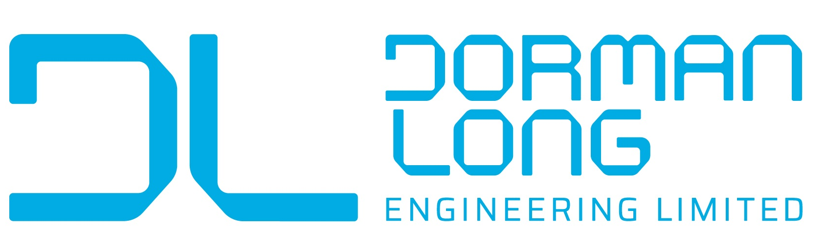
Business Scope
02
01
04
Heavy Industry Fabrication and Construction
Engineering Services
01
06
02
02
05
Asset Management
Procurement and Logistics
05
03
03
06
Galvanising and Protective Coating
04
Project Management

Slide 6
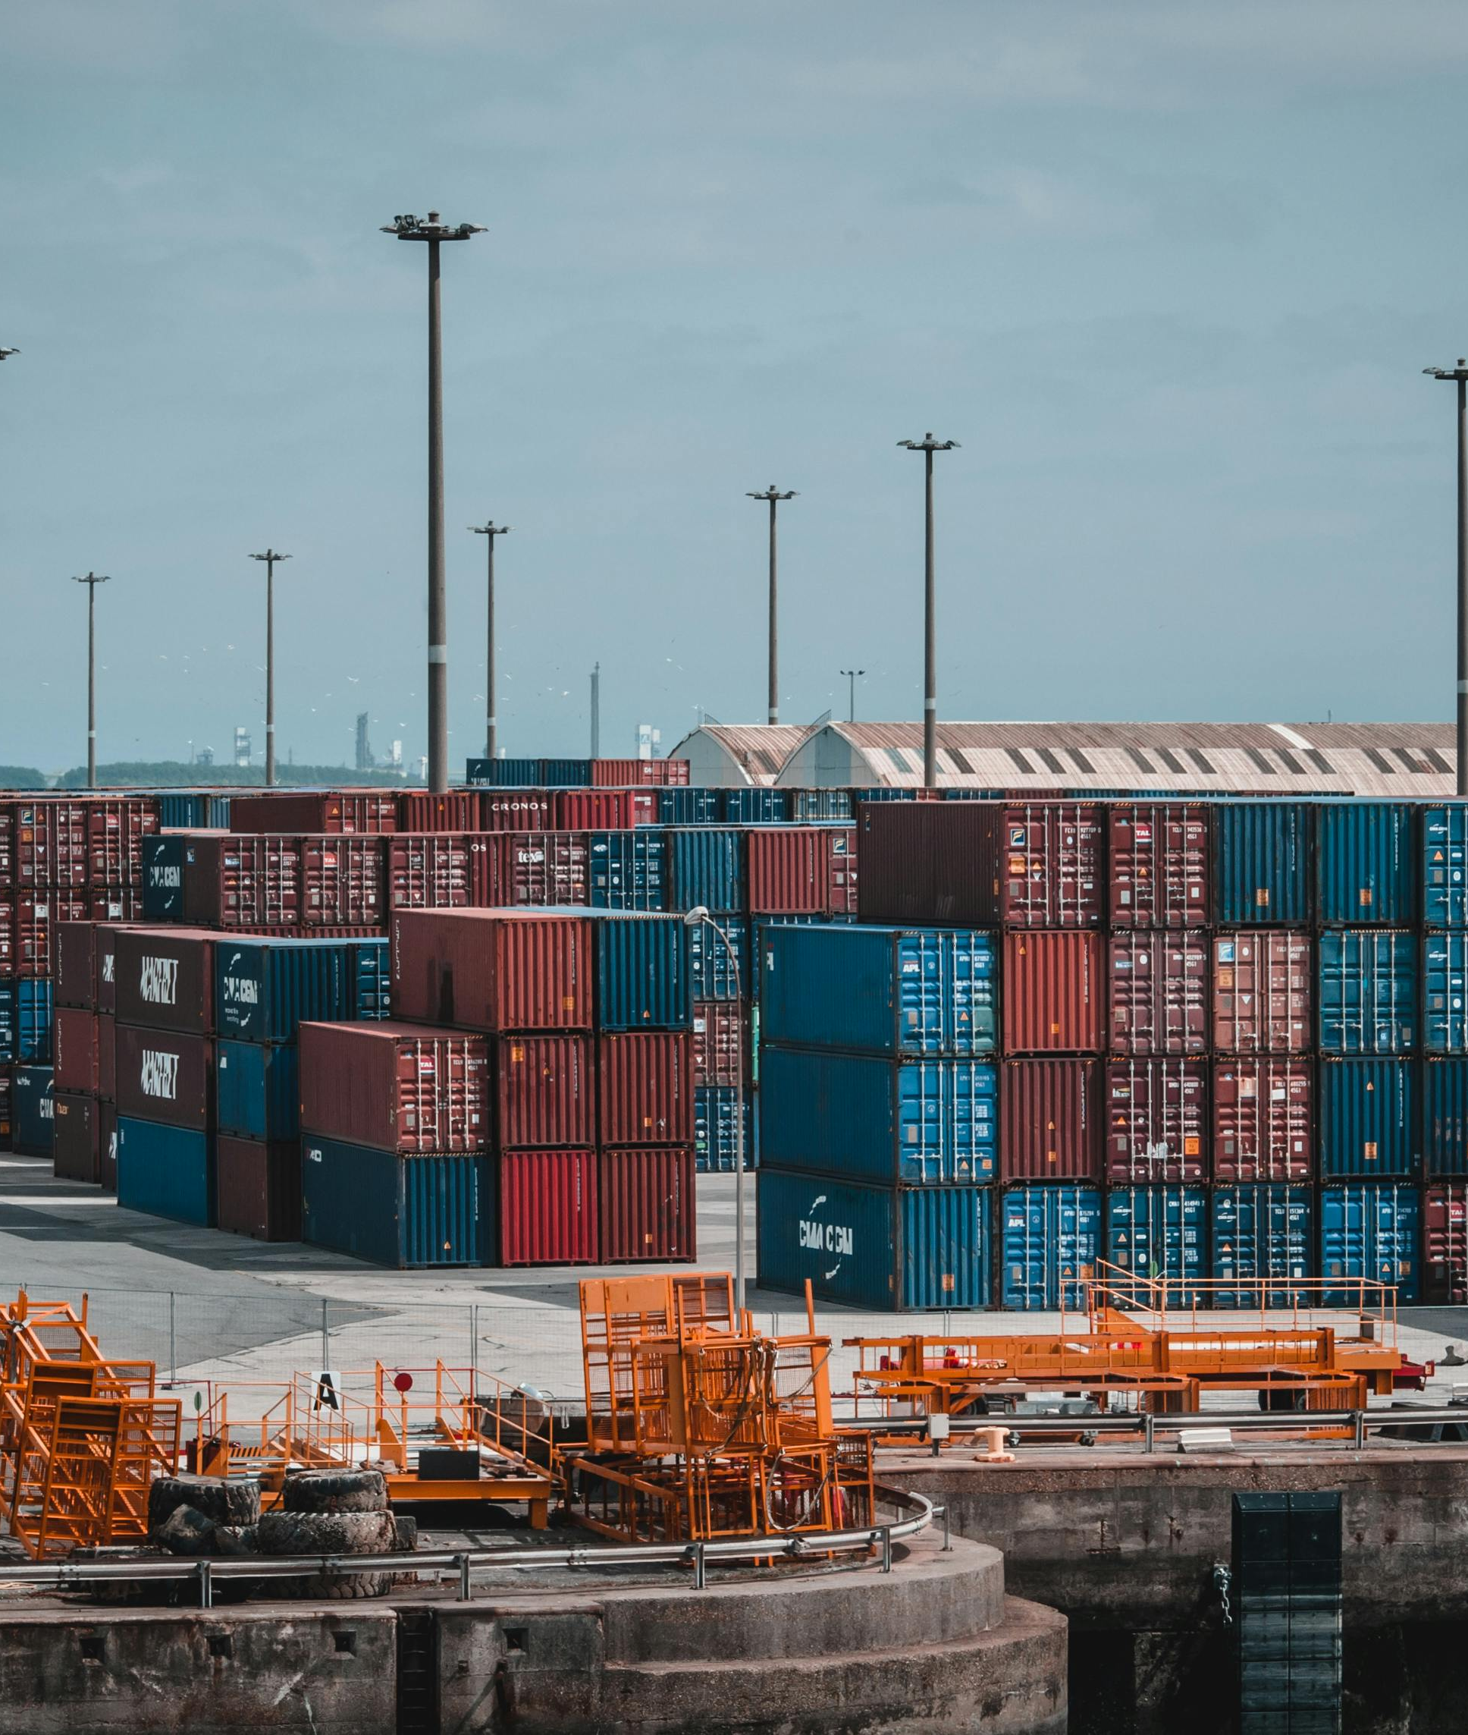
Introduction
Procurement, Logistics & Supply Chain Leveraging In-country Services & Capabilities as a Competitive Advantage in Nigeria.
Nigeria’s Operating Realities
Nigeria presents structural supply chain constraints:
Port congestion (Apapa & Tin Can)
FX volatility and USD scarcity
High ocean freight and demurrage exposure
Customs unpredictability
Inland transportation bottlenecks
Heavy reliance on imported fabricated steel
For most EPC competitors, these risks sit outside their control.
For Dorman Long, they can be structurally mitigated.

Slide 7
Procurement, Logistics & Supply Chain
Procurement Advantage: From Import Buying to Strategic Sourcing
Typical Import-Dependent Model:
Engineering locally
Fabrication offshore
Galvanizing offshore
High USD exposure
Limited cost predictability
Dorman Long Advantage:
With in-house engineering, heavy fabrication, and galvanizing:
✔ Reduced dependence on imported finished steel
✔ Lower dollar-denominated cost components
✔ Bulk raw steel procurement leverage
✔ Ability to negotiate zinc and materials at scale
✔ Faster supplier alignment with project timelines
Procurement becomes proactive, cost-controlled, and less exposed to FX shocks.

Slide 8
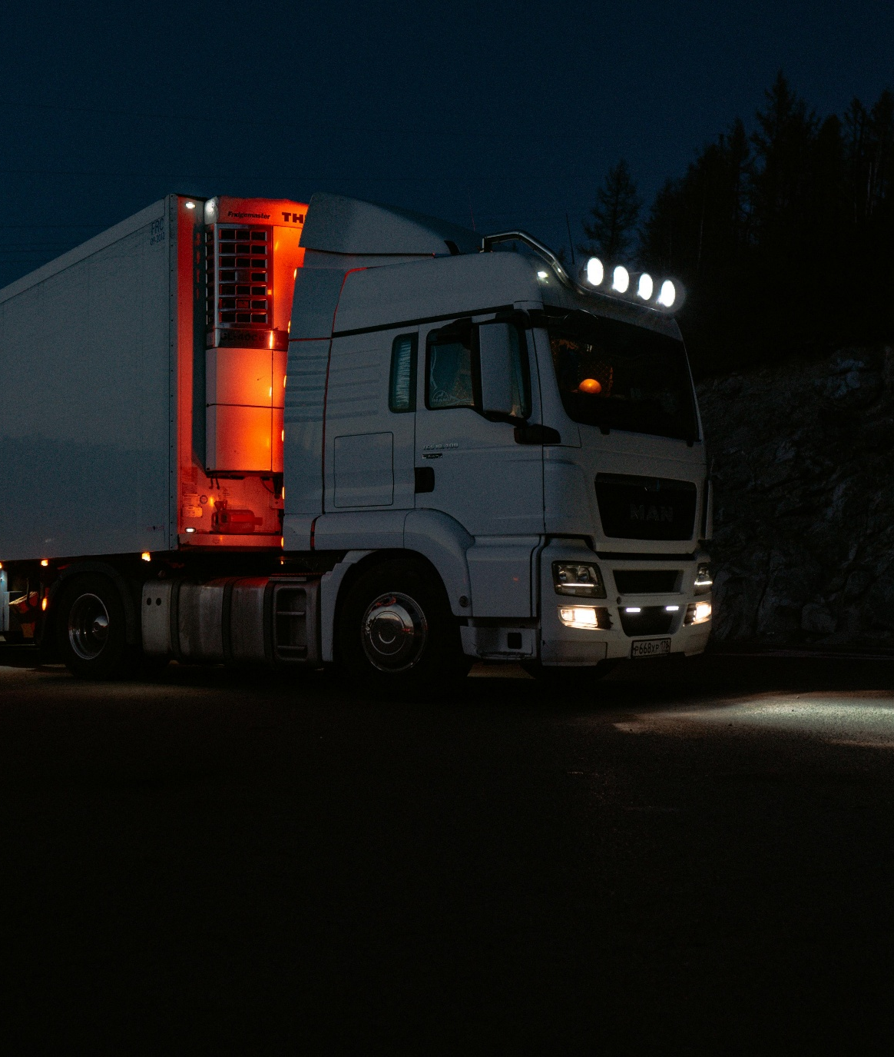
Procurement, Logistics & Supply Chain
Logistics Advantage: Production Control Reduces Transport Risk
Integrated local capability enables:
Elimination of international freight exposure
Avoidance of port demurrage delays
Fewer transport cycles (no offshore → port → inland re-handling)
Reduced transit damage risk
Faster dispatch to project sites nationwide
Outcome:
Lower cost per ton delivered
Improved on-time delivery (OTD)
Greater schedule reliability
In Nigeria, control of logistics equals control of execution risk.

Slide 9
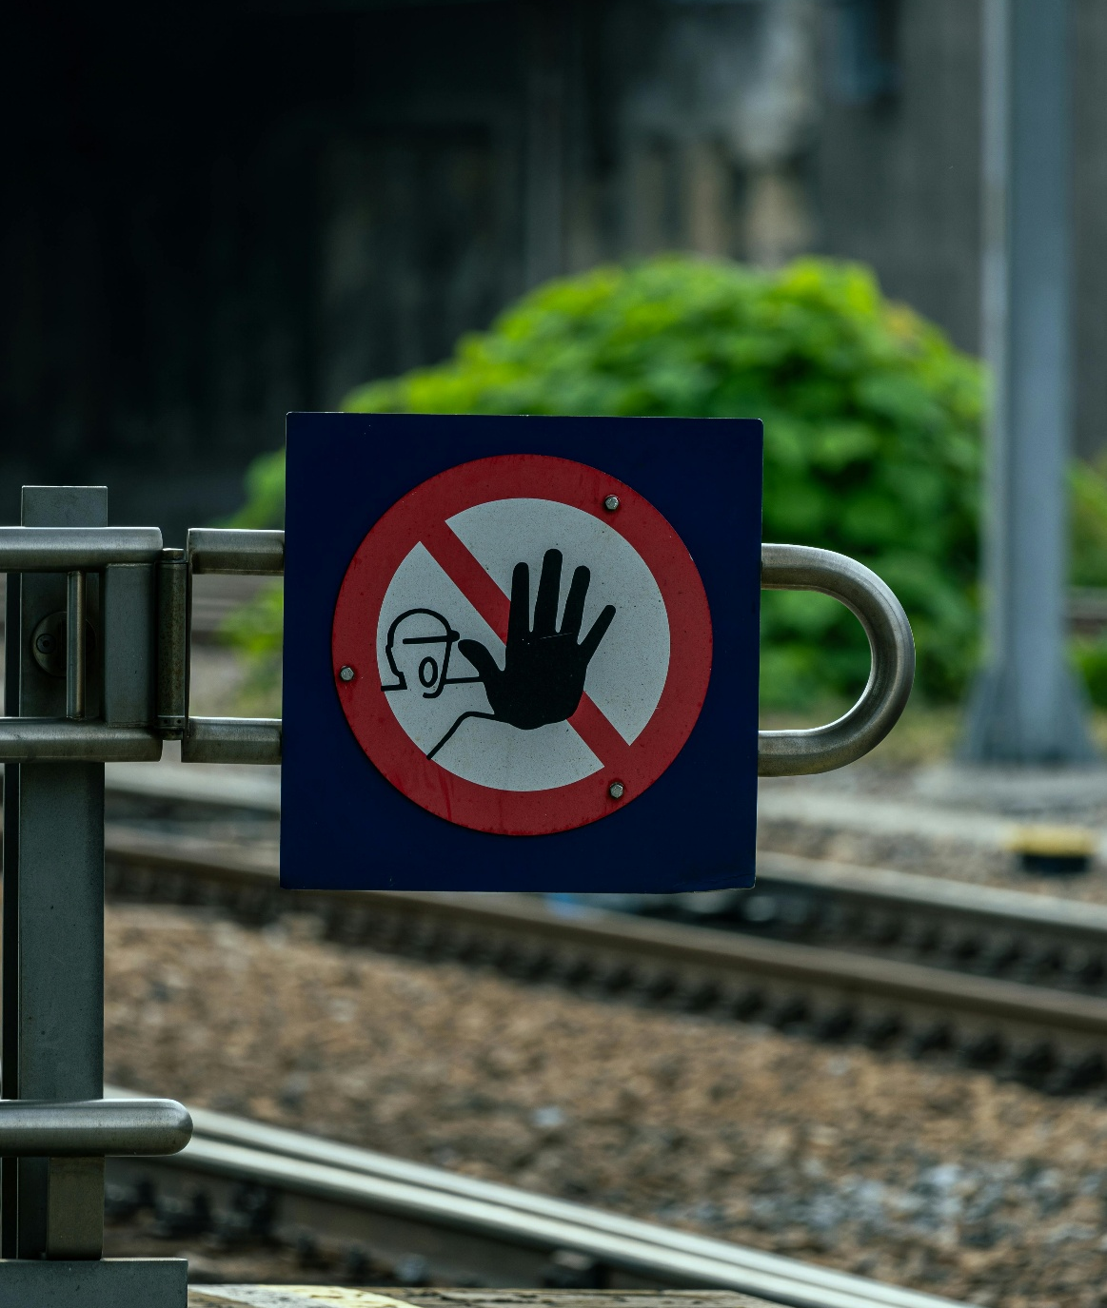
Supply Chain Resilience: Building an Industrial Buffer
Procurement, Logistics & Supply Chain
Import-heavy supply chains are vulnerable to:
FX scarcity
Global steel price volatility
Shipping disruptions
Policy changes
Port shutdowns
Dorman Long’s integrated model creates a semi-closed industrial loop within Nigeria:
Engineering → Fabrication → Galvanizing → Site Delivery
Impact:
Shorter production cycles
Faster recovery from disruptions
Reduced liquidated damages exposure
Stronger client confidence

Slide 10
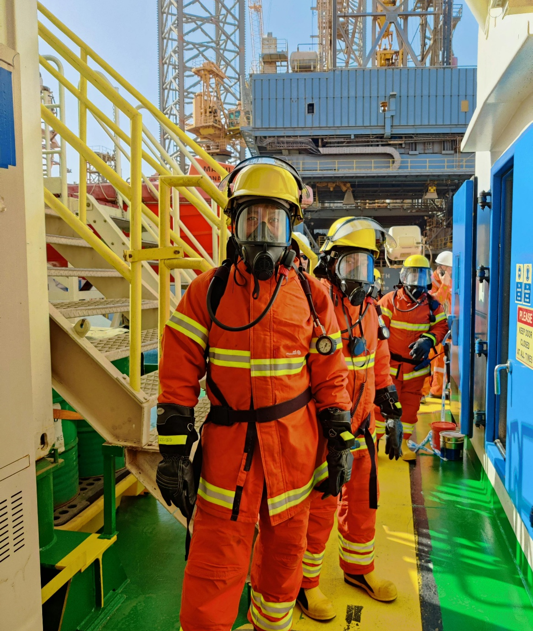

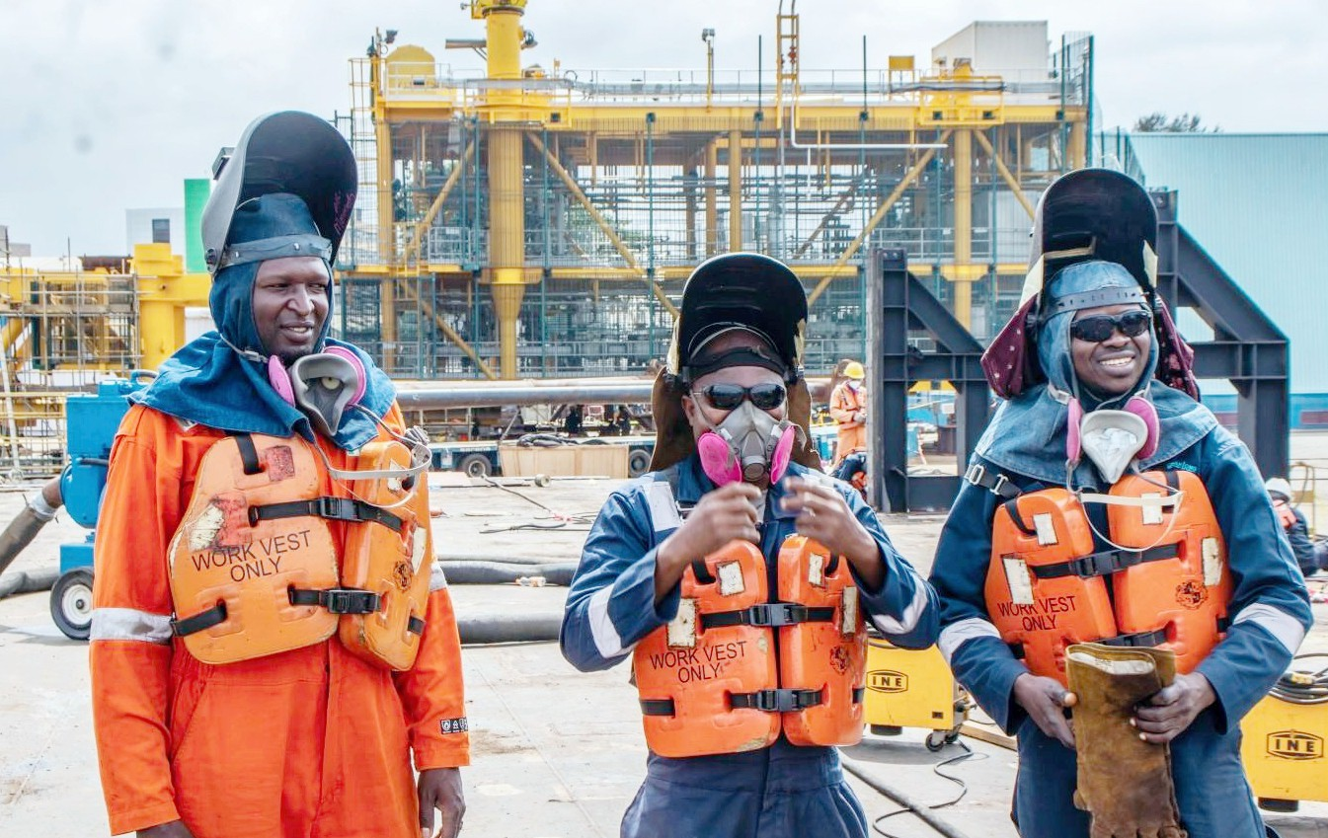
Financial & Competitive Impact
Procurement, Logistics & Supply Chain
Margin Protection
Reduced exposure to USD volatility
Improved pricing stability in bids
Lower landed cost variability
Working Capital Efficiency
Reduced inventory buffers
Better alignment between production and installation
Faster billing cycles
Tender Competitiveness
Stronger local content positioning
Faster mobilization commitments
Enhanced prequalification credibility

Slide 11
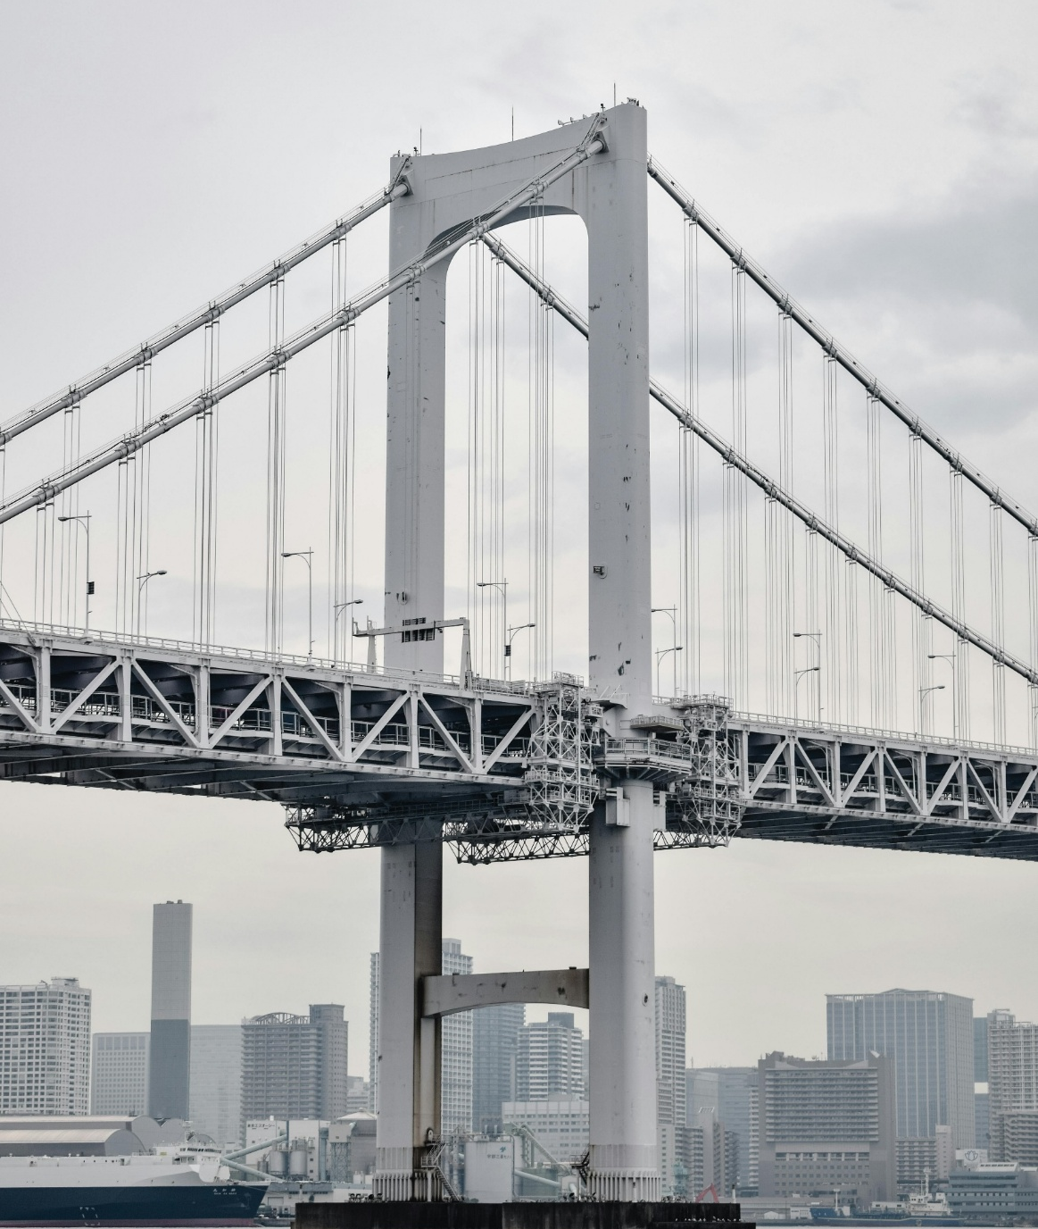
Procurement, Logistics & Supply Chain
Opportunity Scope
For Dorman Long Engineering Limited, procurement, logistics, and supply chain are not support functions — they are competitive weapons when backed by:
Integrated engineering
Heavy fabrication capacity
In-house galvanizing
This delivers:
✔ Lower logistics volatility
✔ Reduced FX exposure
✔ Stronger procurement leverage
✔ Improved margin protection
✔ Enhanced execution certainty
✔ Industrial leadership within Nigeria
In Nigeria’s environment, vertical integration is strategic risk control.

Slide 12
Procurement, Logistics & Supply Chain
Opportunity Scope
Sector Positioning in Nigeria
Integrated capability strengthens positioning in:
Oil & Gas structures (Local Content compliance)
Power transmission towers
Substation steel structures
Marine and jetty infrastructure
Bridges and heavy civil infrastructure
Renewable energy mounting systems
This creates a structural advantage over trading EPC competitors.
In Nigeria’s environment, vertical integration is strategic risk control.

Slide 13
04
Our Facilities

Slide 14
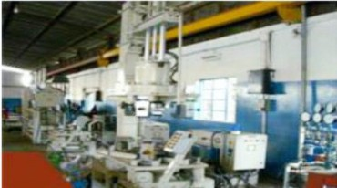
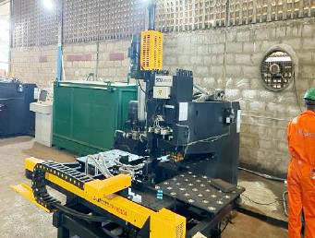
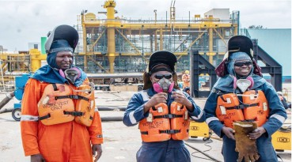


Operational Facilities
Idi-Oro Workstation
Agege Workstation
Naval Dockyard Workstation
Fabrication of Structural Steel and hot-dip galvanizing
6.2m diameter by 30m length

Slide 15
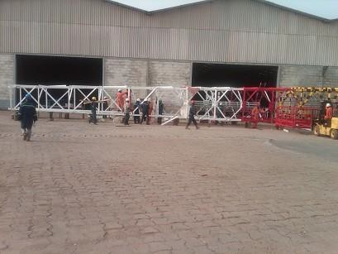
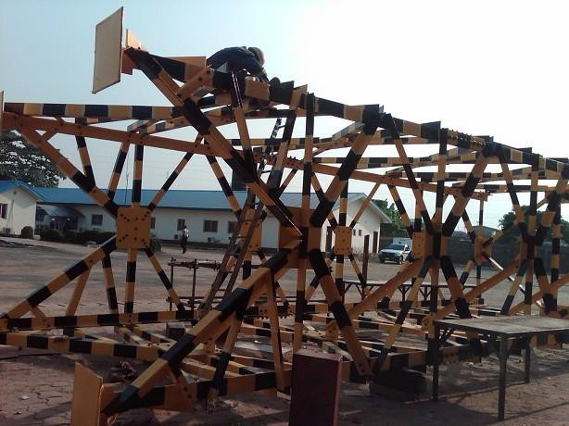
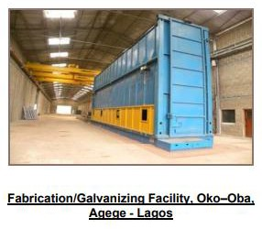
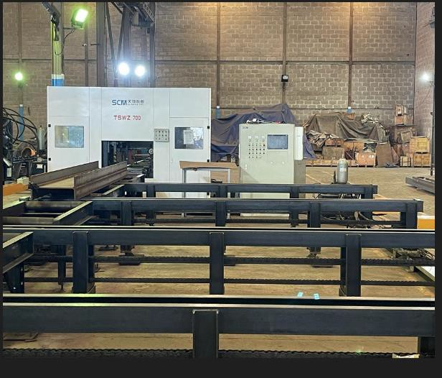
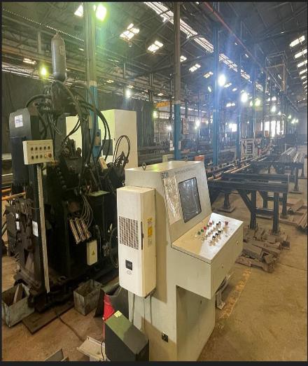
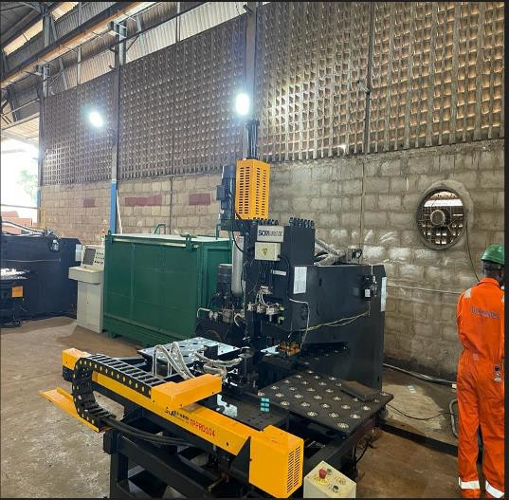
Overview of Facilities
DLE Agege Yard Facility equipped with CNC Machines, Galvanizing Plant, Heavy Fab Shop

Slide 16
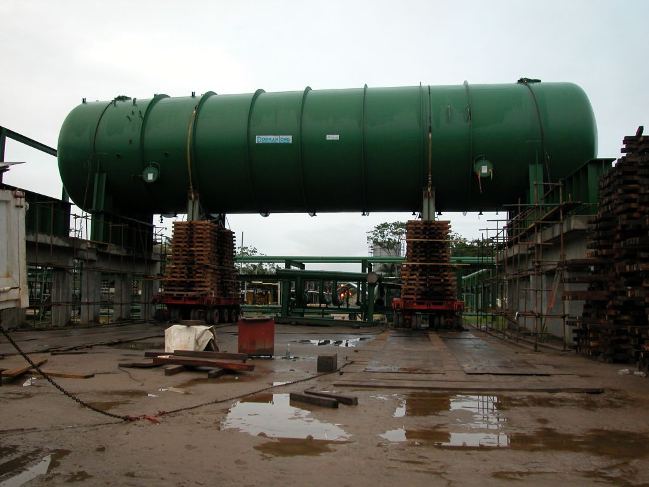
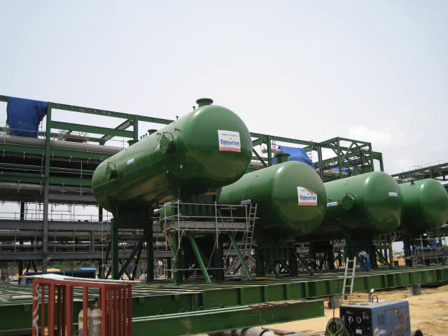
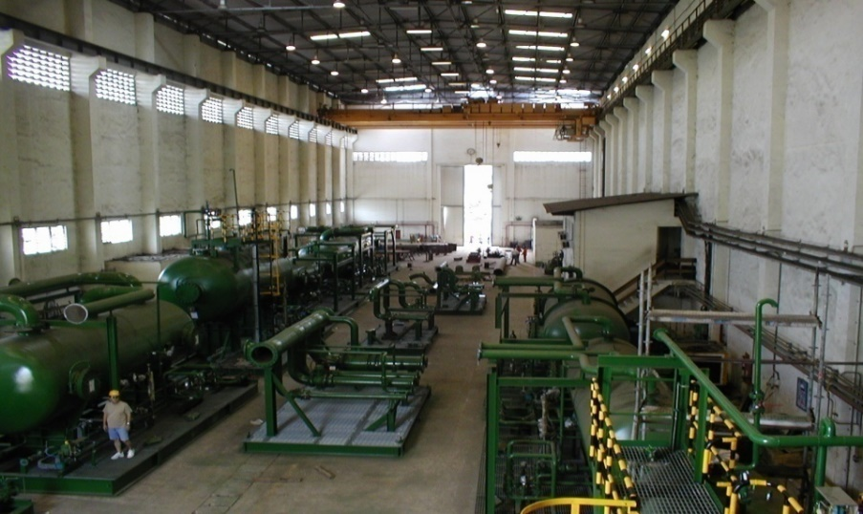
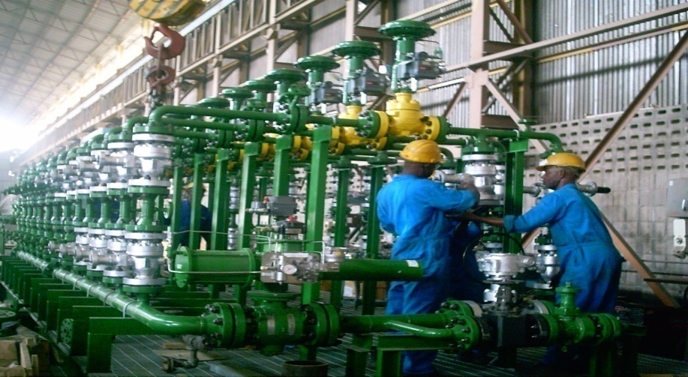
Other Capabilities
05
Fabrication/Manufacturing of Pressure Vessels and Process Equipment

Slide 17
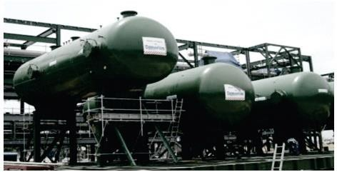
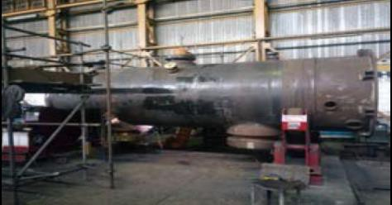
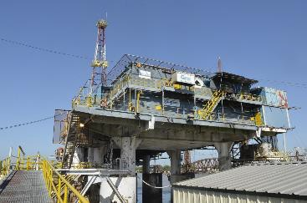
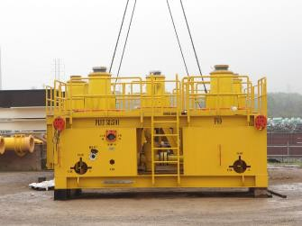
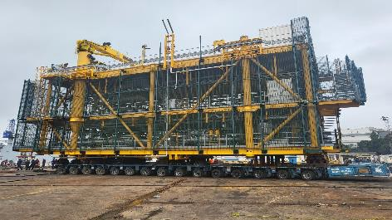
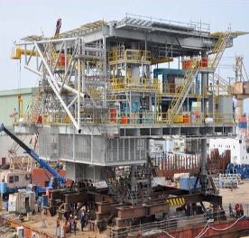
Capabilities - Core Products
DLE is qualiﬁed and experienced in delivering EPCIM projects, starting from engineering design to project execution. Our products and services cover the following specialty areas, Engineering, Construction and Installation and Maintenance.
Pressure Vessels and Drums Tanks
Ships and Pontoons
Offshore Module Structure
Oil Production Platform
Topside Decks

Slide 18
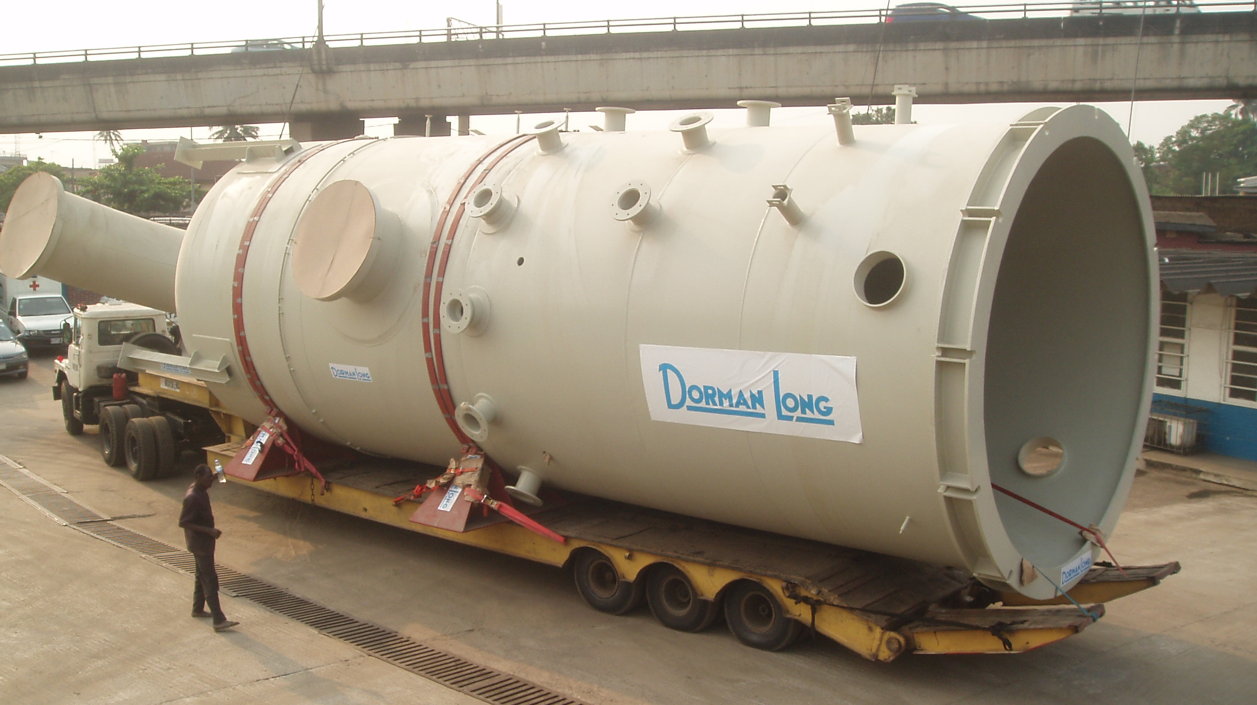
Project Title: NLNG Trains Three & Six Vessels (6 Vessels) Main Contractor: TSKJ
Year of Completion: 2001 & 2006 Client: NLNG

Slide 19
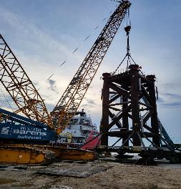
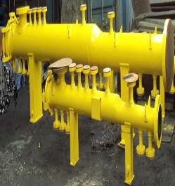
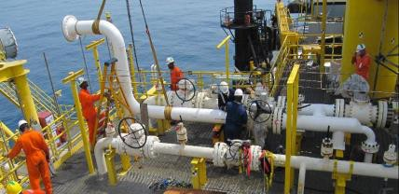
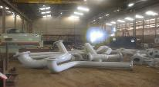
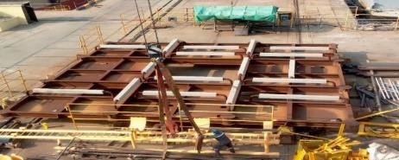
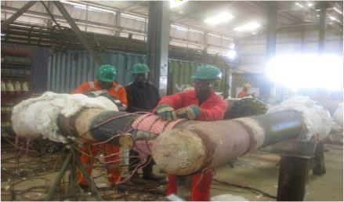
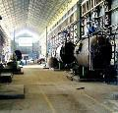
Subsea Structures/Jackets
Pig Launchers, Receivers and Traps
Field Maintenance & Services
Piping Spools and Riser Spools
Post weld Heat Treatment and NDT services
Pressure Vessels and Tanks Fabrications

Slide 20

Asset Management. Field Service Operation

Slide 21
Capabilities - Asset Management Services
Asset Management - Operations & Maintenance Services
A one-stop-shop for asset support services to upstream Oil & Gas Facilities through the Gulf of Guinea from asset commission, operations and de-commissioning.
Leveraging on our core competence in Engineering, Fabrication, Construction and Project Management
Asset Integrity Services
Sludge Tank Cleaning Services
Skilled Manpower provisions
Turnaround Maintenance
Insulation
Well hook-ups, Installation and Welding
Machining Services
Torque and Bolt Tensioning
Habitat Services
Post Weld Heat Treatment
Hydrostatic Pressure Testing
Pre-commissioning & Commissioning
Rope Access
Scaffolding
Blasting & Painting
Inspection & Certification
Post Construction/Installation activities services including reporting and lesson learned
Oversea training to improve national skills base in NCDMB HCD scheme.
Dorman Long has successfully completed BONGA FPSO Shutdown Maintenance for five consecutive times within budget and schedules. Often ahead of schedule, with ZERO LTI
Successfully performed full repair and maintenance activities of the Single Buoy Mooring (SBM)

Slide 22
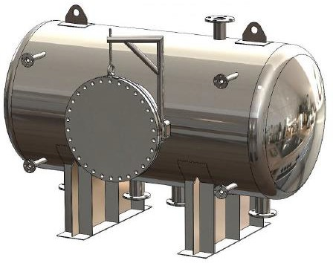
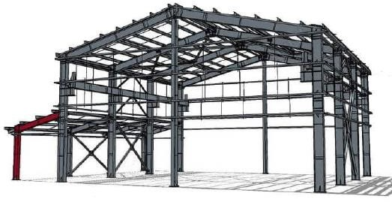

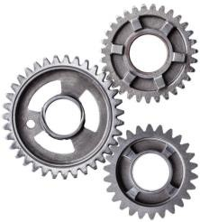
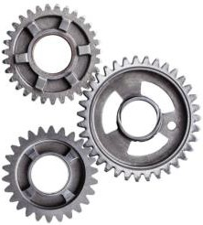
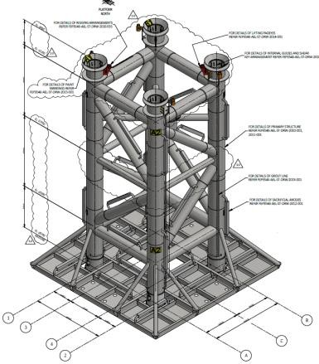

Engineering Services – Products
Steel Structure
Pressure Equipment
Engineered Products
Pipe Spools
Offshore
Structure

Slide 23

Thank You

