Slide 1

Green Manufacturing:
Principles, Practices and Pathways to Sustainable Industry
Michael Onafowokan, FNSE
Executive Director, Coleman Wires and Cables

Slide 2
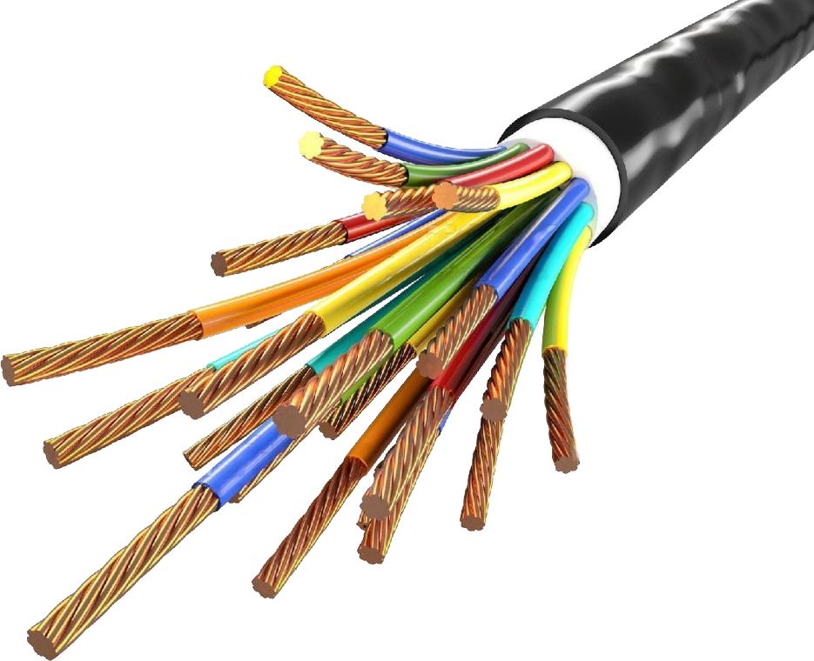

“To truly transform our economy, protect our security, and save our planet from the ravages of climate change, we need to ultimately make clean, renewable energy the profitable kind of energy.”
— Barack Obama

Slide 3

Green Manufacturing integrates environmental sustainability into manufacturing processes to reduce resource consumption, minimize waste and emissions, and promote circularity.

Slide 4

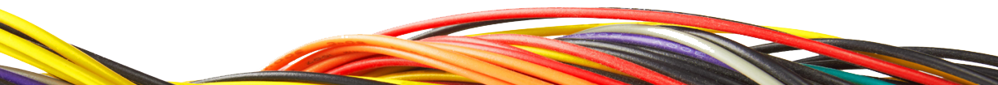

Circularity – 5R Approach
Repair
Reuse
Refurbish
Rebuild
Recycle

Slide 5
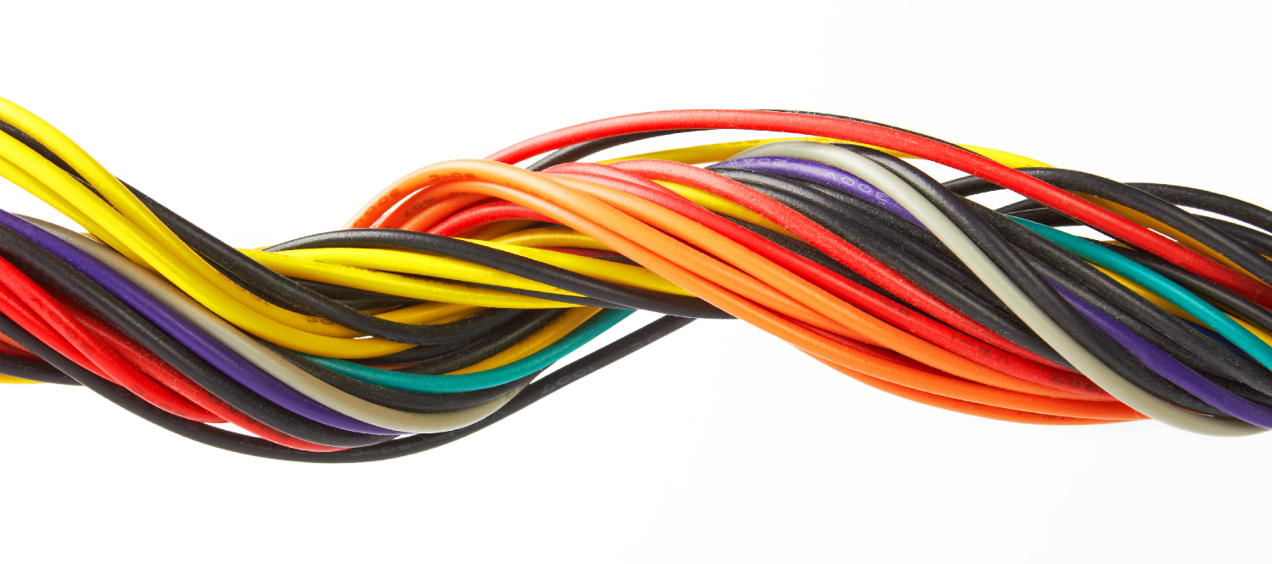
Manufacturing accounts for 37% of global energy use, material consumption, and pollution. Transitioning to *green manufacturing* helps align industrial activity with climate goals, resource constraints, and societal demands for cleaner products. The focus is on optimizing processes, redesigning products, and transforming supply chains to achieve environmental, economic, and social benefits.

Slide 6
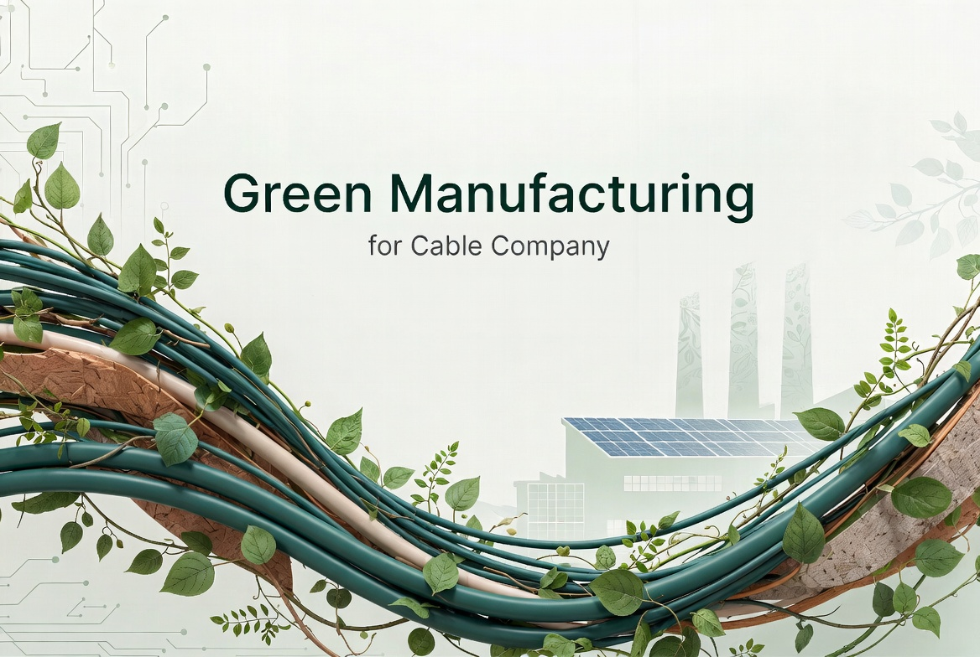
Key Strategies
& Technologies

Slide 7
Incorporating energy efficient systems that champion effective use of energy generated. This is achieved by ensuring all processes are optimized in that they are using just enough energy to achieve process objectives and goals.
At Coleman, we have deployed energy smart systems to ensure manufacturing process energy demands are monitored, regulated and optimised ensuring high net returns per kilowatt hour

Slide 8

At Coleman, we went off grid 5 yrs ago and have since taken our own energy fate into our own hands by deploying a modular power systems which makes available a combined total of 24MW of power across all factories using gas turbines and solar panels which are both cleaner sources with intelligent demand monitoring systems which supplies energy to demand optimizing gas utilization and turbine selection.
We have also moved away from fossil fuel utilization to electrical vehicles – where forklifts, cranes, company vehicles, tour vehicles mobility enhancers are all now electric, reducing significantly our carbon footprint.

Slide 9
Materials & Resources Management
Ensuring manufacturing processes are sustainable with elimination of single use materials to materials that are recoverable, reusable and recyclable. All components that go into our manufacturing processes are completely reusable and recyclable. Industrial polymers, metals, packaging and other components are either recovered for reuse in process, or serve as input raw materials for other industries driving us closer towards our ‘goal zero’ waste target.

Slide 10
Waste Minimization and Circular Design
Optimise product design for easy disassembly, repair and recyclability
Investing in high quality material recovery infrastructure ensures high level material recovery for reuse
Providing incentives to customers that return packaging materials for repairs and reuse.
Zero waste is the ultimate goal.

Slide 11
Process and Operational Improvements
Ensuring technology is deployed in optimization of raw material utilisation by using smart measurement devices linked to closed feedback loops for optimal material delivery
Employment of advanced control systems that ensure product standards are maintained by automation of quality control and assurance processes minimising non conformances
Use AI driven processes and maintenance practices that ensure preventive activities take the fore minimizing downtime and waste generation.

Slide 12
Supply Chain and Procurement
Sharing long term goals with supply chain stakeholders, sharing the green culture and promoting zero waste goals.
Working with stakeholders across board to ensure the green culture in manufacturing is also engendered by them.

Slide 13

Measurement & Assessment

Slide 14


Life Cycle Assessment
Carbon Footprinting
Material flow analysis
Environmental Management System (EMS) – ISO 14001
Use Key Performance Indicators (KPIs) – ROE,Waste/Recycle Rates
To continually improve, measurement and assessment of above key areas are paramount

Slide 15
Green manufacturing is both an environmental imperative and a business opportunity. By combining design innovation, efficient operations, circular strategies, and supportive policies, manufacturers can reduce environmental impacts while enhancing competitiveness and resilience. The transition requires coordinated action across firms, governments, and civil society, guided by measurable targets and continuous improvement.
CONCLUSION

Slide 16


Question & Answer

Slide 17


THANK YOU

