Slide 1
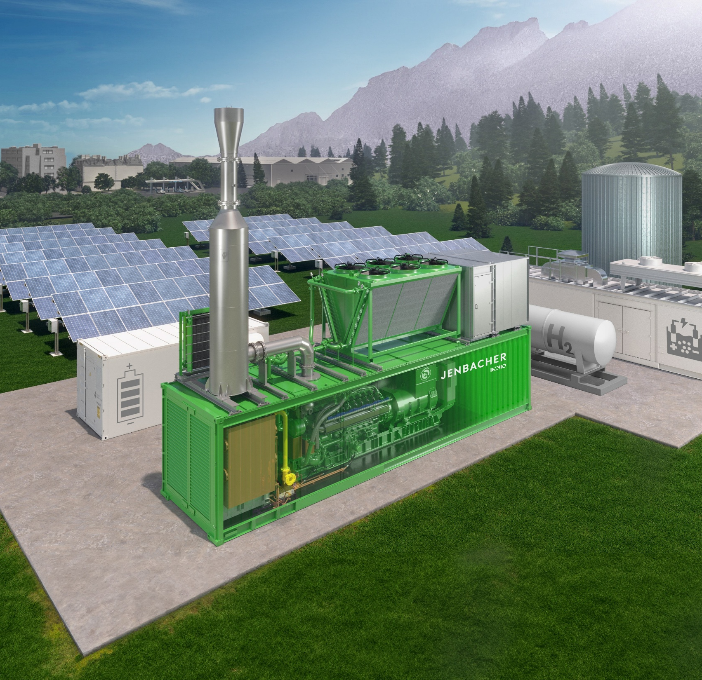
Energy optimisation and efficiency for industrial competitiveness in West Africa.
Ahmad Aliyu,
Commercial Leader.
March 2026.

Slide 2
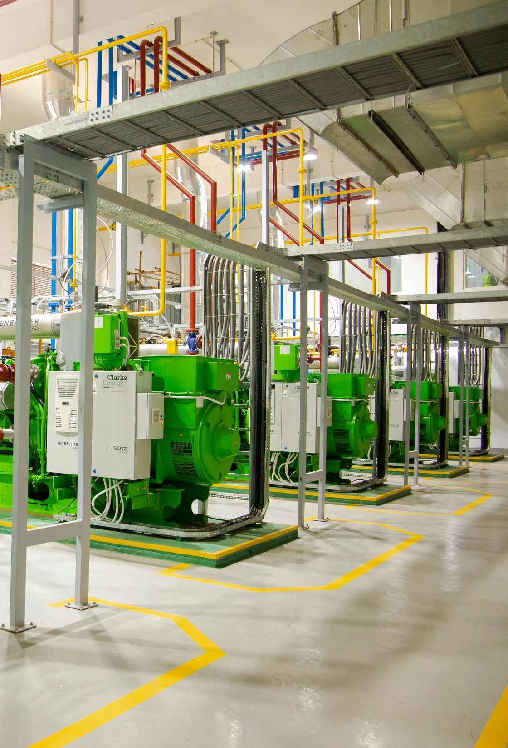
Term definitions
Energy efficiency
Energy optimisation
Less energy utilisation per unit output or kW.
System management to generate more output or kW.
Focuses on equipment improvement or upgrade.
Focuses on controls integration, additional supply mix and operational-level strategy.
Comes before optimization.
Comes after efficiency.

Slide 3


Where is energy going?
~ 41m (68%) urban population
~ 108m (54%) urban population
121GW
36GW
5.9GW
27.6GW
Grid deficit market size: ~US$109.85B
*NERC – Nigerian Electricity Regulatory Commission.
*TCN – Transmission Company of Nigeria.
*NISO – Nigerian Independent System Operator Ltd.
*Nigeria Electricity Market Intelligence Report 2021.
*PPI – Presidential Power Initiative.
*Eskom 2024 | *World Bank Open Data 2022
Notes:
Global shift from Energy Access to Energy Efficiency, and then Energy Optimisation. The graph above highlights a head-to-head comparison of the two (2) largest markets in Western and Southern areas of Africa to assess the energy deficit, and define or set energy baseline, which is the starting point for measuring improvements. The deficit spans the entire infrastructure, from generation, to transmission, to spinning reserves (to balance the grid) and distribution, the ultimate questions is, Where do we go from there? Where is energy going? How do scale the challenges of attracting investments to the generate more power, and transmission, and grow peaking power applications to stabilise our girds, and ultimately solve revenue collection issues/problems, ensuring the entire value chain is first cost reflective, and efficient and then optimised. Since efficiency comes before optimisation.

Slide 4
Where is energy going?
Decentralised systems
Diversification
Policy shift (Electricity Act, 2023)
Revenue collection
Future Energy landscape
Notes:
The future energy landscape cannot be built solely around hydrocarbons; its resilience demands policy shirts and enforcement, decentralised or distributed systems, energy diversification, and effective collection methods.

Slide 5



Market realities
Post‑recession energy discourse triggering a re-examination of national energy priorities, interplay of other source of energy, including portfolio efficiency upgrades and optimisation.
Fuel subsidy removal was a catalyst for energy transition causing a shift from typical energy consumption to energy planning.
The soaring adoption of Solar PV representing cheapest incremental unit of electricity, especially for C&I with scope 1&2 emissions reduction mandates, pressure from global supply chain, and sustainability disclosures tied to financing.
Data source: Google Trend (2017 – 2025)
Notes:
Right after the recession, the topics around what the future of Nigeria’s energy landscape (by extension, West Africa, because it contributes 50% of West Africa’s GDP and population) is no longer dictated solely by oil prices or fiscal subsidy decisions. It is now defined by market realities, global sustainability pressures, and technology-enabled alternatives.
Following the implementation of full removal of petroleum subsidy in 2023, the topic around solar PV and adoption has soared – accelerating the C&I sector’s migration toward solar PV, hybrid energy systems, and cleaner operational footprints to improve its cost per product or meet corporate carbon reduction goals.

Slide 6
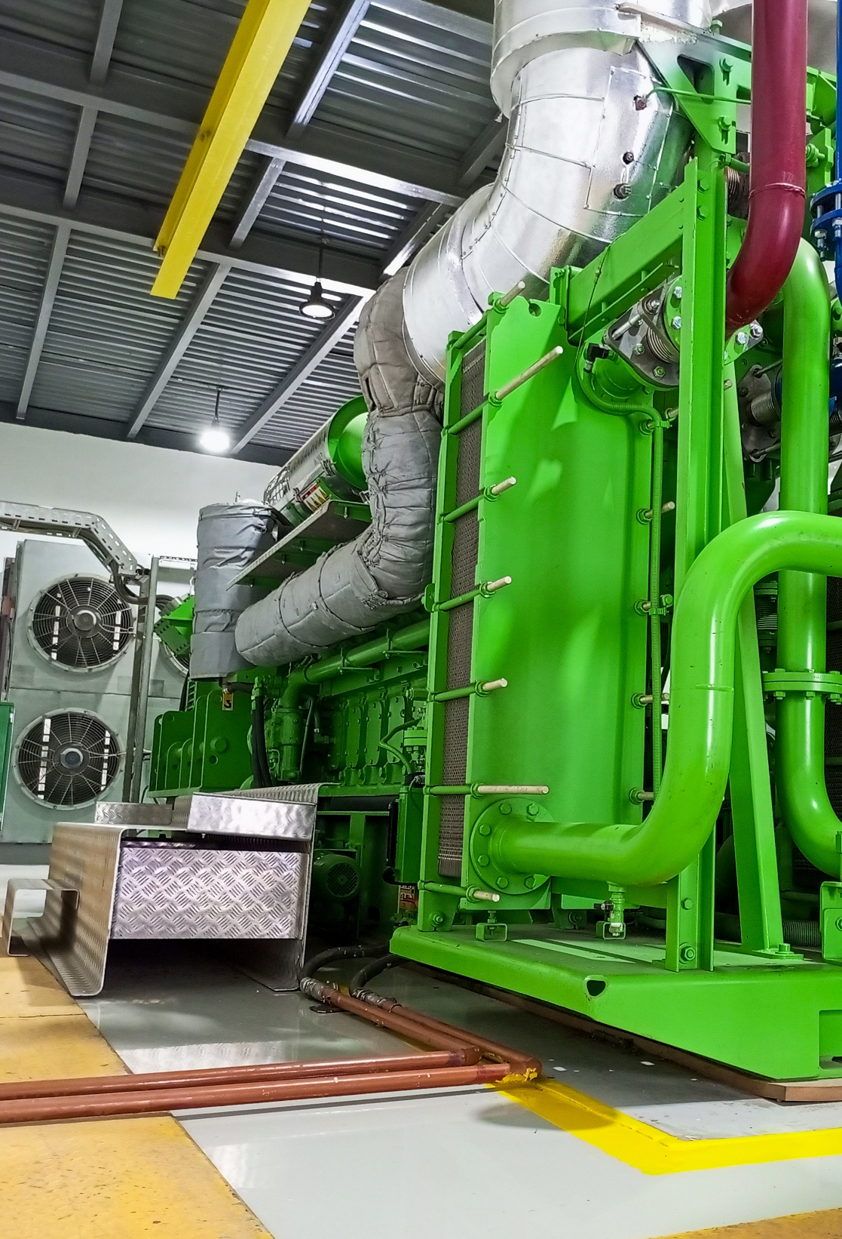






Case studies
Energy efficiency
Commercial load centre
Gas engine
Absorption Chiller
Boiler
CO₂ recovery
Industrial load centre

Slide 7
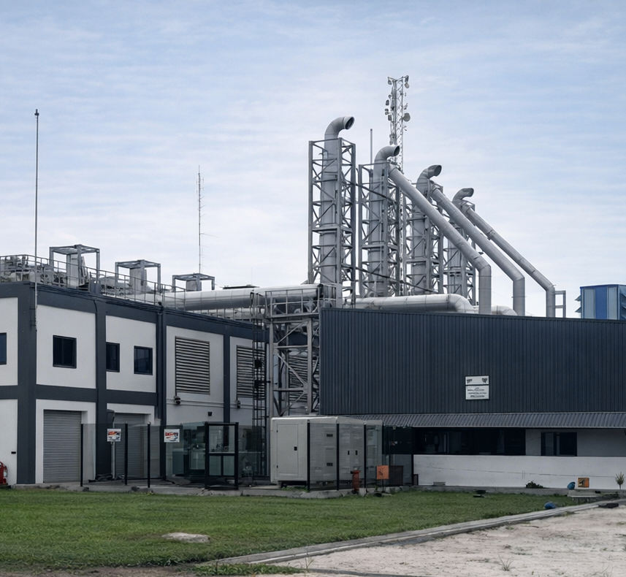




Case studies
Energy efficiency
Commercial load centre
12MW
8 tonnes of hot water
Industrial load centre

Slide 8
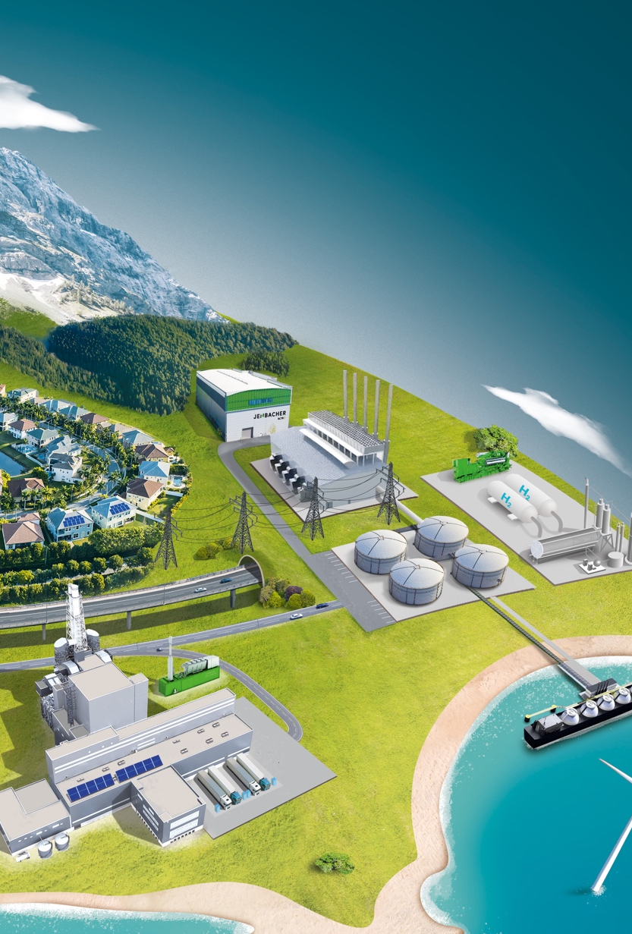








Case studies
Energy optimisation
Diesel set backup
Solar PV
Commercial load centre
Gas genset
Microgrid controller
BESS
Wind turbine
Industrial load centre

Slide 9
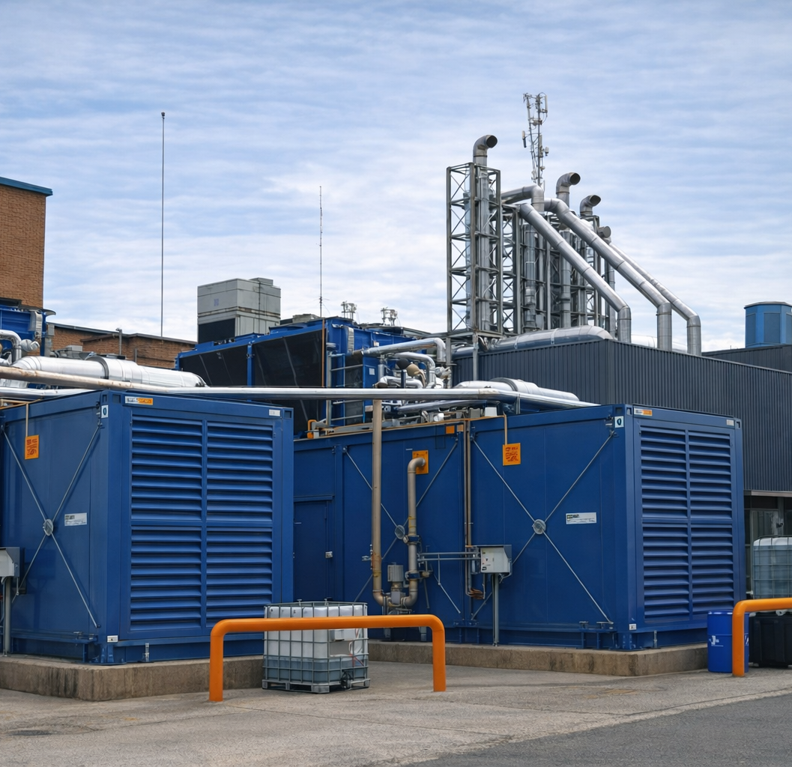





Case studies
Energy optimisation
Energy optimisation
Grid supply
5MW
Industrial load centre
10-tonne steam
800kW

Slide 10
Ahmad Aliyu,
Commercial Leader,
ahmad.aliyu@clarke-energy.com
www.clarke-energy.com

