Slide 1
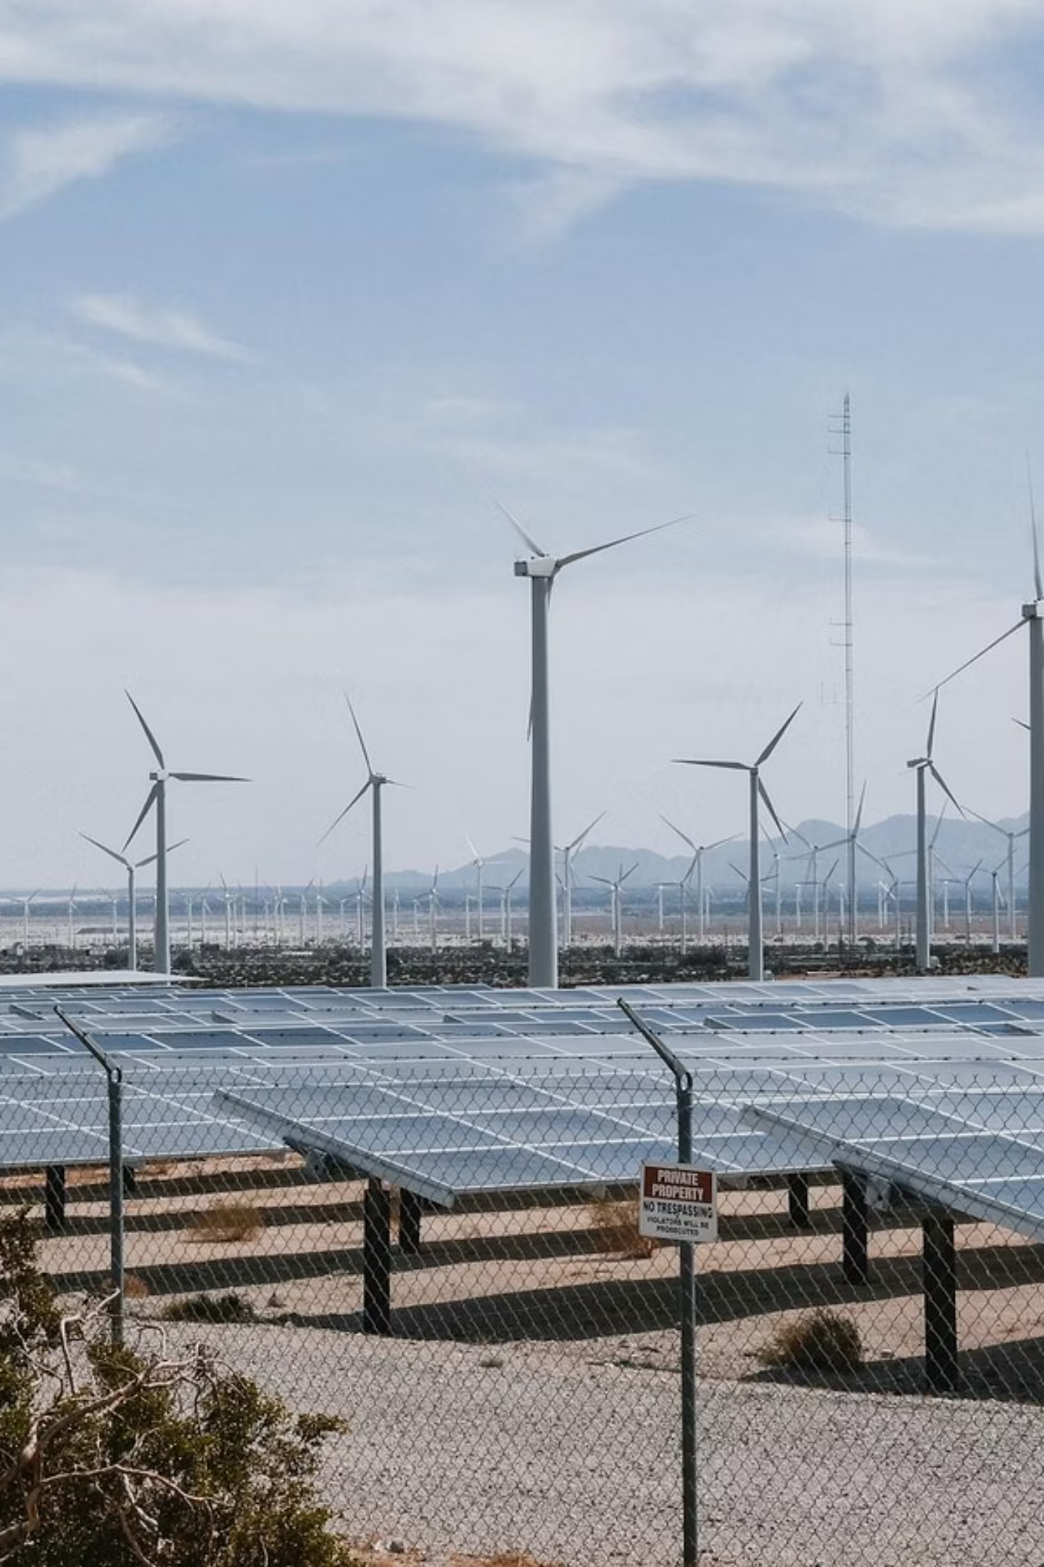

Energy Security for Industrialization – The Role of Renewables for Sustainable Manufacturing in West Africa
Powering West Africa's industrial transformation through clean, reliable energy solutions
Presented by
Dr. Olusanmi A. Adeniran, Ph.D., PMP, CQA
President | Abacoll Solutions LLC, Dallas, Texas, USA
March 4, 2026
West Africa Industrialization, Manufacturing and Trade Summit & Exhibition 2026

Slide 2









About Abacoll
Dr. Olu Adeniran
Ph.D., PMP, CQA
President
Engineering and management consulting company
Located in Dallas, TX
Established in 2018
Our Business
Sustainable Energy
Renewables
Clean Energie
Energetic Minerals
Asset Integrity Solutions
Advanced NDT Inspection
Mechanical Integrity Inspection
Advanced solutions for pipeline assessment
Advanced Materials & Manufacturing Solutions
Alternate Materials & Manufacturing Development
Product Lifecycle Management
Material Quality Advisory
General Consulting, Engineering, and Analysis
Engineering, Procurement, & Construction (EPC)
Materials Performance & Protection
Training & Technical Development
Dr. Zhiru Shi
Ph.D., PMP, PSM1
Director, Engineering
Dr. Davidson Akwada
Ph.D., PMP, CSSBB
Director, QEHS
2
Notes:
Introduction - Definition of Additive Manufacturing (AM), Importance in Aerospace
Current Global Trends - Adoption Rates in Aerospace, Technological Advancements, Key Players, and Regions
Applications in Aerospace - Prototyping, Tooling, End-Use Parts, Quality Assurance
Benefits of Additive Manufacturing - Cost Reduction, Weight Savings, Design Flexibility,
Challenges and Limitations - Material Constraints, Regulatory Hurdles
Future Opportunities - Innovations in Materials, Integration with Other Technologies, Expansion into New Markets
Case Studies - Successful Implementations, - Lessons Learned
Conclusion - Summary of Key Points, Future Outlook
Q&A Session

Slide 3
Agenda
West Africa's Industrial Energy Challenge
Opportunities for Medium and Small-Scale Manufacturing
Case Studies Across West Africa
Economic Benefits
Renewable Energy Systems Requirements
Overcoming Implementation Barriers
Conclusion
3
Notes:
Introduction - Definition of Additive Manufacturing (AM), Importance in Aerospace
Current Global Trends - Adoption Rates in Aerospace, Technological Advancements, Key Players, and Regions
Applications in Aerospace - Prototyping, Tooling, End-Use Parts, Quality Assurance
Benefits of Additive Manufacturing - Cost Reduction, Weight Savings, Design Flexibility,
Challenges and Limitations - Material Constraints, Regulatory Hurdles
Future Opportunities - Innovations in Materials, Integration with Other Technologies, Expansion into New Markets
Case Studies - Successful Implementations, - Lessons Learned
Conclusion - Summary of Key Points, Future Outlook
Q&A Session

Slide 4
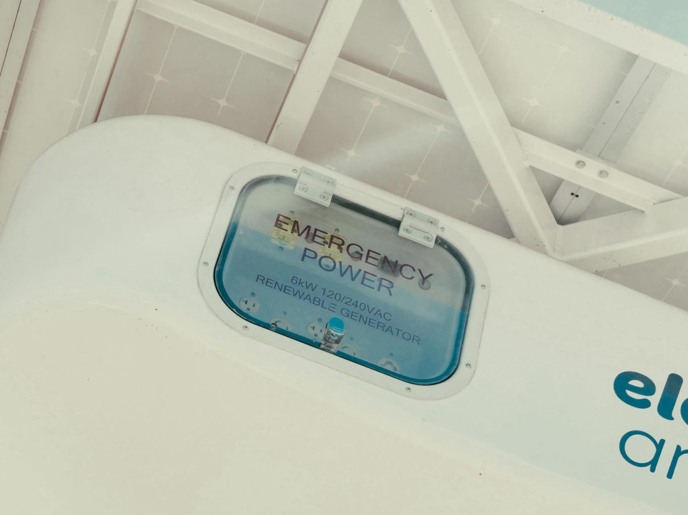
OVERVIEW
West Africa's Industrial Energy Challenge
Renewables presents a transformative pathway to reliable, affordable, and sustainable industrial power that can unlock the region's manufacturing potential
West Africa's industrialization ambitions face critical bottleneck, unreliable energy access
Manufacturing facilities across the region lose over average of 56 production days annually due to power outages
Economic losses in productivity and competitiveness amounting to billions of dollars.
4

Slide 5
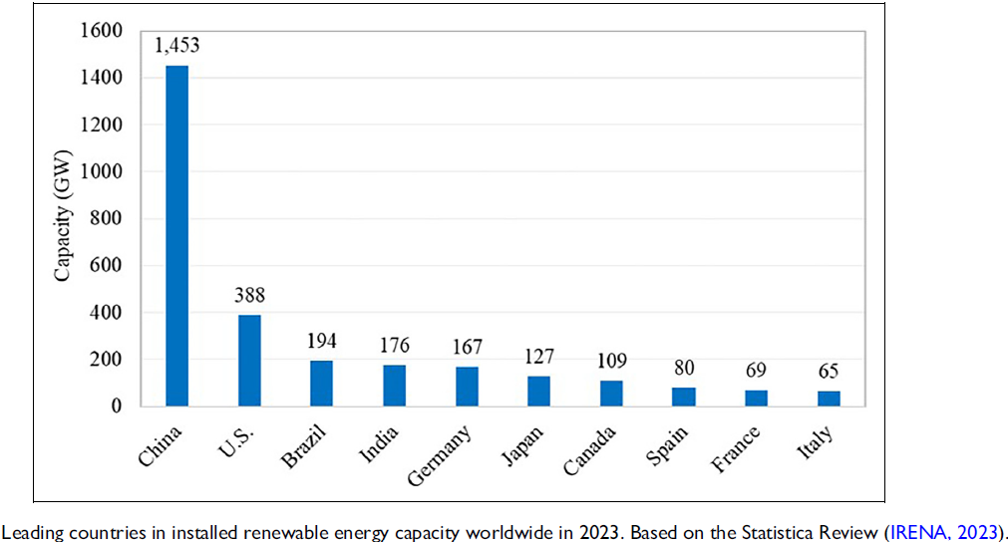
Global Renewable Energy Leading Countries
There is a direct relationship between renewable energy and economic development
6

Slide 6




Sectoral Applications Across Industries
Different sectors require tailored renewable energy solutions
Solutions based on unique consumption patterns, process requirements, and operational constraints
Understanding sector-specific needs enables optimal system design
Heavy Industry
Cement, steel, mining - require baseload power with large-scale wind and solar-plus-storage
Light Manufacturing
Energy-intensive industries like cement and steel benefit most from hybrid systems with substantial storage capacity
Light manufacturing sectors with daytime-heavy loads achieve excellent results with solar-only installations
Food processing requires highly reliable systems due to spoilage risks from outages
Textiles, electronics assembly - optimal for rooftop solar with grid backup
Agro-Processing
Food, beverages, packaging - benefit from solar-diesel hybrids with reliability focus
Pharmaceuticals
Require ultra-reliable systems with redundancy and premium power quality
6

Slide 7
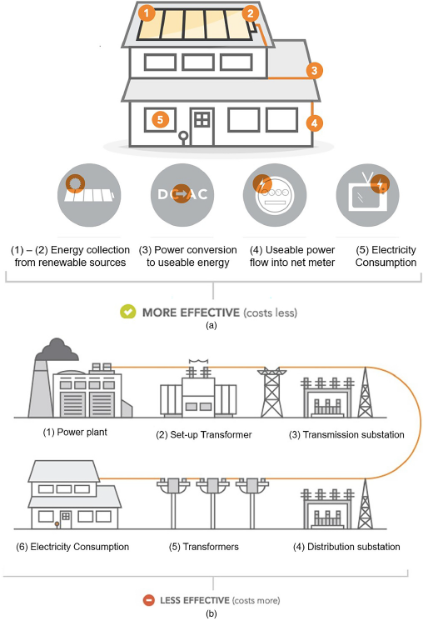
OPPORTUNITY
The Opportunity for Medium and Small-Scale Manufacturing
Energy Independence
Cost Competitiveness
On-site generation reduces grid dependency
Eliminates costly outages that disrupt production schedules
Solar and wind now offer lower levelized costs than diesel generators
Predictable long-term pricing
Sustainability Credentials
Operational Reliability
Green energy access opens doors to international markets and climate-conscious supply chains
Modern renewable systems with battery storage provide 24/7 baseload power for continuous operations
7

Slide 8

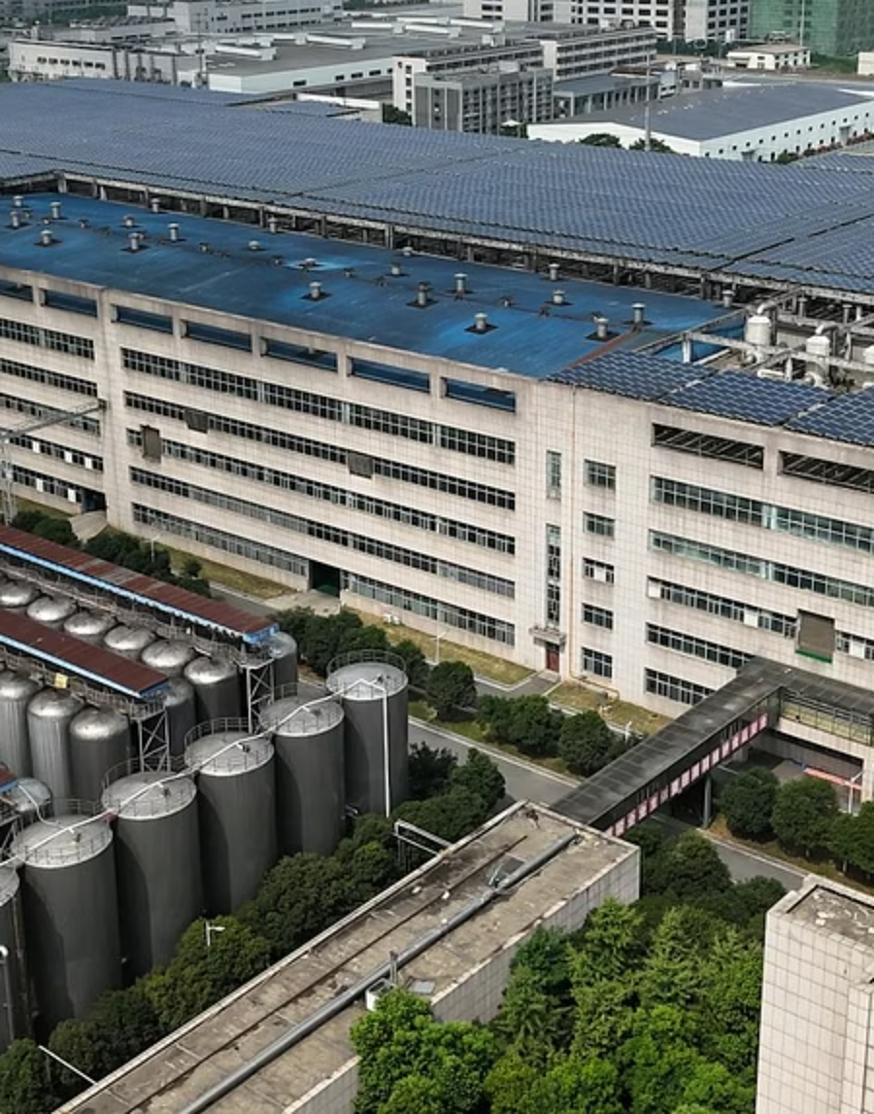
CASE STUDY
Nigerian Breweries Ibadan: A Renewable Energy Pioneer
Represents one of West Africa's most successful industrial renewable energy deployments.
Installed a 2.5 MW solar photovoltaic system in 2019, complemented by energy efficiency upgrades across its production lines
Project Highlights
2.5 MW solar capacity installed
$3.2 million total investment
30% reduction in grid dependence
2,100 tons CO₂ avoided annually
3.8-year payback period
25-year operational lifespan
This installation generates approximately 3,400 MWh annually, meeting 30% of the facility's daytime energy requirements
Solar array covers 10,000 square meters of rooftop space, transforming an underutilized asset into a productive power generation site
Energy Cost Reduction
System Uptime
Jobs Creation
Annual savings of $680,000 in electricity expenses, improving product margins
Minimal maintenance requirements with exceptional reliability performance
Direct and indirect employment during with ongoing operations
The success inspired Nigerian Breweries to replicate the model across five additional facilities, demonstrating scalable renewable integration
8

Slide 9
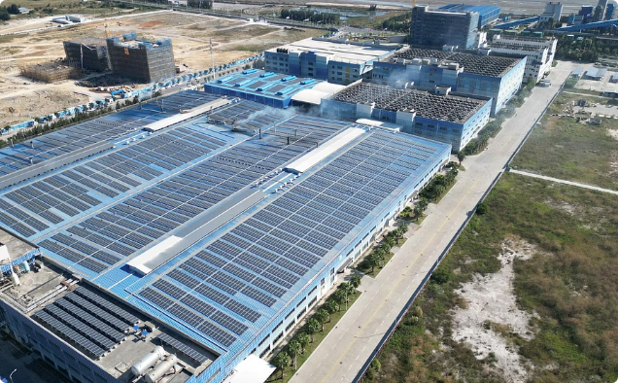
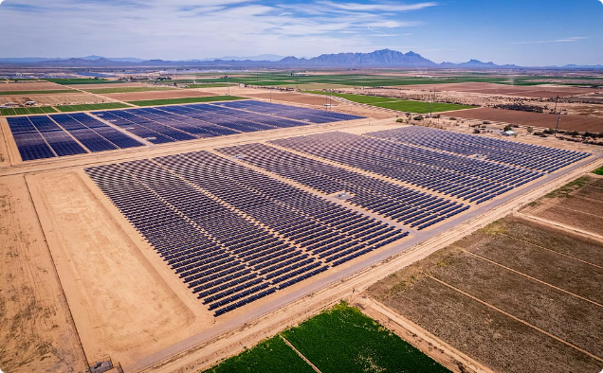
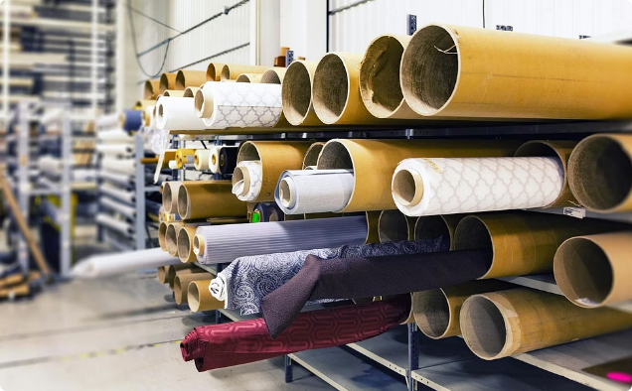
REGIONAL EXAMPLES
Renewable Energy Success Stories Across West Africa
Unilever Ghana
Dangote Cement Senegal
Côte d'Ivoire Textiles
1.5 MW rooftop solar system powers soap and detergent manufacturing in Tema, achieving 40% renewable energy mix
3 MW solar-diesel hybrid reduces fuel consumption by 35% at Pout cement facility, saving $1.2M annually
First wind-powered textile plant uses 5 MW wind farm to manufacture export-quality fabrics sustainably
9

Slide 10
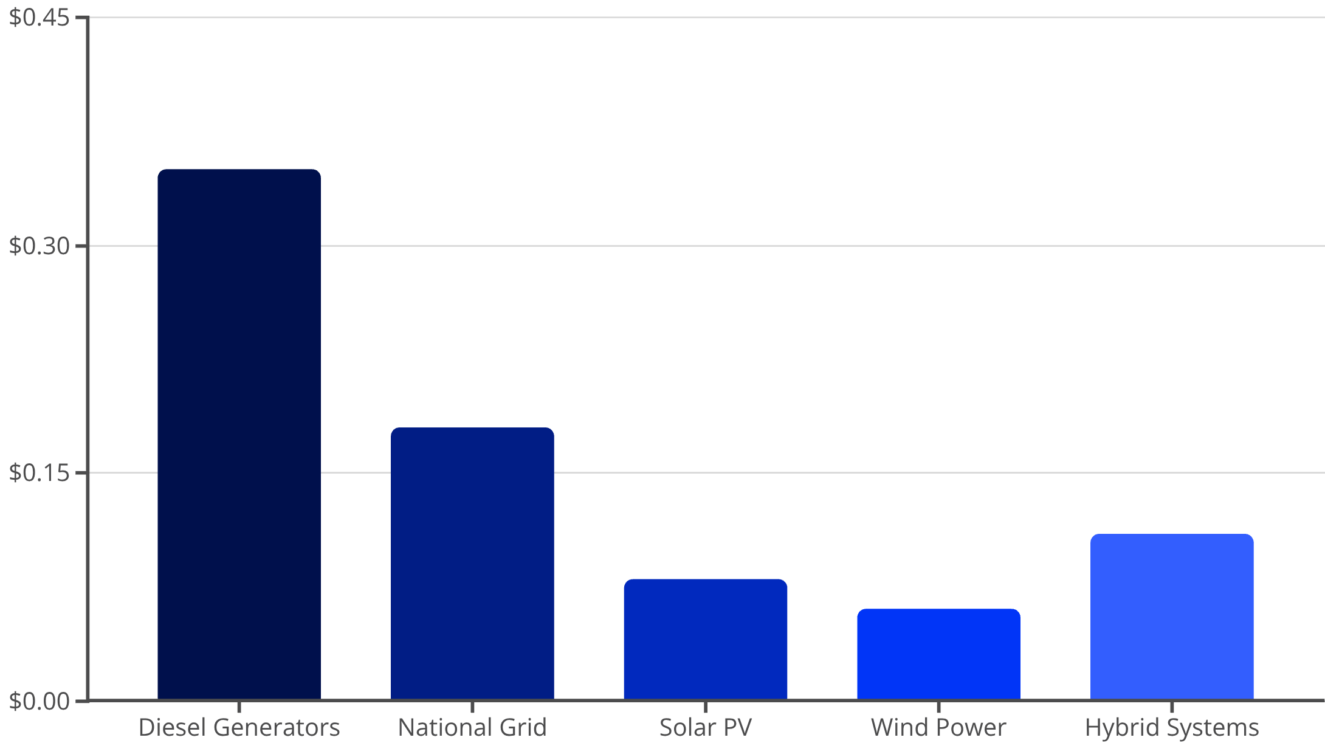
Economic Benefits of Industrial Renewable Energy
Renewable Energy Competitive Advantage
The economics favor renewable energy adoption for West African industries
Solar and wind now cost 60-75% less than diesel generation, the backup source for unreliable grids
With system costs declining 15-20% annually and fossil fuel prices volatile, the business case strengthens continuously
Renewable investments today lock in decades of predictable, low-cost energy that enhances competitiveness in global markets
10

Slide 11
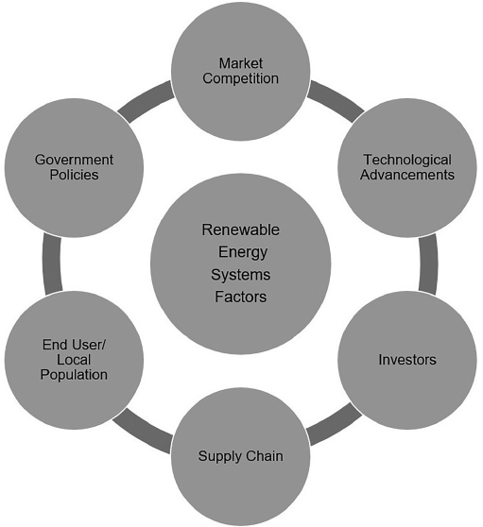




SYSTEMIC FACTORS
Renewable Energy Systems Requirements
Successful renewable energy integration requires coordinated action across multiple systemic dimensions.
West Africa's progress require strengthening institutional frameworks, improving technical capacity, and growing financial sector engagement
Regulatory Clarity
Financial Infrastructure
Technical Capacity
Transparent licensing, standardized contracts, and predictable grid interconnection processes
Local banks developing renewable energy expertise and green financing products
Growing pool of certified installers, engineers, and maintenance professionals
Public-Private Partnership
Collaborative models sharing investment risk and aligning stakeholder interests
Renewable Energy Systems Factors.
Review the publication referenced in Appendix A for more details
11

Slide 12
Policy Environment and Financial Incentives Accelerating Deployment
Favorable Policy Environment Driving Adoption
West African nations can benefit from progressive policy frameworks to actively encourage industrial renewable energy investment
These regulatory advances could help to create enabling conditions for private sector participation and reduce investment risk
See Appendix B for policy instruments in some of the leading renewable energy installed capacity countries
Key Financial Incentives
Capital investment rebates of 20-30%
Import duty exemptions on equipment
Accelerated depreciation schedules
Tax credits for renewable generation
Concessional lending facilities
Carbon credit monetization support
Investment Support Mechanisms
West African governments should establish comprehensive incentive packages that would significantly improve project financial viability
Mechanisms to address the primary barriers of high upfront costs and limited access to affordable capital
12

Slide 13


INNOVATION PIPELINE
Future Technologies on the Horizon
Near-term
Long-term
2024–2026: Advanced batteries and smart grids
2031–2035: Fusion pilots and carbon-negative tech
Medium-term
2027–2030: Green hydrogen and modular nuclear
The renewable energy technology landscape continues rapid evolution, with breakthrough innovations moving from laboratory to commercial deployment
West African industries positioning themselves as early adopters will capture competitive advantages in efficiency, cost, and market access.
13

Slide 14
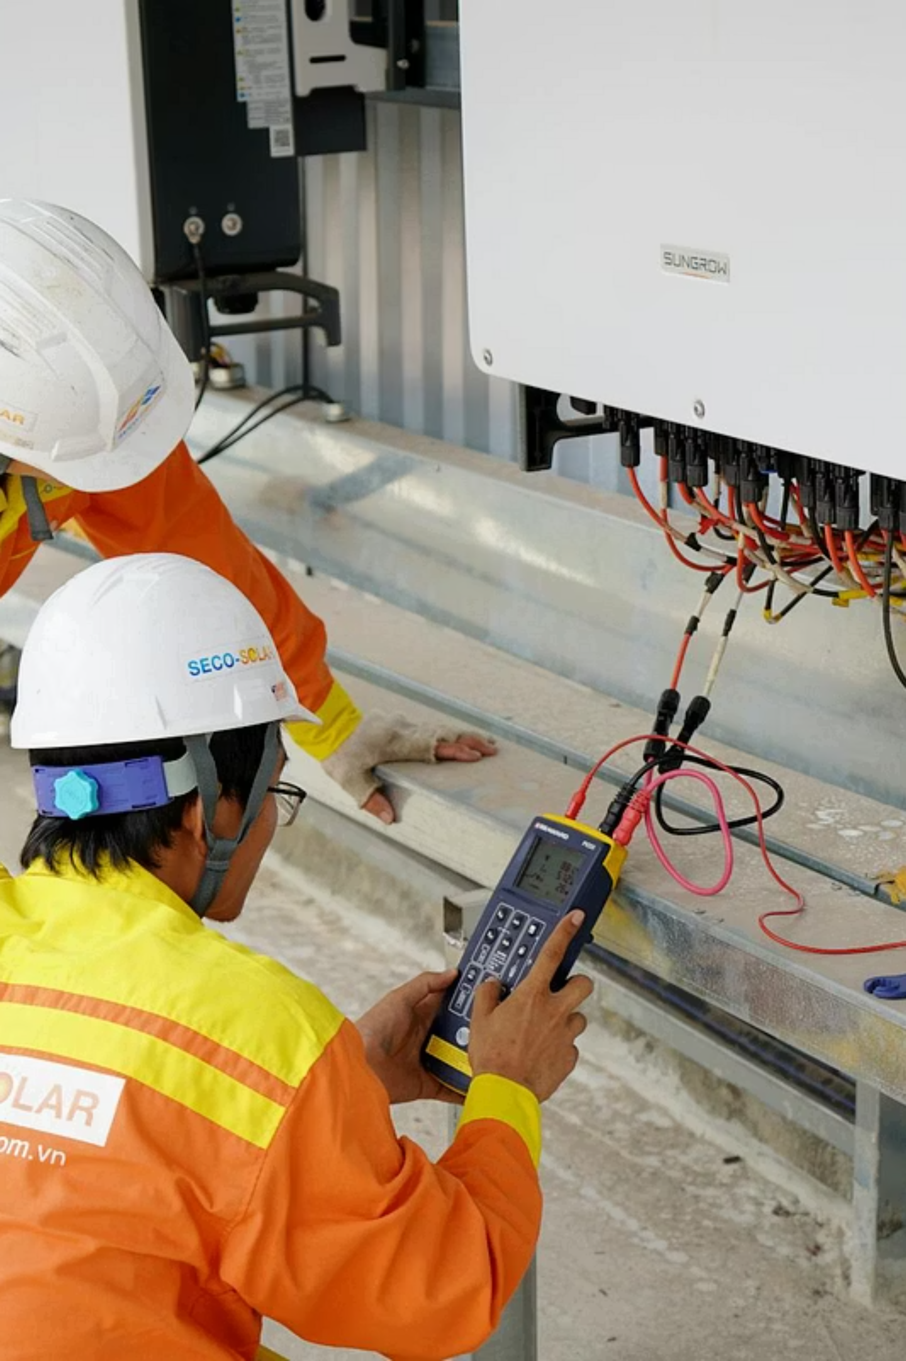
Overcoming Implementation Barriers
Upfront Capital Requirements
Technical Knowledge Gaps
Grid Integration Complexity
While operating costs are low, initial investments of $1-3 million per MW deter smaller manufacturers. Solutions include pay-as-you-go models, leasing arrangements, and blended finance structures that reduce or eliminate capital outlays.
Many industrial decision-makers lack familiarity with renewable technologies, leading to risk-averse choices. Peer learning networks, demonstration projects, and technical assistance programs build confidence and competence.
Interconnection processes remain bureaucratic in some jurisdictions, delaying projects by months. Standardized procedures, digital permitting platforms, and dedicated industrial liaison officers streamline approvals.
14

Slide 15

IMPLEMENTATION ROADMAP
Strategic Priorities for Policymakers
Mobilize Blended Finance
Strengthen Policy Frameworks
Structure catalytic public capital to de-risk private investment through guarantees, first-loss facilities, and concessional lending windows
Harmonize regulations
Guarantee grid access, and
Establish transparent interconnection standards with predictable timelines
Demonstrate Success
Build Technical Capacity
Support flagship projects across key sectors to build evidence base, generate peer learning, and attract private sector interest
Invest in vocational training, certification programs, and centers of excellence to develop local renewable energy workforce
15

Slide 16
Conclusion: Renewable Energy as Industrial Catalyst
Renewables represents far more than an environmental imperative for West Africa—it is the foundation for competitive, sustainable industrialization
The region's abundant solar, wind, and hydropower resources, combined with rapidly improving technologies and favorable economics, create unprecedented opportunities
Success stories from Nigerian Breweries, Unilever Ghana, and others demonstrate technical feasibility and strong financial returns
Progressive policy frameworks across Nigeria, Ghana, and Senegal provide enabling conditions, while innovative financing models address capital constraints
The path forward requires coordinated action:
Policymakers must maintain supportive regulatory environments
Financial institutions to develop tailored products, and
Industries should embrace renewable energy as strategic infrastructure
Local engineers/ industry encouraged by government programs should encourage innovations renewable technologies
West Africa's industrial future will be powered by the sun, wind, and ingenuity of its people
16

Slide 17
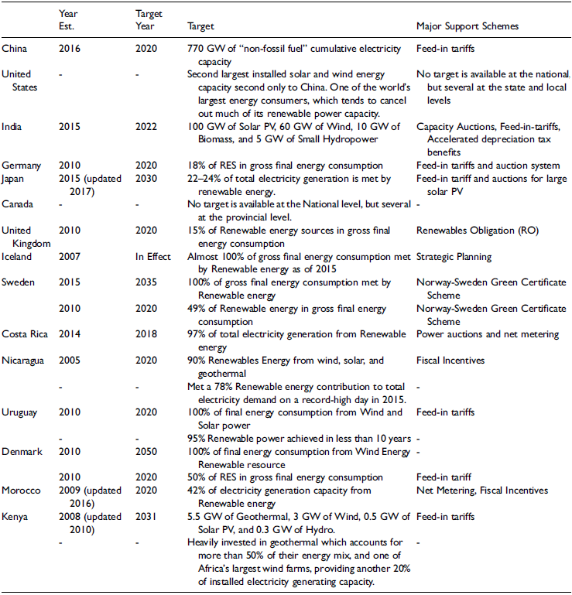
Appendix A:
Policy instruments
in some of the
leading renewable
energy installed
capacity countries
Based on Statistica Review, 2021
17

Slide 18

Questions
18

Slide 19
Contact
Dr. Olusanmi Adeniran, Ph.D., PMP, CQA
President, Abacoll Solutions LLC
Dallas, TX, United States
olu@abacoll.com | www.Abacoll.com
+1(682)561-4015
19

Slide 20
References
Olusanmi Adeniran. Systemic factors in modern renewable energy development across national income categories https://journals.sagepub.com/doi/epub/10.1177/27533735241285352
Leading countries in installed renewable energy capacity worldwide in 2023. Based on the Statistica Review (IRENA, 2023).
Policy instruments in some of the leading renewable energy installed capacity countries. Based on the Statistica Review (Statistica Review, 2021)
20

