Slide 1
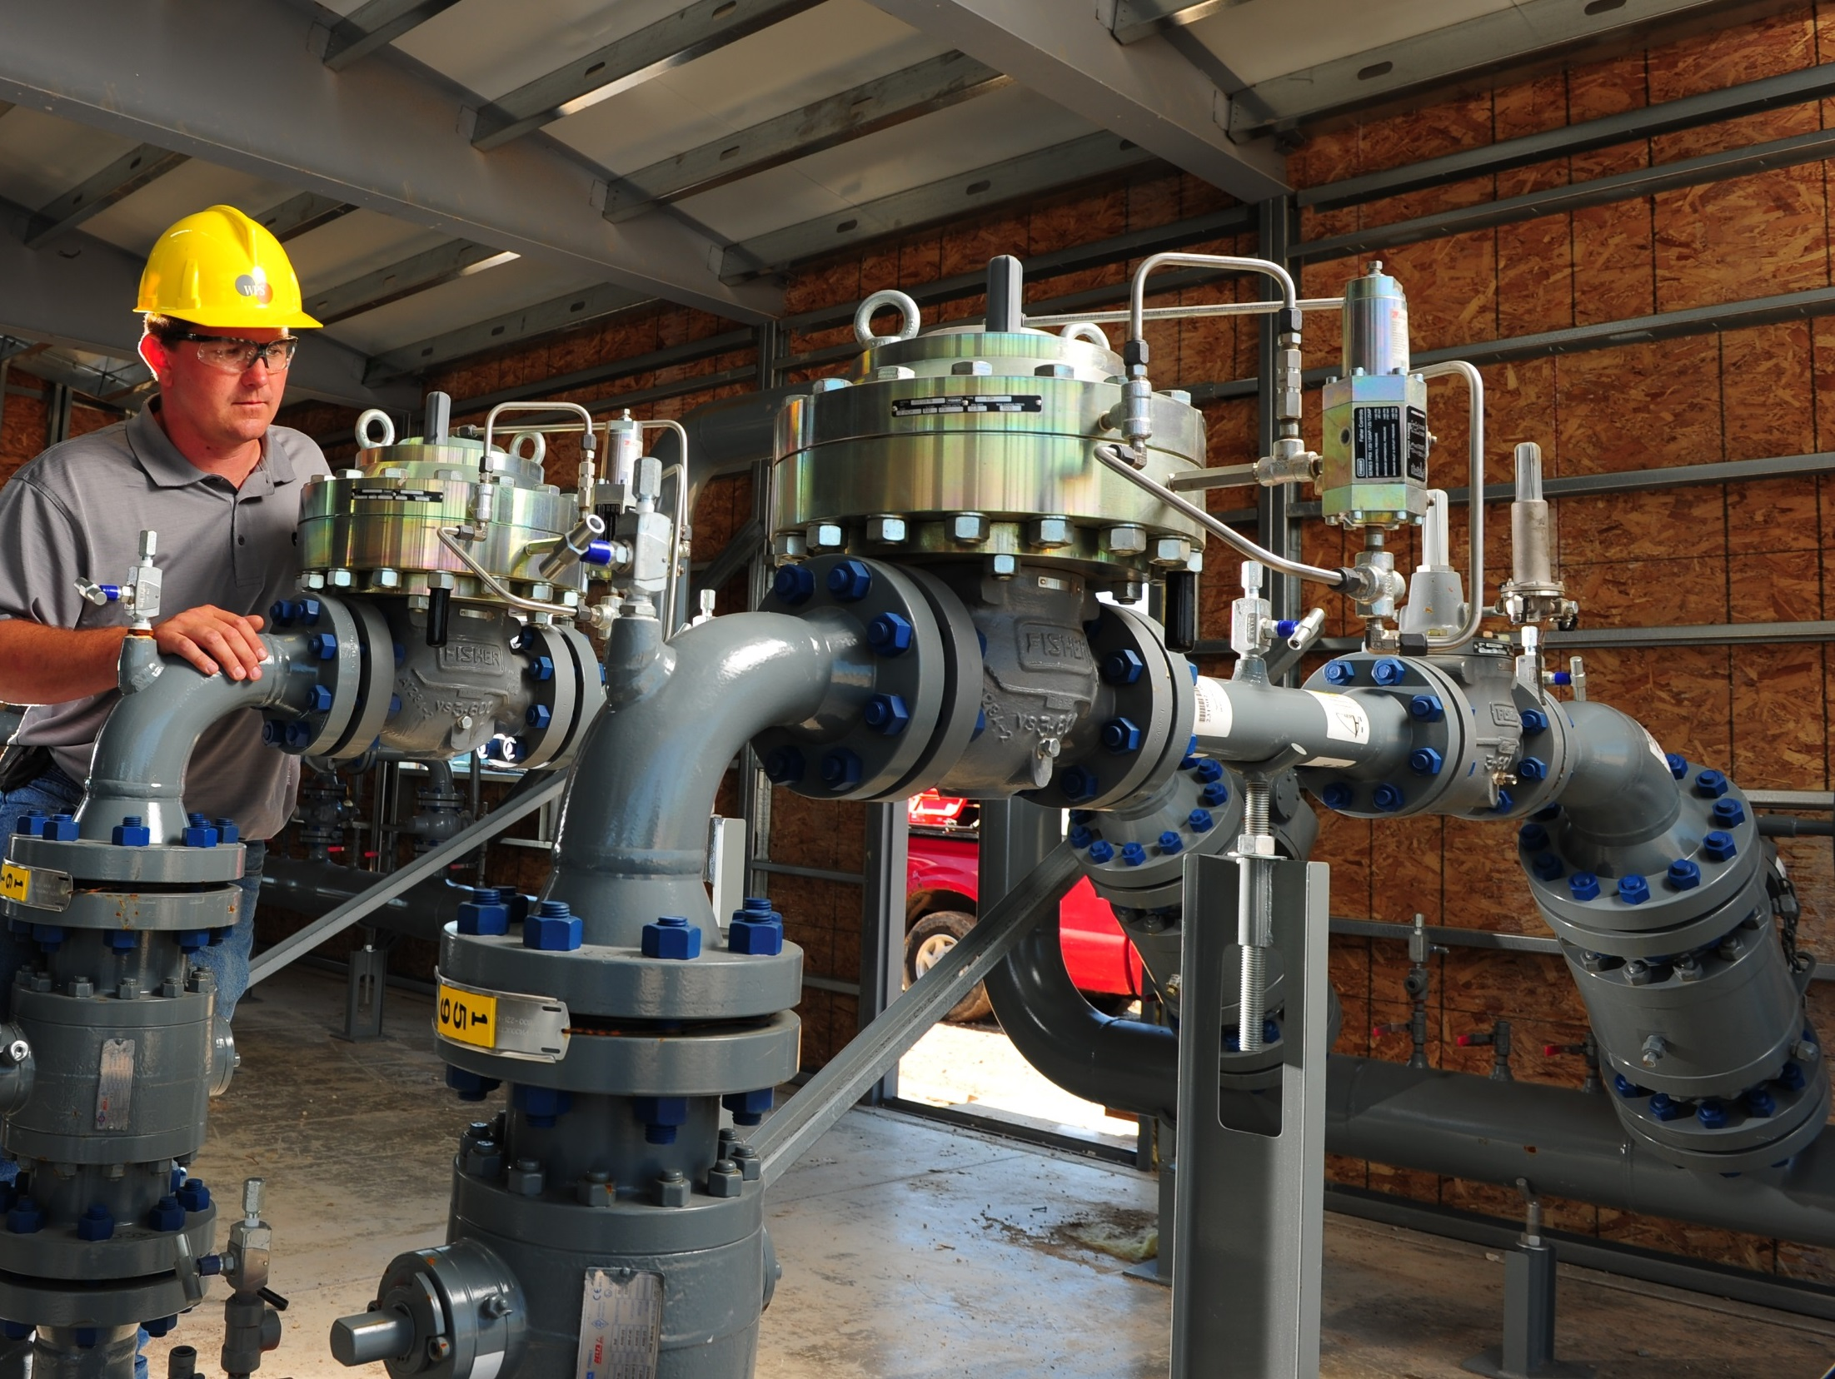

Optimizing Gas Operations with Emerson’s Smart PRMS
Presenter: Sharon Igwe

Slide 2
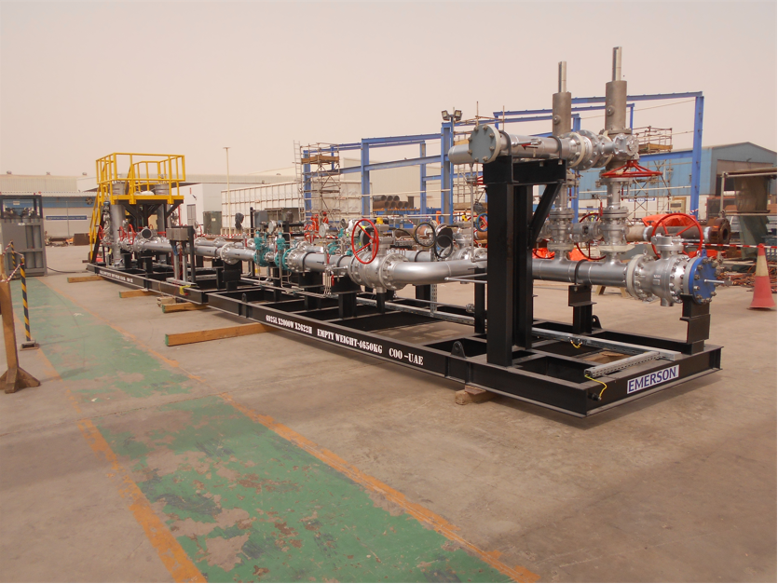
Introduction to Smart PRMS
PRMS is a Pressure Reduction Metering Skid package used in the transmission of Natural Gas aimed to ensure safety, gas pressure reduction and measure gas flow.
Emerson’s Smart PRMS is a digital platform designed to optimize gas distribution operations.
It addresses industry challenges like safety, remote monitoring and shutdown, capacity management & custody accuracy.
CORE ATTRIBUTES
Automated outlet pressure control
Max flow rate limitation
Split distribution of flow across 2 or more streams
Remote close of streams
Continuous recorded monitoring of system conditions
Smart management of preheat gas with 20% - 70% consumption reduction/GHG
Notes:
Custody accuracy – like a prepaid meter
Digital transformation: Remotely monitor and control station flow, pressure, gas temperature & Take immediate actions based on the ongoing events
Safety – zero events in the grid: Isolate the station in real time, Reduce emissions in the NatGas station due to accurate pressure control & Prevent unplanned failures
Improve operational efficiency: Reduce field trips, Apply for governmental incentives on carbon footprint reduction, Increase station capacity without changing pneumatic device, Increase lifecycle by reducing stress on critical parts (reg. pads, filter cartridge) & Improve boiler room management to decrease the average water temperature needed to heat the gas at inlet point

Slide 3
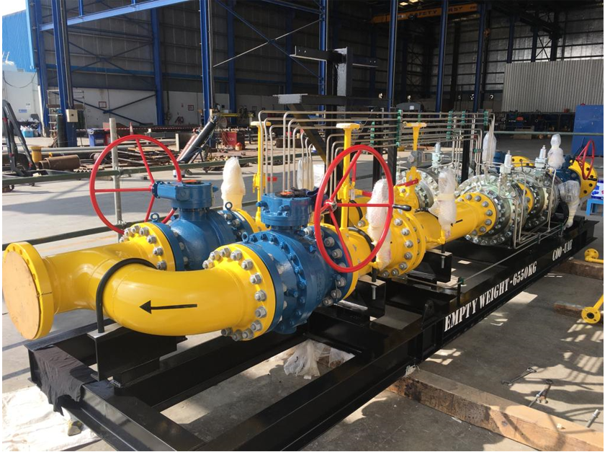
Limitations of Conventional PRMS
Manual monitoring
Limited diagnostics
Poor visibility
Reactive maintenance
Inconsistent metering accuracy
Lack of integration

Slide 4
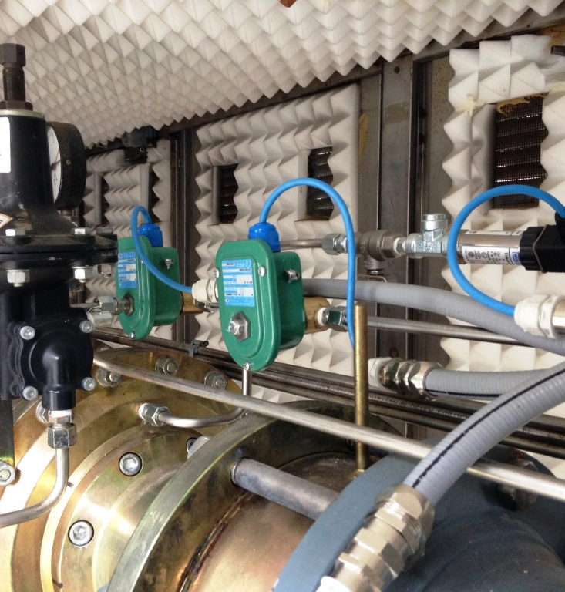
What Makes It “Smart”? - The Remote Automated Flow
Remote Control
Flow
Limitation
Incorporating a control unit, customizable touch screen interface and smart software, the RAF system is highly scalable with the ability to automatically manage not only individual equipment, but also a complete pressure reducing and metering station and an entire grid. … and much more, all within a single integrated system
RAF is compatible with most loading type pilot operated pressure regulators.
Functional Monitoring
RAF
Split Flow Range
Smart Gas
Preheating
Control
Remote Shut Down
Custody Transfer Optimization
Notes:
It is not just mechanical pressure reduction — it is a data-enabled pressure management system.
It includes an extensive range of communication modes, programmable logic offers a variety of features which simplify, optimize and secure the management of any natural gas installation
The RAF is a smart software, it is connected to the solenoid valve and connected back to the SCADA systems to support the solenoid valve with turning off and on the valve.

Slide 5
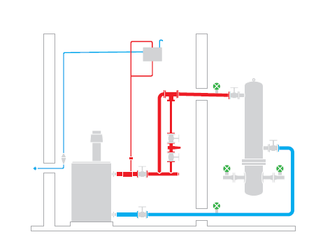
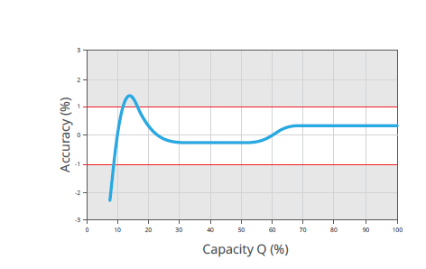
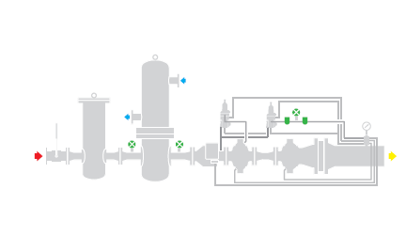
Functional Capabilities
Custody Transfer: By limiting the minimum value to guarantee and acceptable level of accuracy, it reduces non-invoiced leakages for low demand scenarios.
Pressure Control: The RAF provides a smart modulation of distribution pressure based on the consumption profile allowing a reduction in average distribution pressure.
Capacity Management: The RAF manages the capacity of the station itself by balancing the gas flow, pressure levels and equipment workload automatically, it ensures we deliver the maximum safe output without stressing the system.
Gas heating management: The RAF system optimizes the gas heating system, used when necessary to increase the gas temperature. This will allow considerable savings
Notes:
In custody transfer applications the high level of accuracy required across the entire range can be problematic. RAF can control these types of situations by limiting the capacity to a minimum value to guarantee an acceptable level of accuracy. These capabilities will also reduce non-invoiced leakages for low-demand scenarios (CTM functionality).
to provide full control and monitoring of an entire pressure reducing and metering station. The RAF system provides also smart modulation of distribution pressure based on real daily consumption profiles, allowing a reduction in the average distribution pressure
3. The operators will be able to select from different operating logics
4. The RAF system optimizes the gas heating system, used when necessary to increase the gas temperature. This will allow considerable savings

Slide 6
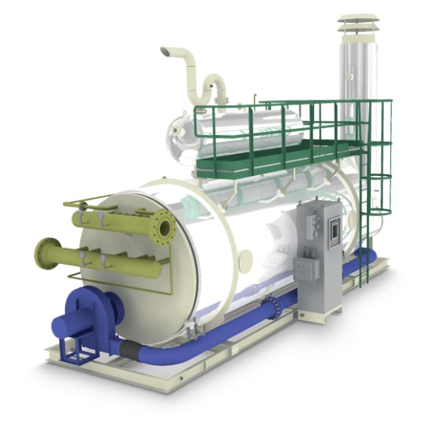
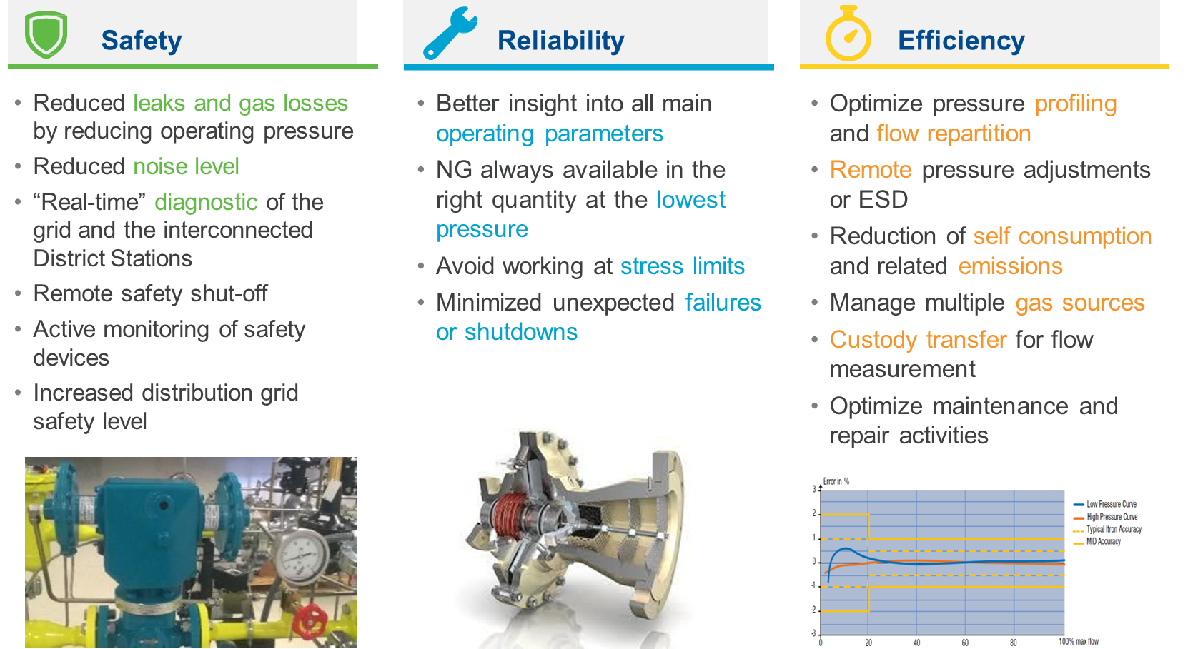
Benefits
Efficiency
Safety
cost savings
sustainability.
Notes:
1. Split flow range will reduce the total noise level and will ensure better working conditions for all regs. Split Flow in RAF evenly distributes flow across multiple pressure reduction lines by making slave lines match the master's loading pressure when flow exceeds a set threshold. This balances regulator workload, extends maintenance intervals and can reduce noise.
2. RAF allow the balancing of gas networks flow rate and pressure, totally by remote. It’s equipped by serial ports RS485 and Ethernet Ports with Modbus protocol.
3. Ensure on-going accuracy and repeatability while complying to regulations.
4. RAF - Gas Pre-Heating Control - Reduce energy consumption for preheating and optimize gas outlet temperature
5. Accurate reporting
6. Improved environmental compliance our leak detection and remote sensing
7. RAF allow the balancing of gas networks flow rate and pressure, totally by remote. It’s equipped by serial ports RS485 and Ethernet Ports with Modbus protocol.

Slide 7
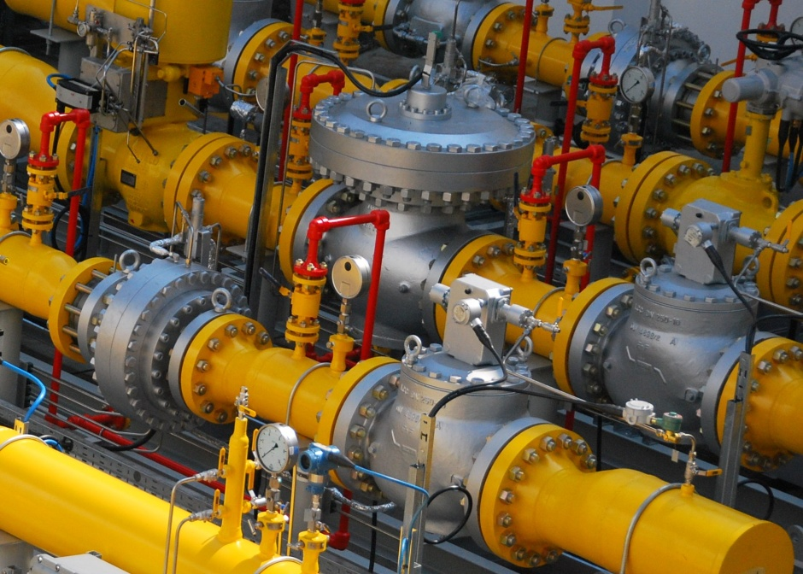
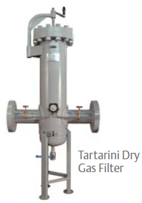
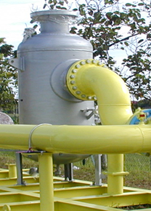
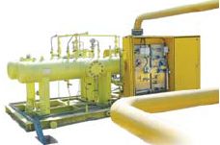
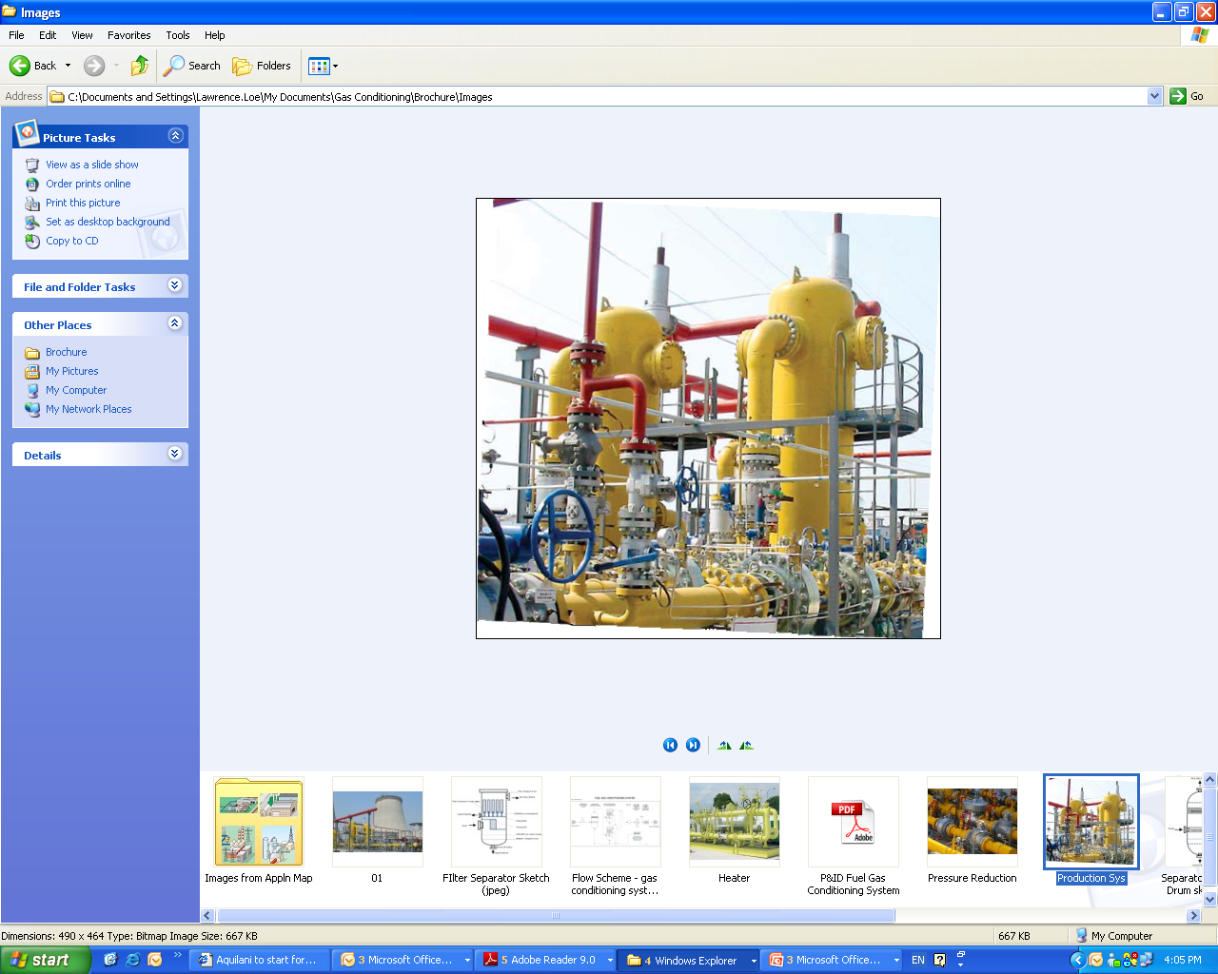
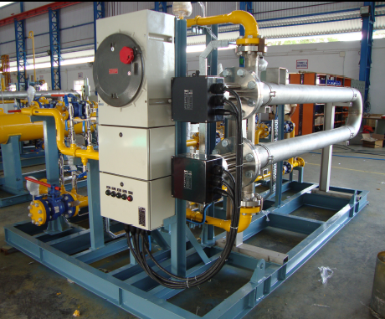
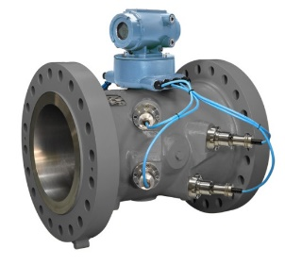
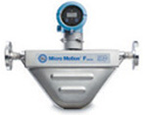
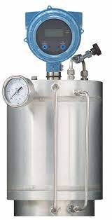
Natural Gas Skids - Gas Conditioning Solution - PRMS
Gas Conditioning System
Complete Gas Conditioning System from
the Technology Leader
Pressure Regulators & SSV
Tartarini Dry
Gas Filter
Odorizing Solution
Condensate
Separator
Filter Separator
Heater
USM, Coriolis & SGM Meters
Notes:
Typical Emerson components include:
Fisher control valves
Digital valve controllers
Ultrasonic flow meters
Flow computers
Gas chromatographs
SCADA integration
Explain how integration reduces mismatch risk.

Slide 8
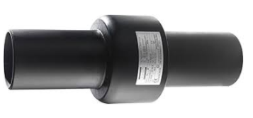
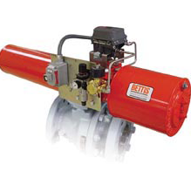
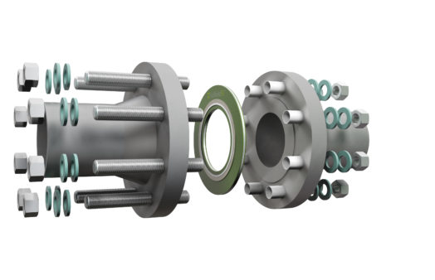
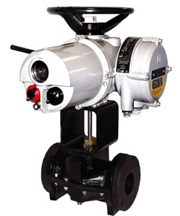
Station Inlet & Outlet (Safety & Isolation)
Electrical isolation & cathodic protection
Monolithic vs. flanged joints
Emergency shutdown valves (ESD)
Smart automation: automatic shutdown & blowdown
Smart Solutions
Automatically shut down the ESD valves on high PT HH or GD alarm
Automatically open blow down valves on high GD alarm.
Notes:
Every production station begins with safety. Smart PRMS ensures corrosion protection through insulation joints and provides reliable emergency isolation with ESD valves. The system’s intelligence means shutdowns and blowdowns happen automatically when abnormal conditions are detected — reducing risk and protecting both people and assets.

Slide 9
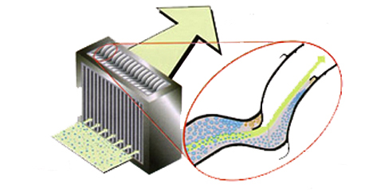
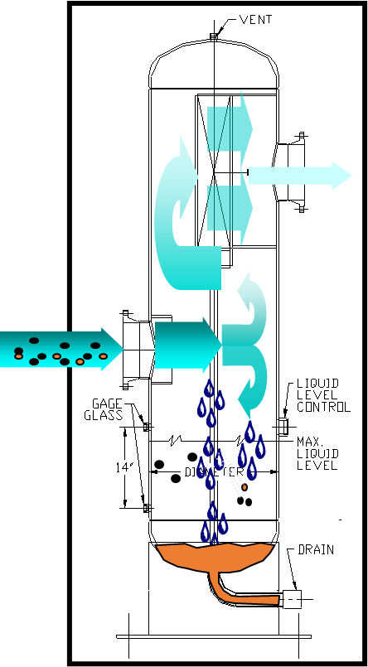
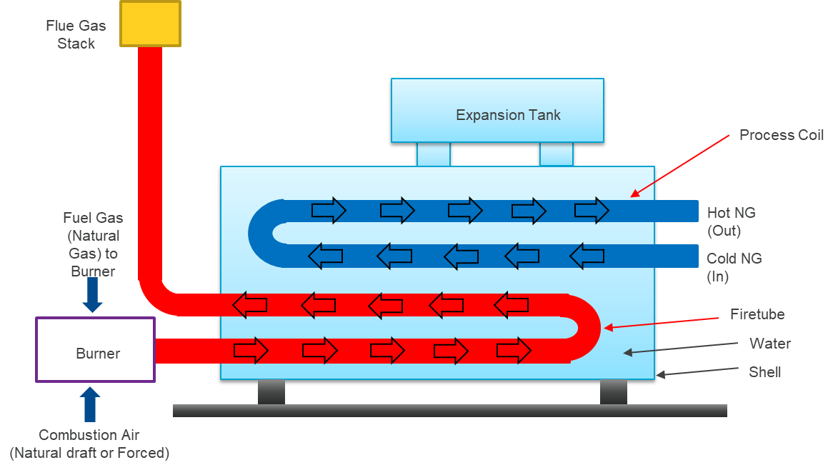
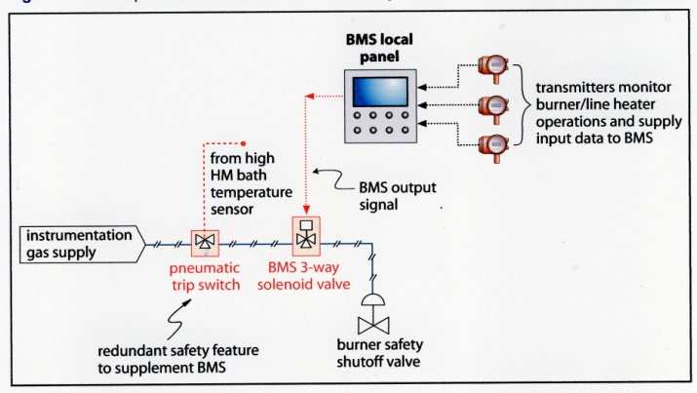
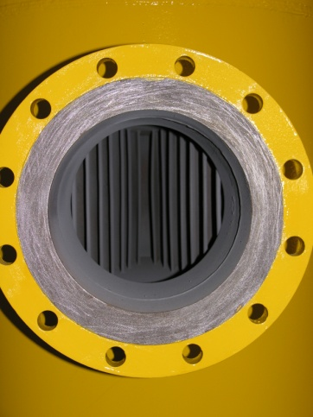


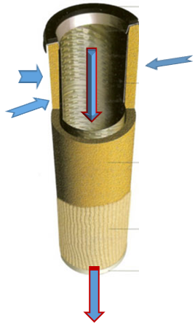
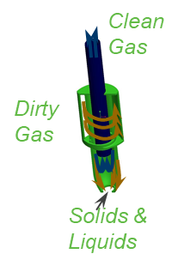
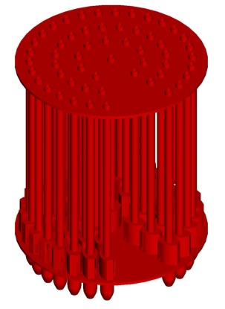
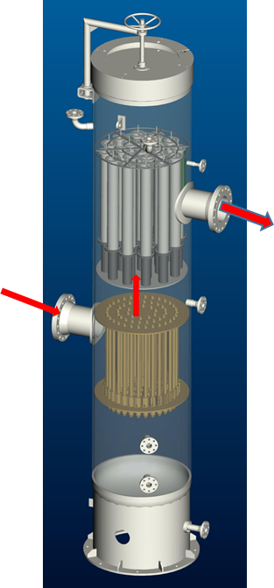
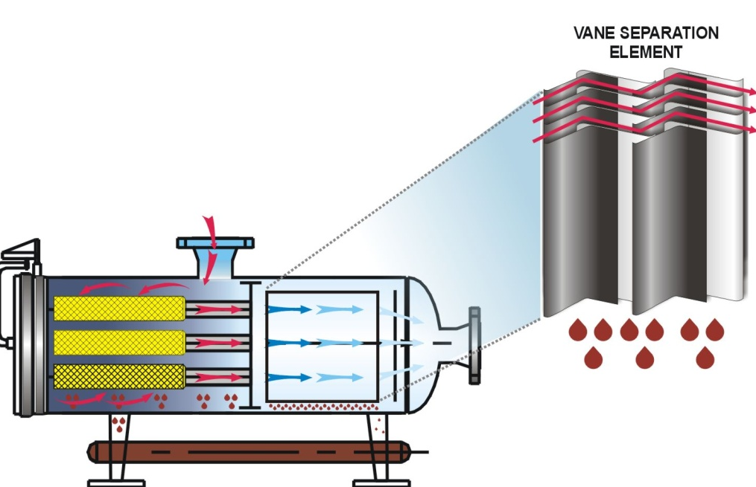
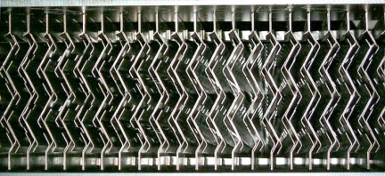
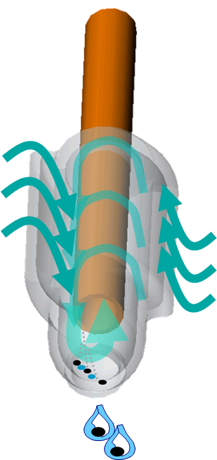
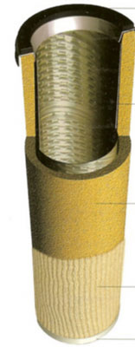
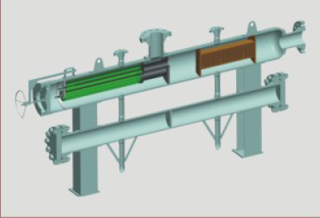
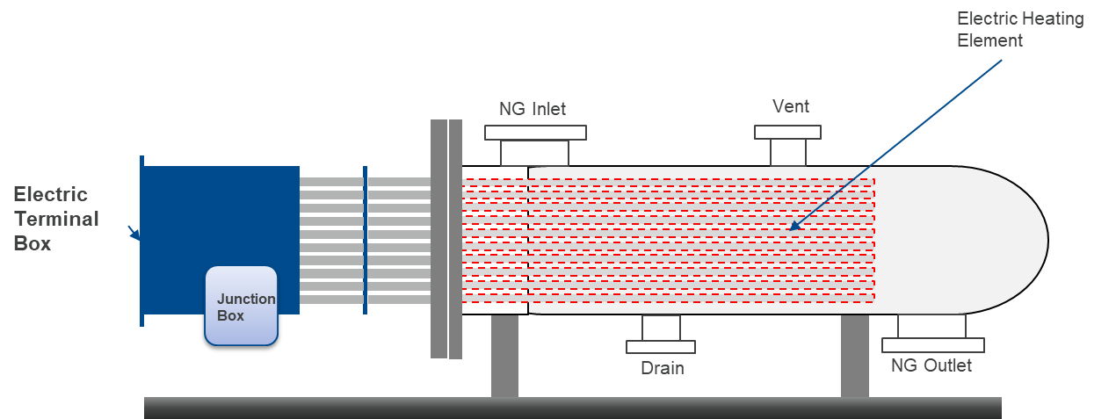
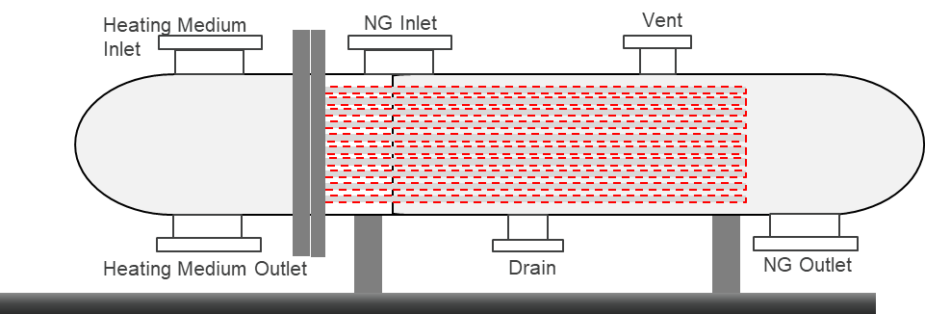
Filtration & Heating (Gas Conditioning Essentials)
Vane Demister
Two‑stage filtration: multicyclones + coalescers
Removal of solids, liquids, and mist
Heating solutions: indirect water bath, electric heaters
Smart controls for condensate drains & heater management
Inlet Diverter
1st Stage Multicyclones
1st Stage Cartridge Filter
Smart Solutions
Automatically Open /Close condensate drain valves on level
High Differential Alarm
2nd Stage Vane Demister
Notes:
Gas conditioning is critical for efficiency. Smart PRMS integrates advanced filtration to remove contaminants and heating systems to counter the Joule‑Thomson effect. Automated drain valves and heater management ensure continuous, reliable operation without manual intervention.

Slide 10
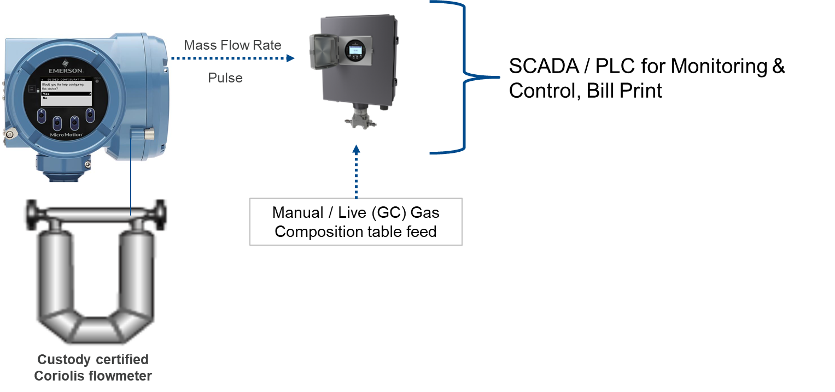
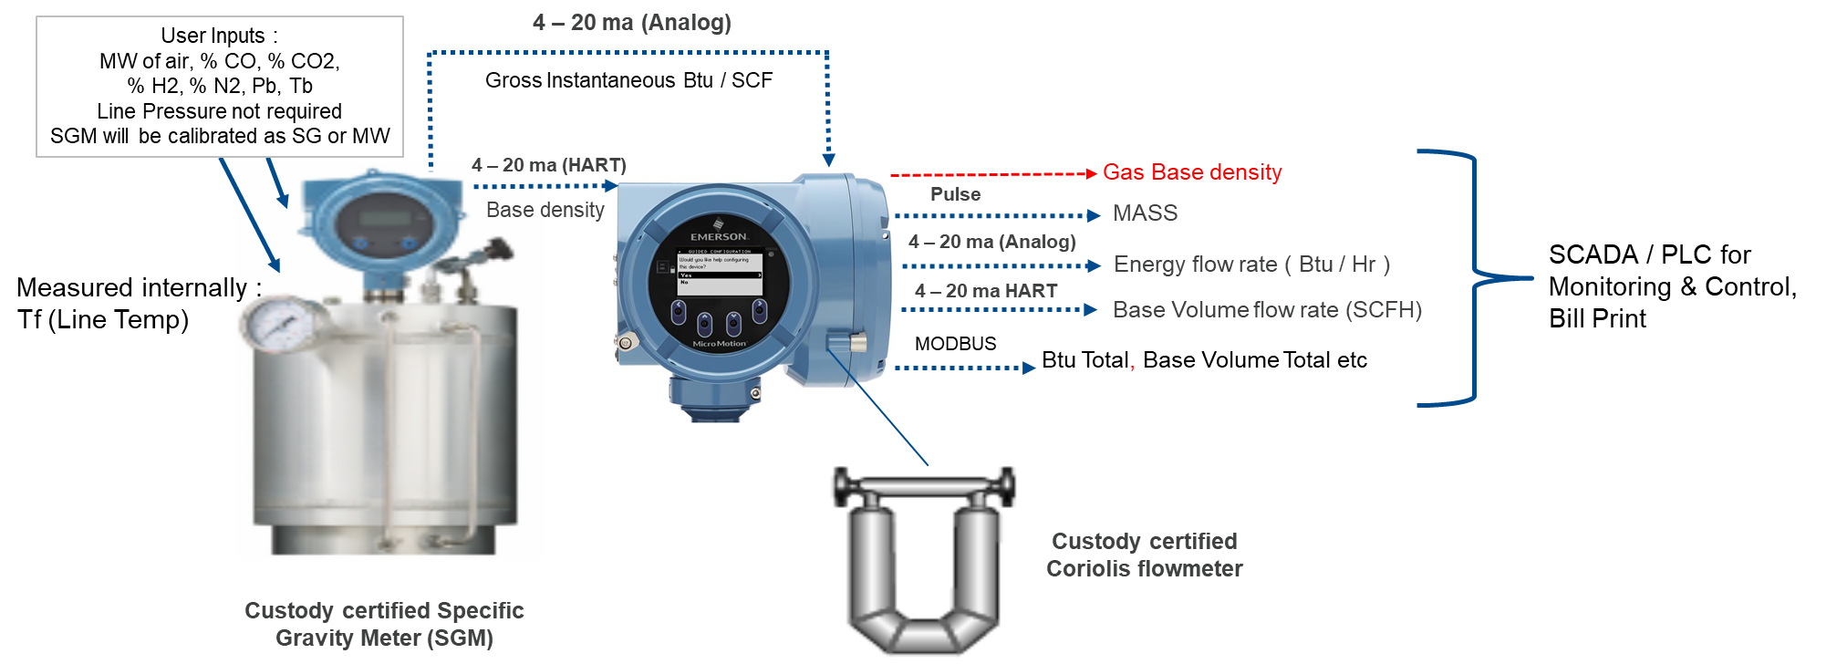
Metering & Flow Control (Accuracy & Efficiency)
Ultrasonic & Coriolis meters: custody transfer accuracy
No moving parts → reduced maintenance
Globe & rotary valves for stable flow control
Smart solutions: automatic meter proving & stream changeover
Smart Solutions
Equipartition Pressure Control across multiple streams
Flow Limitation
Pre-Paid Solutions
Notes:
Revenue assurance depends on accurate metering. Smart PRMS leverages ultrasonic and Coriolis meters for custody transfer compliance, while digital valve controllers ensure stable flow. Automated proving and stream changeover reduce downtime and keep operations efficient.

Slide 11
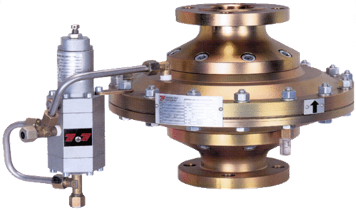
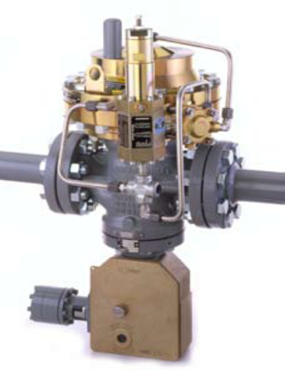
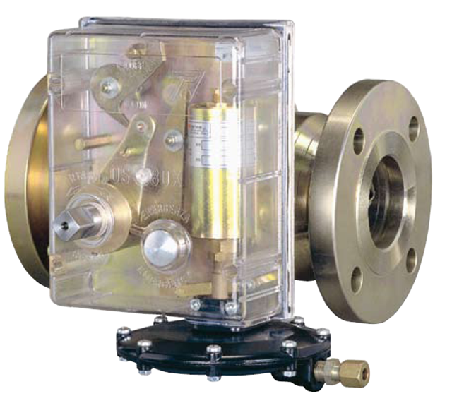
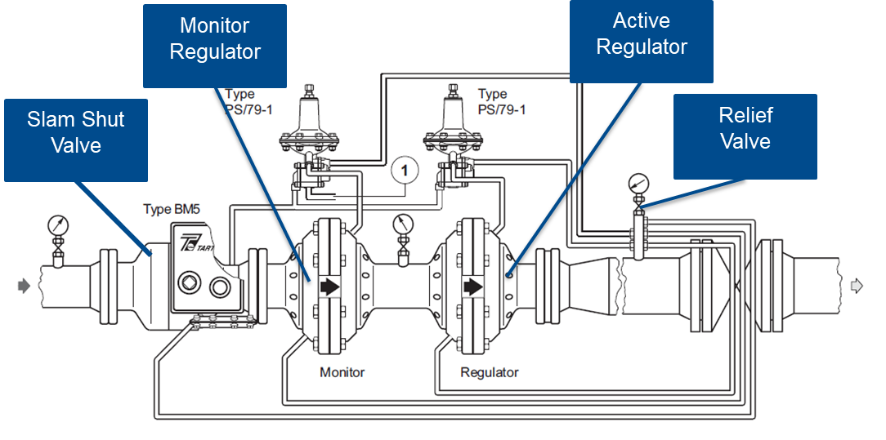
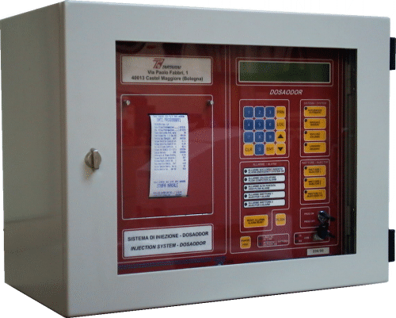
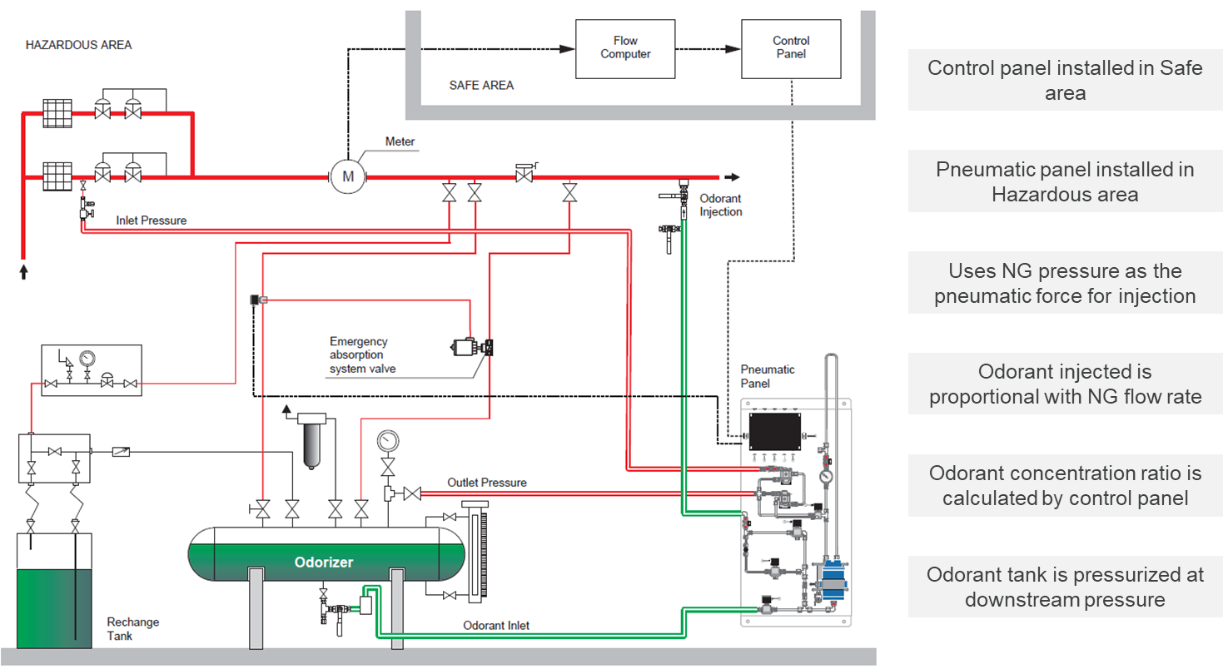
Pressure Reduction & Odorant Injection (Reliability & Safety)
Pressure regulators & slam‑shut valves
Overpressure protection & remote set‑point control
Odorant injection for safety compliance
Smart odorization management
Smart Solutions
Equipartition Pressure Control across multiple streams
Flow Limitation
Flow Control
Automatic Meter Proving
Automatic Stream Changeover
Notes:
Pressure reduction and odorization are about reliability and safety. Smart PRMS provides precise pressure control with slam‑shut valves and predictive maintenance. For odorization, automated injection ensures consistent safety compliance while minimizing maintenance costs.

Slide 12
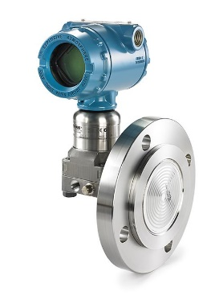
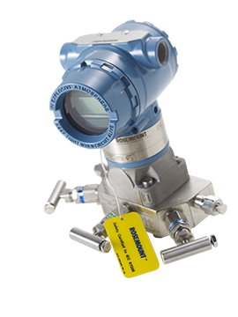
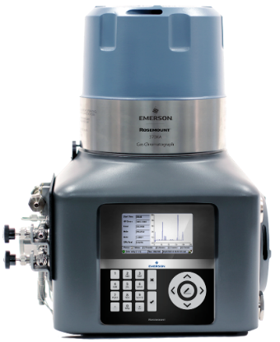
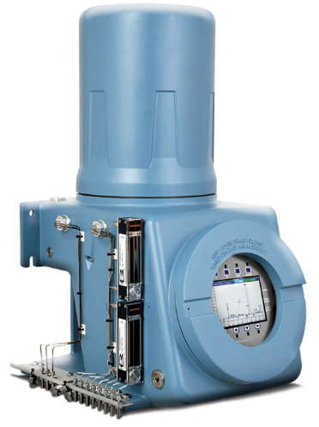






Advanced Analytics & Instrumentation (Smart Layer)
Gas chromatographs for composition analysis
Intelligent transmitters & flow computers
Real‑time diagnostics & predictive monitoring
ESG integration: emissions monitoring, reduced flaring
FB1000
Smart Solutions
Optimization of gas heating
Heater/Burner Management – Switch over of heaters
FB2000
Notes:
The intelligence layer is what makes PRMS truly smart. Emerson integrates chromatographs, transmitters, and flow computers to deliver real‑time diagnostics. This not only improves reliability but also supports ESG goals — reducing flaring, monitoring emissions, and ensuring compliance.

Slide 13



ROI & Business Case
OPEX
CAPEX
Reduced site visits
Reduced downtime
Better metering revenue assurance
You invest in intelligent devices
Supports Integration of assets
Notes:
Smart PRMS is not an expense — it is a risk reduction and revenue assurance system. It helps optimize both sides — justifying CapEx while delivering OpEx efficiency.

Slide 14

Local Capability
As the ASP & LBP of Emerson, IKOSH has a PRMS assembly plant in country (Port Harcourt) supporting the initiative of local content and knowledge sharing.
The plant is a 1000sqm facility, fully equipped.
We are fully compliant with all regulatory and statutory requirements and ISO certified.
Equipped engineers trained for the assemble, installation, maintenance and support of the skid.

Slide 15
Future of PRMS – We are the Future
AI-based anomaly detection
Digital twins
Cloud analytics
Integrated pipeline optimization
Remote unmanned stations
Notes:
As seen in our RAF system
Through our SCADA you can mirror your plants
With the Smart PRMS you have a one stop integrated SMART solutions
With the one stop data collection,

Slide 16

Smart PRMS transforms a traditional pressure station into a digital, intelligent, secure, and revenue-optimized asset.
Thank You

Slide 17
FAQ’s
How Is Cybersecurity Handled?
Can It Integrate With Third-Party Systems?
How Does It Reduce Methane Emissions?
What Happens If Communication Fails?

