Slide 1

Strategic procurement capability as a catalyst for West Africa’s industrial revolution Chukwudi Uche: CIPS Country Director, Nigeria.
3 March 2026

Slide 2
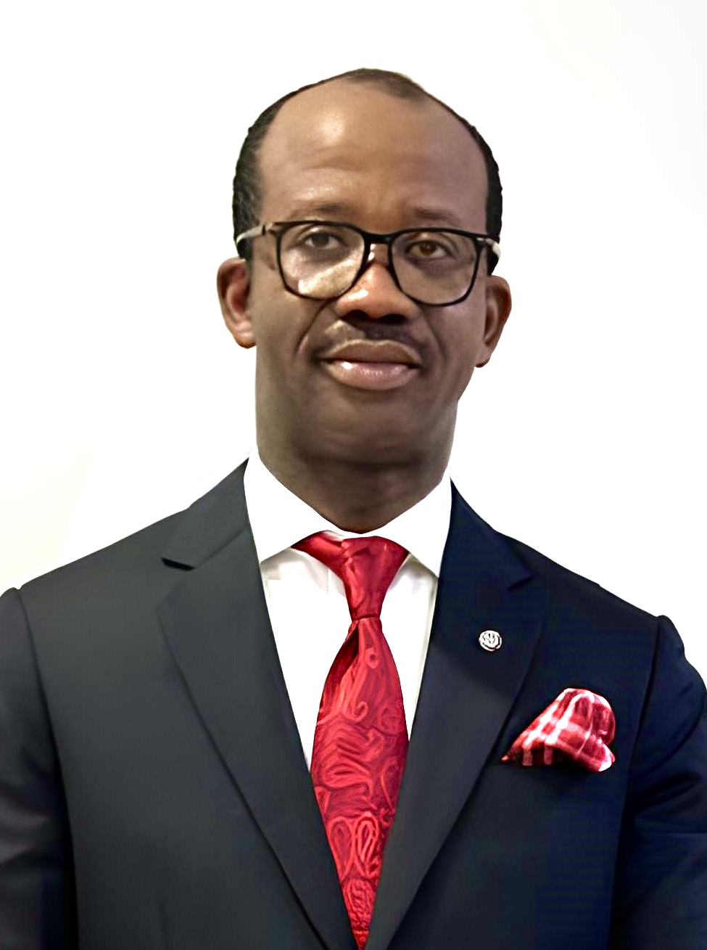
Chukwudi Uche CIPS Country Director-Nigeria
Procurement and Supply Professional: Over 20 years
MSc Supply Chain Management (University of Liverpool)
BSc Pharmacy (University of Nigeria)
CIPS Fellow (Chartered)
Certificate in organizational leadership (HBS Online)
Project Management Practitioner
Former Country Manager, CIPS Health Procurement Africa Programme
Resident of Abuja, Nigeria

Slide 3
Outline
Opening quote
Food for thought
Strategic procurement essentials
Insights from CIPS work in Nigeria’s health sector
Procurement diagnostic findings
Supporting quote-1
Recommended approach towards building capacity for strategic procurement
Supporting quote-2
Concluding remarks
Closing quote

Slide 4
West Africa’s industrial revolution will not be accelerated by factories and policies alone—but by strategic procurement professionals with the capability to create value towards sustainable industrial growth

Slide 5
Food for thought
Have you wondered why air travel remains the safest means of transportation?
What do you think will be the fate of well-built aircrafts without well trained pilots?
Well trained pilots who obey flight rules make for safe air travels
Capability makes the difference towards safe air travels
Same way capability makes the difference in strategic procurement
Could there be any industrial revolution without strategic procurement as its driver?
If no, it can only be handled for impact by ethical procurement professionals

Slide 6
Strategic procurement essentials-1
Clear alignment with organisational strategic direction
Not just about short term savings but long-term value creation
Encourages supplier development and local content development
Drives sustainability and ethical sourcing

Slide 7
Strategic procurement essentials-2
Enabled by strategic mindset (strategic sourcing), professional standards, skills, and digital literacy
Prioritizes risk management especially in the current VUCA world
Ensures that stakeholders and suppliers are well managed
Performance and value measurement driven

Slide 8
Statements of fact to note-1
Traditional buying-focused procurement cannot support industrialisation
Skills gap limits procurement’s impact in West Africa
Industrial policy and strategies fail when procurement capability is weak or an afterthought
West Africa cannot industrialise with 20th-century procurement skills in a 21st-century economy

Slide 9
Statements of fact to note-2
Factories do not industrialise economies but people do
Implementation of local content provision in relevant procurement or industrial policies across West Africa can only be made possible by qualified procurement professionals
Expected increase in domestic market share of locally made goods can only be facilitated by qualified procurement professionals
Optimization of high level of raw materials imports by manufacturers is only possible with qualified procurement professionals

Slide 10
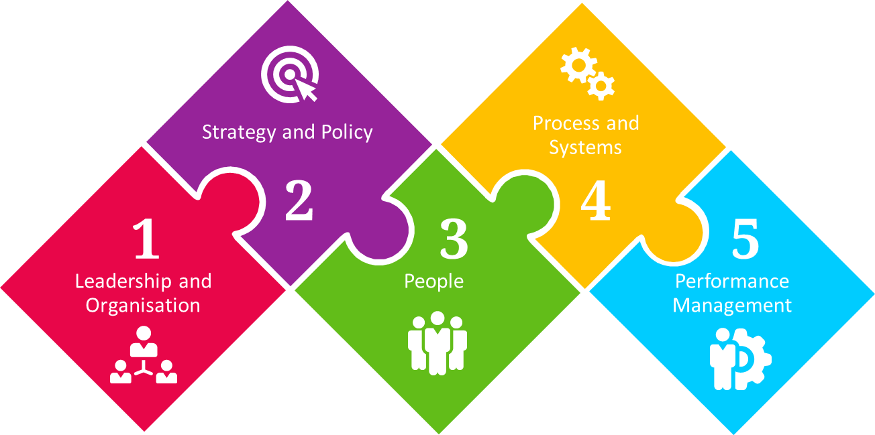
Insights from CIPS work in Nigeria’s health sector
The Diagnostic Framework
Carried out initial procurement diagnostic activities in a total of eight States in Nigeria between 2021 to 2023
Diagnostics focused on 5 improvement blocks of Leadership and organisation; strategy and policy; people; processes and systems; and performance management
The relevant dimensions reviewed under “people” include investment in people as well as personal development and performance
Scoring framework ranged from a minimum of 1 for adhoc level of maturity and 5 for standard level of maturity
A re-diagnostic exercise has been carried out in 2025 in a total of 4 States
Findings on dimensions that are “people” focused provide a great insight on the current reality on procurement workforce

Slide 11
Procurement diagnostic findings
Comments:
Evidence shows that efforts in the area of investment in people as well as personal development and performance have been inadequate.
Recorded improvement between 2023 and 2025 is primarily linked to CIPS qualification programme programme support for a select number of participants within the focus states.
1-1.9 Ad hoc
2-2.9 Tactical
3-3.9 Developing
4-4.9 Effective
5 Standard
Diagnostic Area | Average Score 2023 (in 8 States) | Average Score 2025 (in 4 States) | Variance | % Increase
Investment in People | 2.6 | 3.8 | 1.1 | 43%
Personal Development and Performance | 1.6 | 2.5 | 0.9 | 53%

Slide 12
When public procurement professionals are strategic and well-equipped, government spending becomes a powerful driver of industrialisation, job creation, and investor confidence.

Slide 13
Recommended approach towards building capacity for strategic procurement
A
Assessment of current capability through skills gap analysis
B
Skills and roles definition for procurement professionals within procuring entities using agency specific organization and competency framework documents. Make budget for capacity development
c
Implementation of relevant capacity building programme. Professionalize procurement team.

Slide 14
Recommended approach towards building capacity for strategic procurement-2
E
Embedding of procurement code of conduct to ensure ethical and transparent procurement practices amongst procurement practitioners within a procuring entity
F
Hands on coaching and mentoring of procurement practitioners in the procuring entity through procurement technical assistance
G
Monitoring of progress through use of repeat skills gap analysis

Slide 15
Organisations that invest in procurement capability don’t just reduce costs—they will secure supply, enable growth, and future-proof their operations in West Africa.

Slide 16
Concluding remarks
Strong procurement capability translates to stronger local suppliers and stronger industries
Procurement remains an engine of industrial policy and economic prosperity
There is urgent need to professionalise and upskill procurement talent
Industries need to offer opportunities for training of procurement professionals through exchanges and internships
Curriculum for training of procurement professionals need to be supported by industry experts
Manufacturers Associations in West Africa should champion procurements skills within all strengthening efforts through National Skills Council
Strategic thinking, commercial acumen, sustainability literacy, and digital skills will be the outcome

Slide 17

Closing quote
If West Africa is serious about a sustainable industrial revolution, then procurement must move from back office function to the centre of economic transformation.

Slide 18
Thank you

