Slide 1

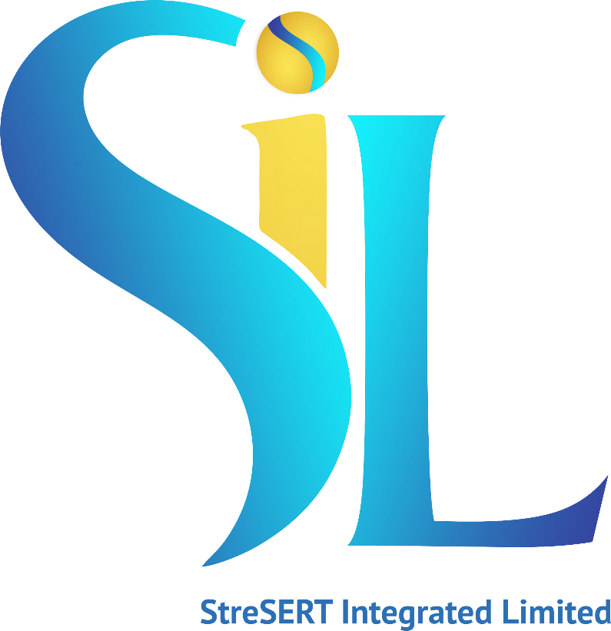
MOVING FROM EXTRACTION TO INTELLIGENCE: RETHINKING WEST AFRICAN’S GROWTH PARADIGM
MARCH 2026.
Privacy Policy
The information contained in this document is confidential and should be treated as proprietary and trade secret. No part of this document may be reproduced or transmitted in any form or by any means, including but not limited to electronic, mechanical, photocopying or recording or stored in any retrieval system of whatever nature without the written consent of StreSERT Integrated and/or DMG.

Slide 2
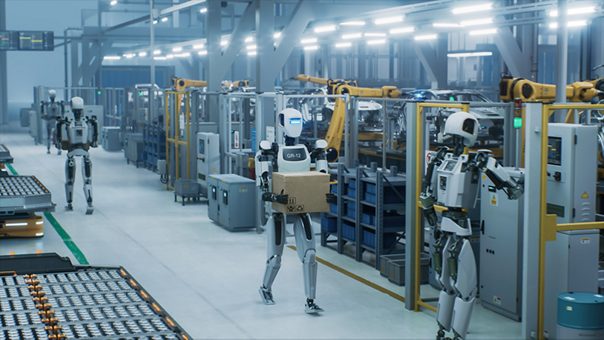

Slide 3

AI is redefining industrial power and rewriting the rules of global competitiveness
Automation and AI are raising the bar for what it takes to succeed in export-led manufacturing,
New laborsaving technologies reduce the importance of low wages in determining costs,
This places a premium on the “competitiveness” of the business environment and the “connectedness” to input and output markets.
African countries will need to meet more demanding ecosystem requirements in terms of infrastructure, logistics and other backbone services, regulatory requirements, and trade restrictions

Slide 4
An AI divide is emerging – industrialized economies are accelerating while others risk falling further behind
While industrialized nations advance swiftly in AI adoption, many developing countries face barriers that prevent them from fully harnessing these transformative technologies.
There also seems to be a widening the gap between big firms and SMEs especially in terms of the benefits accruing from the adoption of these technologies.
And there are fears that AI, automation and associated emerging technologies could spike unemployment.
  While in the past, overall, the net result on jobs from the implementation of new technologies have been positive, there are concerns that this time things could be different.
If West Africa merely consumes foreign AI models without building its own, we risk a new digital colonialism – trading the export of raw minerals for the export of raw data, a new form of economic dependence.

Slide 5
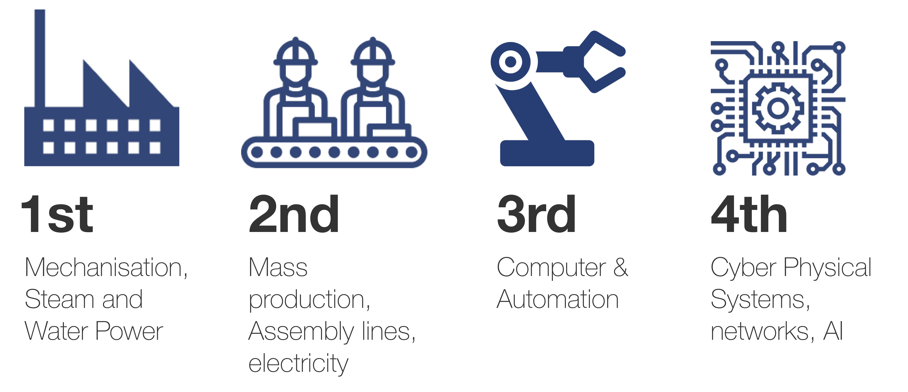
Africa has historically been a consumer of industrial revolutions not a shaper of them
Africa has repeatedly missed out on the industrial revolutions of history—mechanisation, mass production, and digitization.
And might miss out on the fourth industrial revolution currently powered by emerging technologies – machine learning, artificial intelligence (AI) and automation.

Slide 6

The real opportunity is not ‘catching up’ – it is reimagining the growth model
We must change the script. We must stop defining our future by the industrial revolutions we missed and start defining it by the digital infrastructure we are building today.
Stop chasing the industrial revolutions of the past and begin shaping the industrial revolution we want today.
AI gives West Africa the chance to move:
From extraction to intelligence
From labor-cost advantage to productivity advantage
From commodity exports to value-added ecosystems

Slide 7
Sustainable growth requires a unique regional framework that balances high-tech automation with our specific labor markets and social needs.
A Clear Framework Is Required:
Create: Develop indigenous innovation, capacity around artificial intelligence and automation, and new industries
Protect: Embed in indigenous technologies and operating models risk management around jobs, inequality, and digital security.
Compete: Boost industrial productivity and global competitiveness via higher efficiencies and inclusivity.

Slide 8
To achieve the goal of industrialization and economic prosperity for all, indigenous talent and knowledge must anchor the AI strategy
West Africa’s demographic advantage is its greatest asset.
AI systems built around population realities, local languages, local supply chains, and local market realities will outperform imported templates.
Technology must amplify regional talent and intelligence — not replace it.
Focus on developing AI systems that augment rather than replace human workers

Slide 9
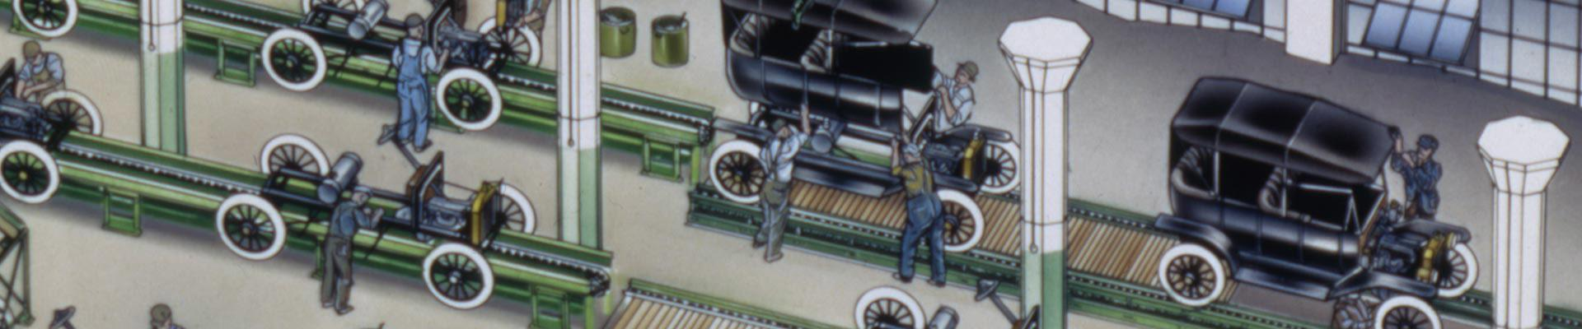
We must design industrial systems for scale and adaptability, without compromising resilience and sustainability
Real industrial revolutions have often come from:
Process optimization, not necessarily pure technology.
And by creating virtuous economic circles
Because we are not bound by legacy infrastructure, we can build AI first systems “from day one” that are:
  Digitally integrated
  Resource efficient
  Environmentally responsible
  People inclusive

Slide 10

Copying foreign industrial models will lock us into yesterday’s constraints
AI systems developed in other regions are often optimised for foreign data sets, languages, and user behaviours.
When these tools are imported wholesale, they risk embedding cultural bias, reinforcing dependency, and misaligning with African realities.
Importing industrial models designed for the West or East will not work here; we must stop copying and start contextualizing.

Slide 11
We have a rare opportunity to bypass legacy industrial mistakes and build smart, AI-native systems from the ground up.
We can structure systems from day one around these emerging technologies, to forge a new industrialization pathway that integrates innovation with the values of resilience, community, and environmental stewardship
  Move from the mindset of AI as tool to general purpose technology
  Embed intelligence into core operations
  Scale through human centered automation
  Proactively adapt systems that learn
  Structurally designed for continuous adaptation
Leapfrogging Requires Systems Thinking — Not Just Technology Adoption

Slide 12
Industrial systems that embrace a new design logic: one that favours small-scale, decentralised, and human-centred innovation
As Is AI innovations
Human centred AI led industrialization
AI solutions that prioritise the interests of investors or donors. | AI solutions that prioritise the needs of local people,
Layering AI on top of legacy processes | Rethinking operating systems and models with AI at the core
Accelerate extractive, inequitable systems | Become a vehicle for local – led innovation, empowerment, and dignity
Dismantle old energy grids | Build clean systems from the outset.
Rework biased algorithms, | Design AI that reflects local values from the start
Complex and fragile supply chains | Simple, resilient supply chains that align with local production and consumption.

Slide 13
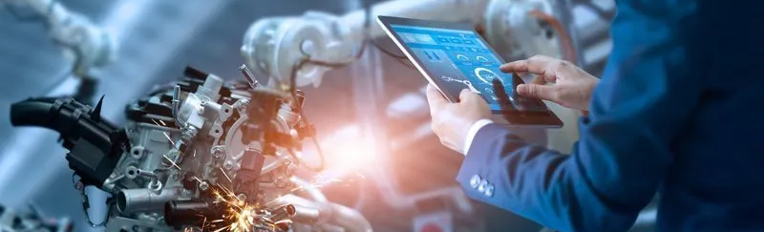
Participation is not the ambition – leadership is
With intentional design grounded in:
Human-centered technology
Indigenous knowledge systems
Regenerative industrial practices
West Africa can do more than join the Fourth Industrial Revolution — it can shape its direction.

Slide 14

A Critical Reality Check: AI Cannot Outrun Infrastructure
The building-up and accumulation of foundational capabilities is critical for long-term development and harnessing these emerging technologies.
These capabilities include infrastructure, technological and productive capabilities.
Despite its vast potential, the adoption and implementation of Artificial Intelligence (AI) in Africa faces several challenges, including a lack of relevant technical skills, inadequate basic and digital infrastructure, insufficient investment in research and development, and a need for more flexible and dynamic regulatory systems.
The hard truth: you cannot automate a void.
AI is a powerful engine, but it requires the fuel of reliable electricity and the road of digital connectivity.

Slide 15
Change leadership and adaptability can help
70%
of digital transformations fail!
How can we increase the odds of success?
And 85% of digital transformations do not achieve their expected benefits.
These facts are true for all geographies; for developed countries and undeveloped nations; for the public and private sector; large companies and small companies; and start-ups and mature companies.
By activating a critical mass of people across sectors – public and private, young and old.
Only by igniting a movement of willing and active representatives from all strata of West African society will we be able to bridge the emerging divide

Slide 16
AI will undeniably shape Africa’s industrial future. How this future plays out will depend on how it is deployed.

