Slide 1

Building Sustainable Talent Pipelines for West African Industry
WEST AFRICA INDUSTRIALISATION, MANUFACTURING & TRADE SUMMIT 2026
Developing Local Capacity for Long-Term Industrial Growth
Technical Seminar
Nneka Eneli,
Director, Workforce Outsourcing
March 2026

Slide 2
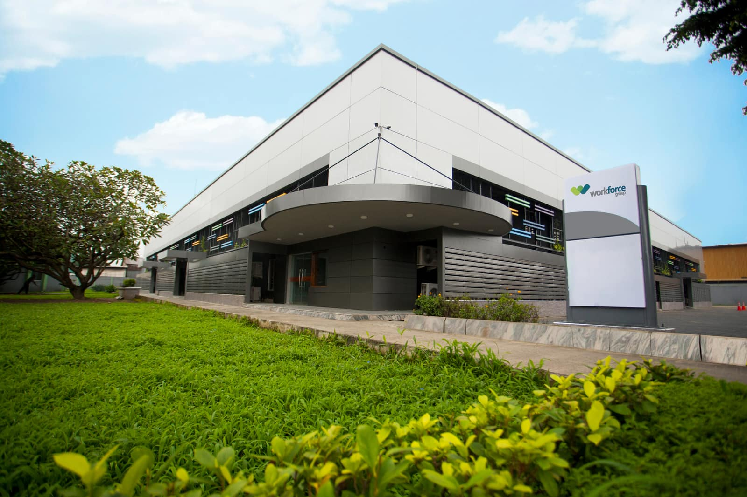

Nneka Eneli
Director, Workforce Outsourcing

Slide 3



Workforce Group
+
=
Your Business
Your People
Our Focus
…we go beyond, we try hardest

Slide 4











We are the most dependable choice to meet your complex talent needs
21+
Years of Providing Excellent Service
300+
Clients across Africa
50+
10+
Industries Served
500+
Partners Across Africa
10,000+
Professionals recruited across Africa
African
Countries
9,000+
Outsourced Employees
1M+
35,000+
Professionals assessed across Africa
ISO 9001:2015
99%
12,000+
Professionals Trained, Delivered in Multiple Languages
Payslips processed
annually
Quality Management Systems Certified
Customer
Retention Rate

Slide 5
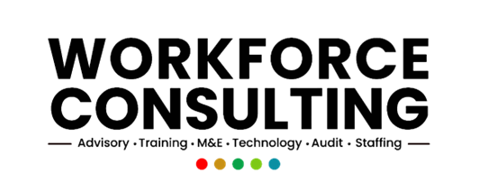




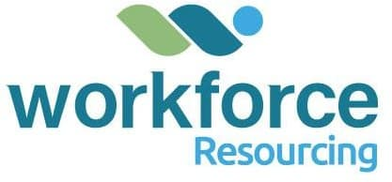

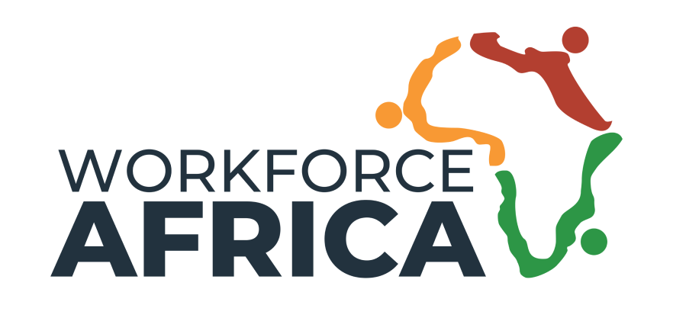



Workforce Group: Who we are
LINES OF BUSINESSES
DIVISIONS

Slide 6

Session objective
This session is designed to equip industrial leaders and policymakers with a strategic roadmap for engineering local technical capacity.
Specifically, we will:
Diagnose the structural weaknesses within current workforce systems
Introduce a sustainable, multi-layered talent pipeline architecture
Examine practical interventions that move localisation from aspiration to measurable outcome
Explore the enabling ecosystem required for long-term technical independence
This is not a conversation about employment. It is a conversation about capability engineering.

Slide 7



Slide 8
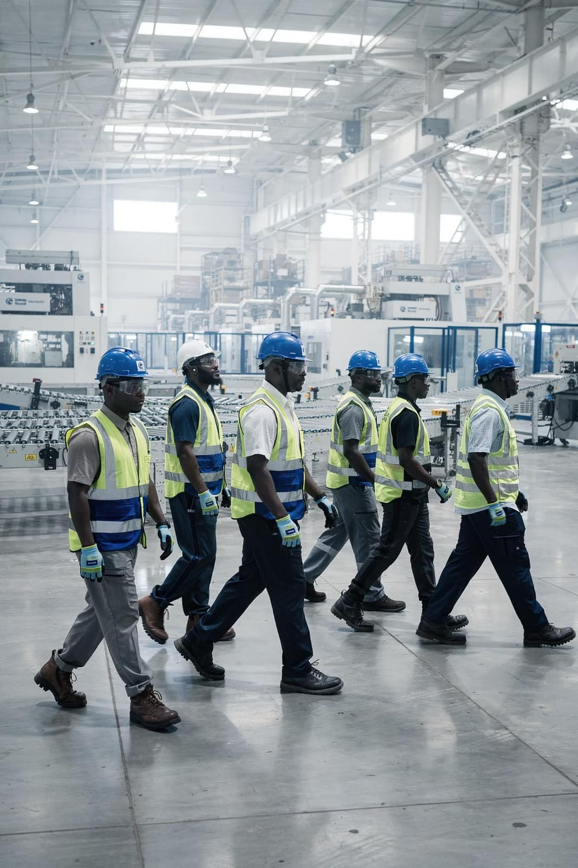
Why This Matters Now
West Africa stands at a defining industrial moment.
Regional value chains are expanding. Manufacturing ambitions are accelerating. AfCFTA integration is reshaping trade flows. Governments are prioritising local production and industrial competitiveness.
The Core Argument
Without intentional talent architecture, industrial growth becomes fragile.
Yet beneath this optimism lies a structural vulnerability.
This session reframes workforce development not as an HR function, but as economic infrastructure — as foundational to competitiveness as power, transport, or raw materials.
Industrial expansion across the region is not matched by a deliberate engineering of technical capacity. Capital investments are rising, infrastructure projects are scaling, industrial parks are being commissioned — but workforce systems are lagging behind.

Slide 9
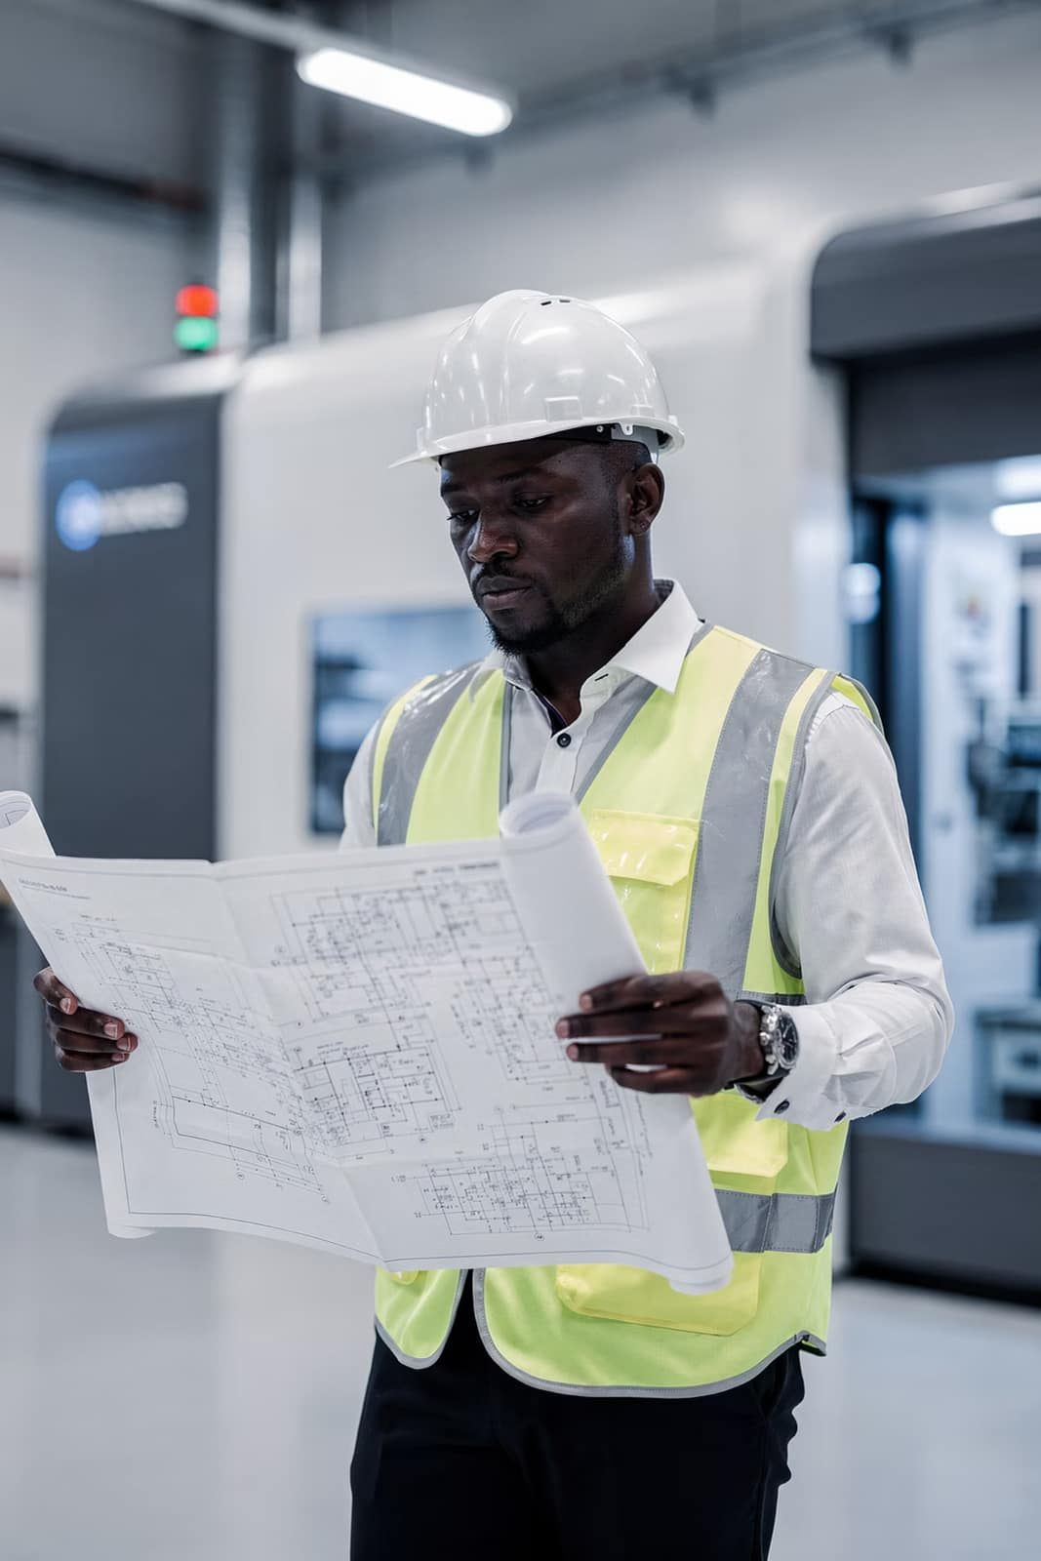
The Industrial Imperative: Talent as Economic Infrastructure
Industrial viability in West Africa depends on three critical ambitions:
Competitive Regional Manufacturing
Execution of Integrated Value Chains
Sustainable Continental Trade Participation
However, industrial policy that lacks a corresponding talent capacity strategy creates structural fragility. Factories may be built. Machinery may be imported. Capital may be deployed.
However, without local technical depth, operational sovereignty remains compromised. Talent must be classified as economic infrastructure — embedded into industrial planning, budgeted for like capital expenditure, and engineered with long-term intent.

Slide 10
The Core Problems:There are 4 systemic gaps affecting West African manufacturing
Education–Industry Misalignment
Universities and polytechnics are not producing job-ready technical talent.
Curriculum is often outdated and theoretical.
Weak Technical & Vocational Pathways
TVET systems lack prestige, investment, and modern equipment.
Limited Industry Collaboration
Manufacturers operate in silos instead of shaping the talent ecosystem collectively
.
Short-Term Talent Thinking
Most firms recruit finished talent rather than build future talent.
________________________________________

Slide 11
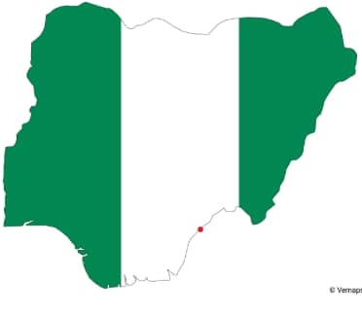

The Data Behind The Problem
Nigeria:
Population: 220M+ (largest in Africa)
Median age: ~18 years
Youth unemployment & underemployment remain high
Manufacturing contributes ~8–10% of GDP (fluctuates)
Heavy reliance on imports for industrial inputs
Ghana:
:
Population: 33M+
Median age: ~21 years
Manufacturing contributes ~12–14% of GDP
Message:
Both countries have demographic advantage — but demographic advantage without industrial absorption becomes economic pressure.

Slide 12
A Hard Question for Industry
Across facilities in Nigeria, Ghana, and Côte d'Ivoire, a persistent dependency remains.
How many of your core technical roles are still expatriate-dependent?
Pause and consider your own operation.
If your expatriate workforce exited tomorrow — what breaks first?
Plant Engineers
Maintenance Leads
Production Supervisors
Technical Specialists
Preventive maintenance?
Advanced diagnostics?
Production continuity?
Compliance systems?
This question reveals the degree of industrial resilience your organisation truly possesses.

Slide 13
The Structural Talent Paradox
West Africa's Demographic Advantage
The region has one of the youngest populations globally. Graduate output continues to expand. Educational enrolment is increasing.
Yet industry consistently reports:
Low technical readiness
Prolonged onboarding cycles
Weak productivity benchmarks
Skills mismatch

Slide 14

The Structural Talent Paradox
The Root Cause
This is not fundamentally a supply problem.
It is a pipeline architecture problem.
Employment is transactional. Capability is strategic.
Most organisations remain trapped in a transactional employment cycle — hiring, replacing, and deploying reactively.
True industrial resilience requires structured capability systems.

Slide 15


Why Industrial Talent Pipelines Fail
Industrial talent systems across the region tend to fail for three structural reasons.
1
Forecasting Deficits
Few organisations undertake disciplined 3–5 year capability forecasting aligned to expansion strategy. As a result, growth becomes reactive and expatriate reliance increases.
2
Weak Capability Transfer Systems
Apprenticeships remain informal. Expatriate-to-local knowledge transfer is assumed rather than engineered. Tacit knowledge leaves when contracts end.
3
Tactical Outsourcing
Outsourcing is often treated as a cost-control mechanism rather than a structured vehicle for building technical depth.
Industrial competitiveness cannot outpace workforce maturity.

Slide 16
From Transactional Employment to Strategic Capability
There is a fundamental distinction between filling roles and building capability.
Transactional Employment
Strategic Capability
Focuses on immediate vacancy resolution. It addresses short-term operational continuity but does not build technical independence.
By contrast, focuses on architecture:
Structured entry pathways
Defined development milestones
Formalised transfer systems
Measurable localisation outcomes
Long-term bench strength
Industrial strength is not measured by headcount. It is measured by technical sovereignty.

Slide 17
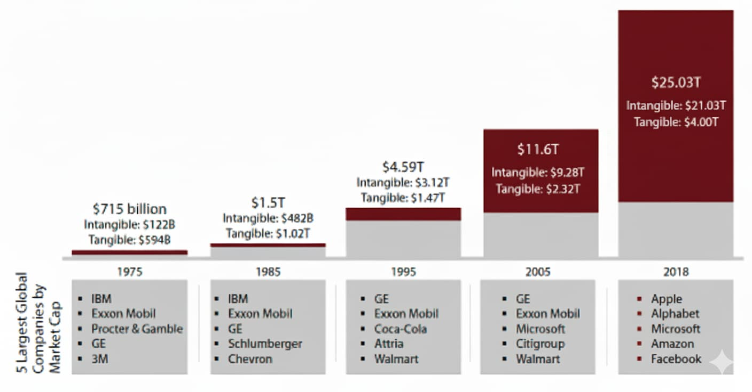
Assets For S&P 500 Companies, 1975 - 2018
The World of Business is Changing!
Tangible Assets
Intangible Assets

Slide 18
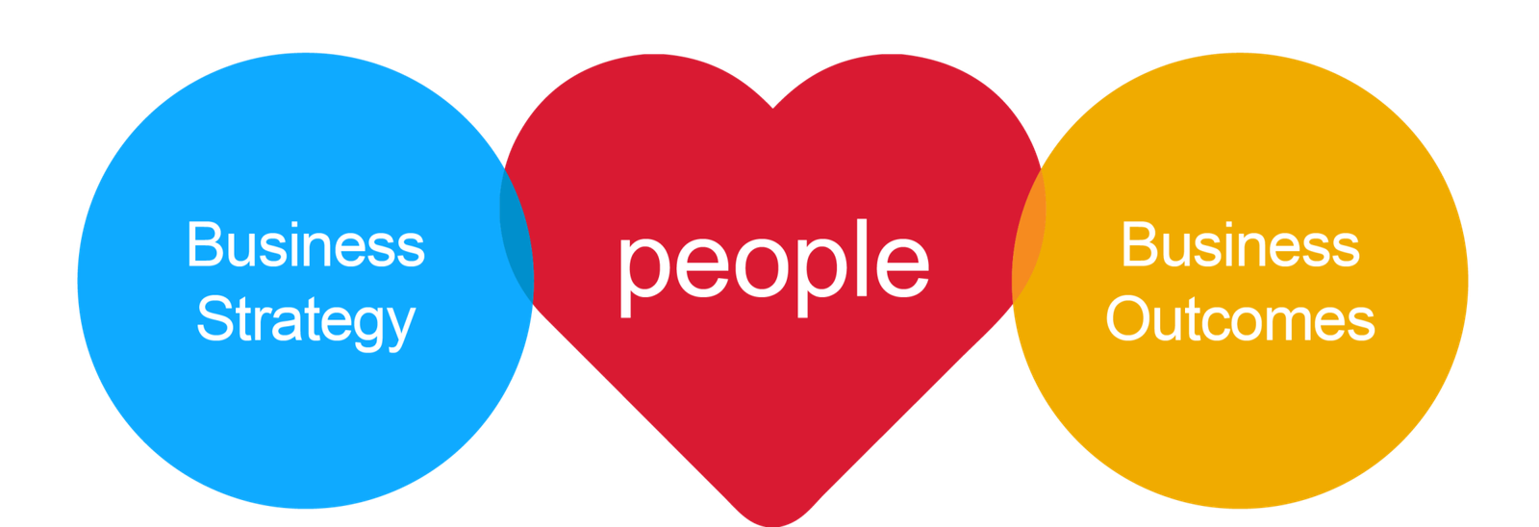
Business Success Is Increasingly In The Hands of Your Most Important Asset
Your People
Nothing happens in business without people!

Slide 19


Business Success Is Increasingly In The Hands of Your Most Important Asset
Your People
The Right People
Nothing happens in business without people!

Slide 20
Boards must recognise that talent strategy is no longer an operational concern — it's a survival imperative that demands executive attention and strategic investment.
Today’s Industrial Talent Reality in West Africa
73%
56%
40%
Executive Risk Priority
Skilled Labour Mobility Threat
Critical Capability Gap
Industrial leaders rank talent availability and retention among their top strategic risks to operational continuity and expansion.
A significant proportion of technically trained professionals are actively exploring relocation, creating sustained pressure on local industrial depth.
Manufacturing and production firms report persistent difficulty filling essential technical roles due to structural skills mismatches.
These figures reveal an industrial talent ecosystem under mounting strain.The convergence of global labour mobility, accelerated digital transformation of production systems, and evolving workforce expectations has intensified structural vulnerability.
For West African industrial organisations, the challenge extends beyond remuneration to include structured technical development, clear progression pathways, operational modernisation, and institutional capability retention.
Boards must recognise that workforce architecture is no longer an operational matter —it is a strategic survival imperative requiring deliberate investment and long-term design.

Slide 21

Adopting Strategic Talent Management
But it starts with a change in talent ideology - mindset
How to change this narrative!
By Adopting Strategic Talent Management
But it starts with a change in talent ideology – mindset!

Slide 22






The Strategic Talent Management Model
To align human capital with industrial strategy, firms must adopt an integrated management model that sits alongside their operational roadmap. The model rests on five interdependent pillars:
Forecast Capability Demand
Design Entry Pathways
Accelerate Structured Development
Identify mission-critical technical roles and project where shortages will emerge over a three to five year horizon.
Construct intentional routes through which fresh talent enters the industrial ecosystem.
Replace ad-hoc training with formalised, milestone-driven progression.
Embed Performance and Productivity Metrics
Plan Succession and Localisation
Align development with measurable output and industrial benchmarks.
Ensure technical independence is not incidental but planned.
Talent strategy must be embedded within industrial planning — not appended to it.
Notes:
Framework

Slide 23



The Three-Layer Sustainable Talent Pipeline Architecture
A robust pipeline is not linear. It is layered.
Layer One: Entry-Level Development
Graduate trainee programmes, structured apprenticeships, and technical bootcamps create the foundation.
Layer Two: Mid-Level Skill Acceleration
Rotational exposure, certification pathways, and expatriate shadowing accelerate competence.
Layer Three: Specialist and Leadership Continuity
Succession planning, knowledge documentation, and internal corporate academies preserve institutional memory.
Pipelines must be multi-layered rather than linear to prevent hollow workforce structures — strong at the top, weak in the middle. Continuous bench strength is engineered, not assumed.
Notes:
Framework II

Slide 24
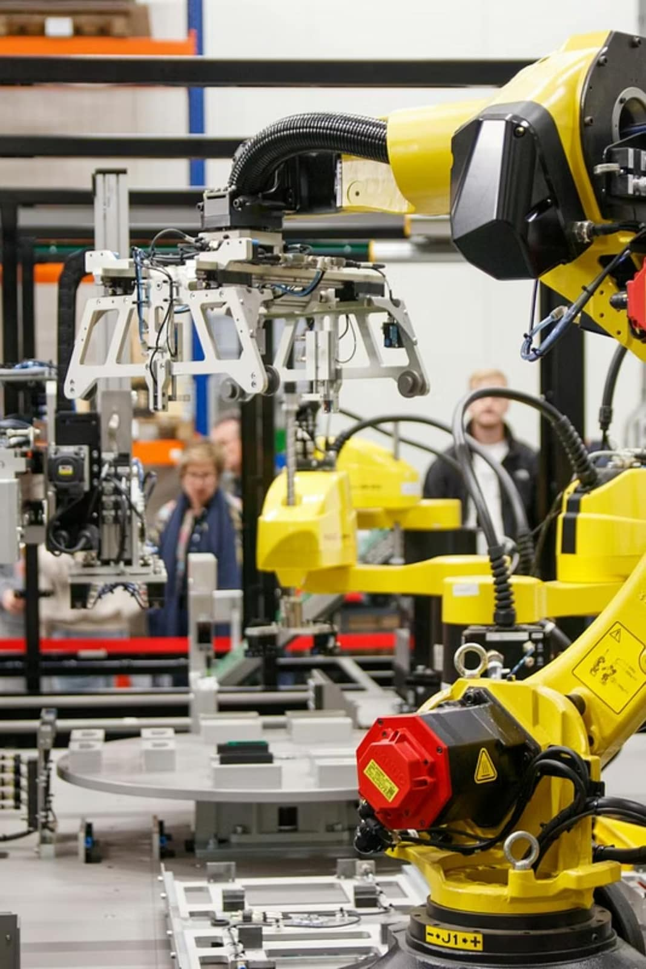




Intervention One: Industry-Led Curriculum Reform
Manufacturers must co-own education.
Actions:
Industry advisory boards in technical institutions
Mandatory industrial attachments
Co-designed modules (automation, mechatronics, lean manufacturing, quality systems)
Faculty immersion in factories
Private sector cannot be a passive consumer of talent.

Slide 25
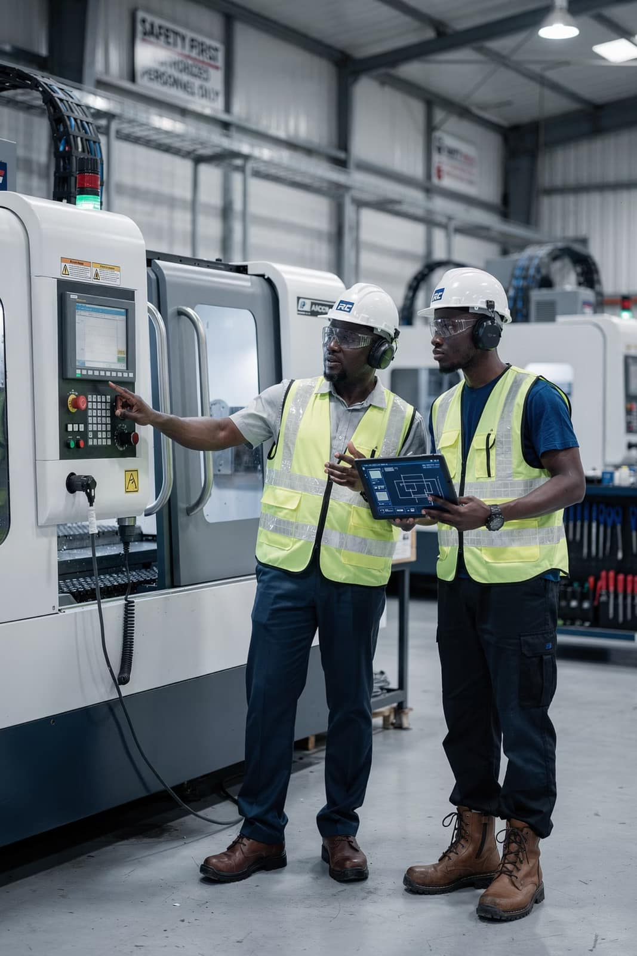

Intervention Two: Industry-Led Apprenticeships
West Africa must transition from internship culture to capability engineering. Industry-led apprenticeship systems require:
Industry-defined competency standards
Paid, structured apprenticeship contracts
Measurable performance benchmarks
Formal certification tied to productivity
A Structured Three-Year Design
Year One — Foundational mechanical and electrical competence
Year Two — Independent task execution under structured evaluation
Year Three — Certification assessment and formal role transition
Apprenticeship must be an industrial system, not a corporate afterthought.

Slide 26
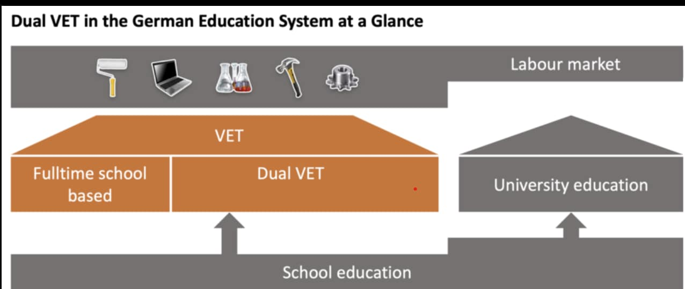
Case Study – Germany’s Dual Vocational System
Germany’s Dual Vocational Education and Training (VET) system integrates classroom learning with structured workplace apprenticeships.
Students typically join after secondary school and train simultaneously in vocational schools (theory) and partner companies (practical skills).
Apprentices spend about 3–4 days in companies and 1–2 days in school weekly for 2–3.5 years.

Slide 27
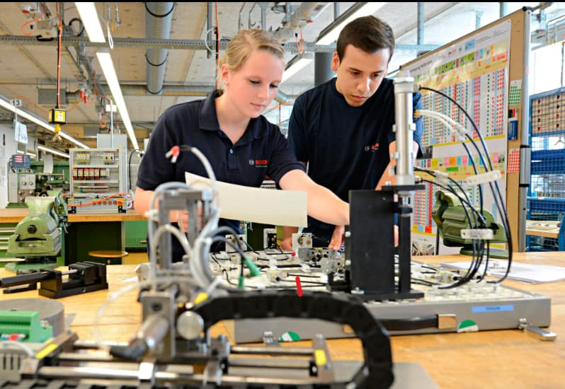
Case Study – Germany’s Dual Vocational System
Impact:
Programmes are industry-driven, apprentices are paid during training, and graduates receive nationally recognised certifications.
Over 430,000 companies participate, helping Germany maintain one of Europe’s lowest youth unemployment rates.
The system demonstrates that strong industrial capability is built through structured talent development pathways.

Slide 28




Intervention Three: Graduate Industrial Acceleration
An 18–24 month structured industrial acceleration programme reduces time-to-productivity and supervisory dependency.
Cross-Functional Plant Rotations
Technical Mastery Milestones
Supervisor Readiness Assessments
Embedded Leadership Fundamentals
The objective is not exposure alone — it is accelerated independence.
Structured acceleration shortens the gap between academic qualification and operational competence.

Slide 29

Intervention Four: Capability Transfer Architecture
Localisation must shift from aspiration to architecture. An effective
transfer system includes:
Shadow Pairing
Deliberate matching of local talent with expatriate specialists
Defined Milestones
Time-bound technical transfer objectives
Technical Playbooks
Codified documentation of tacit expertise
Exit-Linked KPIs
Localisation embedded into expatriate contracts
If knowledge transfer is not measured, it does not occur. Industrial independence must be engineered through formal systems.

Slide 30
Intervention Five: Managed Outsourcing as Capability Infrastructure
Outsourcing, when strategically designed, becomes a talent engine.
Managed Outsourcing Enables:
The Strategic Shift
Pooled technical talent across facilities
Standardised technical assessments
Centralised learning systems
Accelerated deployment readiness
Rather than replacing capability, it builds scalable capability across the ecosystem.
This transforms outsourcing from cost management into capability infrastructure.

Slide 31





Intervention Six: Regional Skills Collaboration
Industrial growth across ECOWAS requires regional workforce alignment.
Cross-Border Certification Recognition
Harmonised Technical Standards
Cross-border recognition of technical certifications
Harmonised technical standards across the region
Shared Regional Training Hubs
Industry Association-Driven Skills Frameworks
Shared regional training hubs for industrial skills
Industry association-driven skills frameworks
Regional manufacturing integration requires regional talent mobility. Without harmonised standards, regional trade integration remains incomplete.

Slide 32
The Enabling Ecosystem: Policy and Partnership
Industrial policy without workforce policy is incomplete.
Governments Must:
Development Partners Must:
Incentivise structured training investment through tax credits
Align curriculum output with industrial demand
Invest in technical colleges
Support public-private skill partnerships
Shift from short-term employment metrics to long-term capacity metrics.
Funding should prioritise industrial skill mapping and the creation of structured training ecosystems.
Sustainable growth requires systemic alignment.

Slide 33
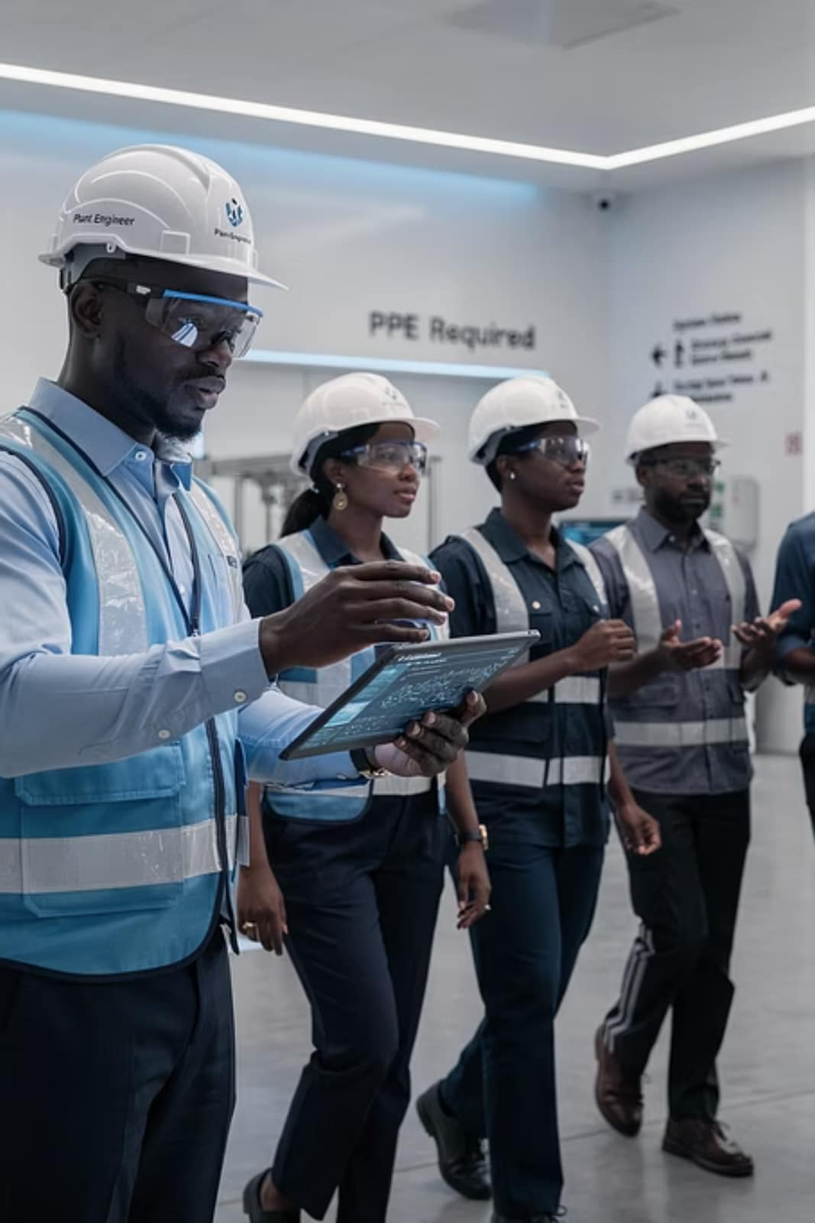
2036 VISION
A Ten-Year Industrial Talent Vision
Local plant engineers leading production facilities.
Technical academies embedded within manufacturing firms.
Cross-border certification allowing seamless workforce mobility.
Structured apprenticeship culture institutionalised.
Measured reduction in expatriate dependency across critical roles.
This vision is achievable — but only if talent is treated as infrastructure today.

Slide 34
Three Strategic Imperatives
01:
Treat Talent as Infrastructure
02:
Design Pipelines, Not Hiring Drives
03:
Make Localisation Measurable
Workforce development must be prioritised alongside physical capital.
Shift from reactive recruitment to long-term capability architecture.
Track technical independence through contractual KPIs and structured reporting.

Slide 35

A Defining Choice
As industrial expansion accelerates across West Africa, every organisation faces a defining choice.
Will you build capability — or will you continue to import it?
The sustainability of regional industrial growth depends entirely on the answer.

Slide 36
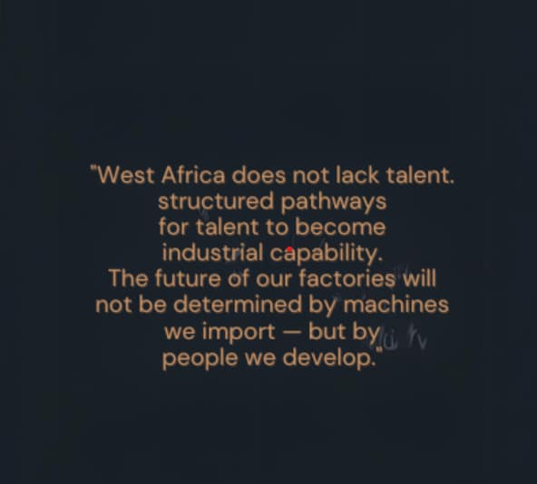

Slide 37
Thank You!
Thank you for your time & attention
Contact
Us
Nneka Eneli
Director, Workforce Outsourcing
Contact Number
+234-903-194-6744
Email Address
nneka@workforcegroup.com

